Slide 1

DiaLingAthens | UoA | CHS-Harvard University
DiaLingAthens & CHS Collaboration
Diachronic Retranslations & Valency Research
HFRI Project: A Corpus-based Valency Lexicon for a Contrastive and Diachronic Study
of Ancient & Medieval Languages
Computational Approaches to Historical Linguistics

Slide 2
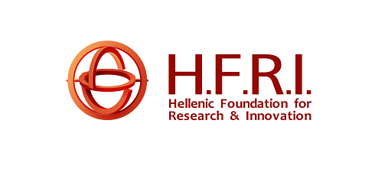
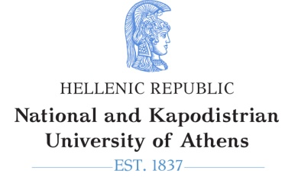
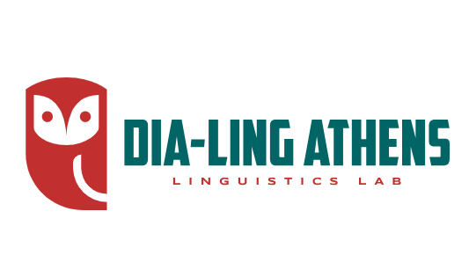
Research Context
The intersection of corpus linguistics and diachronic analysis
This collaboration leverages computational methods to study language change through retranslations. Building on corpus linguistics approaches by McEnery & Hardie (2011), the Helsinki Corpus (Rissanen 1991), and diachronic semantic studies by Traugott & Dasher (2002), we examine how the same texts translated across different periods can track systematic changes in grammatical structures, particularly in verb-argument relationships.
A DiaLingAthens Initiative

Slide 3
Theoretical Foundation
Transitivity Alternations
How verbs change their argument structure over time
Voice Morphology
Evolution of active, passive, and middle voice systems
Case Systems
Diachronic changes in case marking and argument realization
Building on work such as "Transitivity Alternations in Diachrony" (Lavidas 2009) and
Haspelmath's (1993) research on inchoative/causative alternations, this project examines how grammatical categories reorganize over time. The focus is on systematic patterns of change rather than isolated phenomena.

Slide 4
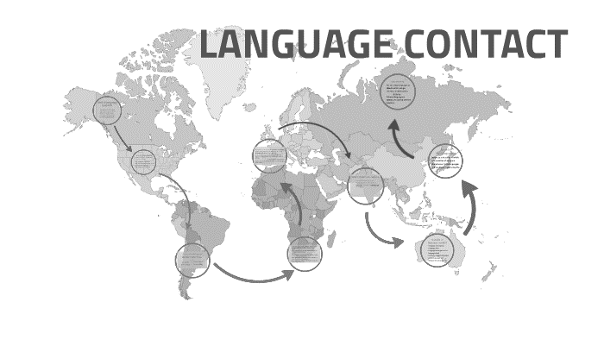
Translations and Language Contact
Studying language contact and change through translations and re-translations
development of morphological and syntactic phenomena (Fischer, 2013; Lavidas, 2022)
can account for semi-natural linguistic change
although not always direct evidence, this setting reflects the processes or parameters which have led to specific diachronic developments of grammar (Baumgarten et al., 2008; Adams et al., 2002)

Slide 5
Retranslations as Source of Linguistic Data
Text Period 1
Text Period 2
Text Period 3
Medieval ranslation
Renaissance translation
Modern translation
Retranslations provide controlled data for observing language change. When the same source text is translated at different historical periods, variations in the target language reveal diachronic shifts in grammar, lexicon, and style. This methodology allows us to distinguish between translator preferences and systematic language change.

Slide 6
Valency Patterns in Diachrony
Labile Verbs
Verbs that alternate between transitive/ intransitive use
Causative-Anticausative
Shifts in causation marking
Deponent Verb
Changes in voice morphology without semantic change
Following research on labile verbs in Greek and English and typological studies on voice systems, we examine how verbs develop or lose the ability to appear in multiple syntactic constructions. This reveals broader patterns of how languages encode agency and causation over time.

Slide 7
Methodological Innovation
Corpus Design
Parallel text alignment
Morphosyntactic annotation
Semantic role labeling
Analysis Tools
▪ Valency pattern extraction
▪ Diachronic comparison
▪ Statistical validation
The project develops new computational tools for analyzing valency changes across time periods. Unlike traditional approaches that rely on isolated examples, this corpus-based methodology allows for quantitative analysis of grammatical change patterns.

Slide 8
Case Studies: Greek Voice System
Example: Evolution of middle voice markers
Ancient Greek: Complex three-way voice system
Modern Greek: Simplified active-passive distinction
The Greek voice system underwent fundamental reorganization. The middle voice, once a productive category, gradually merged with passive constructions. This change occurred through specific stages in the post-classical period, showing how voice systems can restructure over centuries.

Slide 9
Contact Effects Influence of language contact on valency
Indo-European Languages
Shared patterns of voice evolution
Typological Tendencies Universal vs. language-specific changes
Cross-linguistic Patterns
By comparing valency changes across multiple languages, we identify both universal tendencies and language-specific developments. This comparative approach provides particularly rich data for tracking these changes through texts from various periods of the diachrony of Greek and other historical corpora.

Slide 10
Digital Methods in Historical Linguistics
Corpus Annotation
Multi-layer linguistic markup for diachronic analysis
Parallel Text Alignment
Automated matching of translation equivalents
Statistical Modeling
Tracking frequency changes over time
The integration of digital humanities methods transforms how we study language change. This project employs sophisticated computational tools that allow us to move beyond anecdotal evidence to systematic, large-scale patterns of grammatical change.

Slide 11
Text Preprocessing Pipeline
OCR/
Digitization
Annotation
Alignment
Historical texts
Linguistic markup
Parallel texts
The integration of digital humanities methods transforms how we study language change. This project employs sophisticated computational tools that allow us to move beyond anecdotal evidence to systematic, large-scale patterns of grammatical change.

Slide 12
Substrate Influence
Earlier language layers affecting valency systems
Language contact plays a crucial role in valency changes. Research by Heine & Kuteva
(2003, 2005) on contact-induced grammaticalization and Thomason (2001) on
language contact shows how valency patterns can spread through multilingual
communities. In retranslations, we can observe how translators navigate between
source language structures and target language norms.
Contact-Induced Changes in Valency
Areal Features Valency patterns spreading across language boundaries
Translation Effects
How source languages influence target language structures

Slide 13
Valency Query System
The query system allows researchers to search for complex valency patterns across the corpus. Building on annotation frameworks like PropBank (Palmer et al. 2005) and FrameNet (Fillmore et al. 1998), users can specify syntactic constructions, semantic roles, and morphological features, then track how these patterns change frequency and distribution over time. This enables both hypothesis testing and exploratory data analysis.
Pattern Search
Find specific argument structure configurations
Diachronic Tracking
Follow changes across time periods
Statistical Analysis
Quantify frequency and distribution changes

Slide 14
Collaborative Framework
CHS
Harvard University
DiaLingAthens / UoA
HFRI Project on Diachronic Corpora and Valency Linguistic expertise
Criteria for the collection of texts: e.g., open-access texts, diachronic parameter, representative texts, influential texts - the factor of re-translations; pre-processing, tokenization; Annotation of diachronic texts; Historical Syntax and analysis of valency
Digital humanities infrastructure
Text digitization
International collaboration
Interdisciplinary IT & Humanities Team
ARCAS Ecosystem Platform
Text mining, visualization, and more

Slide 15
CHS
Harvard University
-Digital humanities infrastructure
-ARCAS ecosystem softwares
DiaLingAthens
-Historical linguistics expertise
-Diachronic corpus-annotation of historical texts
large-scale corpus
development
access to international scholarly networks for validation and
dissemination of findings.
Notes:
focus on the automatic extraction of valency info based on the digital corpus of preprocessed and annotated texts

Slide 16
Expected Contributions to Historical Linguistics
Empirical: Large-scale data on valency change patterns.
Theoretical: New models of grammatical change.
Methodological: Replicable framework for diachronic corpus studies.
Notes:
This project will provide the field with both empirical findings and theoretical insights. The annotated corpus will serve as a resource for future research, while the analytical methods developed can be applied to other languages and linguistic phenomena.

Slide 17
Innovation
The first diachronic contrastive Valency Lexicon:
includes various language subfamilies
modern methodological tools
electronic annotated texts.
An innovative diachronic study related to:
-linguistic genealogy -language contact
Digitalization of linguistic information.
Creation of a searchable electronic contrastive - typological database of linguistic constructions.
Collection of data will be shared within the scientific community by enhancing international networking.
Notes:
substantial data collection,
¢-innovative diachronic study (both related to linguistic genealogy and language contact)
-the first diachronic contrastive Valency Lexicon that includes early Greek, Romance and Germanic dialects following the modern methodological tools and using electronic annotated texts
-Digitalization of linguistic information allows data to be shared within the scientific community by enhancing international networking.
-the creation of a searchable electronic contrastive - typological database of these constructions.

Slide 18
Theoretical Implications
Grammaticalization Paths: How valency markers develop from lexical sources.
Degrammaticalization: When complex structures become simpler.
Cyclic Changes: Recurring patterns in voice system evolution.
Re-translations: Effective tool to study language change.
Notes:
The findings contribute to broader theoretical debates in historical linguistics. The retranslation corpus offers unique evidence for testing theories about grammaticalization and language change across multiple time periods and languages.

Slide 19
Future Research Directions
Expansion: Include more languages and time periods.
Integration: Connect with typological databases.
Applications: Develop pedagogical resources.
Notes:
The infrastructure developed for this project can be extended to additional languages and linguistic phenomena. Future work may include integration with existing typological
databases, development of teaching materials for historical linguistics, and creation of visualization tools for exploring language change patterns.

Slide 20
Significance for the whole community
Reinforcement of the interest for earlier periods of European languages in a comparative approach.
Creation of a new interest for the history of languages through modern methodology.
The result data collection will be available online and will be used for educational purposes.

Slide 21
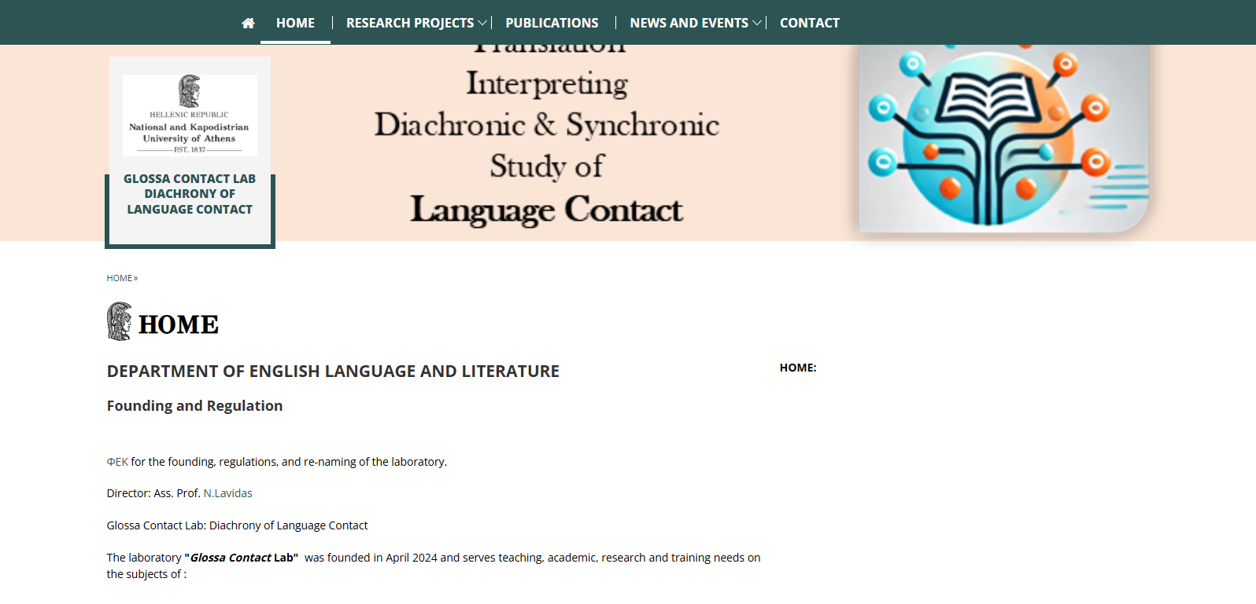
A Corpus-based Valency Lexicon
for a Contrastive and Diachronic Study of Ancient & Medieval Languages
CVL-CDSAML

Slide 22

Thank You
Questions & Discussion
DiaLingAthens / University of Athens
HFRI Project on Diachronic Corpora and Valency
Center for Hellenic Studies
Harvard University

