Slide 1

Iron vulnerability in the Wapiti River region
By Anisha Thammavongsa

Slide 2
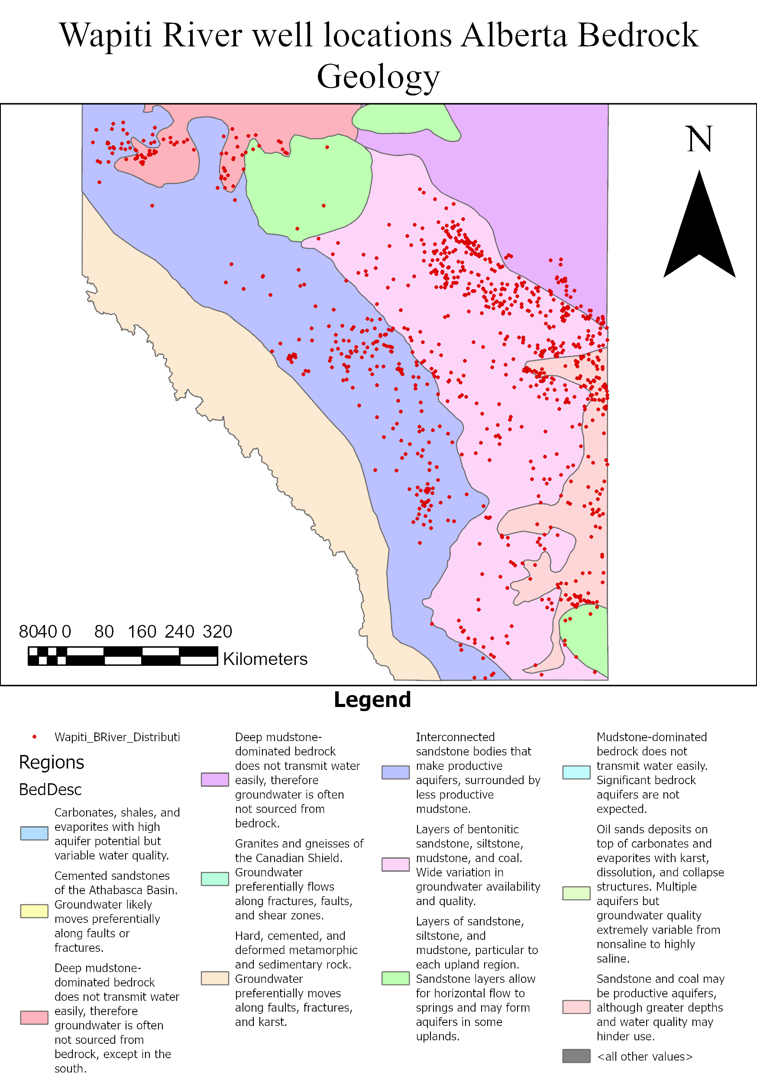
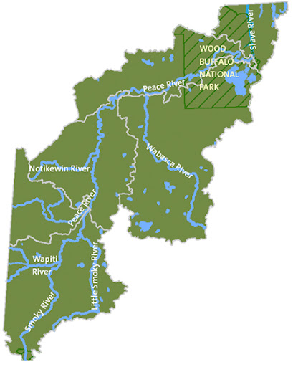
INTRODUCTION
Wapiti River is a source of drinking water to local populations
Historically polluted
Agricultural and mining land use
https://osdp-psdo.canada.ca/dp/en/search/metadata/ECCC-CESI-WATER-1-AB07GJ0030
The goal of this project is ultimately to define the areas of the Wapiti river region that have unsuitable iron concentrations within the water wells.
Notes:
The Wapiti River region in Alberta, Canada is of interest to the project today due to its importance in being a source of drinking water and its commercial land use.
The area of interest is in mid-southern Alberta, which lies on various types of bedrock, which can partially contribute to the flux of total dissolved solids (TDS). However, the main source of contamination and the flux of TDS has come from commercial activities including mining and agricultural uses nearby.
The ultimate goal of this project is to identify the areas of the Wapiti River region containing unsuitable iron concentrations (>0.3 mg/L).

Slide 3
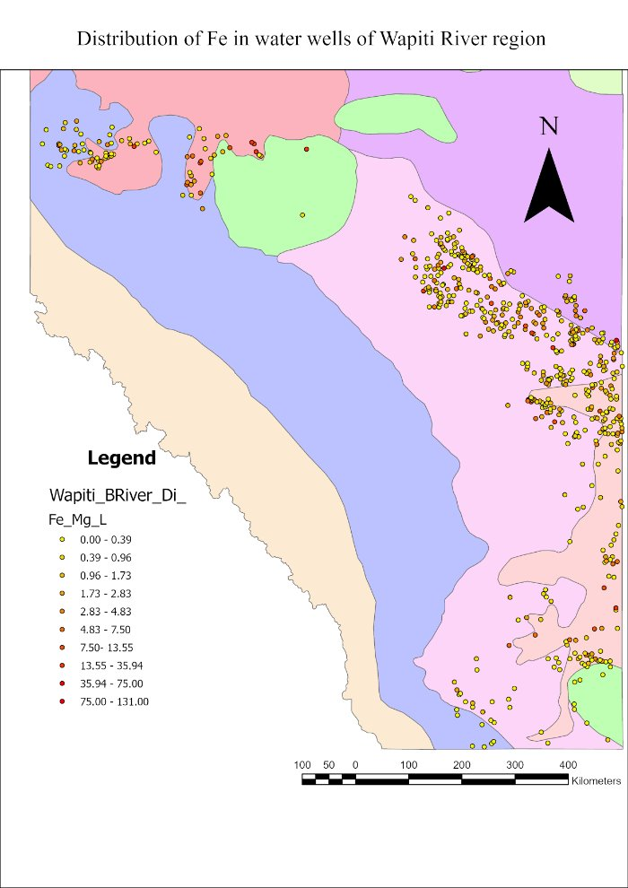
DATA
Collected from Alberta Geologic Survey
Distribution of Total Dissolved Solids in the Wapiti / Belly River HSU (DIG 2017-0026)
And
Hydrogeological Regions of Alberta
Notes:
All data used for the project has come from The Alberta Geologic Survey. Two data sets were used, TDS and bedrock regions of Alberta.
I wanted to use the bedrock geology in terms of its confounding factors that contribute into the particulate loading of wells.

Slide 4
GENERAL FLOWCHART
Wapiti River wells
Spatial Join
Wells + Bedrock data
​
Spatial Trends?
​
Sample points
Alberta Bedrock
IDW
Thiessen Polygon
Vector geometry
Fe
Histogram
​
Interpolation
Kriging
Standard errors prediction
Empirical Bayesian
Kriging
Raster Calculator
Threshold limit
Notes:
The general flow of this project was to first identify the samples that were going to be used and then join them spatially.
Then I wanted to identify the spatial trends from the Iron concentration data by conducting a histogram plot.
A Thiessen polygon was then created in order to identify the regions of interest specifically towards iron concentrations.
Interpolation was then conducted. Both IDW and Kriging were used as interpolation methods in this project.
Following the ordinary Kriging interpolation, standard errors predictions were made by conducting an Empirical Bayesian Kriging interpolation.
Lastly, a raster calculator was done in order to identify areas that exceeded the Fe concentration threshold (0.3 mg/L)

Slide 5
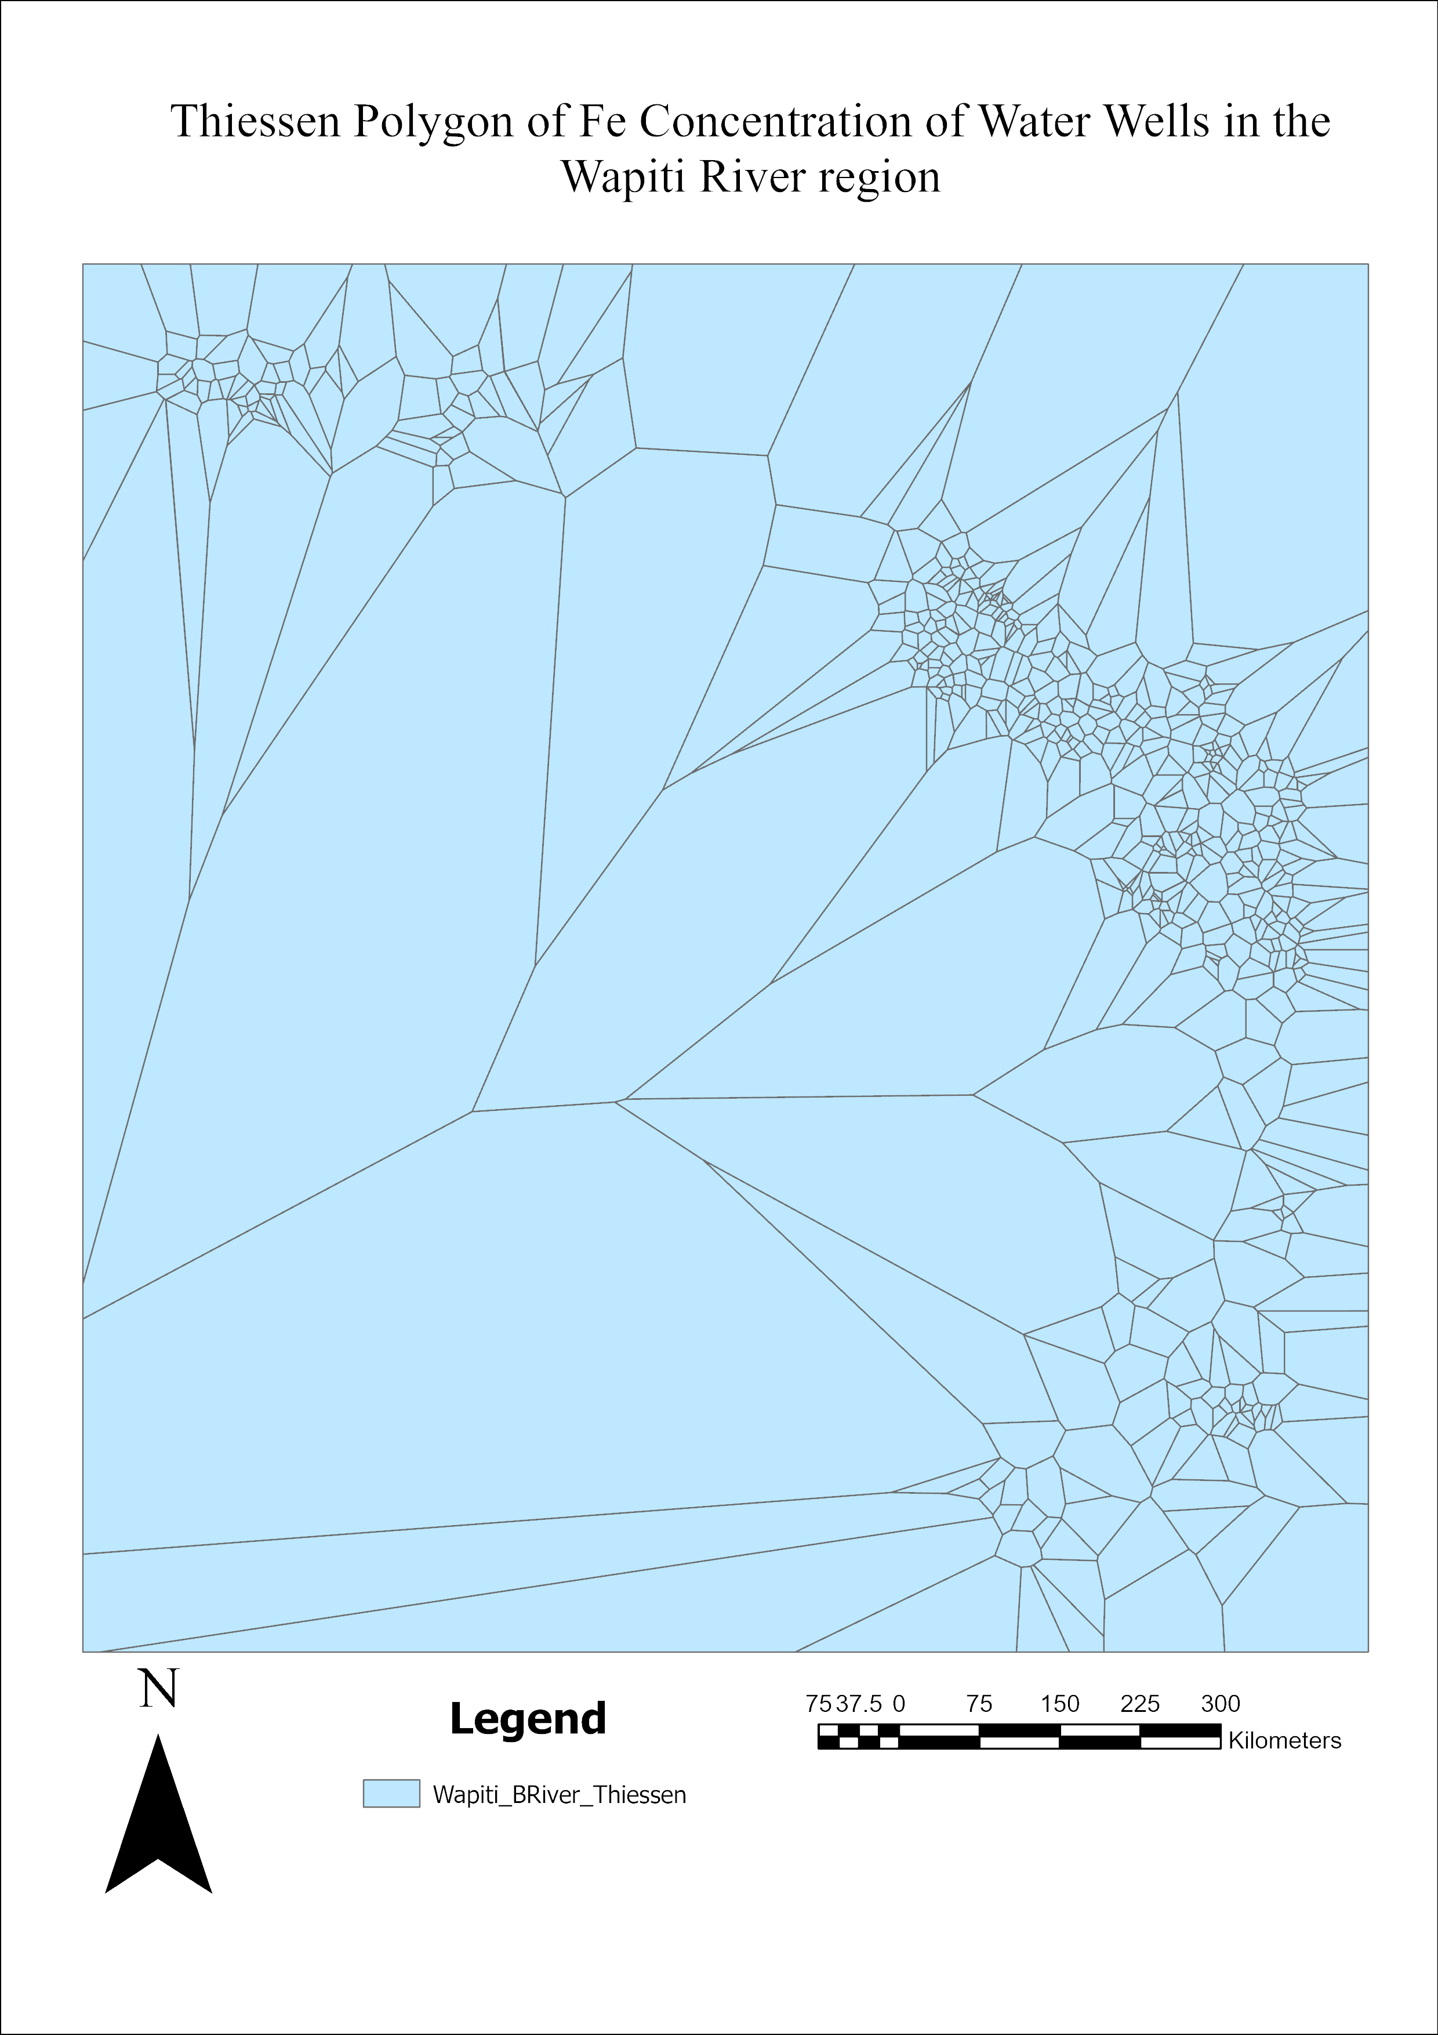
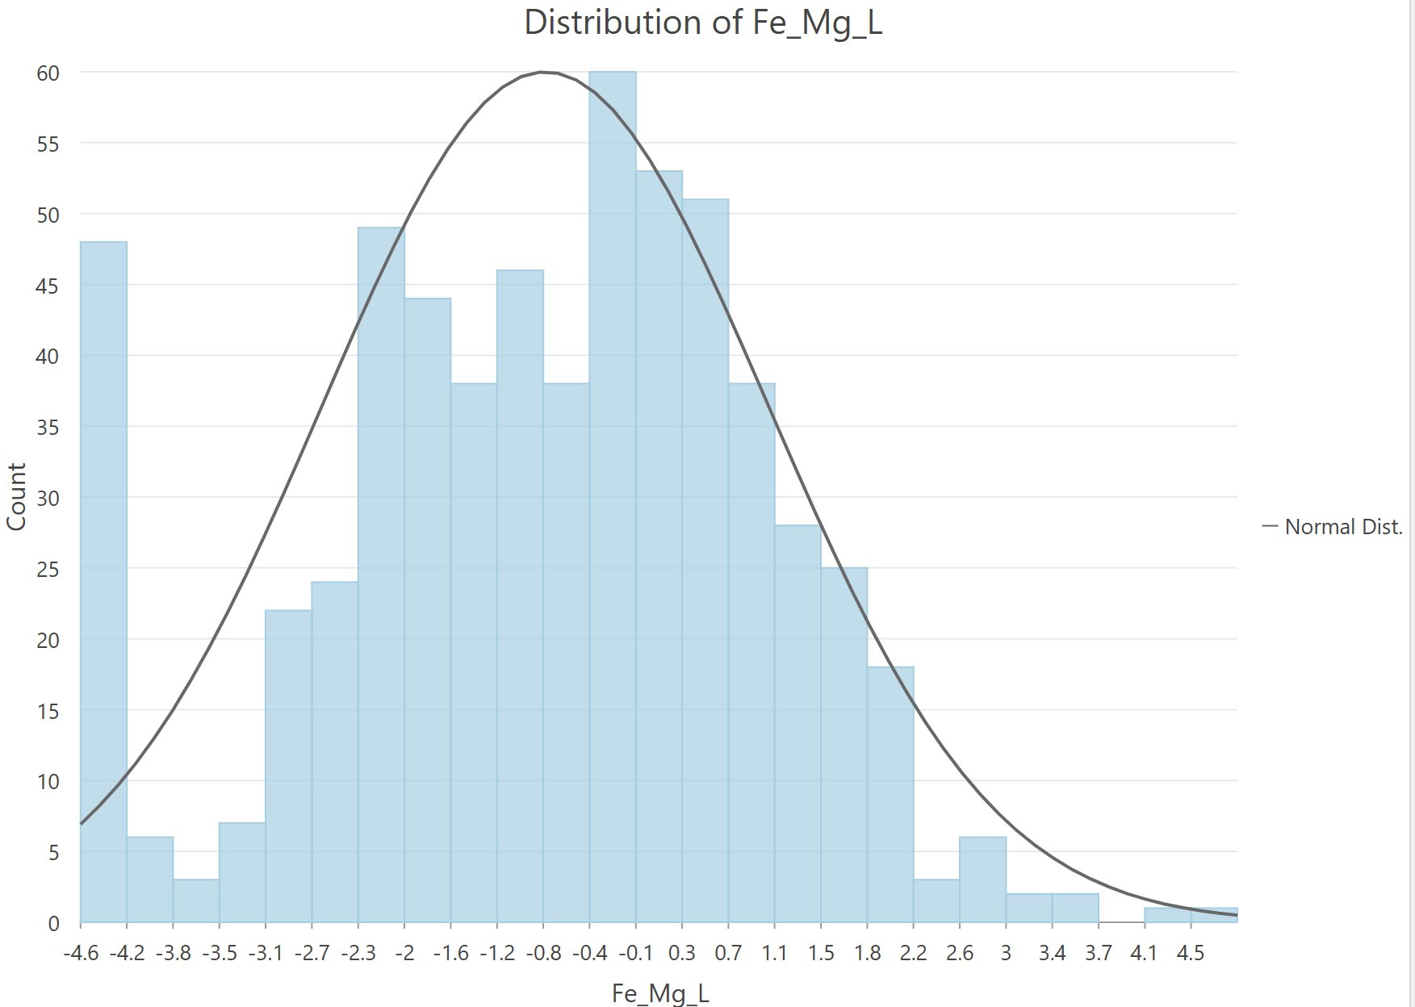
METHODS
Developed Histogram of Iron concentrations (mg/L) with log transformation to determine spatial trends
Thiessen polygon developed in order to identify the areas of study and as a basis for interpolation
Notes:
A histogram plot was built in order to validate spatial trends in Iron concentrations. The plot was log-transformed and presented a normal distribution in data.
Then, a thiessen polygon was created to identify and confirm the regions of interest (Iron concentration)

Slide 6
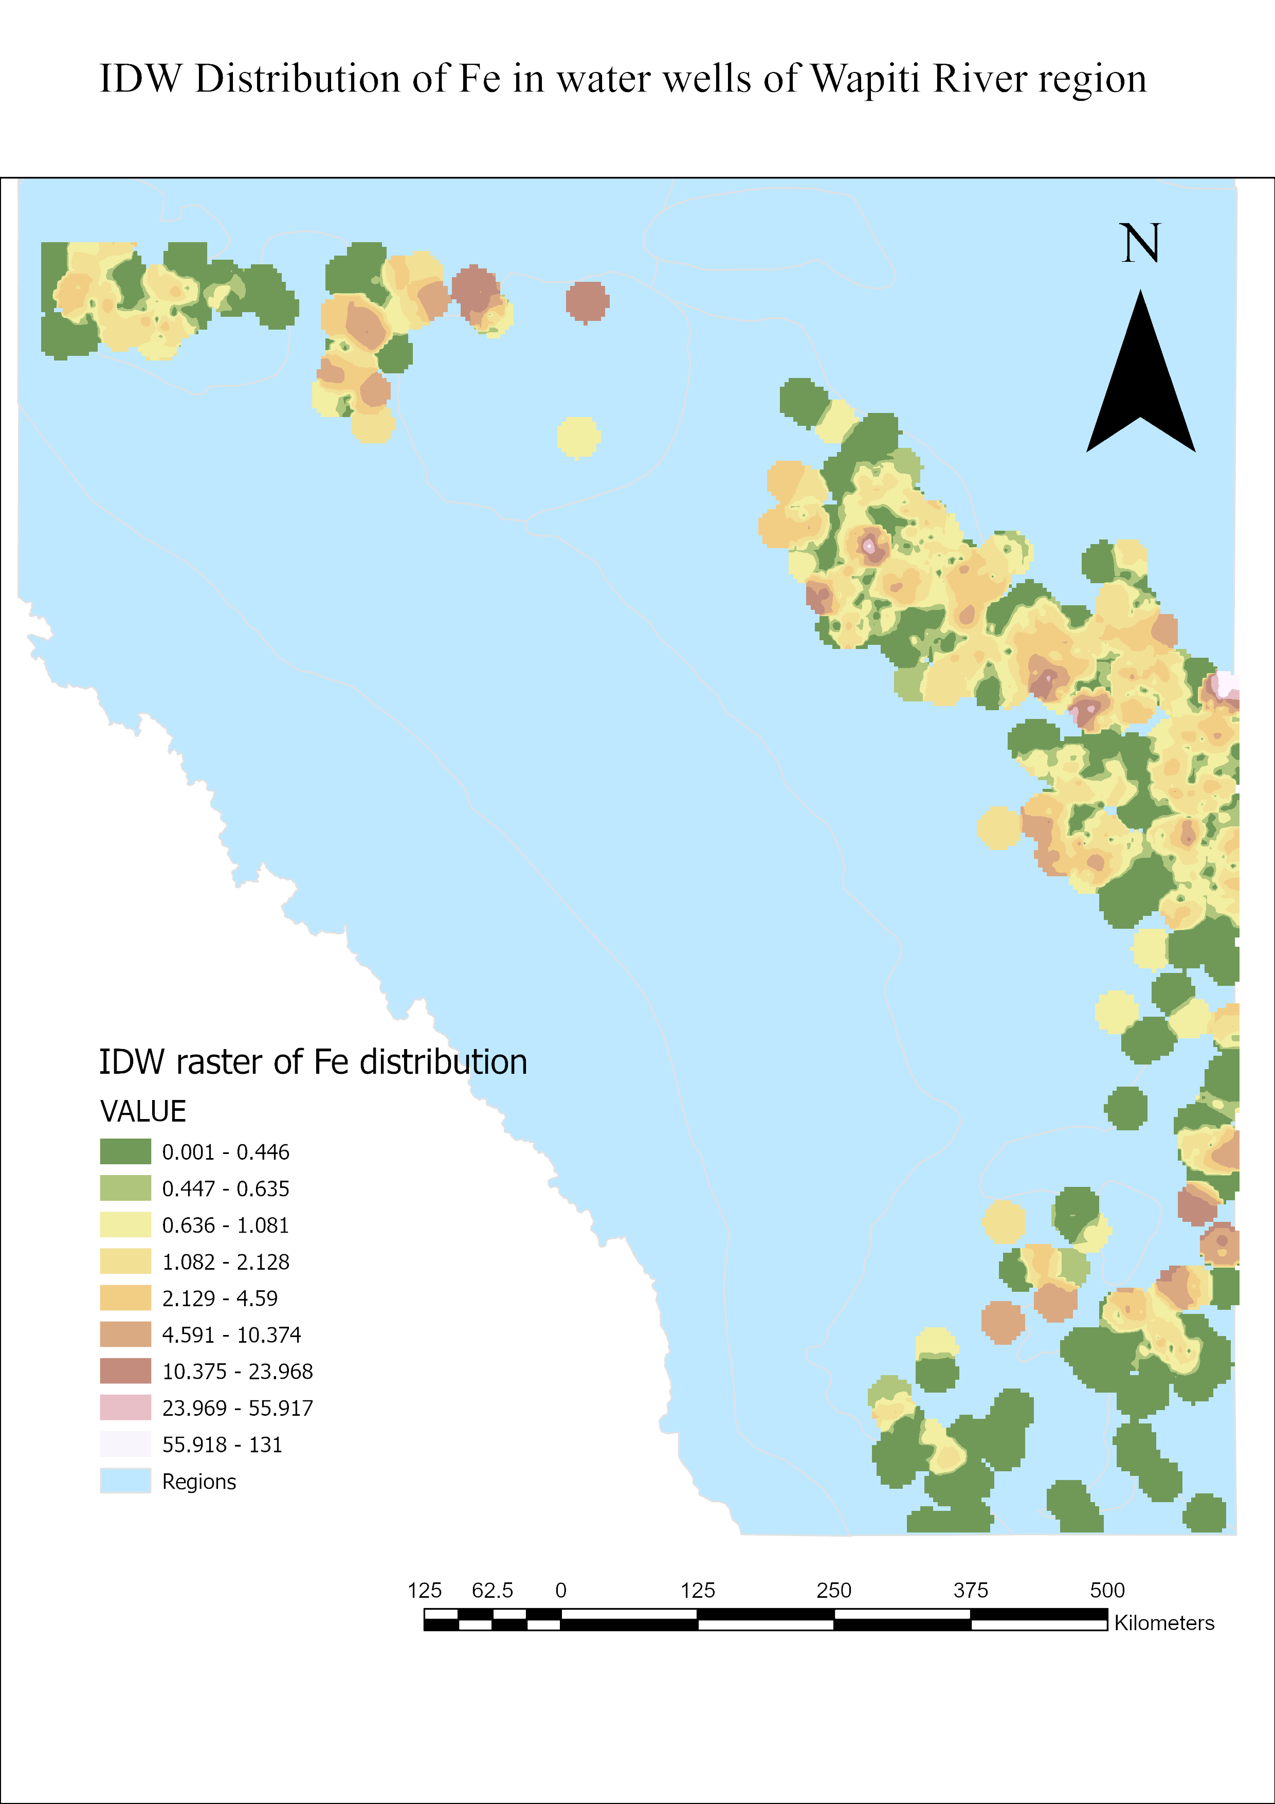
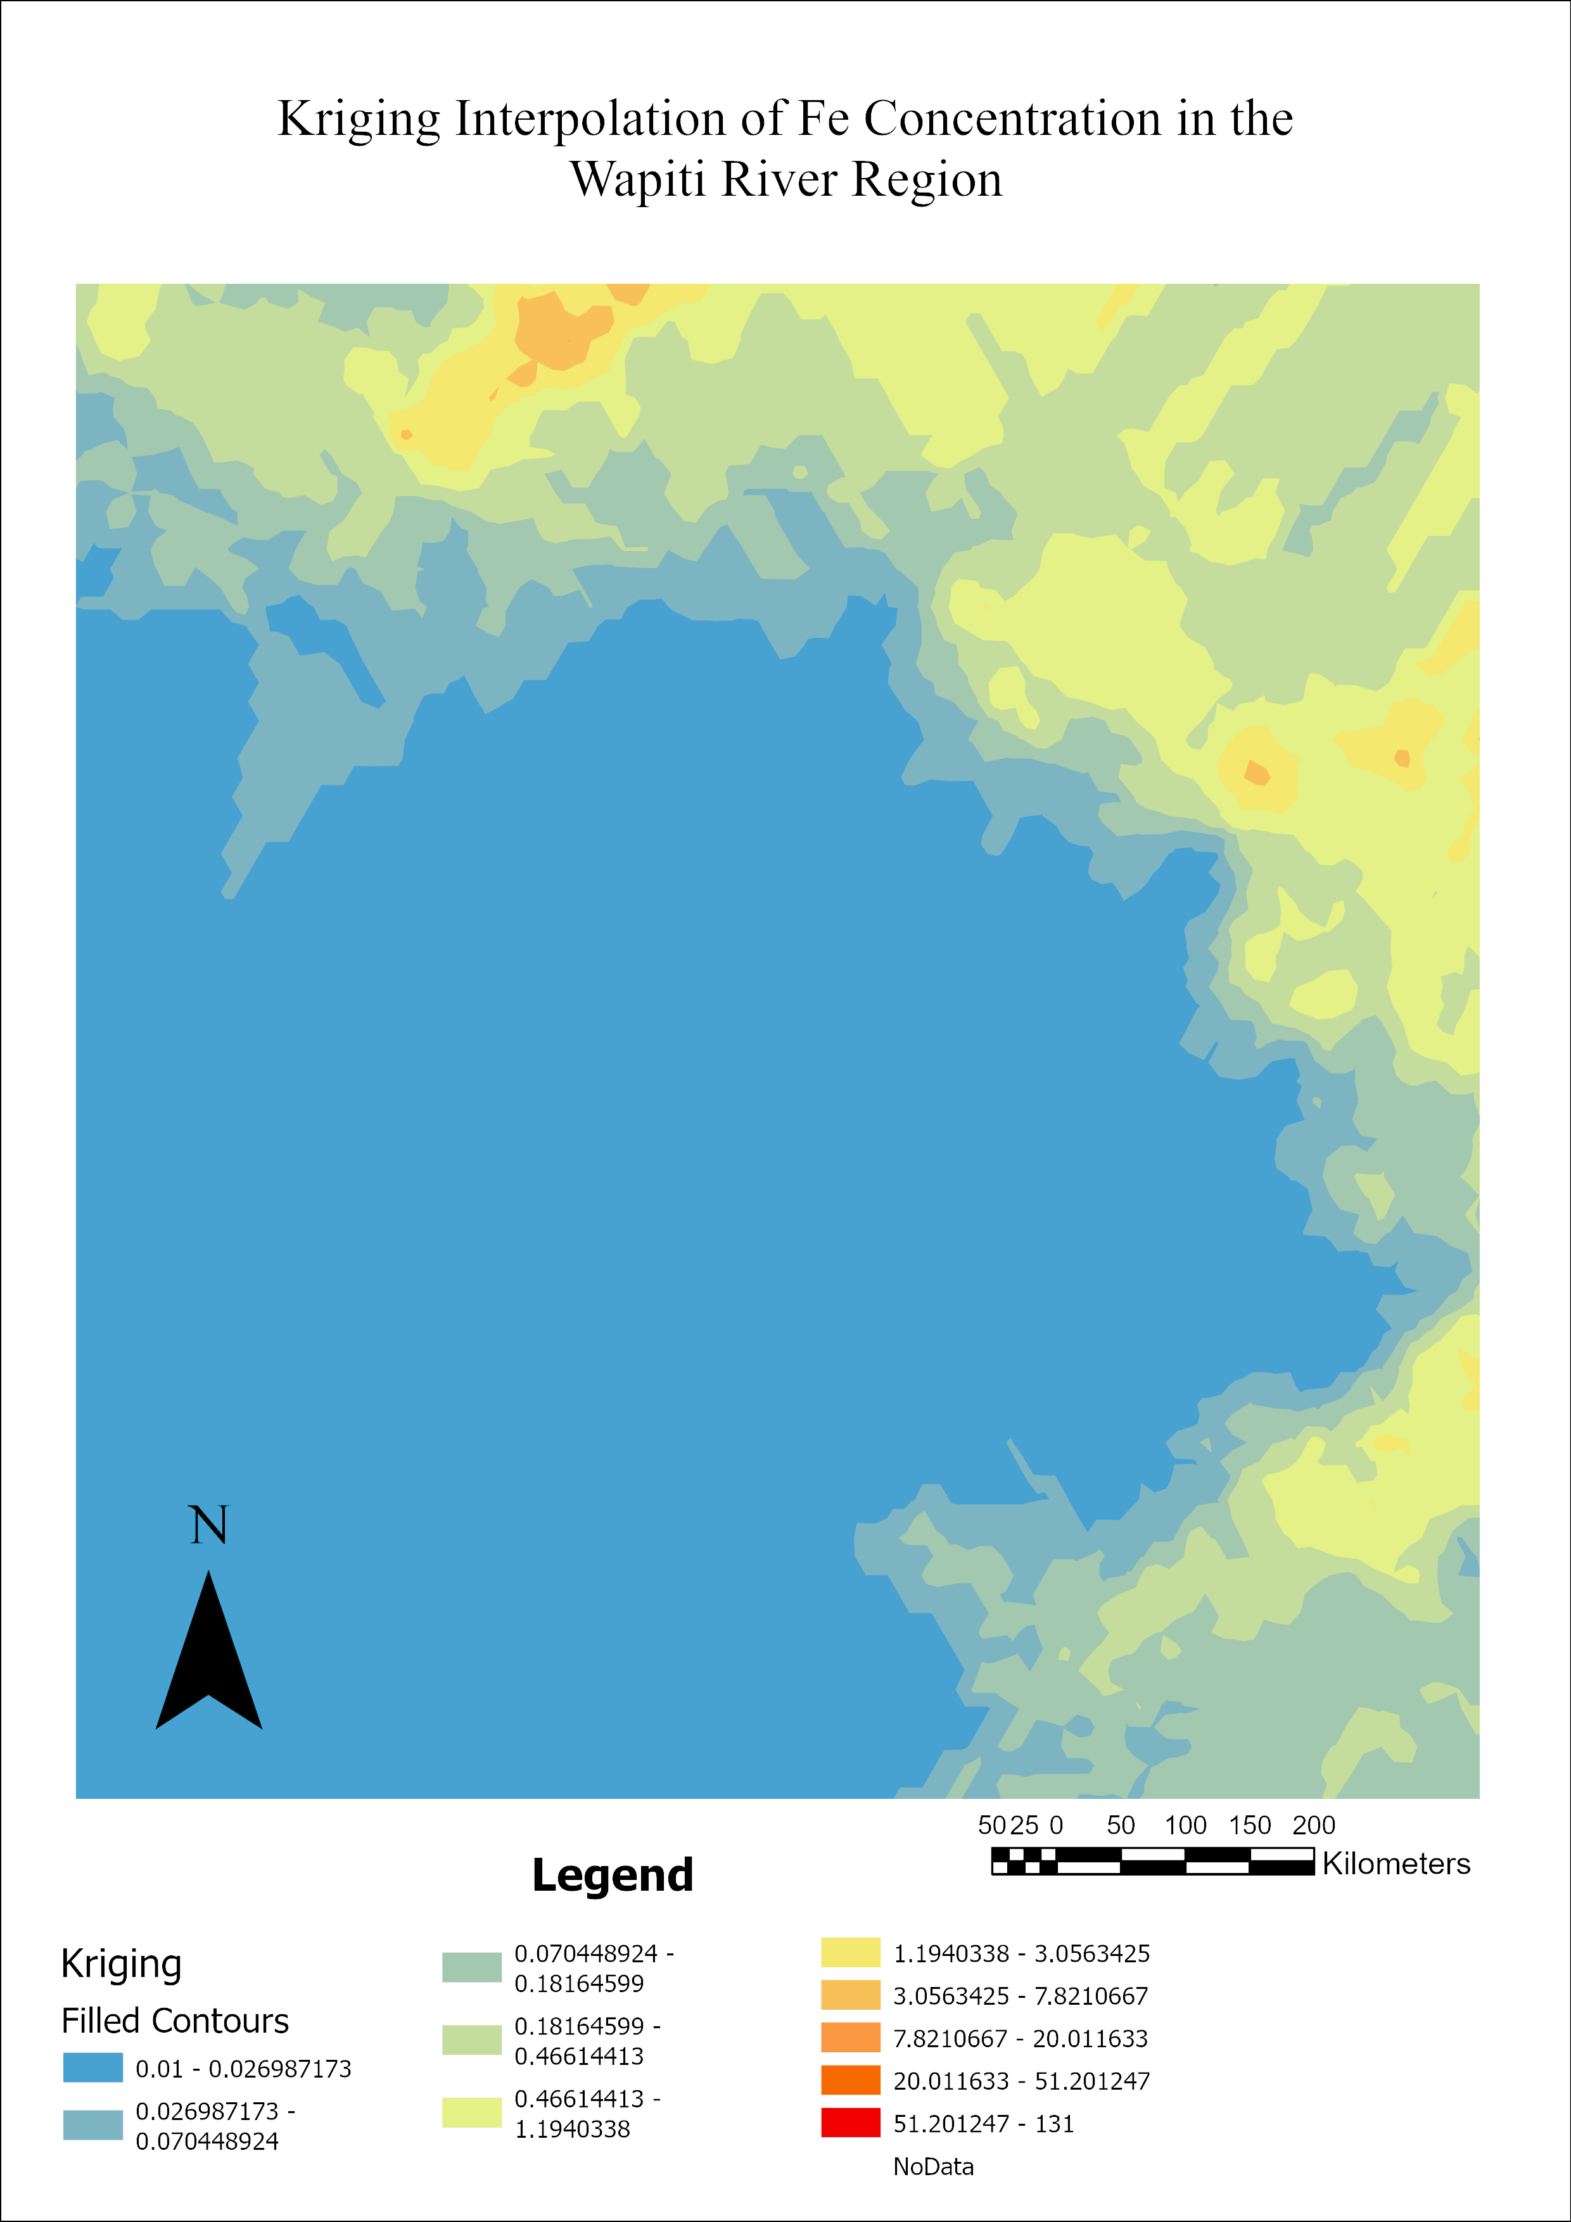
METHODS 2
Interpolation
(both IDW and Kriging)
Comparison of interpolation patterns
IDW is knowledge driven
Kriging is data driven
Notes:
Both Inverse distance weighting and Ordinary Kriging were conducted in order to yield an overall comparison of interpolation patterns.
Based on the visual data, we can see that IDW gives a broad overall picture, however it may be too broad to inference the data here.
Ordinary Kriging however shows a large interpolation area, and by the given overall normal distribution from the histogram on the previous slide, this is the preferred method ongoing in this project.

Slide 7
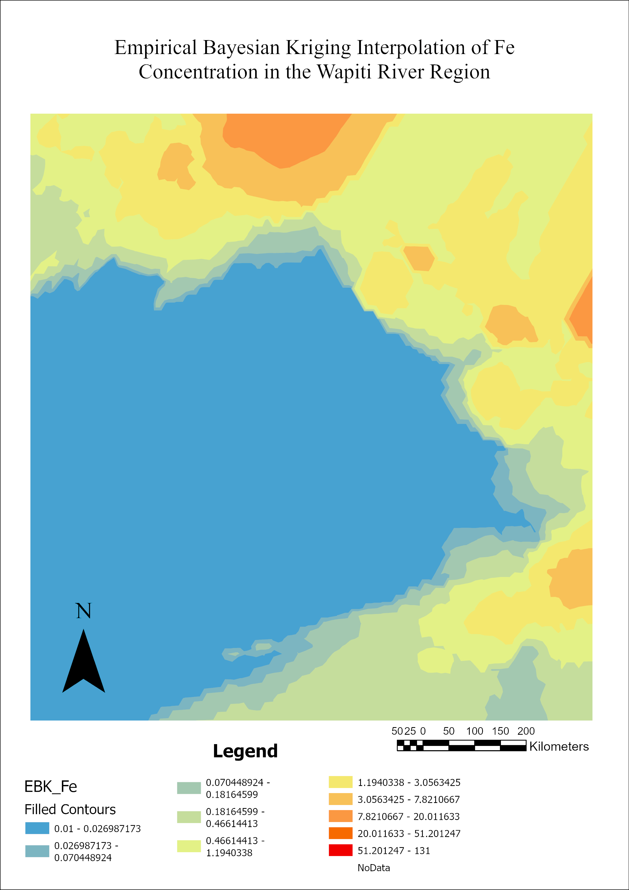
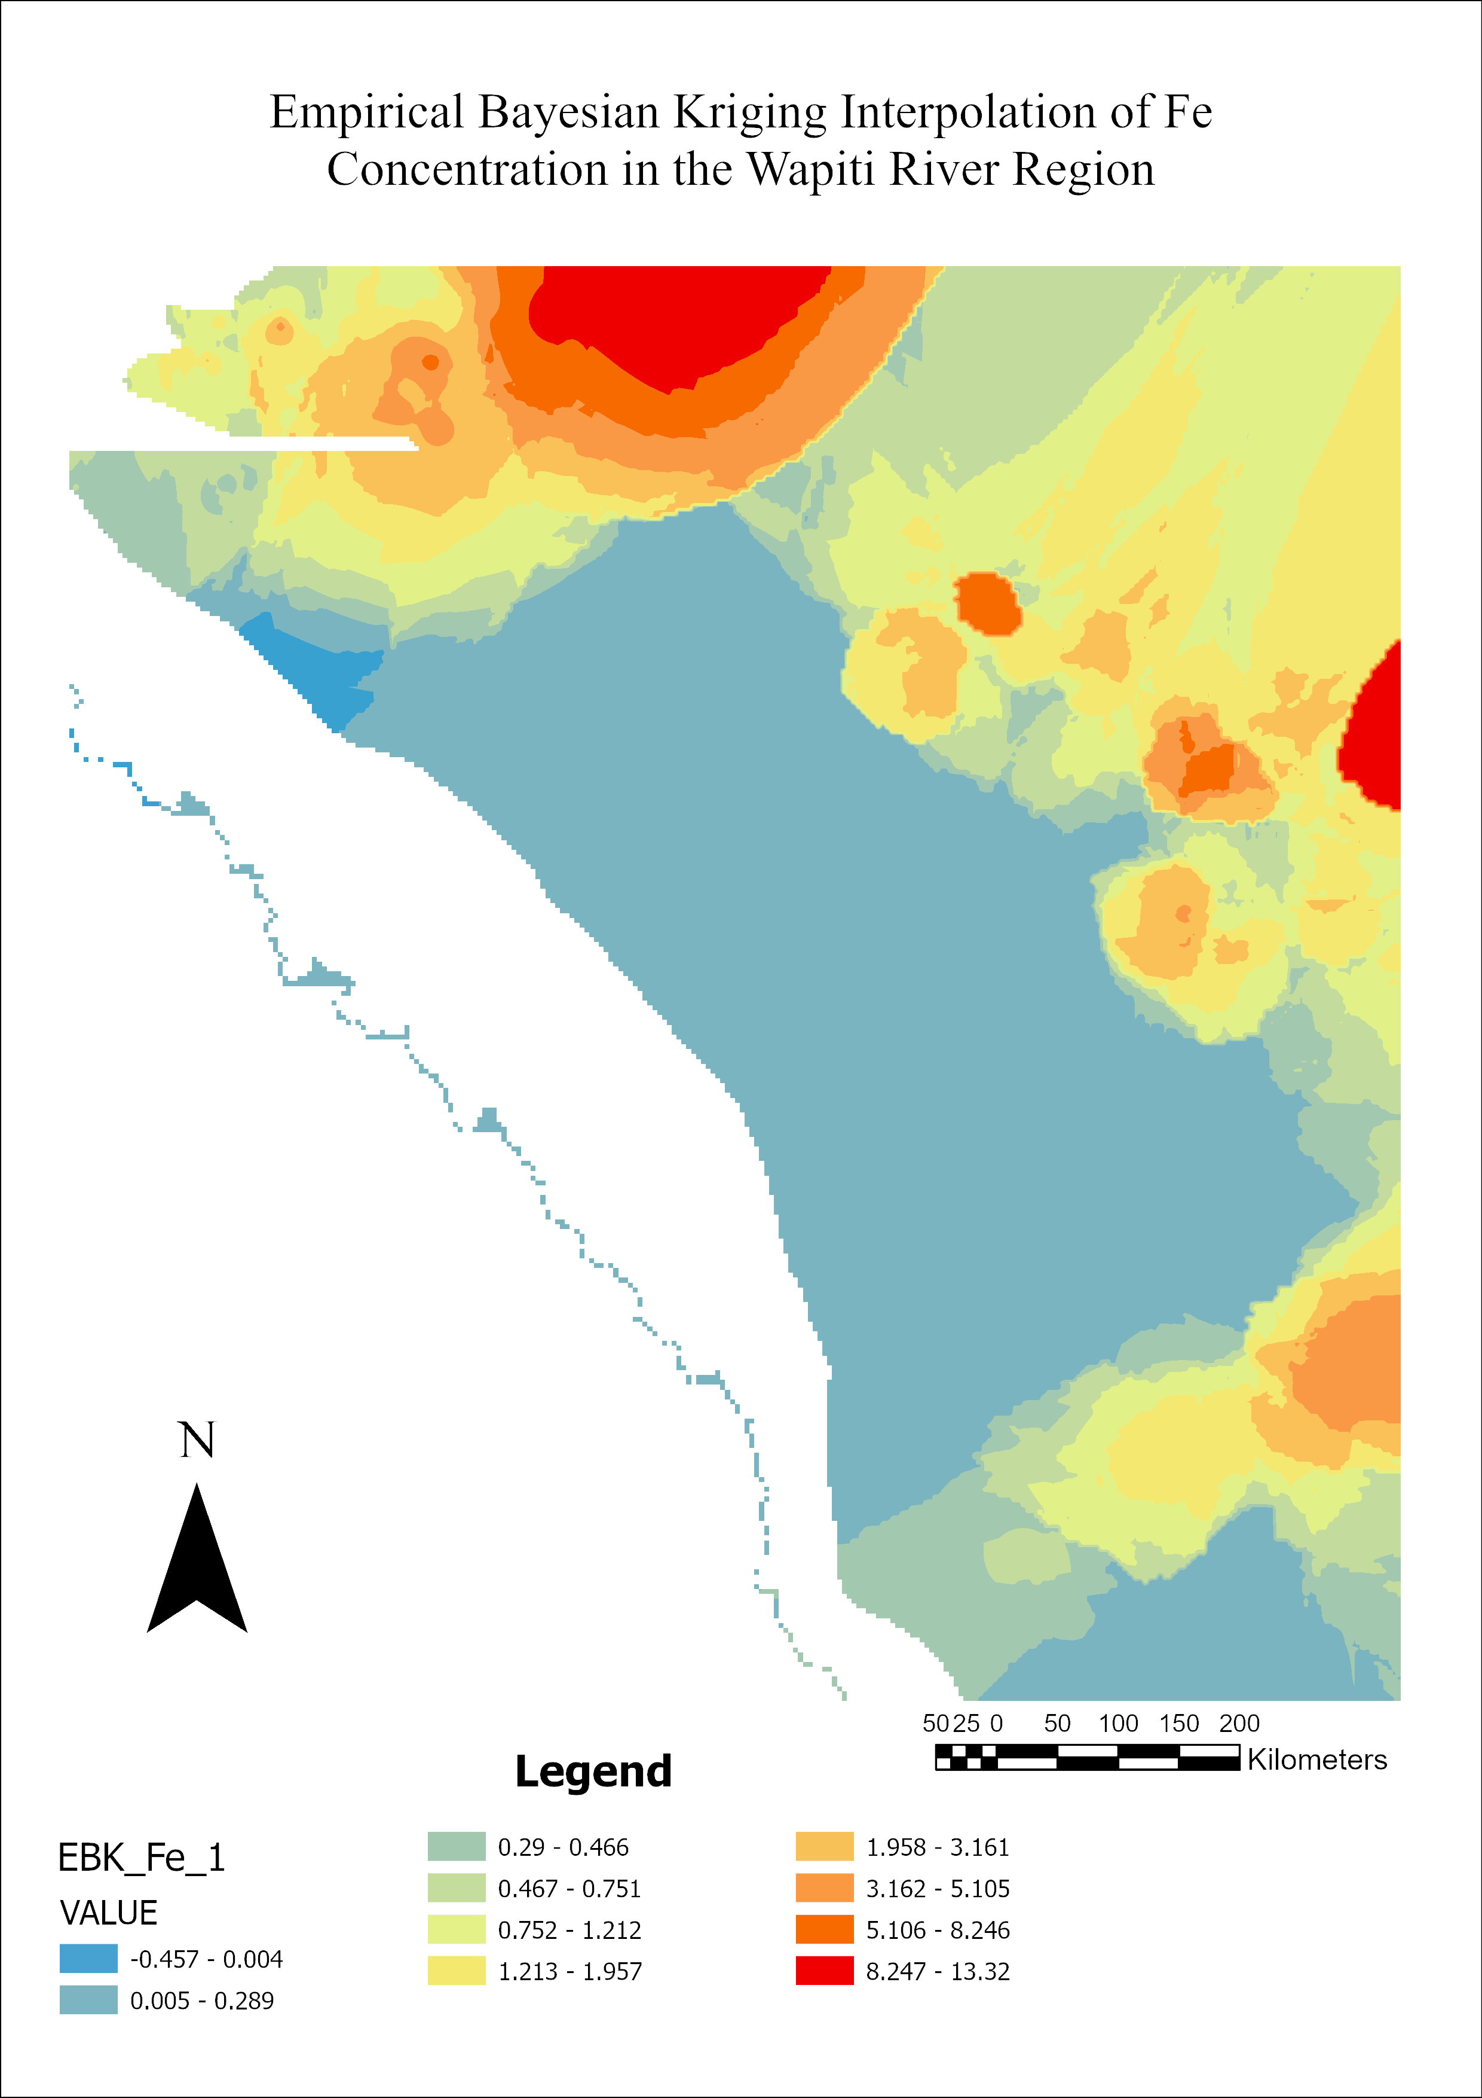
METHODS 3
Standard Errors prediction
Done by using Empirical Bayesian Kriging and masking
Accounting for uncertainty
Notes:
Further analysis is done through Bayesian Empirical Kriging. This is done in order to account for uncertainty within the data and gives a more in depth look into the interpolation analysis.
Comparing the Ordinary Kriging and Bayesian Emprical Kriging, we can identify trends in the Empircal Kriging that was not identified in Ordinary Kriging. We can identify clear regions in the west and northern areas of Wapiti river region with the most significant Iron concentrations.

Slide 8
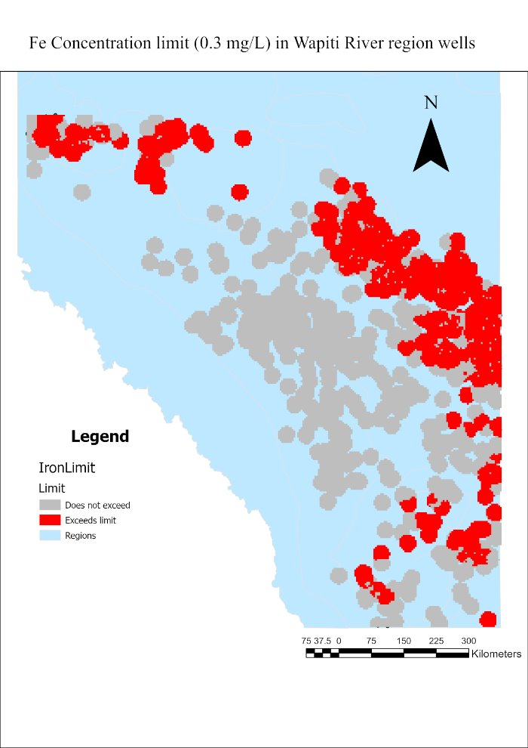
DISCUSSION
Raster Calculator
A limit of 0.3 mg/L was applied (Government of Alberta)
The mid - western region of the Wapiti River exceed the limit
Notes:
Lastly, a raster calculator is done to identify regions that exceed the Fe concentration limit of 0.3 mg/L, which is a value derived from the Government of Alberta for drinking water quality use. Likely from the Bayesian Empirical Kriging model, the raster calculator shows the same trend in regions that present areas that have exceeded the limit.

Slide 9
CONCLUSION
Iron levels exceeded 0.3 mg/L in major regions
Persistent land-use leads to influx in Iron concentrations

Slide 10
REFERENCES
Alberta Geological Survey. Distribution of Total Dissolved Solids in the Wapiti / Belly River HSU (DIG 2017-0026). https://geology-ags-aer.opendata.arcgis.com/datasets/2e91026904a6458685c5b552636741ee_0/explore?location=52.153156,-114.905016,6.75
Alberta Geological Survey. Hydrogeological Regions of Alberta https://geology-ags-aer.opendata.arcgis.com/
Environment and Climate Change Canada, Canadian Environmental Sustainability Indicators. (2019, January 30). Water Quality: Wapiti River above Confluence of Smoky River, Alberta. Natural Resources Canada, Open Science and Data Platform. https://osdp-psdo.canada.ca/dp/en/search/metadata/ECCC-CESI-WATER-1-AB07GJ0030
Common water quality terms | Alberta.ca. (2025, December 12). https://www.alberta.ca/common-water-quality-terms

