Slide 1
Εργασία Αντικειμενοστραφούς προγραμματισμού ΙΙ
Ν.Λιάπης it21950
Α.Χούρλιας it219113

Slide 2

Array Terms Vector , Array Geodesic Vector

Slide 3

Abstract class Traveller

Slide 4
Abstract Calculate Similarity

Slide 5

City Constructor 1

Slide 6
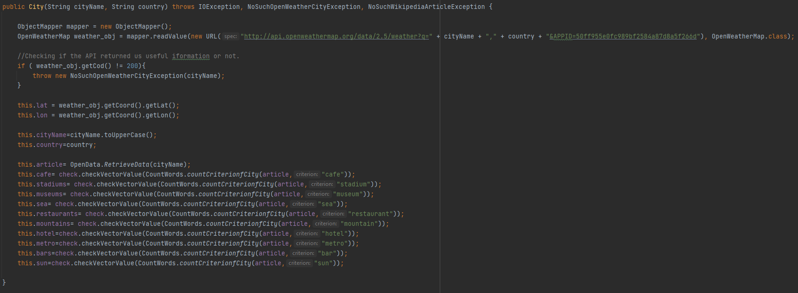
City Constructor 2

Slide 7
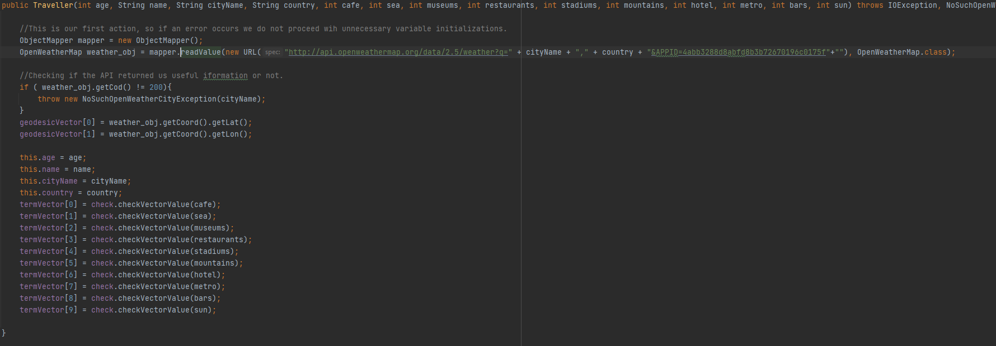
Traveller Constructor 1

Slide 8

Traveller Constructor 2

Slide 9
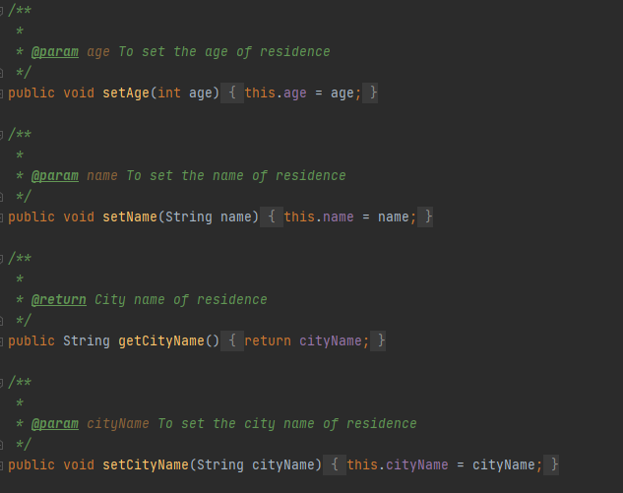
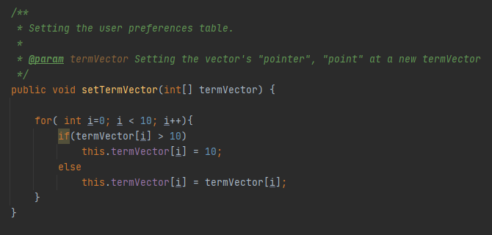
Sampling getters and Setters

Slide 10

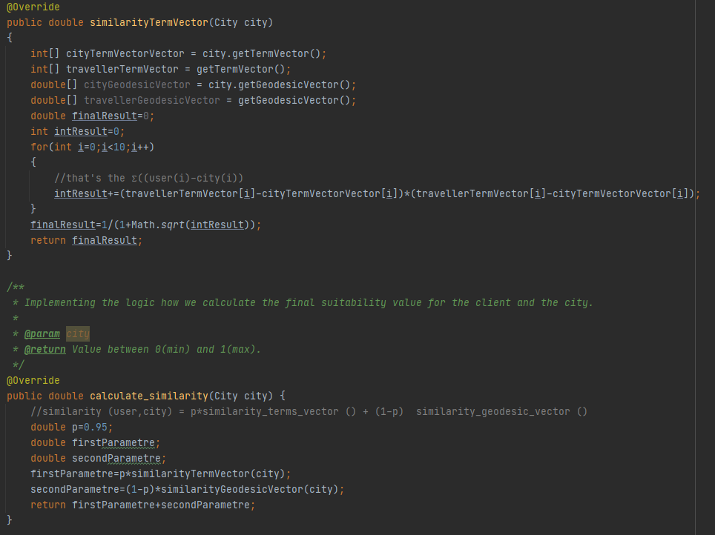
Young Traveller Calculate Similarity

Slide 11

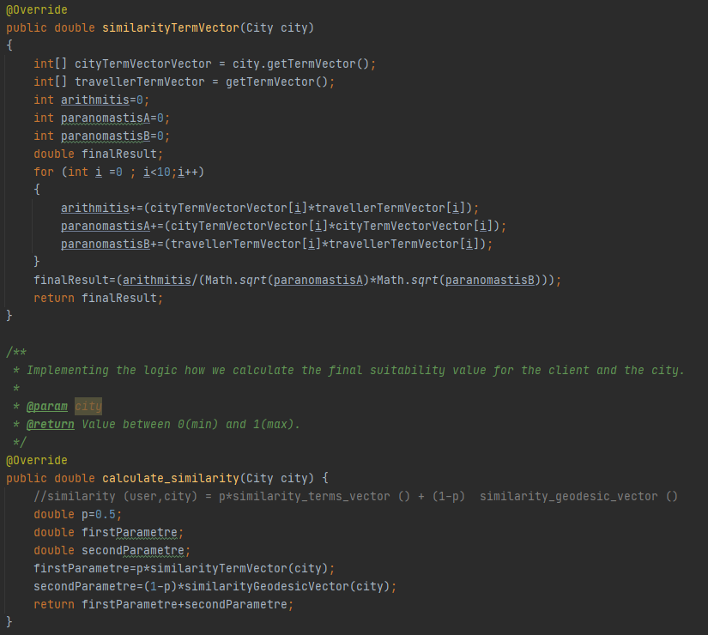
Middle Traveller Calculate Similarity

Slide 12

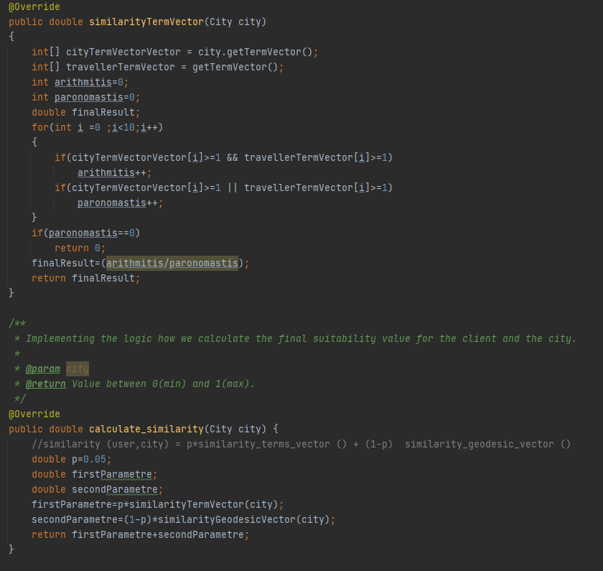
Elder Traveller Calculate Similarity

Slide 13
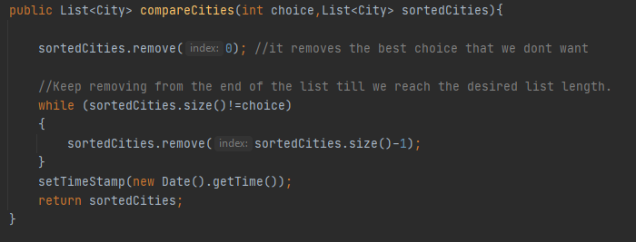

Compare Cities

Slide 14
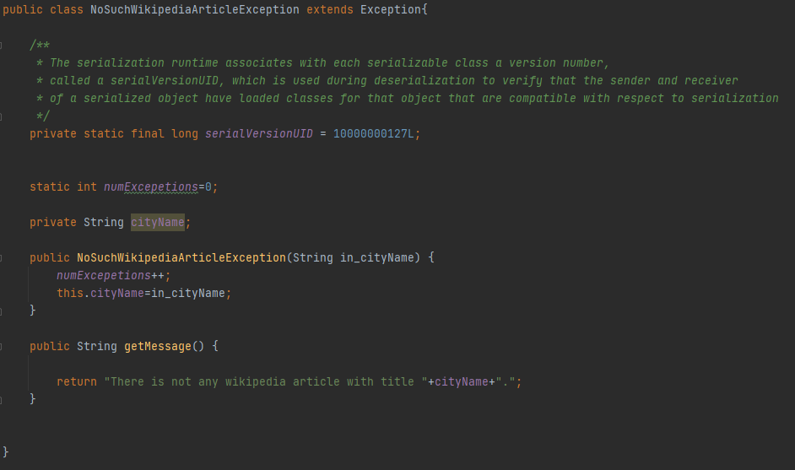
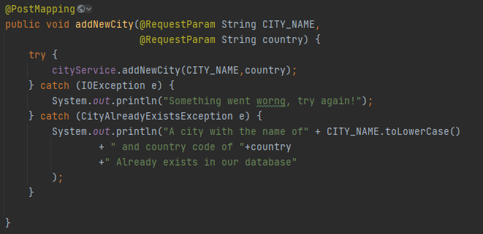

Exceptions

Slide 15
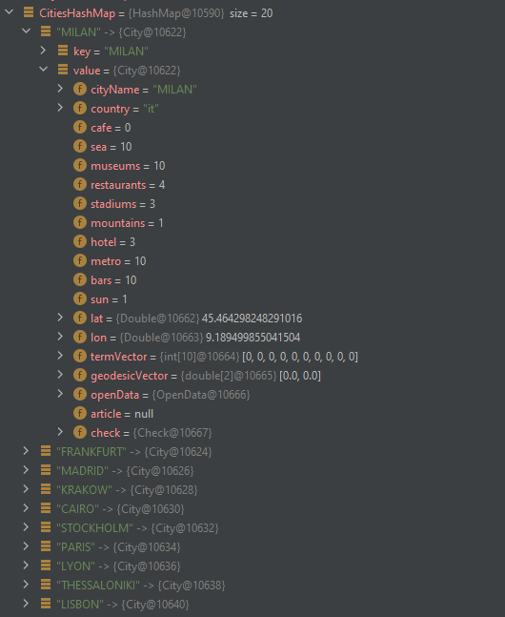

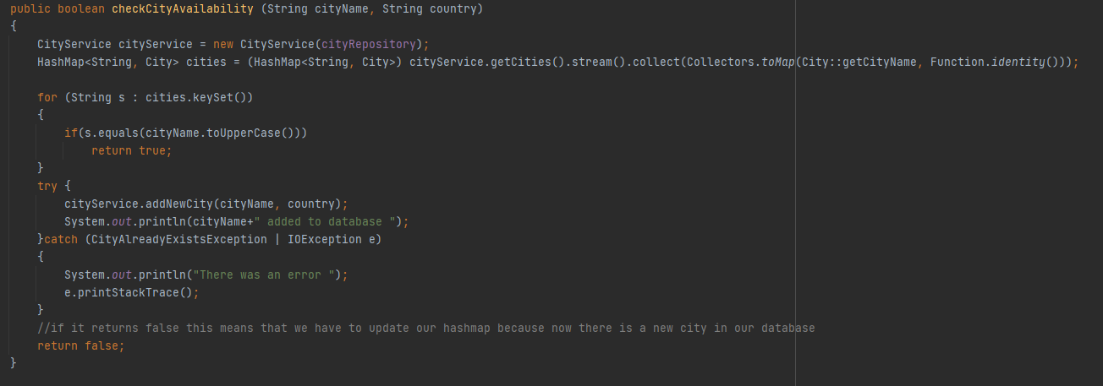
Hash map collection

Slide 16
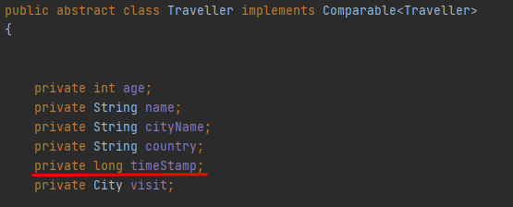
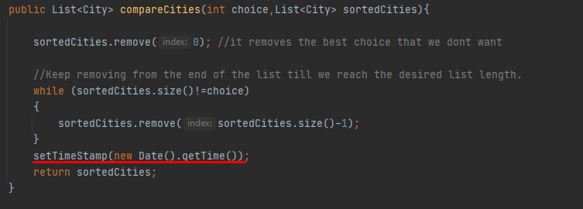

Timestamp

Slide 17

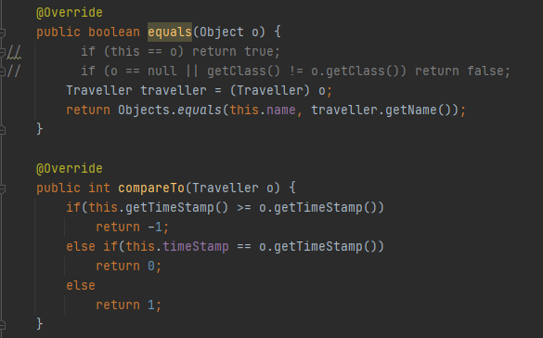

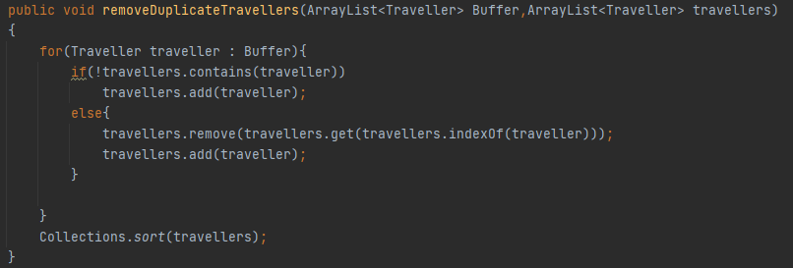
Comparable

Slide 18

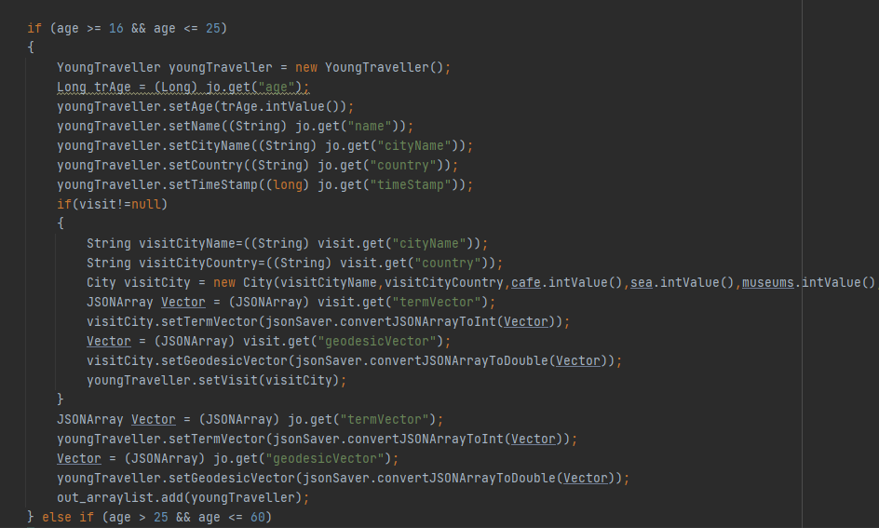
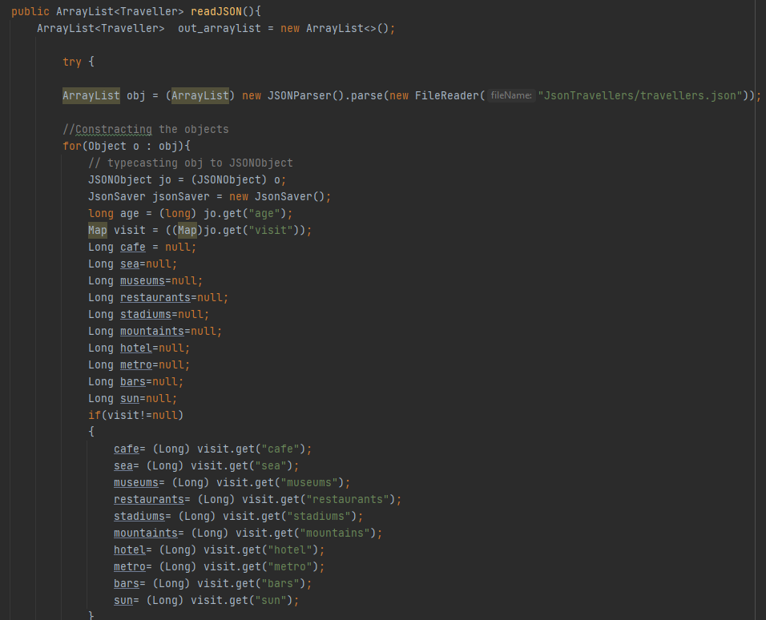
JSON

Slide 19
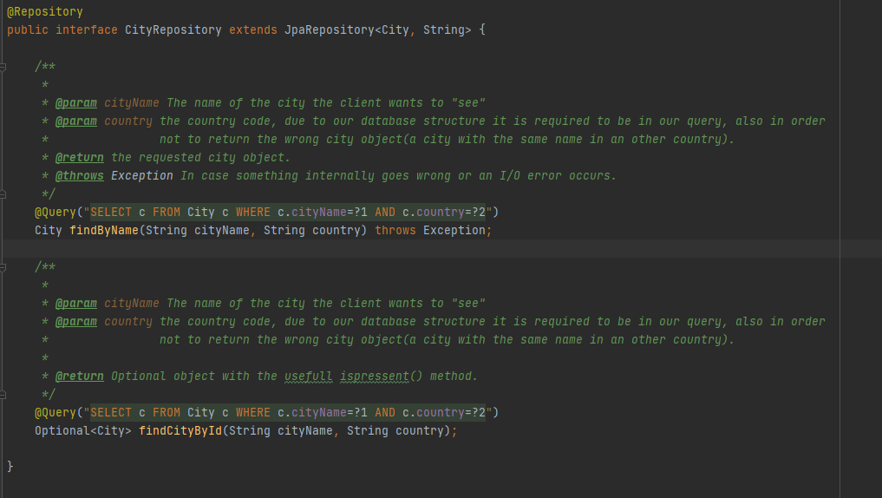
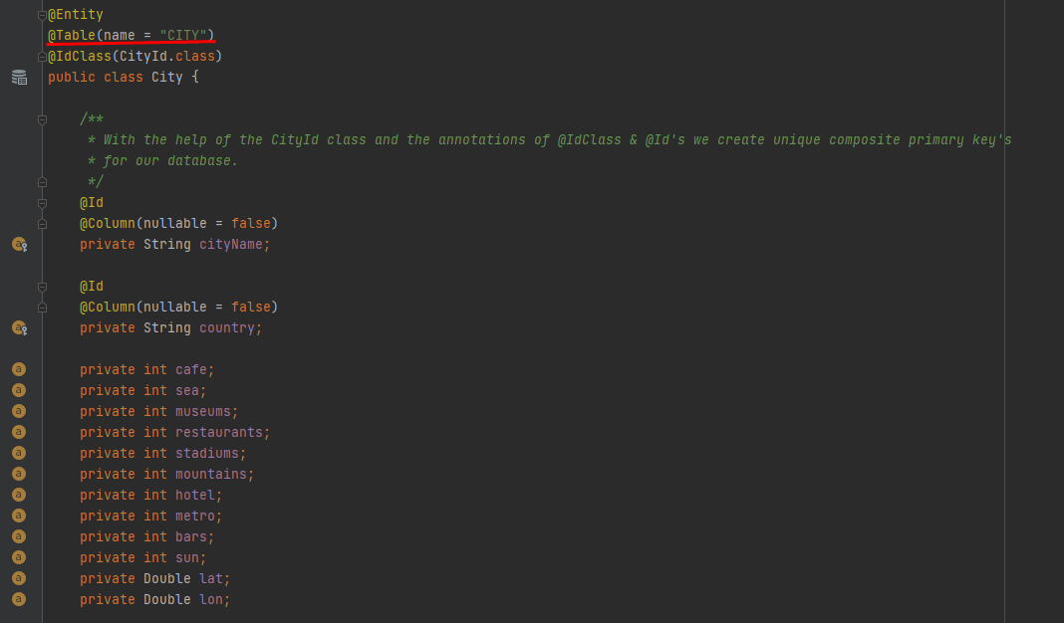
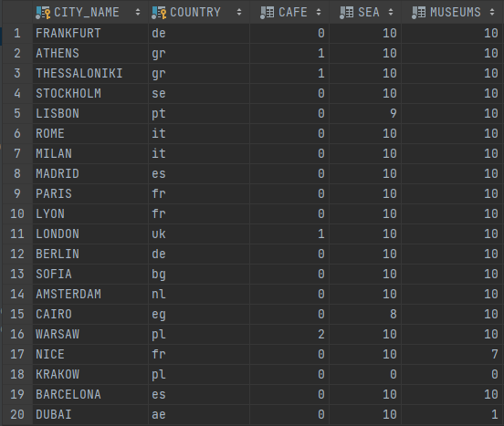
Database

