Slide 1

LogiTech Logistics Analysis & Delay Prediction
Using Data to Improve Delivery Efficiency
Presented by: Mohammed Athar Ansari
Batch: DA604
Mentor: Jaya Pandey

Slide 2
PROJECT OVERVIEW
This project analyzes logistics operations to understand delivery delays, shipment costs, and warehouse performance.
The goal is to use data to identify inefficiencies and improve overall delivery efficiency.
Problem Statement
DELIVERY DELAYS AND OPERATION ISSUES
Many logistics companies face frequent delivery delays, which increase costs and reduce customer satisfaction.
There is no clear system to identify which factors (warehouse, shipment type, or delivery mode) are causing these delays.
As a result, decisions are often reactive instead of proactive, leading to inefficiencies and poor service quality.

Slide 3
BUSINESS OBJECTIVES
Shipment Analysis
Warehouse Analysis
Delivery Analysis
📦
🏭
🚚
TOOLS & TECHNIQUES
• Python (Pandas, NumPy) – Data cleaning and processing
• Matplotlib & Seaborn – Data visualization
• Exploratory Data Analysis (EDA) – Finding patterns and trends
• Power BI – Dashboard creation and insights presentation

Slide 4
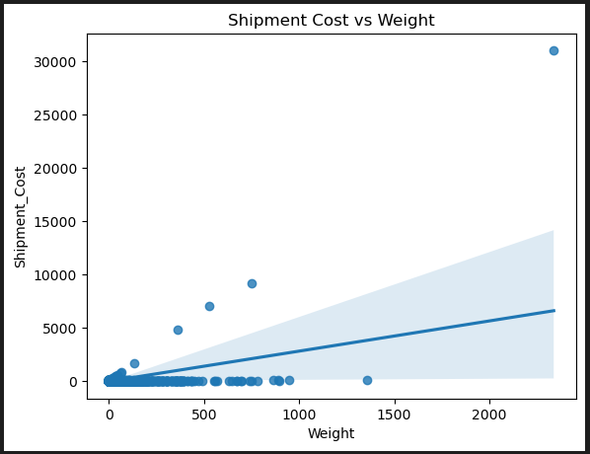
SHIPMENT ANALYSIS
SHIPMENT WEIGHT ANALYSIS
Business Requirement: How does shipment cost vary with weight?
Technique: EDA using Python
Key Insights:
• Most shipments cost less than $1, even at higher weights.
• Shipments between 300–700 Kg weight cost around $5K–$9K.
• One shipment (~2200 Kg) has very high cost (~$31K).
Interpretation: Cost usually increases with weight, but not for all shipments.
Business Recommendation:
• Focus on high-cost shipments like the ~$31K case.
• Improve pricing consistency based on weight.

Slide 5
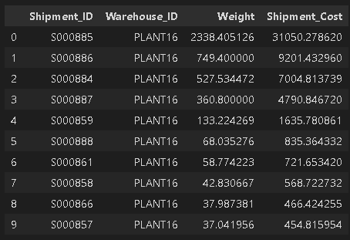
SHIPMENT ANALYSIS
Top 10 Shipments
Business Requirement: Which shipments contribute most to total cost?
Technique: SQL (Join)
Key Insights:
Top shipment costs $31,050
Next highest costs are $9,201 and $7,004
Top 3 shipments contribute a large share of total cost
Interpretation: Total cost is driven by a few high-cost shipments rather than all shipments equally.
Business Recommendation:
Monitor high-cost shipments and optimize routes and pricing for these cases.

Slide 6
SHIPMENT ANALYSIS
FACTORS AFFECTING SHIPMENT COST
Business Requirement: What factors affect shipment cost the most?
Technique: Multiple Linear Regression
Output:
Key Insights:
• Model accuracy is very low (R² = -39.51)
• Shipment cost is not well explained by these factors
• Other important factors are missing
Interpretation: Shipment cost depends on more factors than just weight, delivery time, and warehouse utilization.
Factor | Impact on Cost
Weight | +3.05
Delivery Time | -115.67
Warehouse Utilization | -9.89
Business Recommendation: Include additional factors like distance, shipping method, and packaging to better understand shipment cost.

Slide 7
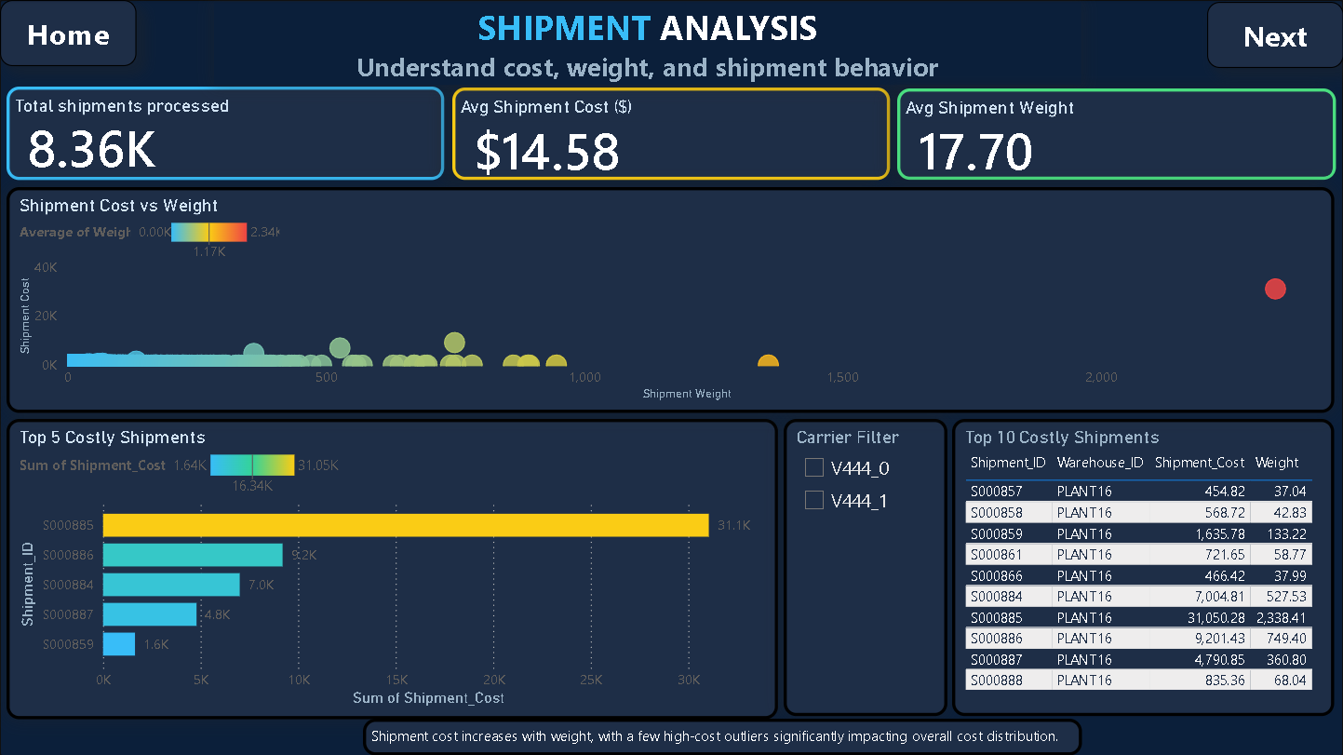
SHIPMENT ANALYSIS
Shipment Performance Dashboard
Business Requirement : Which shipments are the most expensive?
Technique: Power BI Dashboard
Key Insights:
Shows total shipments, average cost, and weight
Highlights high-cost shipments
Allows filtering by warehouse
Interpretation: The dashboard makes it easy to track shipment cost and quickly spot expensive shipments.
Click to view full dashboard.
Business Recommendation: Use the dashboard to monitor shipment cost regularly, identify high-cost shipments early, and support faster decision-making.

Slide 8
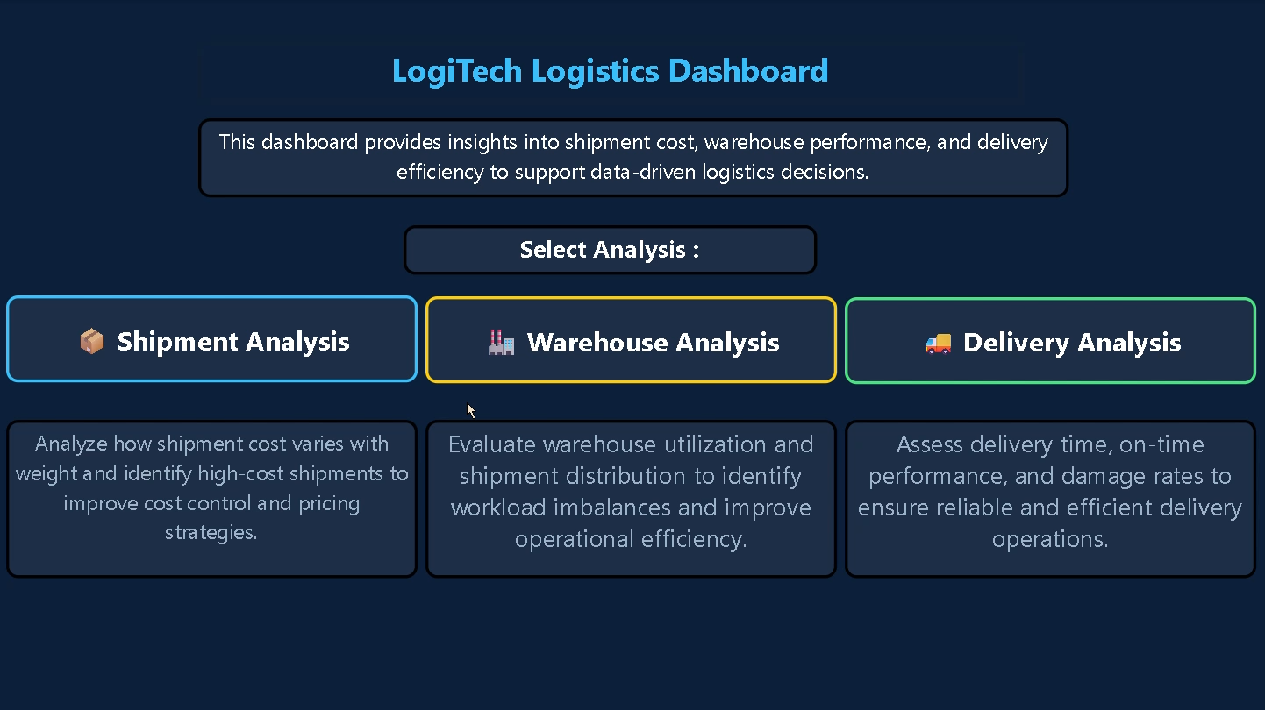

Slide 9
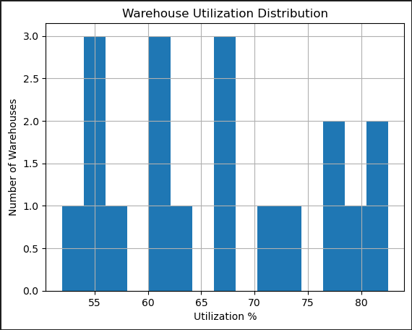
warehouse ANALYSIS
Warehouse Utilization Overview
Business Requirement : How is shipment load spread across warehouses?
Technique: EDA using Python
Key Insights:
• Warehouse utilization ranges from about 52% to 83%.
• Most warehouses fall between 55% and 70%.
• Only a few warehouses are above 75% utilization.
Interpretation: Most warehouses are moderately utilized, with a few nearing high usage.
Business Recommendation:
• Increase usage of low-utilization warehouses.
• Avoid overloading highly utilized warehouses.

Slide 10
WAREHOUSE ANALYSIS
Impact of Warehouse on Shipment Damage
Business Requirement : Does shipment damage happen more in some warehouses than others?
Technique: Chi-Square Test
Hypothesis:
H0 (Null Hypothesis): Shipment damage is NOT related to warehouse location.
H1 (Alternative Hypothesis): Shipment damage IS related to warehouse location.
Key Insights:
• P-value is 0.6579 (greater than 0.05)
• Damage cases are similar across warehouses
• No significant relationship found
Interpretation : Shipment damage does not depend on warehouse location.
Output :
T-Statistic: -3.5096
P-value: 0.0005
Conclusion: Damage does not depend on warehouse
Business Recommendation: Focus on other factors like packaging, handling, or transportation instead of warehouse location to reduce damage.

Slide 11
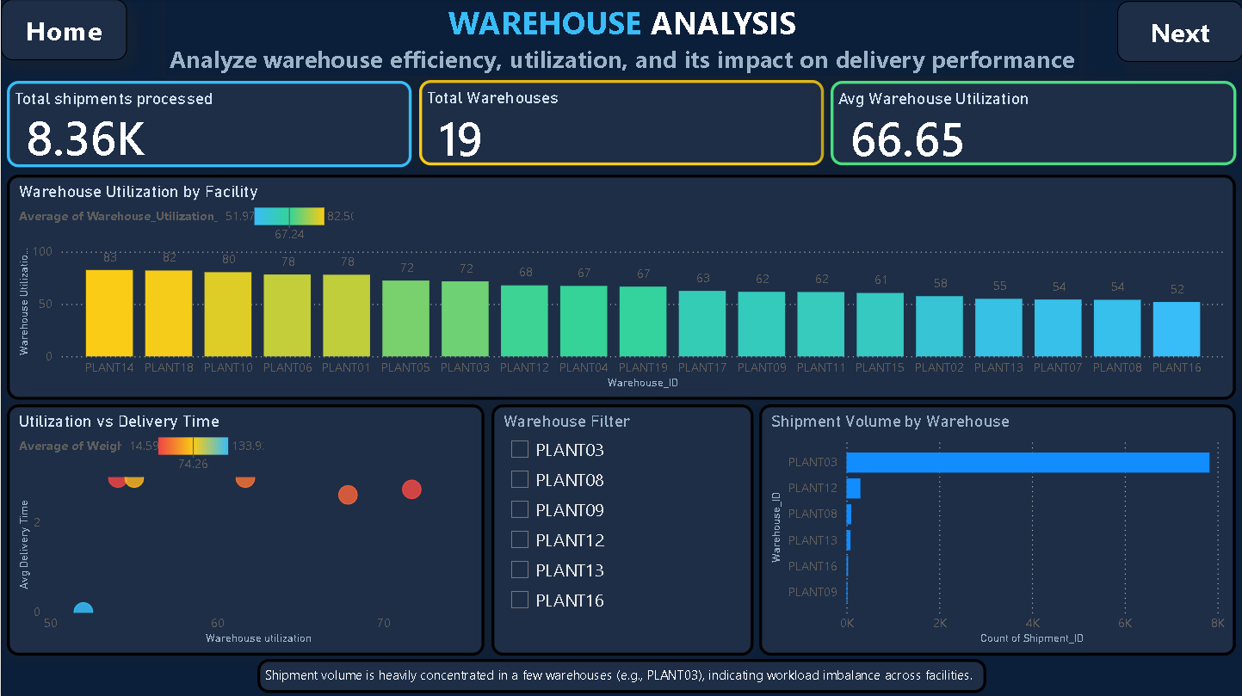
WAREHOUSE ANALYSIS
Warehouse Performance Dashboard
Business Requirement : Which warehouses are performing better than others? Technique: Power BI Dashboard
Key Insights:
• Warehouse utilization ranges from about 52% to 83%
• A few warehouses handle most shipments (e.g., PLANT03)
• Higher utilization shows slightly higher delivery time
Interpretation : Warehouse workload is uneven and affects delivery performance.
Click to view full dashboard.
Business Recommendation:
Balance shipment load across warehouses to improve efficiency and reduce delays.

Slide 12
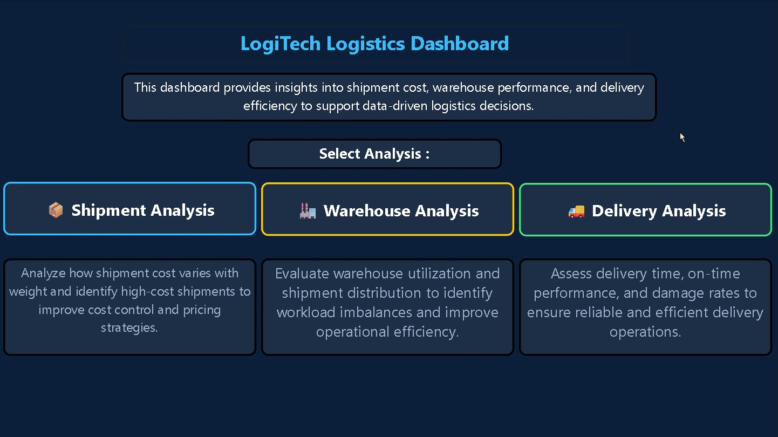

Slide 13
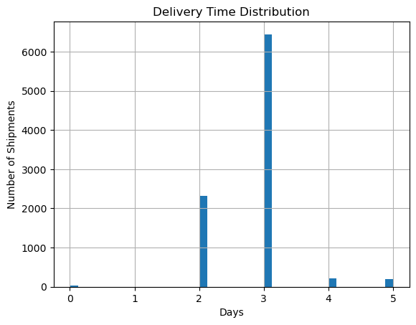
DELIVERY ANALYSIS
DELIVERY TIME ANALYSIS
Business Requirement : How long do deliveries usually take?
Technique: EDA using Python
Key Insights:
• Around 6,200 deliveries take 3 days
• Around 2,100 deliveries take 2 days
• Very few deliveries take more than 3 days
• Some deliveries show 0 days due to data recording for ground mode
Interpretation: Most deliveries are completed within 2–3 days.
Business Recommendation:
Maintain the 2–3 day delivery standard and reduce delays beyond 3 days.

Slide 14
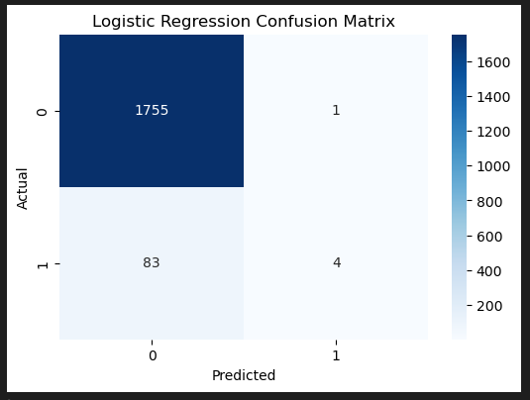
DELIVERY ANALYSIS
Predicting Delivery Delays
Business Requirement : Can delivery delays be predicted?
Technique: Logistic Regression
Key Insights:
• 1755 on-time deliveries correctly predicted
• Only 4 delayed deliveries correctly predicted
• Model struggles to predict delayed cases
Interpretation : Delivery outcomes can be predicted using historical data.
Business Recommendation: Use predictive models to identify risky shipments and take action before delays occur.

Slide 15
DELIVERY ANALYSIS
COMPARISON OF DELIVERY TIME
Business Requirement : How much longer do delayed shipments take compared to normal deliveries?
Technique: Independent T-Test
Hypothesis:
H0 (Null Hypothesis): There is NO difference in delivery time between normal and delayed shipments.
H1 (Alternative Hypothesis): Delayed shipments take longer than normal deliveries.
Key Insights:
• P-value is 0.0005 (less than 0.05)
• There is a clear difference in delivery times
Interpretation: Delayed shipments take more time than normal deliveries
Delayed shipments take much longer than normal deliveries, which affects overall performance.
Output :
T-Statistic: -3.5096
P-value: 0.0005
Conclusion: Delayed shipments take significantly longer time than normal deliveries.
Business Recommendation : Identify and fix the causes of delays to reduce delivery time and improve efficiency.

Slide 16
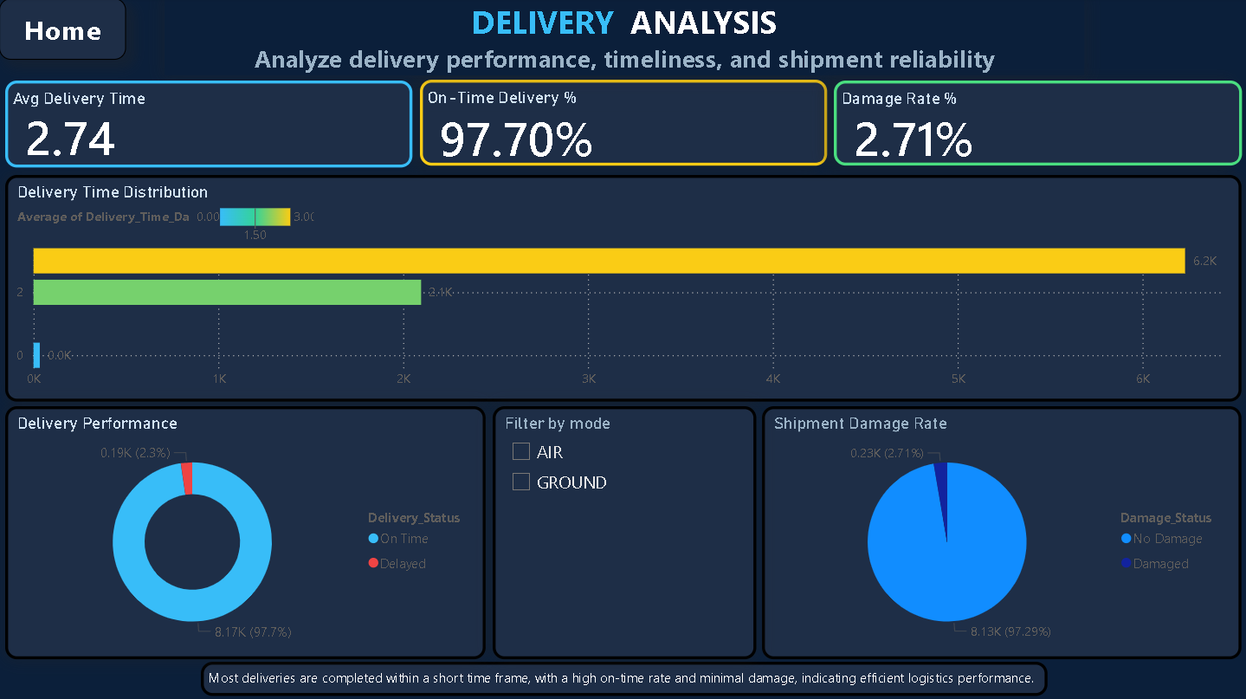
DELIVERY ANALYSIS
Delivery Performance Reliability
Business Requirement : How reliable is delivery performance?
Technique: EDA + KPI Analysis
Key Insights:
• 97.7% deliveries are on time
• Only 2.3% deliveries are delayed
• Damage rate is low at 2.71%
Interpretation : Delivery performance is highly reliable.
Click to view full dashboard.
Business Recommendation:
Maintain current performance and focus on reducing the small number of delays.

Slide 17
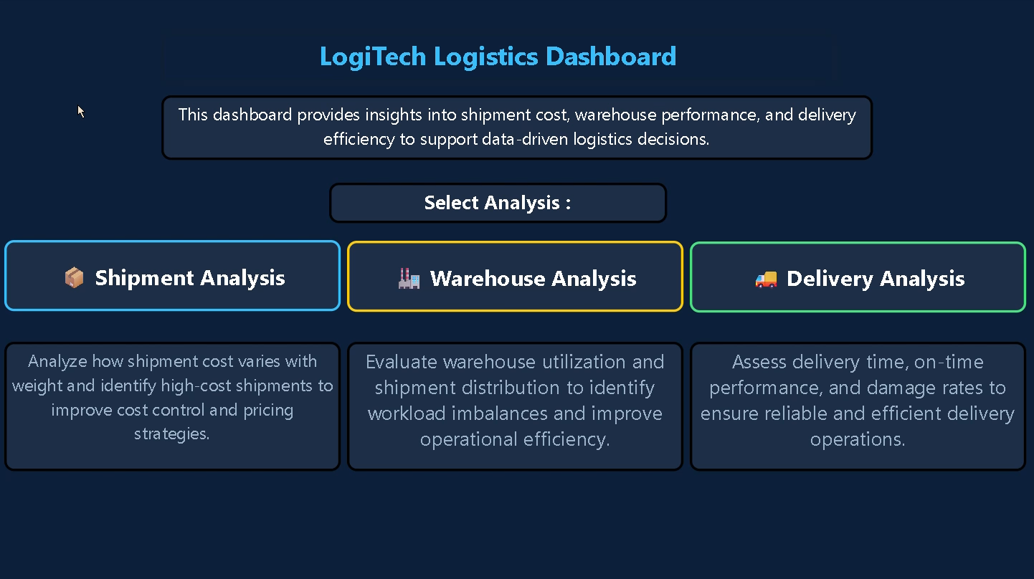

Slide 18
SUMMARY
Shipment Analysis:
Shipment cost increases with weight, but a few high-cost shipments (up to $31,050) drive most of the total cost.
Warehouse Analysis:
Warehouse utilization ranges from 52% to 83%, with workload unevenly distributed. One warehouse handles around 8,000 shipments, while others handle fewer than 500.
Delivery Analysis:
Most deliveries are completed within 2–3 days (around 6,200 shipments in 3 days). On-time delivery rate is 97.7%, with only 2.3% delays.
Statistical & ML Insights:
Shipment damage is not related to warehouse location (p-value = 0.6579). Delayed shipments take longer than normal deliveries. Predictive models can identify most shipments correctly, but delayed cases are harder to detect.

Slide 19
CONCLUSION
1. Shipment cost is mainly influenced by weight, but a small number of shipments contribute most of the total cost.
2. Warehouse workload is uneven, with a few warehouses handling most shipments.
3. Delivery performance is strong, with most deliveries completed on time within 2–3 days.
4. Shipment damage is not linked to warehouse location, suggesting other factors affect damage.
5. Delivery delays can be predicted using past data, but delayed shipments are harder to identify.
RECOMMENDATION
1. Review high-cost shipments to optimize pricing, routes, and handling processes.
2. Distribute workload more evenly across warehouses to improve efficiency.
3. Maintain current delivery performance and reduce delays beyond 3 days.
4. Focus on packaging, handling, and transportation to reduce shipment damage.
5. Use predictive models to identify possible delays early and take action.

