Slide 1


Prepared by group 12
Crypto Currency Analysis
Group: G12
Samrat Madake 2324000381
Raviraj Patil 2324000445
Atharv Bhosale 2324000461
Udhhav Borgalli 2324000545

Slide 2





Introduction
1.Cryptocurrencies have emerged as a highly dynamic and rapidly evolving asset class, attracting significant attention from investors, traders, and analysts worldwide..
2.This project focuses on developing an advanced predictive model to forecast the future prices of cryptocurrencies, such as Bitcoin and Ethereum, using historical data and other relevant features.
3.By incorporating factors like market sentiment, technical indicators, and macroeconomic variables, this model aims to provide accurate price predictions that can support both short-term trading strategies and long-term investment decisions.
PROBLEM STATEMENT:
Analysis of volatility in price of Crypto and future price prediction.

Slide 3

Objectives
Key objectives include:
To predict the accurate price.
To analyse market sentiment.
To manage the risk.
To optimize trading strategies.
To make user-friendly visualisation.

Slide 4
Methodology
To predict the future price of a cryptocurrency using historical data and relevant features, you'll need to follow a structured approach. Here's a high-level overview of how you can approach this problem:
Problem Definition
Objective: Predict the future price of a cryptocurrency (e.g., Bitcoin, Ethereum) based on historical data.
Prediction Horizon: Define whether you want to focus on short-term (e.g., next hour, day) or long-term predictions (e.g., next week, month).
Data Collection
Historical Price Data: Collect historical price data (open, close, high, low, volume) from reliable sources (e.g.,
CoinMarketCap, Yahoo Finance, Alpha Vantage).
Additional Features:
Technical Indicators: Moving averages etc.

Slide 5
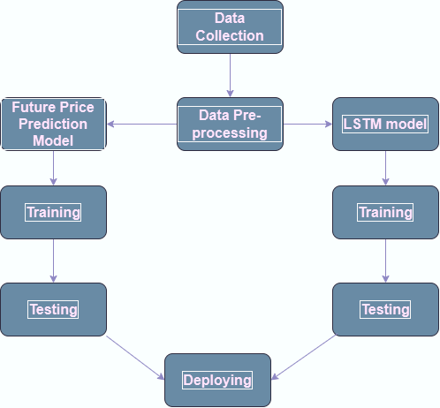
Data Preprocessing
Cleaning: Handle missing values, remove outliers.
Feature Engineering: Create new features (e.g., moving averages ).
Normalization/Scaling: Normalize or scale the data to ensure consistency.
Time Series Formatting: Convert the data into a format suitable for time series analysis, such as sliding windows.
Exploratory Data Analysis (EDA)
Visualization: Plot the historical prices and other features to understand the trends, seasonality, and correlations.
Correlation Analysis: Identify the relationships between different features and the target variable (price).|
Model Selection
Baseline Models: Start with simple models like
LSTM, Moving Average.
# Machine Learning Models:

Slide 6
Training and Validation
Splitting Data: Split the data into training, validation, and test sets.
Model Training: Train the selected models using the training set.
Hyperparameter Tuning: Use techniques like Grid Search, Random Search, or Bayesian Optimization to find the best
parameters.
Cross-Validation: Use cross-validation to assess model performance and avoid overfitting.
Model Interpretation
Feature Importance: Analyze which features contribute most to the predictions.
SHAP Values: Use SHAP values to interpret individual predictions.
Deployment
Dashboard: Create a Website for dashboard to visualize predictions and other relevant metrics.
10.Challenges to Consider
Volatility: Cryptocurrency markets are highly volatile, making predictions challenging.
Data Quality: Ensure the quality and reliability of the data.
Overfitting: Avoid overfitting, especially with complex models like deep learning.

Slide 7
1. Crypto Trend Prediction Based on Wavelet Transform and Deep Learning Algorithm
Authors : Sumesh Eratt Parameswarana,, Vidhyalavanya Ramachandran, Swati Shukla.
Published on : International Conference on Machine Learning and Data Engineering (ICMLDE 2023)
1.Objective: Predict cryptocurrency prices using wavelet transforms and Bi-LSTM networks.
2.Methodology: Analyzed SHIB cryptocurrency data from Yahoo Finance, applying wavelet transforms for feature extraction.
3.Results: Achieved lower Mean Square Error (MSE), Mean Average Error (MAE), and Root Mean Square Error (RMSE) compared to existing methods.
4.Future: Applications in areas such as agricultural product price prediction, variations in climatic conditions, and the availability of
certain agricultural products in the market.
5.The limitations of the prediction model include:
Assumption of Stationarity: The model relies on the assumption that cryptocurrency prices are stationary, leading to potential inaccuracies.
Volatility of Crypto Prices: Cryptocurrency prices are highly volatile, making predictions speculative and uncertain.
Need for Additional Features: Such as social media sentiment or market trends, to enhance prediction accuracy.
LINK : https://www.sciencedirect.com/science/article/pii/S1877050924007889

Slide 8
2.Cryptocurrency price forecasting – A comparative analysis of ensemble learning and deep learning methods
Authors : Ahmed Bouteska, Mohammad Zoynul Abedin *, Petr Hajek, Kunpeng Yuan
Published on : International Review of Financial Analysis 92 (2024) 103055
1.Research Focus: The study aims to compare the deep learning and ensemble learning methods in forecasting prices of four major
cryptocurrencies: Bitcoin, Ethereum, Ripple, and Litecoin.
2.Methodology:
-The analysis includes trading data up to August 31, 2023, and considers the impact of the COVID-19 pandemic by splitting the data into pre- and post-COVID-19 periods.
-Various machine learning models, including LSTM, GRU, and ensemble methods like LightGBM, are evaluated against traditional models like ARIMA and SVM.
3.Key Findings:
-LSTM and GRU neural networks outperform traditional statistical methods and some contemporary models in terms of forecasting error.
-Ensemble learning approaches, particularly gradient boosting, show better accuracy and robustness compared to random forests.
4.Data Limitations:
The analysis is based on historical trading data, which may not fully capture future market dynamics or sudden market changes.
The study primarily focuses on four major cryptocurrencies, which may limit the generalizability of the findings to other cryptocurrencies or the broader market.
LINK : https://www.sciencedirect.com/science/article/pii/S1057521923005719

Slide 9
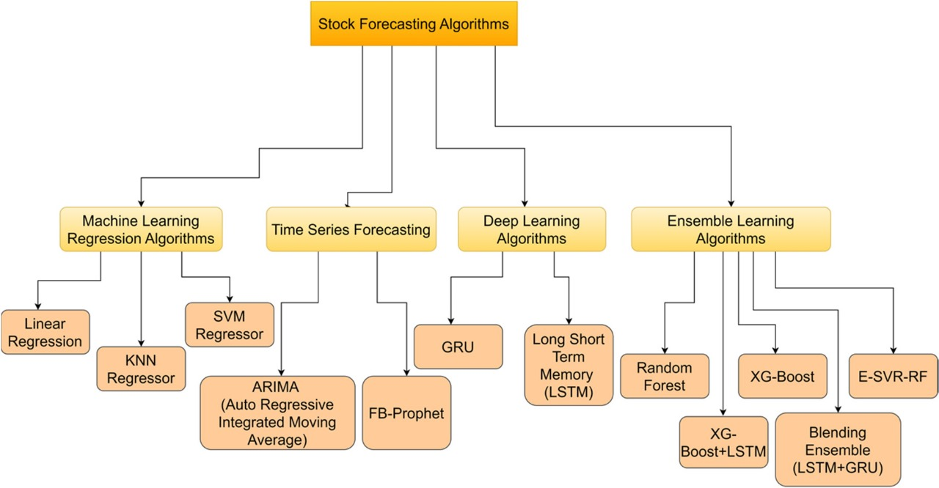
3.Forecasting Stock Market Prices Using Machine Learning and Deep Learning Models: A Systematic Review, Performance Analysis and Discussion of Implications
Authors : Gaurang Sonkavde , Deepak Sudhakar Dharrao , Anupkumar M. Bongale , Sarika T. Deokate , Deepak Doreswamy and Subraya Krishna Bhat.
Published on : International Journal of Financial Studies . 26 July 2023
1.Objective: The paper provides a systematic review of various machine learning (ML) and deep learning (DL) models used for
stock price prediction.
It also analyzes their performance and discusses future research directions.
2.Different Methods:
1.Machine Learning Regression Algorithm
2.Time Series Forecasting
3.Deep Learning Algorithm
4.Ensemble Learning Algorithms
3.Applications:
Stock price prediction, market trend analysis, portfolio optimization,
and algorithmic trading.
LINK : https://www.mdpi.com/2227-7072/11/3/94

Slide 10
4. Stock Market Prediction with High Accuracy using Machine Learning Techniques
Authors : Malti Bansal, Apoorva Goyal, Apoorva Choudhary.
Published on : 4th International Conference on Innovative Data Communication Technology and Application
1.Research focus: The paper explores machine learning (ML) algorithms for predicting stock prices of 12 major Indian companies using 7 years of historical data.
2.Algorithms used:
K-Nearest Neighbors (KNN)
Linear Regression (LR)
Support Vector Regression (SVR)
Decision Tree Regression (DTR)
Long Short-Term Memory (LSTM) (Deep Learning)
3.Dataset: Stock prices of 12 companies including Adani Ports, ICICI Bank, Tata Steel, and others, collected from 2005 to 2021.
4.Limitation: Computational complexity: Deep Learning models like Long Short-Term Memory (LSTM) can provide more accurate predictions,
but they require more
Computational power and time for training and testing.
5.Conclusion: Deep Learning, particularly LSTM, is the most effective for stock price predictions in volatile markets.
LINK :https://www.sciencedirect.com/science/article/pii/S1877050922020993

Slide 11
5.Cryptocurrency: Analysis, Visualization and Prediction
Authors : K. Solanki, P. Aggarwal, A. Swamy.
Published on : Project Report for Indian Institute of Technology, Bombay - DS 203: Programming for Data Science (2022)
1.Objective: Analyze historical cryptocurrency prices, visualize trends, and predict future prices using machine learning.
2.Key Concepts:
- Cryptocurrencies are digital currencies secured by cryptography, operating on a decentralized system.
- Major cryptocurrencies include Bitcoin, Ethereum, Litecoin, and Ripple.
3.Methodology: Utilized datasets from coinmarketcap.com, performed data visualization, and applied LSTM models for price prediction.
4.Findings: Identified price correlations among cryptocurrencies and analyzed the impact of external factors like COVID-19 on market trends.
5.Limitations of the project include potential overfitting of the LSTM model due to its complexity, reliance on historical data that may not account for
sudden market changes, and the challenge of accurately capturing external factors influencing cryptocurrency prices. Additionally, the model's predictions
may be affected by the inherent volatility of the cryptocurrency market.
LINK : https://homepages.iitb.ac.in/~kandarp.solanki/assets/Crypto_Project.pdf

Slide 12








Conclusion
Based on historical data we can analyse the price using different indicators.
2) This analysis has been done for historical data.
3) Based on this analysis technique we can create a model for real time data series i.e, future price prediction.

Slide 13




Thank you

