Slide 1

StockGuard: Smart Inventory and Expiry Tracker
Group No.: SE_IT_C
Group members with Student Id
Atharv Raut - [25104034]
Alankar Shinde - [25104018]
Samarth Rokade - [25104128]
Sujeet Salunke - [25104019]
Project Guide
Prof. Rucha Kulkarni

Slide 2
Contents
Introduction
Objectives
Scope
Proposed System
Features
Block Diagram/ System Architecture
E-R Diagram
Technology Stack
Results
Conclusion and Future Scope

Slide 3
1. Introduction
StockGuard is a web app that helps small shops track stock, expiry dates and sales.
Problem Identified :
    Products expire on the shelf without anyone noticing
    Popular items run out without warning
    Overbuying and paper registers lead to losses
Solution Proposed :
    Record every delivery as a batch with its expiry date
    Alert the owner on WhatsApp before items expire
    Suggest reorders based on actual sales

Slide 4
2. Objectives
To track the stock of every item in real time
To alert the shop owner before products expire
To prevent overbuying using sales-based reorder advice
To identify the top-selling products
To replace paper registers with a digital sales log

Slide 5
3. Scope
Expiry tracking: batch numbers and expiry dates for all stock
Sales history: digital log of daily and monthly sales
Real-time stock counts as items are added or sold
Product registry: add, edit or remove items with prices
Can be applied in kirana stores, medical shops, bakeries and dairy shops
Useful to small shop owners and their staff

Slide 6
4. Proposed System
Product and Stock Management :
    Add products with category, price and low-stock level, and record each delivery as a batch with its expiry date.
Expiry Tracking :
    Each batch is marked fresh, expiring soon or expired. Expired stock cannot be sold.
Billing (First Expiry, First Out) :
    A sale takes stock from the batch that expires first, and stock updates instantly on every screen.

Slide 7
4. Proposed System (contd.)
WhatsApp Alerts :
    A daily summary at 9 AM of expired, expiring and low-stock items, plus an instant alert when stock runs low.
Reports :
    Daily and monthly sales, top products, reorder suggestions and waste, with CSV export.
Secure Login :
    Each shop has its own account. Passwords are stored encrypted and every request is checked with a token.

Slide 8
5. Features
User can register and log in securely
User can add, edit and remove products
User can add stock batches with expiry dates
User can create bills, and stock updates instantly
User can see expiring, expired and low-stock items
User gets WhatsApp alerts before items expire
User can view sales reports and export them as CSV

Slide 9
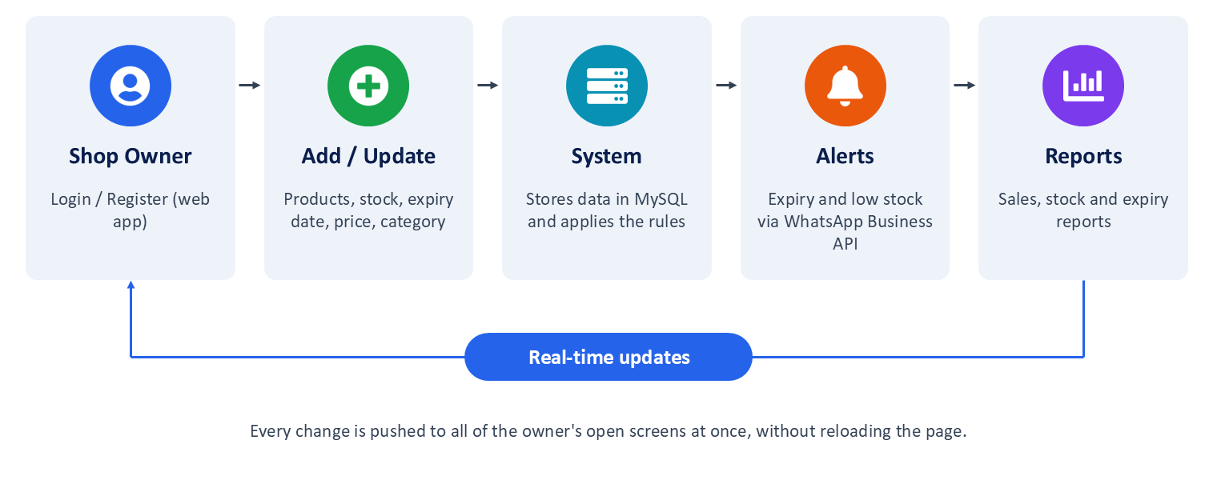
6. Block Diagram/ System Architecture
Fig. 1: Block diagram (workflow) of StockGuard

Slide 10
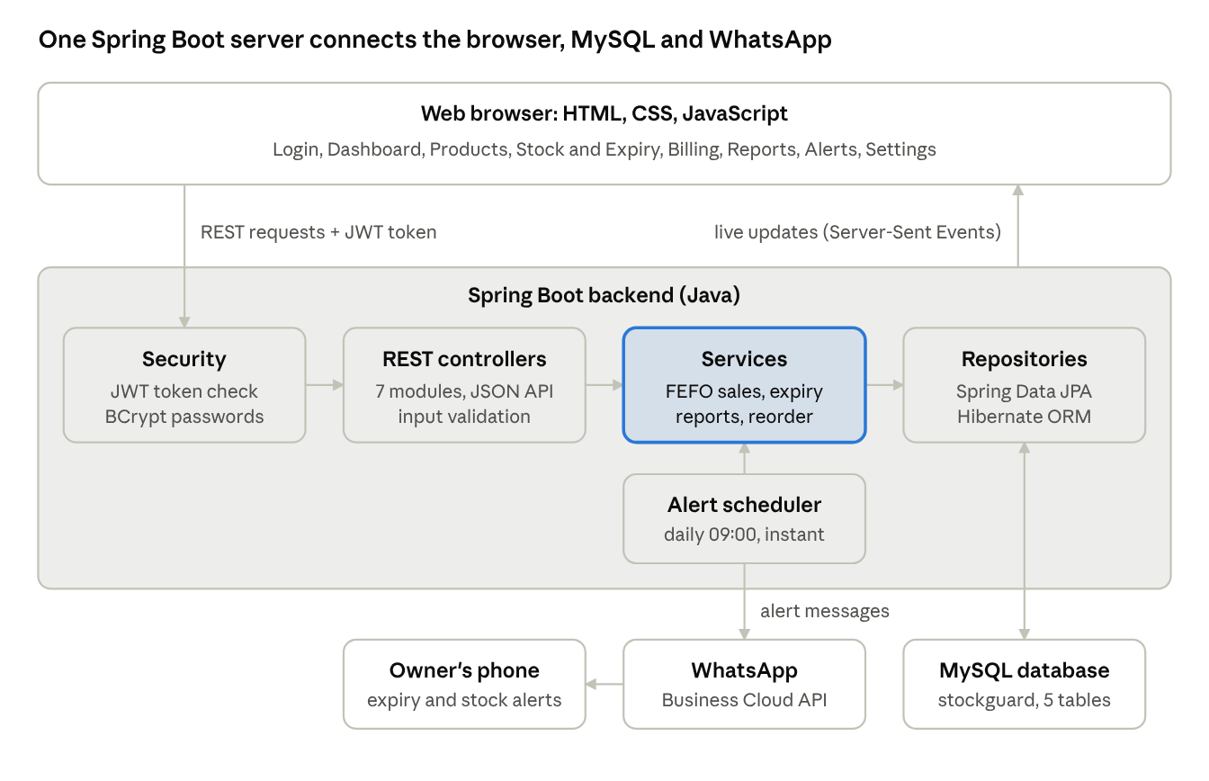
6. Block Diagram/ System Architecture
Fig. 2: System architecture of StockGuard

Slide 11
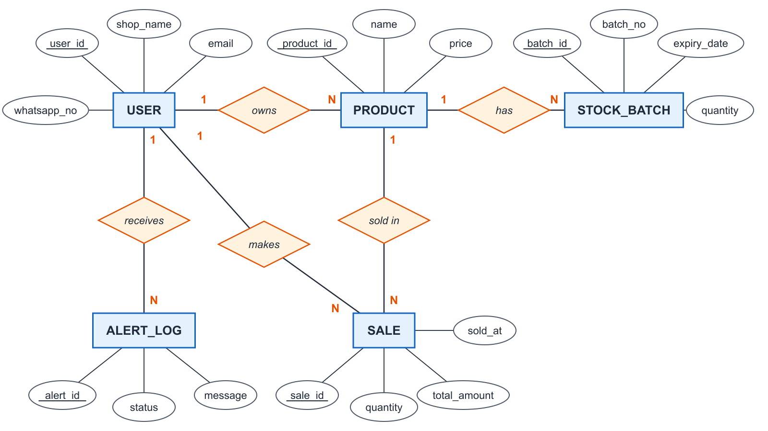
7. E-R Diagram
Fig. 3: E-R diagram of the StockGuard database

Slide 12
8. Technology Stack
Frontend-
HTML5, CSS3, JavaScript (Chart.js for graphs)
Backend-
Java 17, Spring Boot 3 (REST API, Spring Security with JWT, Spring Data JPA, Scheduler)
Database-
MySQL 8 (5 tables)
Notifications-
WhatsApp Business Cloud API
Tools-
IntelliJ IDEA, Apache Maven, DBeaver

Slide 13
9. Results
The system is fully developed and tested:
Frontend (GUI): login, dashboard, products, stock and expiry, billing, reports, alerts and settings pages
Backend: Spring Boot REST API with secure login, first-expiry-first-out billing and scheduled WhatsApp alerts
Database: MySQL with 5 tables; all 15 test cases passed

Slide 14
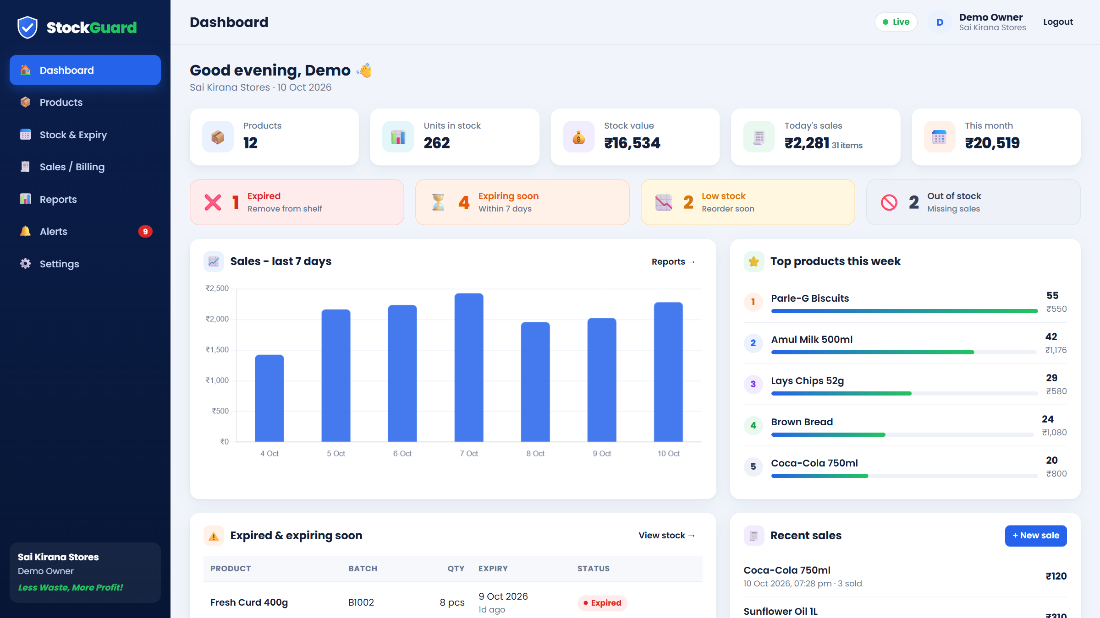
9. Results (contd.)
Fig. 4: Dashboard - stock, sales and alerts at a glance

Slide 15
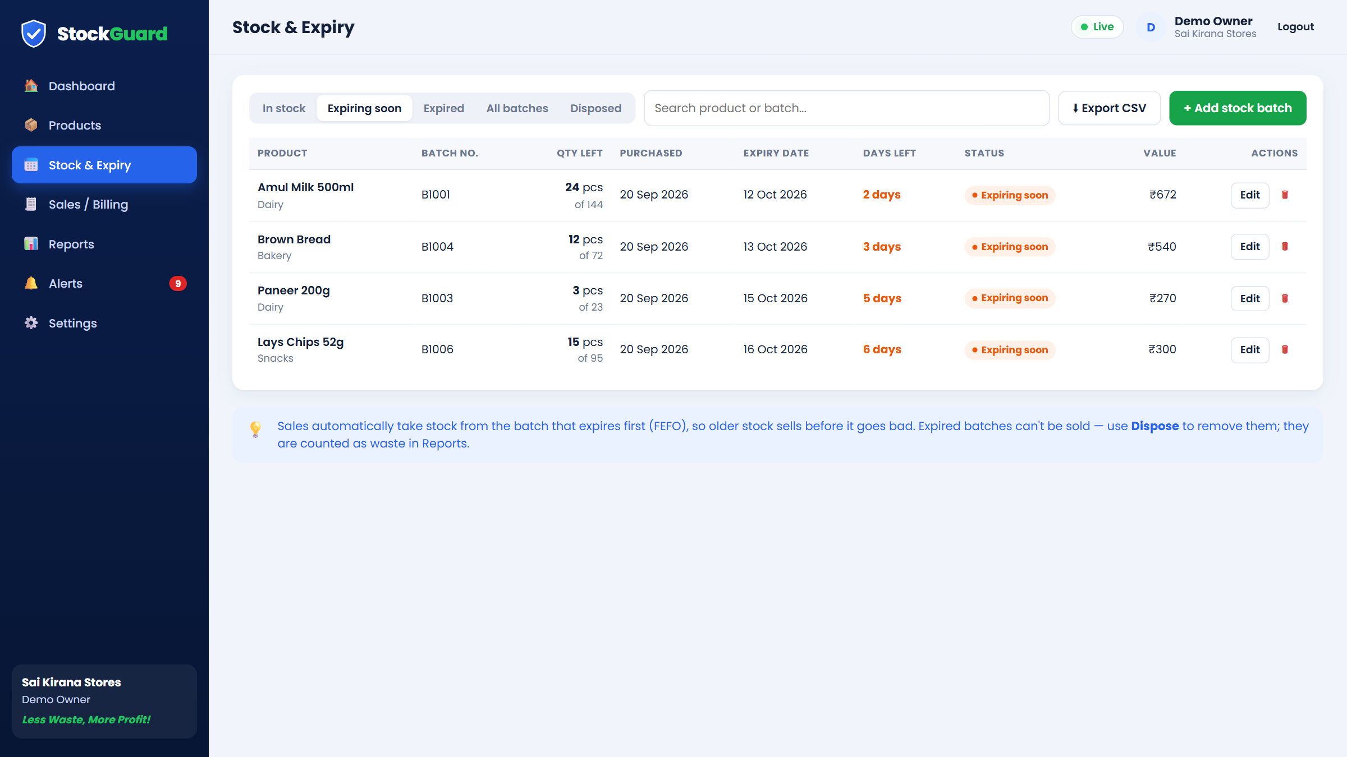
9. Results (contd.)
Fig. 5: Stock and Expiry - batches expiring within 7 days

Slide 16
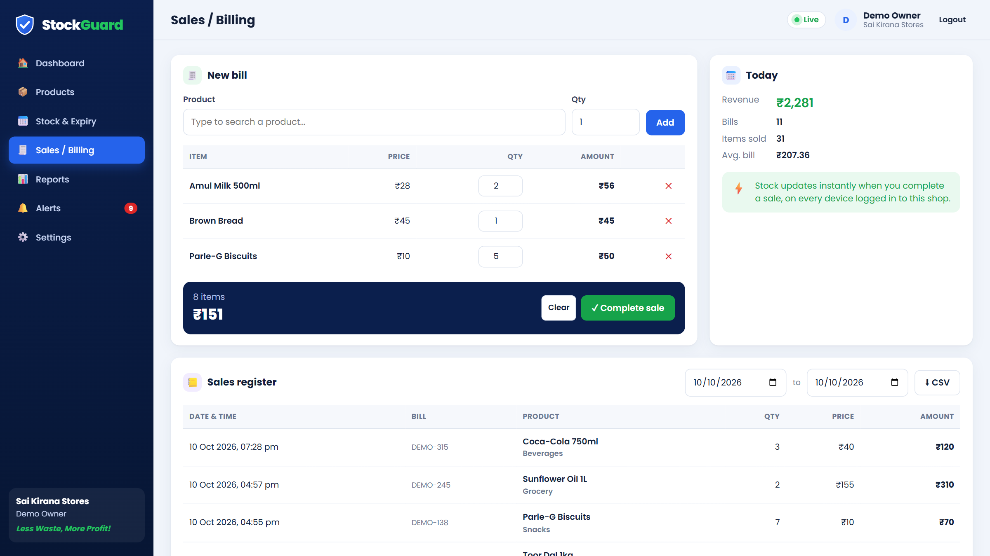
9. Results (contd.)
Fig. 6: Sales / Billing - creating a bill

Slide 17
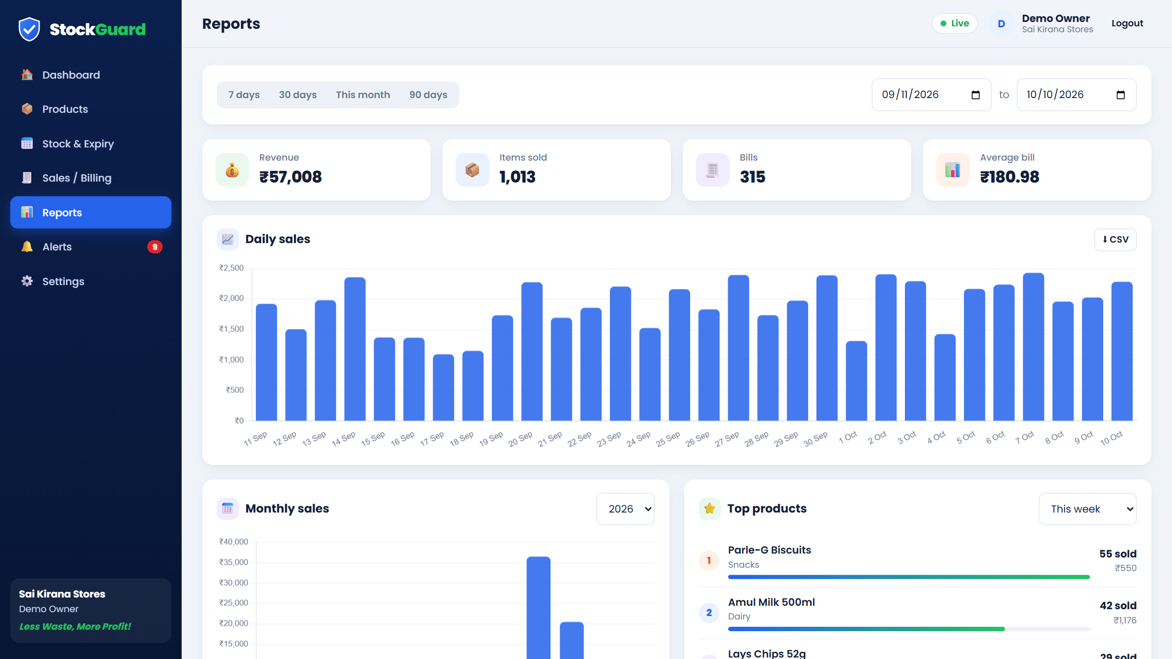
9. Results (contd.)
Fig. 7: Reports - daily sales and top products

Slide 18
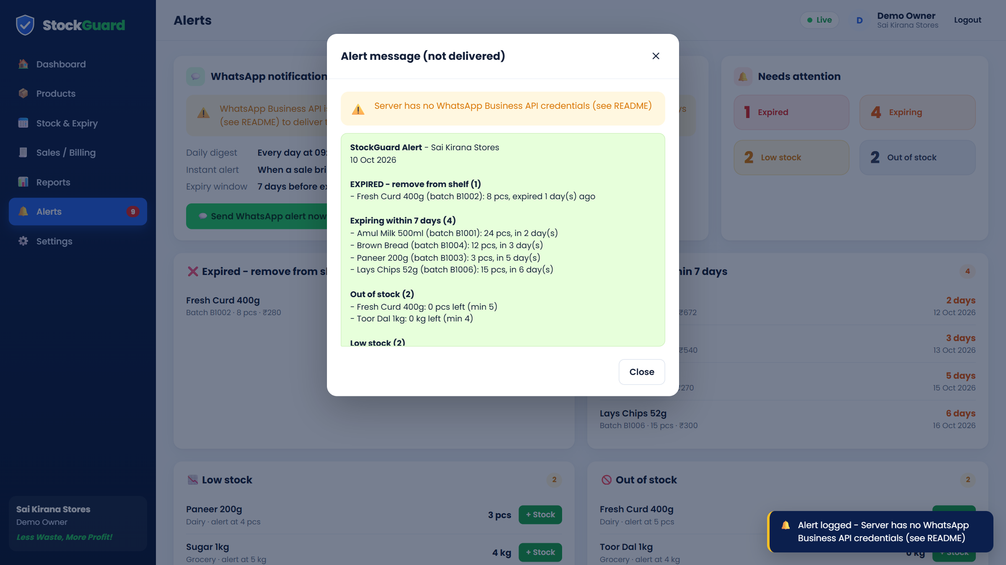
9. Results (contd.)
Fig. 8: WhatsApp alert message (preview)

Slide 19
Conclusion and Future Scope
Conclusion :
    StockGuard tracks stock and expiry dates together and blocks the sale of expired goods.
    WhatsApp alerts and reorder advice help owners waste less and earn more.
Future Scope :
    Barcode scanning, staff accounts and GST invoices
    Sales forecasting and an Android app with offline billing

Slide 20
Thank You...!!

