Slide 1


StockGuard
Smart Inventory | Track Expiry | Grow Your Business
Small Business Inventory + Expiry Tracker
Group No.
SE_IT_C7
Project guide
Prof. Rucha Kulkarni
Group members
Atharv Raut · Alankar Shinde
Samarth Rokade · Sujeet Salunke
Notes:
Introduce the team and the project. StockGuard is a web app that helps small shop owners track stock and expiry dates, and warns them on WhatsApp before products expire.

Slide 2




Small shops lose money to expired and out-of-stock items
Expired stock
Stock-outs
Overbuying
Paper registers
Products expire on the shelf unnoticed and are thrown away, or sold by mistake.
Popular items run out without warning, so customers buy elsewhere.
Without sales data, slow items are over-ordered and then expire.
Hard to search, easy to lose, and they never send a reminder.
Real problem: inventory and expiry losses eat directly into a small shop's thin margins.
Notes:
Explain the four ways a small shop loses money. Most kirana stores still use paper registers, so nobody is warned before an item expires or runs out.

Slide 3
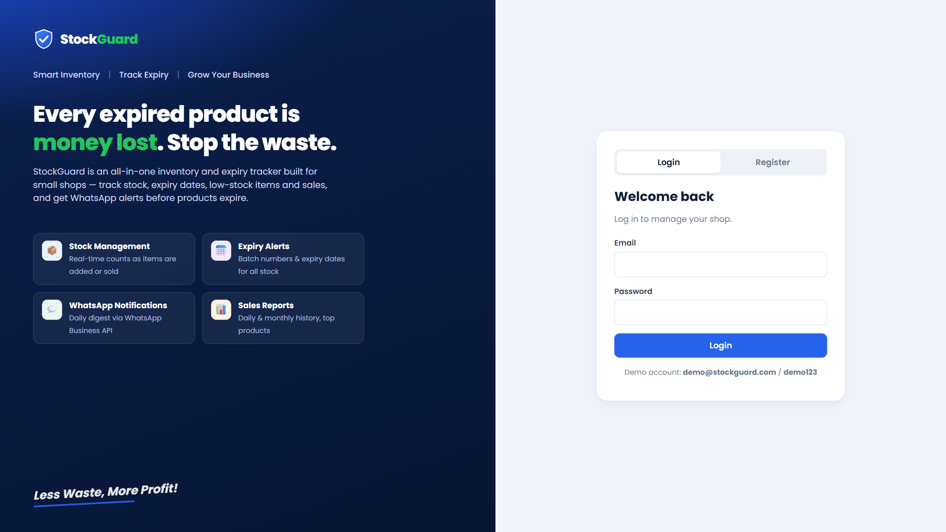

StockGuard tracks stock, expiry dates and sales in one app
An all-in-one inventory and expiry tracker that protects small-shop margins by cutting preventable waste.
Designed specifically for small shops
Tracks stock, expiry dates, low-stock items and sales
Alerts the owner on WhatsApp before products expire
Runs in any browser, on a PC or a phone
Login and register page
Notes:
Our solution: one simple web app. The owner logs in, adds products and deliveries, records sales, and StockGuard does the tracking and reminding.

Slide 4
Five objectives, each met by a working feature
Track stock easily
Live stock count, updated on every sale and delivery
1
Keep a clear count of every item on the shelves
Catch expiring items
Expiry status per batch, in-app and WhatsApp alerts
2
Get alerts before products reach their expiry date
Stop overbuying
Reorder advice from the last 30 days of sales
3
Order only what actually sells
Spot top products
Best sellers by week, 30 days or 90 days
4
See which items bring in the most sales
Replace paper logs
Digital sales register with CSV export
5
Move away from registers and spreadsheets
Notes:
These are the five objectives from our poster. The right-hand column shows the feature that delivers each one.

Slide 5




Scope: four core features for everyday shop work
Out of scope
Supplier payments and purchase orders
GST invoicing and accounting
Barcode scanner hardware
Multiple branches or staff logins
Expiry tracking
Sales history
Record batch numbers and expiry dates for all stock.
A digital log of all daily and monthly transactions.
Real-time stock counts
Product registry
Inventory updates automatically as items are added or sold.
Add, edit or remove items with names, categories and prices.
Notes:
The four scope items from the poster. We also state clearly what we did not build, such as GST invoicing and supplier payments.

Slide 6
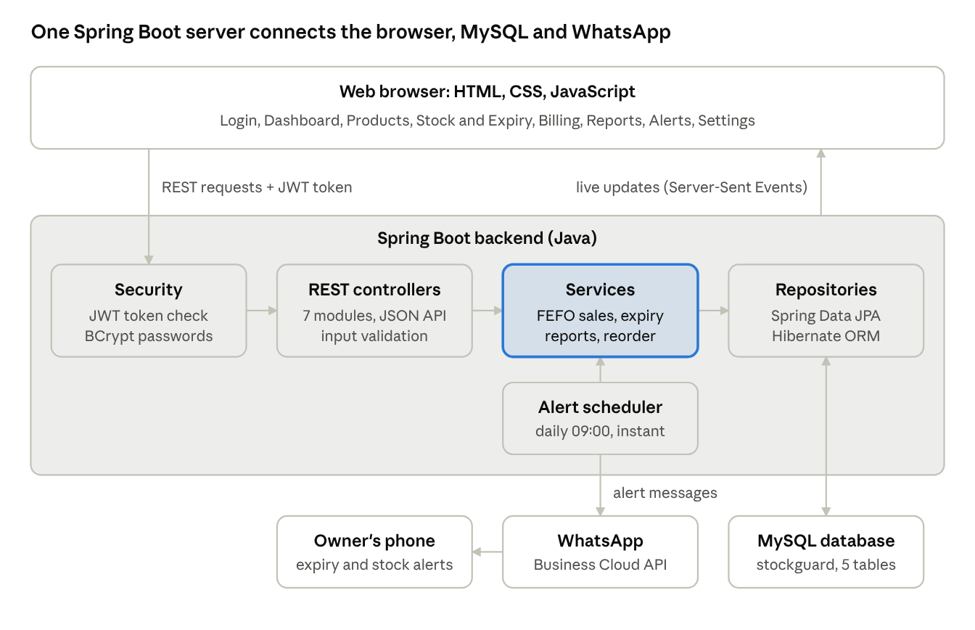



Three-tier architecture: browser, Spring Boot, MySQL
Browser
HTML, CSS and JavaScript pages call a REST API with a JWT token.
Spring Boot
Security, controllers, services and repositories in layers.
Data and alerts
MySQL stores the data; WhatsApp delivers the alerts.
Notes:
Every request passes the JWT security check, then goes controller to service to repository to MySQL. The scheduler sends WhatsApp alerts, and changes are pushed back to the browser as live updates.

Slide 7





Workflow: from shop owner to reports, with live updates
Shop Owner
Add / Update
System
Alerts
Reports
Login / Register (web app)
Products, stock, expiry date, price, category
Stores data in MySQL and applies the rules
Expiry and low stock via WhatsApp Business API
Sales, stock and expiry reports
Real-time updates
Every change is pushed to all of the owner's open screens at once, without reloading the page.
Notes:
This is the workflow from the poster. The owner adds data, the system processes it and stores it in MySQL, alerts go out on WhatsApp, and reports show the results. Server-Sent Events push every change back to the screen.

Slide 8



Technology stack: free, standard and proven
FRONTEND
BACKEND
DATABASE
HTML5, CSS3, JavaScript
Java + Spring Boot 3
MySQL 8+
No framework; Chart.js graphs; works on phones
REST API, JPA, Security, Validation, Scheduling
5 tables, created automatically by Hibernate
NOTIFICATIONS
SECURITY
REAL-TIME
WhatsApp Business API
JWT + BCrypt
Server-Sent Events
Cloud API for expiry and low-stock alerts
Token login; passwords stored encrypted
Open screens refresh after every change
Notes:
Every layer uses free, widely used technology. Spring Boot handles the REST API, security and the daily alert schedule. MySQL stores everything.

Slide 9
Database design: five MySQL tables
users
products
stock_batches
id (PK)
owner_name, shop_name
email (unique)
password (BCrypt hash)
whatsapp_number
expiry_alert_days
1 : N
id (PK)
owner_id (FK → users)
name, category
price, unit
low_stock_threshold
active (soft delete)
1 : N
id (PK)
product_id (FK → products)
batch_number
quantity, initial_quantity
expiry_date, purchase_date
status (ACTIVE / DISPOSED)
1 : N
1 : N
alert_logs
sales
Design notes
id (PK)
owner_id (FK → users)
trigger_type
status
message
created_at
id (PK)
owner_id (FK → users)
product_id (FK → products)
bill_number
quantity, unit_price
total_amount, sold_at
Stock = sum of a product's active batches
Soft delete keeps old sales in reports
Disposed batches feed the waste report
Notes:
One user owns many products, sales and alert logs. Each product has many stock batches, each with its own expiry date. Stock is calculated from the batches, not stored as one number.

Slide 10
Sales take the batch that expires first, never expired stock
First Expiry, First Out (FEFO)
Example: sell 10 packets of milk
Lock the product row so two counters can't sell the same unit
Load batches with stock, sorted by expiry date
Skip batches that have already expired
Reject the bill if fresh stock is too low
Take units from the earliest batch first
Send a WhatsApp alert if stock hits the low-stock level
Batch OLD1 · expired 2 days ago
Blocked: expired
Batch A · expires in 3 days
Takes all 8
Batch B · expires in 30 days
Takes 2, leaves 8
Bill saved: 10 sold. Expired stock was never touched, and the oldest fresh stock left the shelf first.
Notes:
This is the core rule of the system. When we sell, StockGuard always picks the batch that expires first, so old stock doesn't go bad on the shelf. Expired batches are blocked from sale.

Slide 11
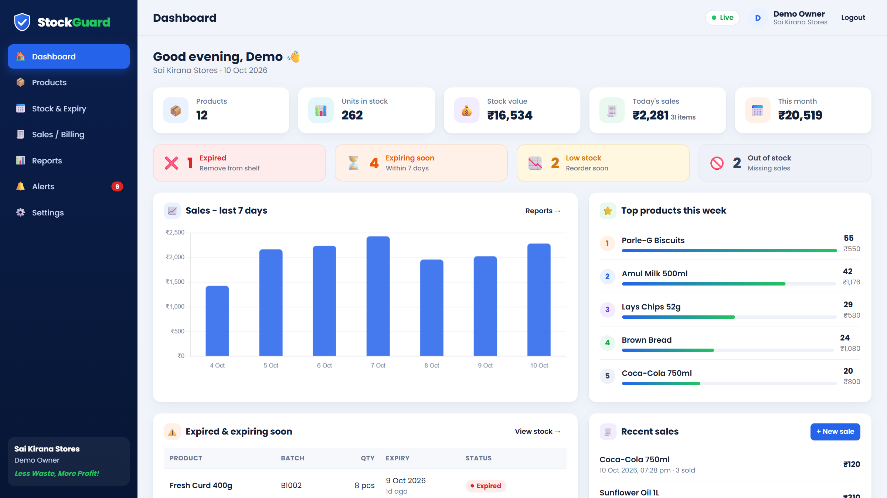

Dashboard shows stock, sales and alerts at a glance
Key numbers
Products, stock value, today's and monthly sales
Alert cards
Expired, expiring soon, low and out of stock
Trends
7-day sales chart and this week's top products
Notes:
The dashboard is the first screen after login. The owner sees today's sales, stock value and what needs attention, without opening any other page.

Slide 12
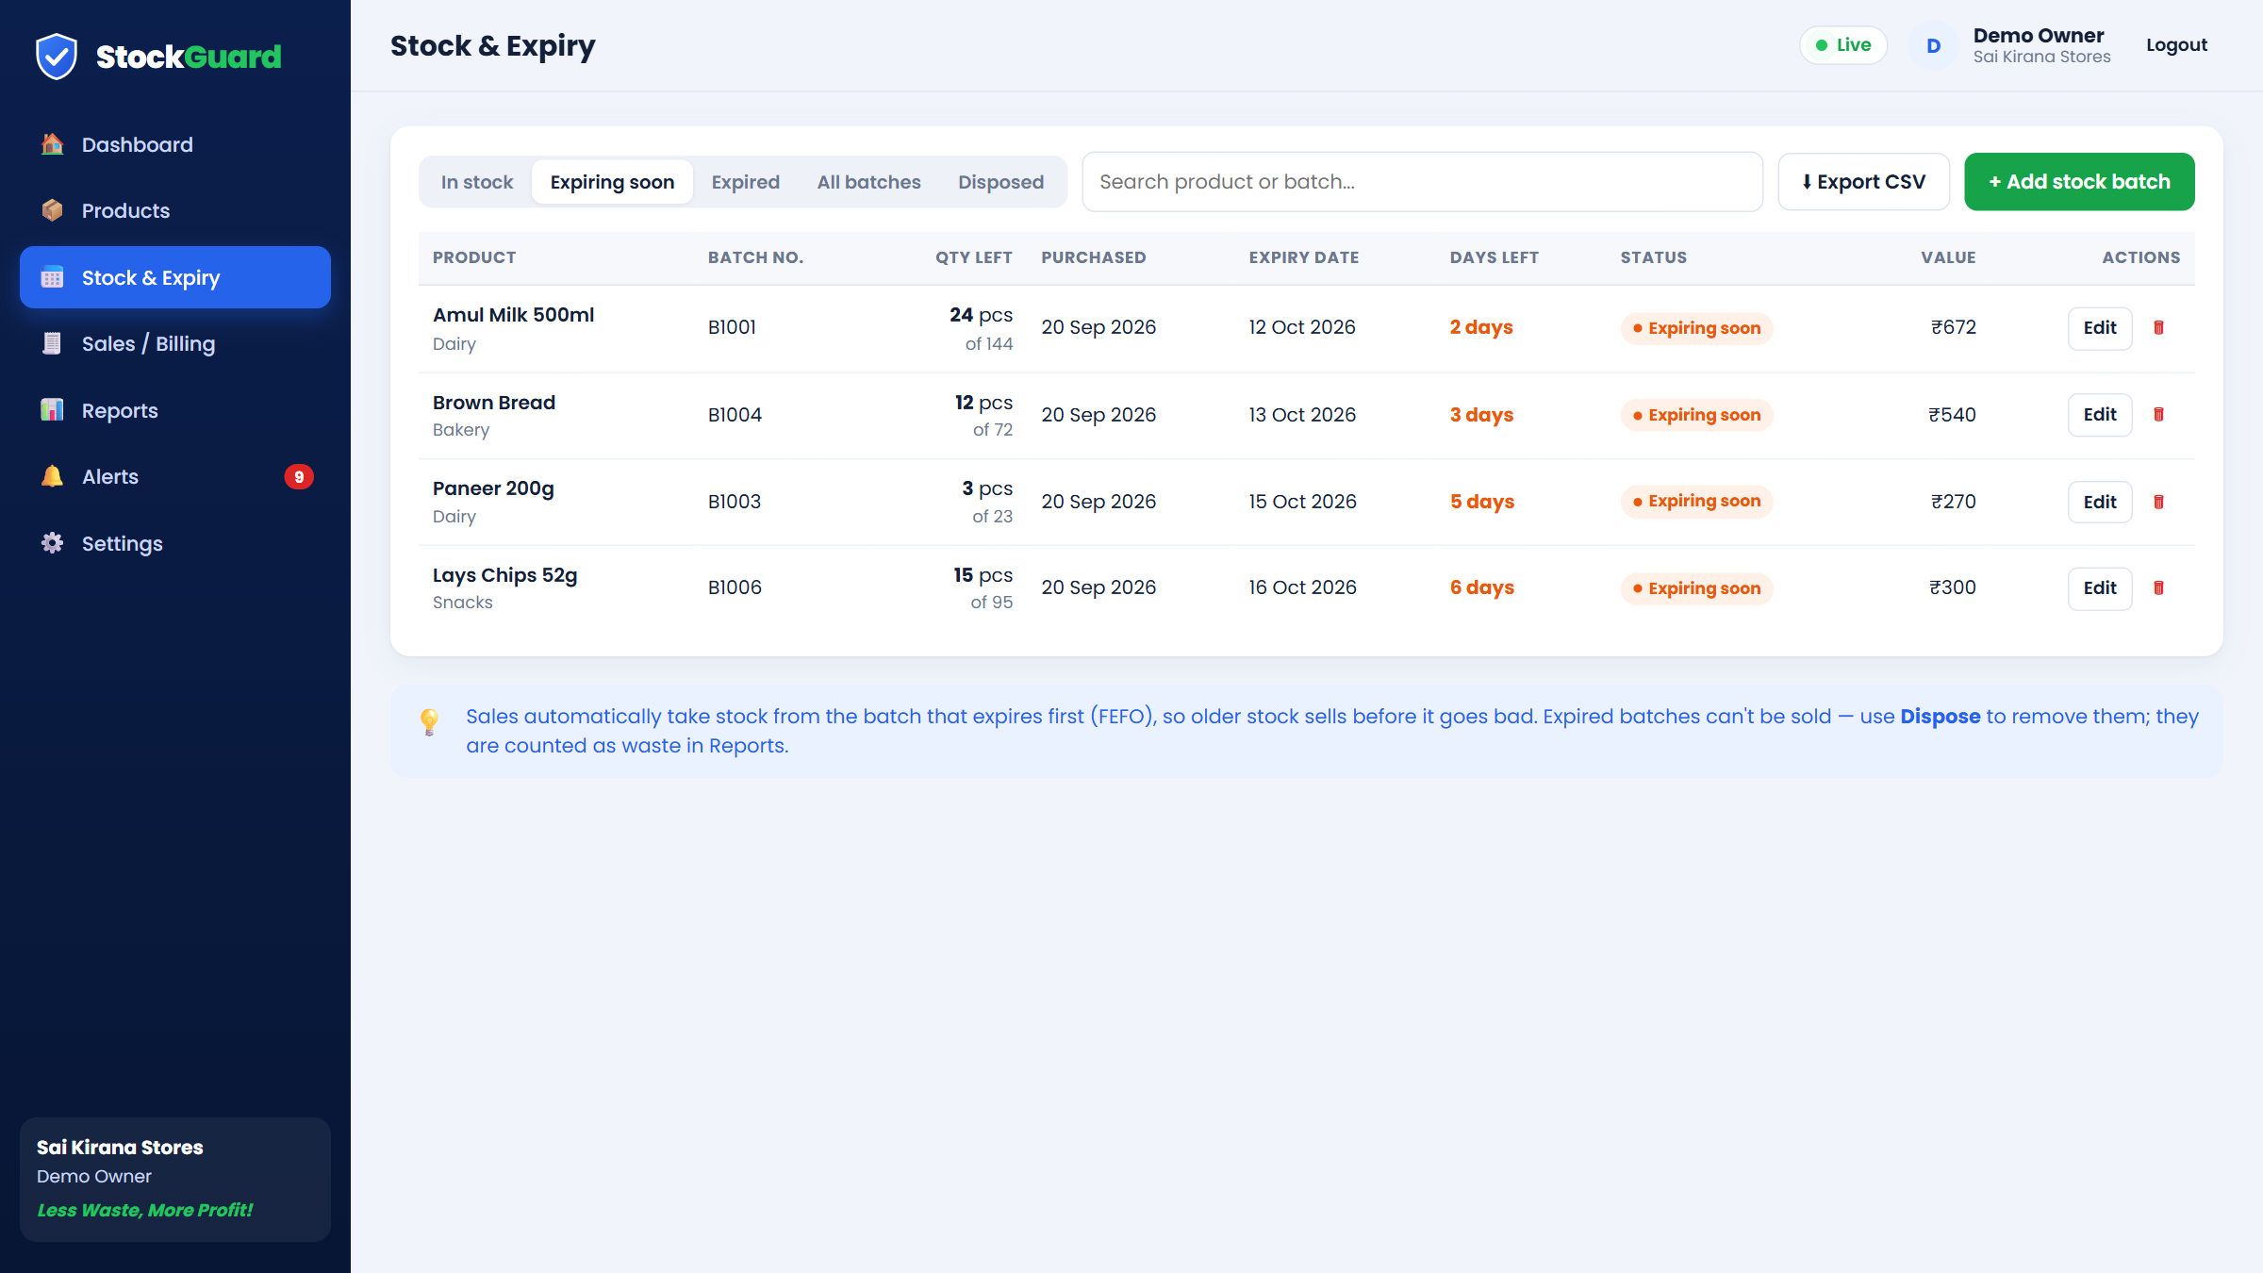



Every batch carries its own expiry date
Filters
In stock, expiring soon, expired or disposed
Days left
Shown in orange when close, red when expired
Dispose
Remove expired stock; its value counts as waste
Notes:
Each delivery is recorded as a batch with a batch number and expiry date. This view is filtered to batches expiring within 7 days.

Slide 13
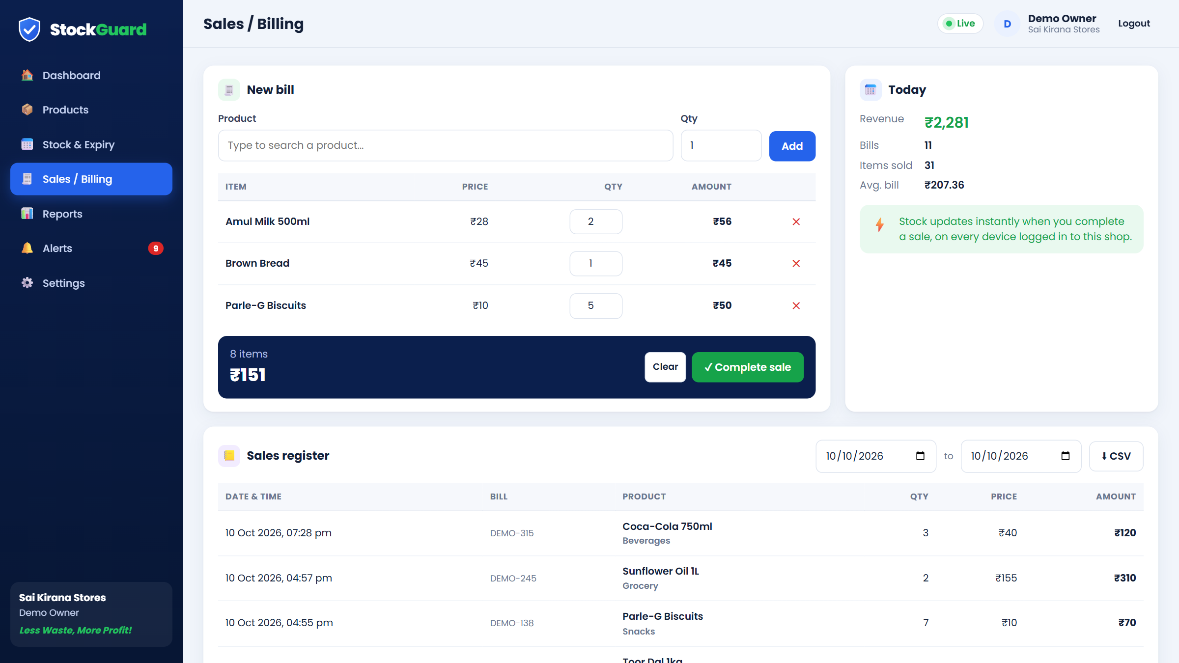


Billing updates stock the moment a sale is completed
Quick bill
Search a product, enter quantity, add to the bill
Safe stock
Cannot oversell or sell expired goods
Sales register
Every sale is logged, filterable by date
Notes:
The billing page works like a simple point of sale. Completing the sale deducts stock first-expiry-first-out and records each line in the sales register.

Slide 14
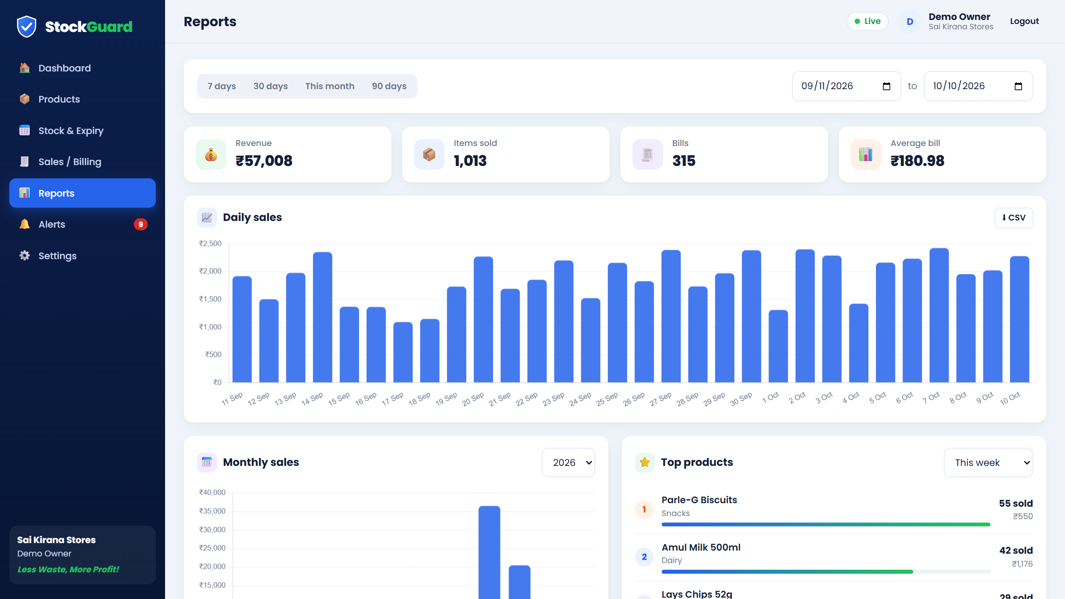


Reports show what sells and what to reorder
Sales charts
Daily and monthly revenue
Top products
Best sellers by week, 30 or 90 days
Reorder + CSV
Advice from 30 days of sales; export any report
Notes:
Reports turn the sales history into decisions: which products sell best, and how much to reorder so the owner doesn't overbuy.

Slide 15
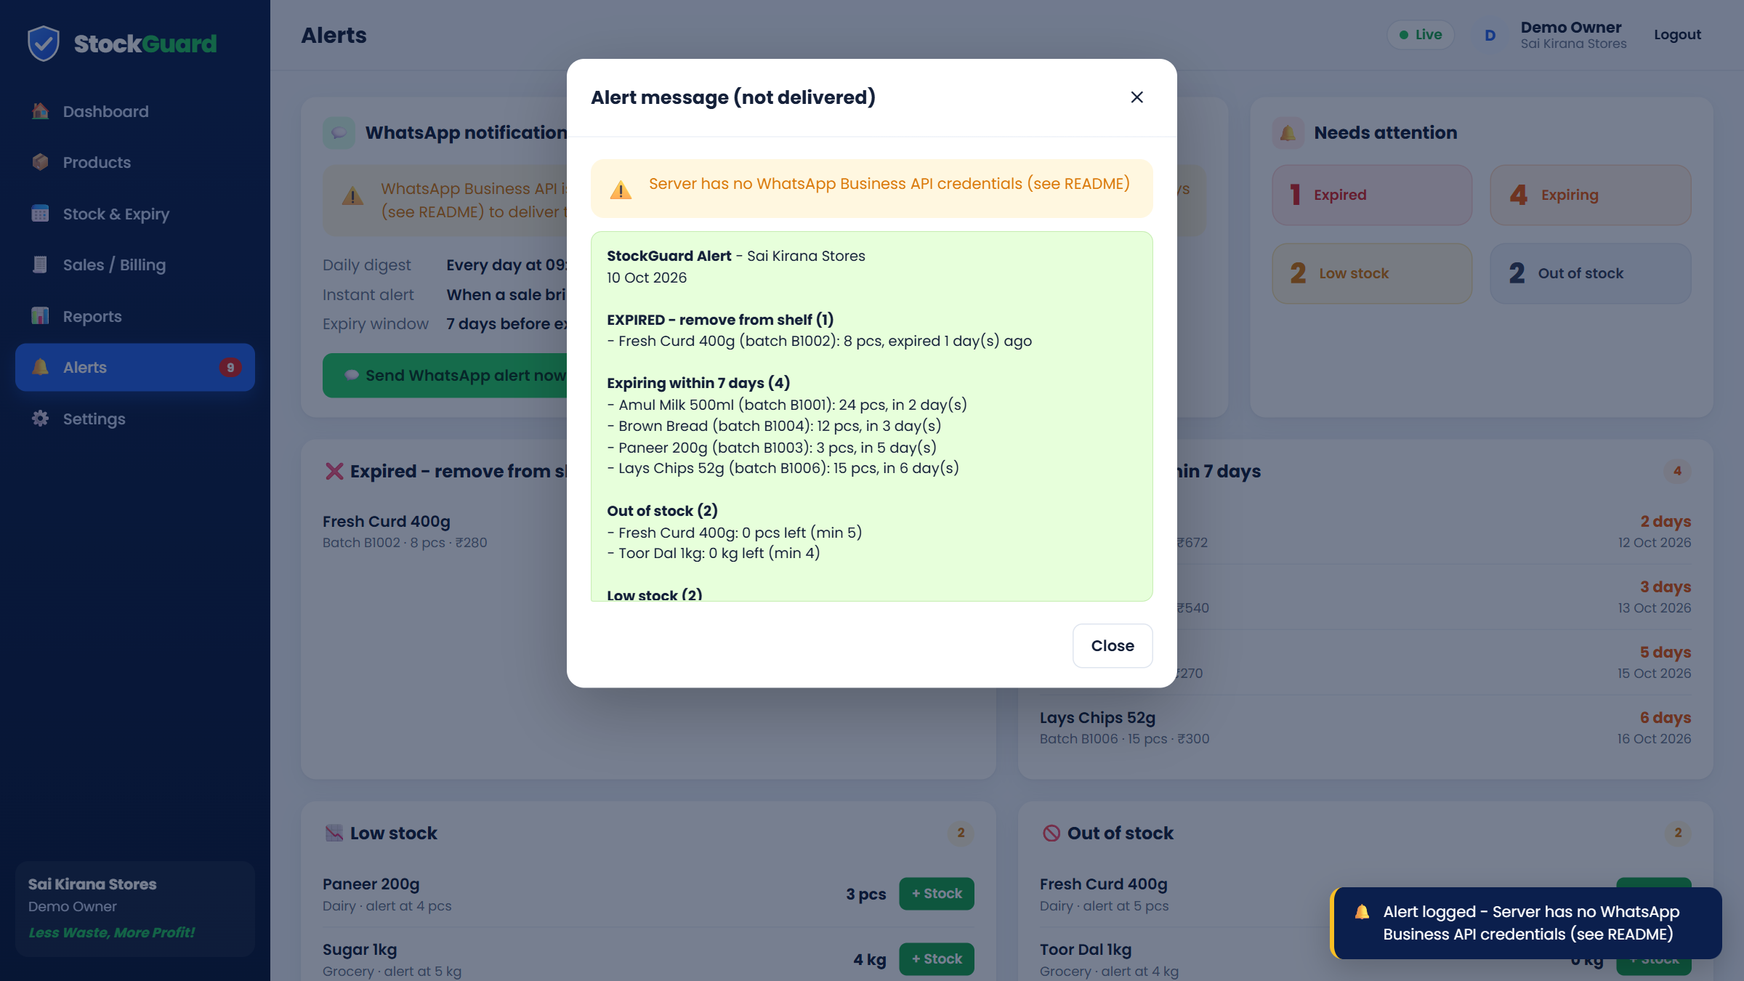
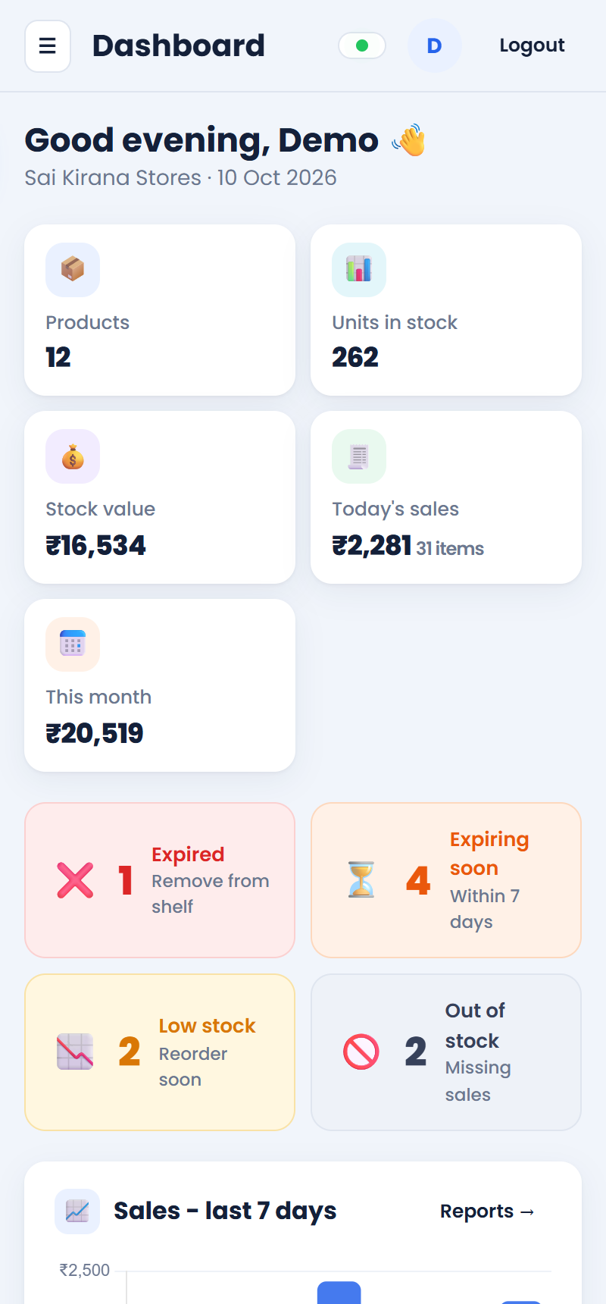
Owners get expiry and low-stock alerts on WhatsApp
Alert preview: daily digest at 9:00 AM, instant low-stock alert and a Send-now button. Delivered on WhatsApp once the Meta API keys are added.
Works on phones
Notes:
Alerts are sent through the WhatsApp Business Cloud API. Every alert is also saved in the alert history. The whole app is responsive, so the owner can use it from a phone.

Slide 16
Testing: all 15 test cases passed
Test case | Expected result | Result
Wrong password | 401 error, "Wrong email or password" | Pass
Sell 19 when 18 are fresh | Rejected: "Only 18 pcs available" | Pass
Sell 10 from two batches | Earliest-expiring batch used first | Pass
Shop A reads Shop B's product | 404 Not found | Pass
Sale drops stock below limit | Instant low-stock alert logged | Pass
Start on MySQL, register | Database and 5 tables created | Pass
15 / 15
test cases passed
2 automated tests (mvn clean install)
10 API checks of business rules
2 browser checks, desktop and phone
1 full run on MySQL
Notes:
We tested the build, every important business rule through the API, every page in a real browser, and a full run on MySQL. All 15 passed.

Slide 17
Results from the demo shop: problems found on day one
₹16,534
9
stock value tracked live
items flagged: expired, expiring or low
₹57,008
64
30 days of sales analysed
units of milk to reorder: 3 days of stock left
Demo shop "Sai Kirana Stores": 12 products and 30 days of sample sales.
Notes:
Using the demo shop, StockGuard immediately found an expired batch, four batches about to expire and four low or out-of-stock items. The reports showed the best sellers and advised reordering milk before it runs out.

Slide 18

Advantages and limitations
Advantages
Limitations
Built for small shops; works on a phone
Blocks sale of expired goods; sells oldest stock first
Alerts arrive on WhatsApp, which owners already use
Reorder advice cuts overbuying and stock-outs
Free, open technologies with no licence cost
Secure login; each shop's data kept separate
WhatsApp delivery needs a Meta Business account and an approved template
Stock is counted in whole units (packs, pieces)
One login per shop; no staff roles yet
Needs a network connection to the server
Notes:
Be honest about limitations: WhatsApp needs a Meta Business setup, and loose items sold by weight need a pack unit.

Slide 19






Future scope
Barcode scanning
Staff accounts
Supplier orders
Phone camera for faster billing
Owner and cashier roles, activity log
Purchase orders from reorder advice
GST invoices
Sales forecasting
Android app
Print or send bills on WhatsApp
Plan for festivals and seasons
Offline billing that syncs later
Notes:
Possible next steps if the project continues: barcode scanning, staff accounts, supplier orders, GST invoices, forecasting and an Android app.

Slide 20

Less Waste, More Profit!
Tracks stock and expiry dates together, in real time
Blocks expired sales and warns owners on WhatsApp
Shows what sells and how much to reorder
Thank you · Questions?
Group SE_IT_C7 · Guide: Prof. Rucha Kulkarni
Notes:
Summarise in one line: StockGuard helps small shops waste less and earn more. Then invite questions, and offer a live demo of the app.

