Slide 1
DIPLOMA IN AI & ML
GTTC Belagavi
AI / ML-BASED ROAD CONDITION DETECTION SYSTEM
ROADGUARD
PRESENTED BY
Atharv Shetty
ROLL NO
Fast road condition screening from images
8080110
GUIDE
PROJECT REVIEW · DEPARTMENT OF DIPLOMA IN AI & ML
K.S. Shirur

Slide 2
SYSTEM READOUT · 01
RoadGuard turns road images into a fast condition check
INPUT
CLASSIFICATION
OPERATIONAL VALUE
Road image
Two states
Faster screening
AI/ML-based system for detecting road condition from images
Normal Road or Damaged Road
Reduces dependence on slow manual inspection
2

Slide 3
THE NEED · 02
Manual inspection can miss damage when speed matters
MANUAL INSPECTION
DETECTION GAP
Time-intensive
Damage can wait
Road inspection takes significant time when performed manually.
Damage may not be identified quickly enough.
PUBLIC SAFETY
Unsafe road conditions can affect public safety. An automated detection system is needed for faster screening.
3

Slide 4
BUILD OBJECTIVES · 05
Five objectives define the RoadGuard build
01
02
03
04
05
Detect
Preprocess
Develop
Deploy
Display
Detect normal and damaged roads
Apply image preprocessing techniques
Develop a neural network using NumPy
Create a web-based prediction system
Display results through a user-friendly interface
4

Slide 5
SYSTEM STACK · 04
The system combines a lightweight model with a web interface
BUILD LAYER
WEB LAYER
Python
Flask + React
Numerical and vision stack:
NumPy and OpenCV
Web stack:
Flask with React + Vite
DATA AND COLLABORATION
ARCHITECTURE POSTURE
Kaggle Dataset and GitHub
Lightweight model · usable web interface
5

Slide 6
END-TO-END ARCHITECTURE · 05
One image moves through five connected stages
User → React Frontend → Flask Backend → Image Preprocessing → Neural Network → Prediction Result
1
2
3
4
5
6
User
React
Flask
Preprocess
Network
Result
Image input
Frontend
Backend
Image processing
Model prediction
Result display
6

Slide 7
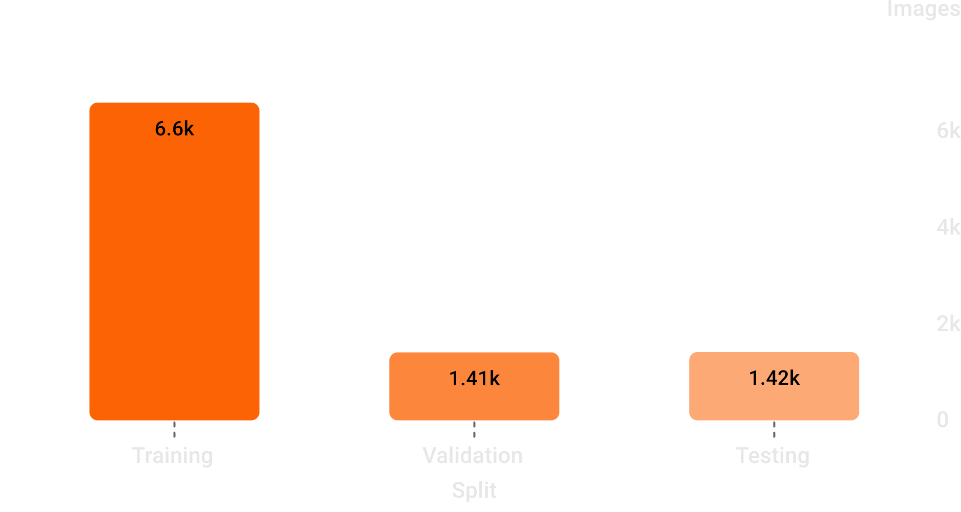
DATASET REGISTER · 06
The dataset is split to test generalization, not just training fit
ROAD ISSUES DETECTION DATASET
9,425 images
Damaged road images collected from road issue categories.
Normal road images collected separately.
SPLIT BY PURPOSE
Training · 70% · 6,596 images
Validation · 15% · 1,411 images
Testing · 15% · 1,418 images
7

Slide 8
PREPROCESSING PIPELINE · 06
Preprocessing reduces every image to 3,072 normalized inputs
01
02
03
04
05
06
Read
Resize
RGB
Normalize
Flatten
Send
Read the input image
Resize to 32 × 32 pixels
Convert to RGB format
Normalize pixel values
Flatten the image data
Send the feature vector to the neural network
IMAGE SHAPE
INPUT FEATURES
32 × 32 pixels
3,072
8

Slide 9
MODEL ARCHITECTURE · 07
A compact NumPy network separates normal from damaged roads
INPUT LAYER
HIDDEN LAYER
OUTPUT LAYER
PREDICTION
3,072
32
1
Normal / Damaged
Input features
ReLU activation
Sigmoid activation
Input layer: 3,072 → Hidden layer: 32 + ReLU → Output layer: 1 + Sigmoid → Normal / Damaged
The hidden layer uses ReLU activation.
The output layer uses Sigmoid for the final prediction.
THE MODEL IS DEVELOPED USING NUMPY.
9

Slide 10
APPLICATION HANDOFF · 08
Flask handles prediction while React makes it usable
BACKEND
FRONTEND
Flask
React
API
Image processing
Prediction API
Model metrics
Image upload
Webcam capture
Prediction result and prediction history
MODEL OUTPUT
INTERFACE ROLE
PREDICTION PATH
Connects model output to a practical user workflow.
Image → Flask prediction → React result
10

Slide 11
ROADGUARD
THANK YOU
QUESTIONS?
11

