Slide 1

Welcome!

Slide 2
Modern Database System
Assignment No: 16
Title: Implementation of External Merge Sort
Name: Atharv Chaudhari,
Roll No: 02,
Batch: BC-I

Slide 3
What is external merge sort?
The external merge sort algorithm is used to efficiently sort massive amounts of data.
when the data being sorted cannot be fit into the main memory and resides in the slower external memory.
The chunks of data small enough to fit in the RAM are read, sorted, and written out to a temporary file during the sorting phase.
In the merge phase, the sorted sub-files are combined into a single larger file.

Slide 4
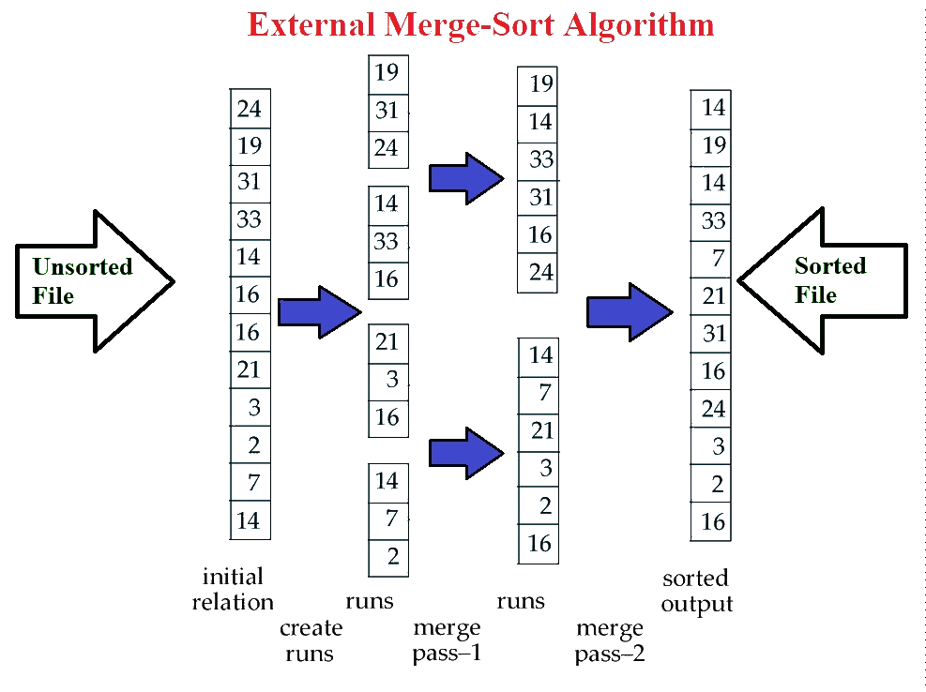

Slide 5
Algorithm
📋

Slide 6
Roadmap
Import Necessary Libraries
Split Unsorted File Into Parts
Combine Sorted Files By Using Min Heap
1
3
5
2
4
6
Create Unsorted File By Using numpy.random
Sort Sliced Files
Final Output As Sorted File

Slide 7
Read input file such that at most ‘run size’ elements are read at a time. Do following for every run read in an array.
Sort the run using Merge Sort.
Store the sorted array in a file. Let’s say ‘i’ for I’th file.
Merge the sorted files using the approach discussed merge k sorted arrays.

Slide 8
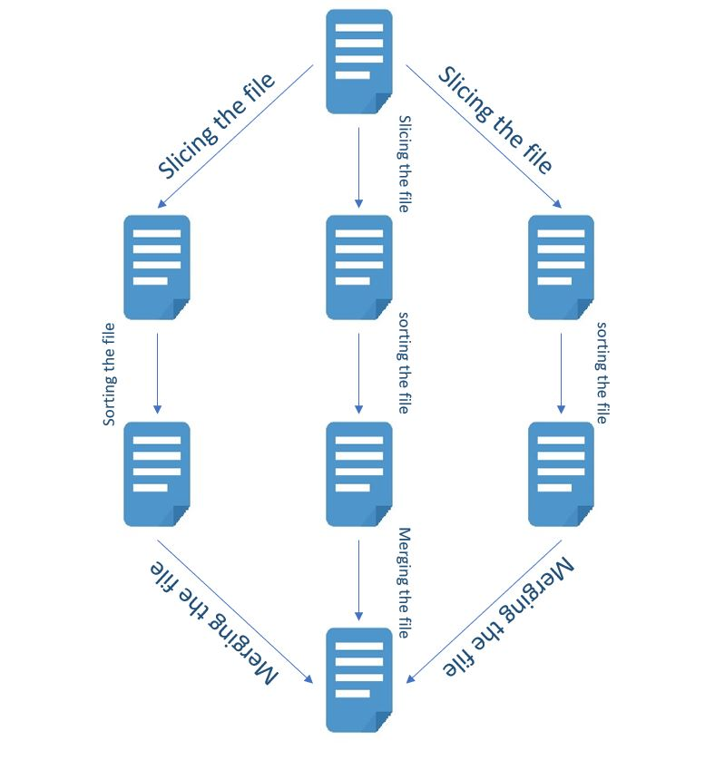
Working of Algorithm In file system

Slide 9

Input / Output
Unsorted File
10
30
5
7
23
Sorted File
5
7
10
23
30

Slide 10
Implementation Concept
TOOLS USED
Jupyter Notebook,
Visual Studio
LANGUAGE USED
Python
Numpy,
Shutill,
Os,
pandas
PACKAGES, MODULES USED
hybrid sort-merge technique
TECHNIQUE USED

Slide 11
Conclusion
we have seen how the external merge sort exactly works, how it sorts the records which fits into the main memory in detail.

Slide 12
Thank You!

