Slide 1
Ordinal vs Nominal Approaches to
Sentiment Classification
A Comparative Study on Amazon Electronics Reviews
Atharv Chaudhary · Kien Nguyen · Zijie Liu
Foundations of Artificial Intelligence

Slide 2
Why Sentiment Classification Matters
📊 SCALE OF THE PROBLEM
Real-World Impact Example
Millions of product reviews posted daily across e-commerce platforms
Customer writes a 5★ review:
"Absolutely love this product! Works perfectly."
💼 BUSINESS APPLICATIONS
❌ System predicts: 1★
Customer satisfaction monitoring
Product improvement insights
Brand reputation tracking
Consequences:
• Unhappy customer gets apology email
• Wrong business decisions
• Damaged trust and reputation
⚠️ THE CRITICAL GAP
Most ML systems treat 1★→5★ errors the same as 4★→5★ errors.
But predicting 1-star for a 5-star review is catastrophic!
🔬 Research Question
Can ordinal methods reduce severe errors?

Slide 3
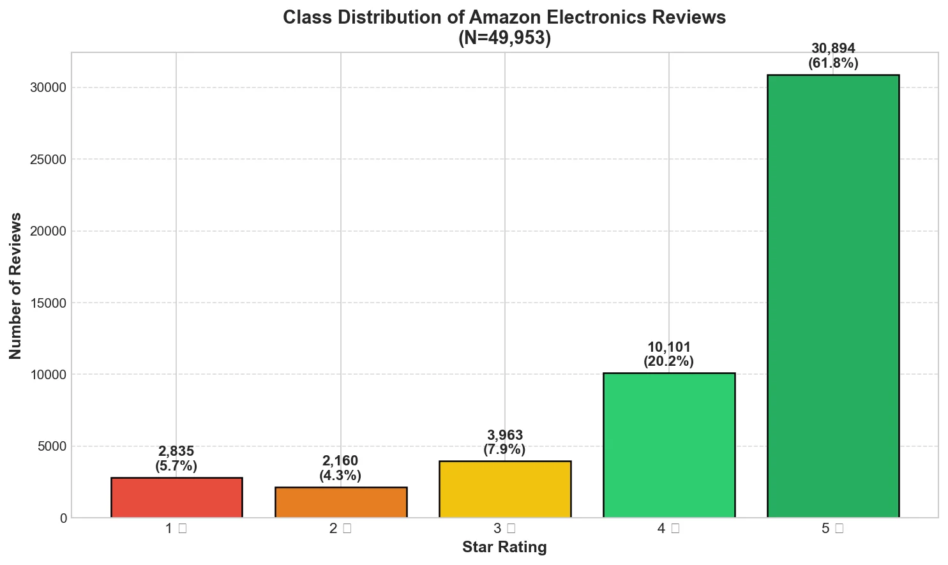
Data Analysis: Class Distribution
Amazon Electronics Reviews Dataset (McAuley Lab, UCSD) — N = 49,953
⚠️ Severe Imbalance
14.3:1 ratio
5★ vs 2★ reviews
Dataset Statistics
Total: 49,953 reviews
80/20 Train/Test Split
Class Breakdown
5★: 30,894 (61.8%)
4★: 10,101 (20.2%)
3★: 3,963 (7.9%)
2★: 2,160 (4.3%)
1★: 2,835 (5.7%)

Slide 4
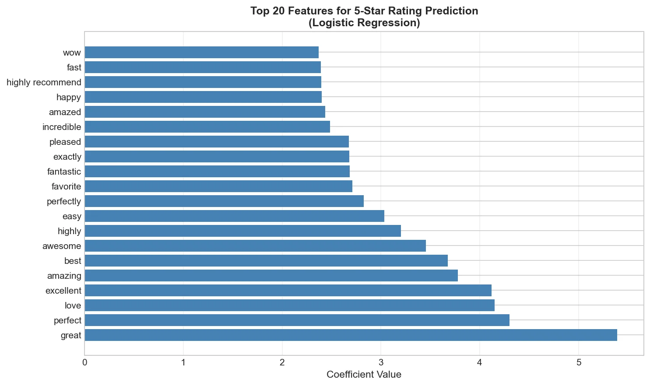
Feature Discovery: Word Analysis
Identifying discriminative features for sentiment classification
✓ Top 5★ Words
great, love, perfect, excellent, amazing
✗ Top 1★ Words
return, waste, broke, terrible, money
💡 Key Discovery
Bigrams capture negation patterns
"not good" vs "good"
🎯 Feature Selection
• 5,000 TF-IDF features
• Unigrams + Bigrams
• Stopwords removed

Slide 5
Related Work That Inspired Our Study
📖 FOUNDATIONAL WORK
📖 METHODOLOGICAL FOUNDATION
"Opinion Mining and Sentiment Analysis"
"Regression Models for Ordinal Data"
Pang & Lee (2008)
McCullagh (1980)
What they did:
Established ML approaches using Naive Bayes and SVM on movie reviews
What they did:
Introduced proportional odds model for ordinal regression
Key limitation:
Treated sentiment as binary, ignoring ordinal structure
Key insight:
Models P(Y≤k) respecting ordinal structure
✓ Our validation:
Logistic Regression > Naive Bayes (65.95% vs 63.12%)
✓ Our validation:
Ordinal methods reduce severe errors by 48%

Slide 6
Data Processing Pipeline
Raw Text
→
Preprocessing
→
TF-IDF
→
Encoding
→
Train/Test
→
Models
1. Text Preprocessing
2. TF-IDF Vectorization
3. Label Encoding
4. Train/Test Split
Before: "GREAT product!!"
After: "great product"
✓ Lowercase
✓ Punctuation removal
✓ Stopword filtering
TF-IDF(t,d) = TF(t,d) × IDF(t)
• max_features = 5,000
• ngrams = (1, 2)
Why bigrams?
Captures "not good"
Nominal:
1★=A, 2★=B, 3★=C...
(No order relationship)
Ordinal:
1★=1, 2★=2, 3★=3...
(Preserves 1<2<3<4<5)
80%
20%
Train: 39,962
Test: 9,991
✓ Stratified sampling

Slide 7
Learning Algorithms: Models Compared
NOMINAL APPROACH
Treats ratings as unordered categories
ORDINAL APPROACH
Respects ordering 1 < 2 < 3 < 4 < 5
Multinomial Naive Bayes
Ridge Regression
P(class|text) ∝ P(class) × ∏P(word|class)
min ||Xw - y||² + α||w||²
✓ Fast, works with sparse data
✗ Independence assumption
✓ Penalizes distant errors heavily
✗ Lower exact accuracy
Logistic Regression (Softmax)
Ordinal Logistic Regression
P(class k) = softmax(Wx + b)
P(Y ≤ k) = σ(θₖ - Xw)
✓ Calibrated probabilities, interpretable
✗ All errors penalized equally
✓ Learns K-1 thresholds between classes
✗ More complex, slower training
NOMINAL VIEW
1★→5★ error = 4★→5★ error (both just "wrong")
ORDINAL VIEW
1★→5★ ≫ 4★→5★ (4-class vs 1-class error)

Slide 8
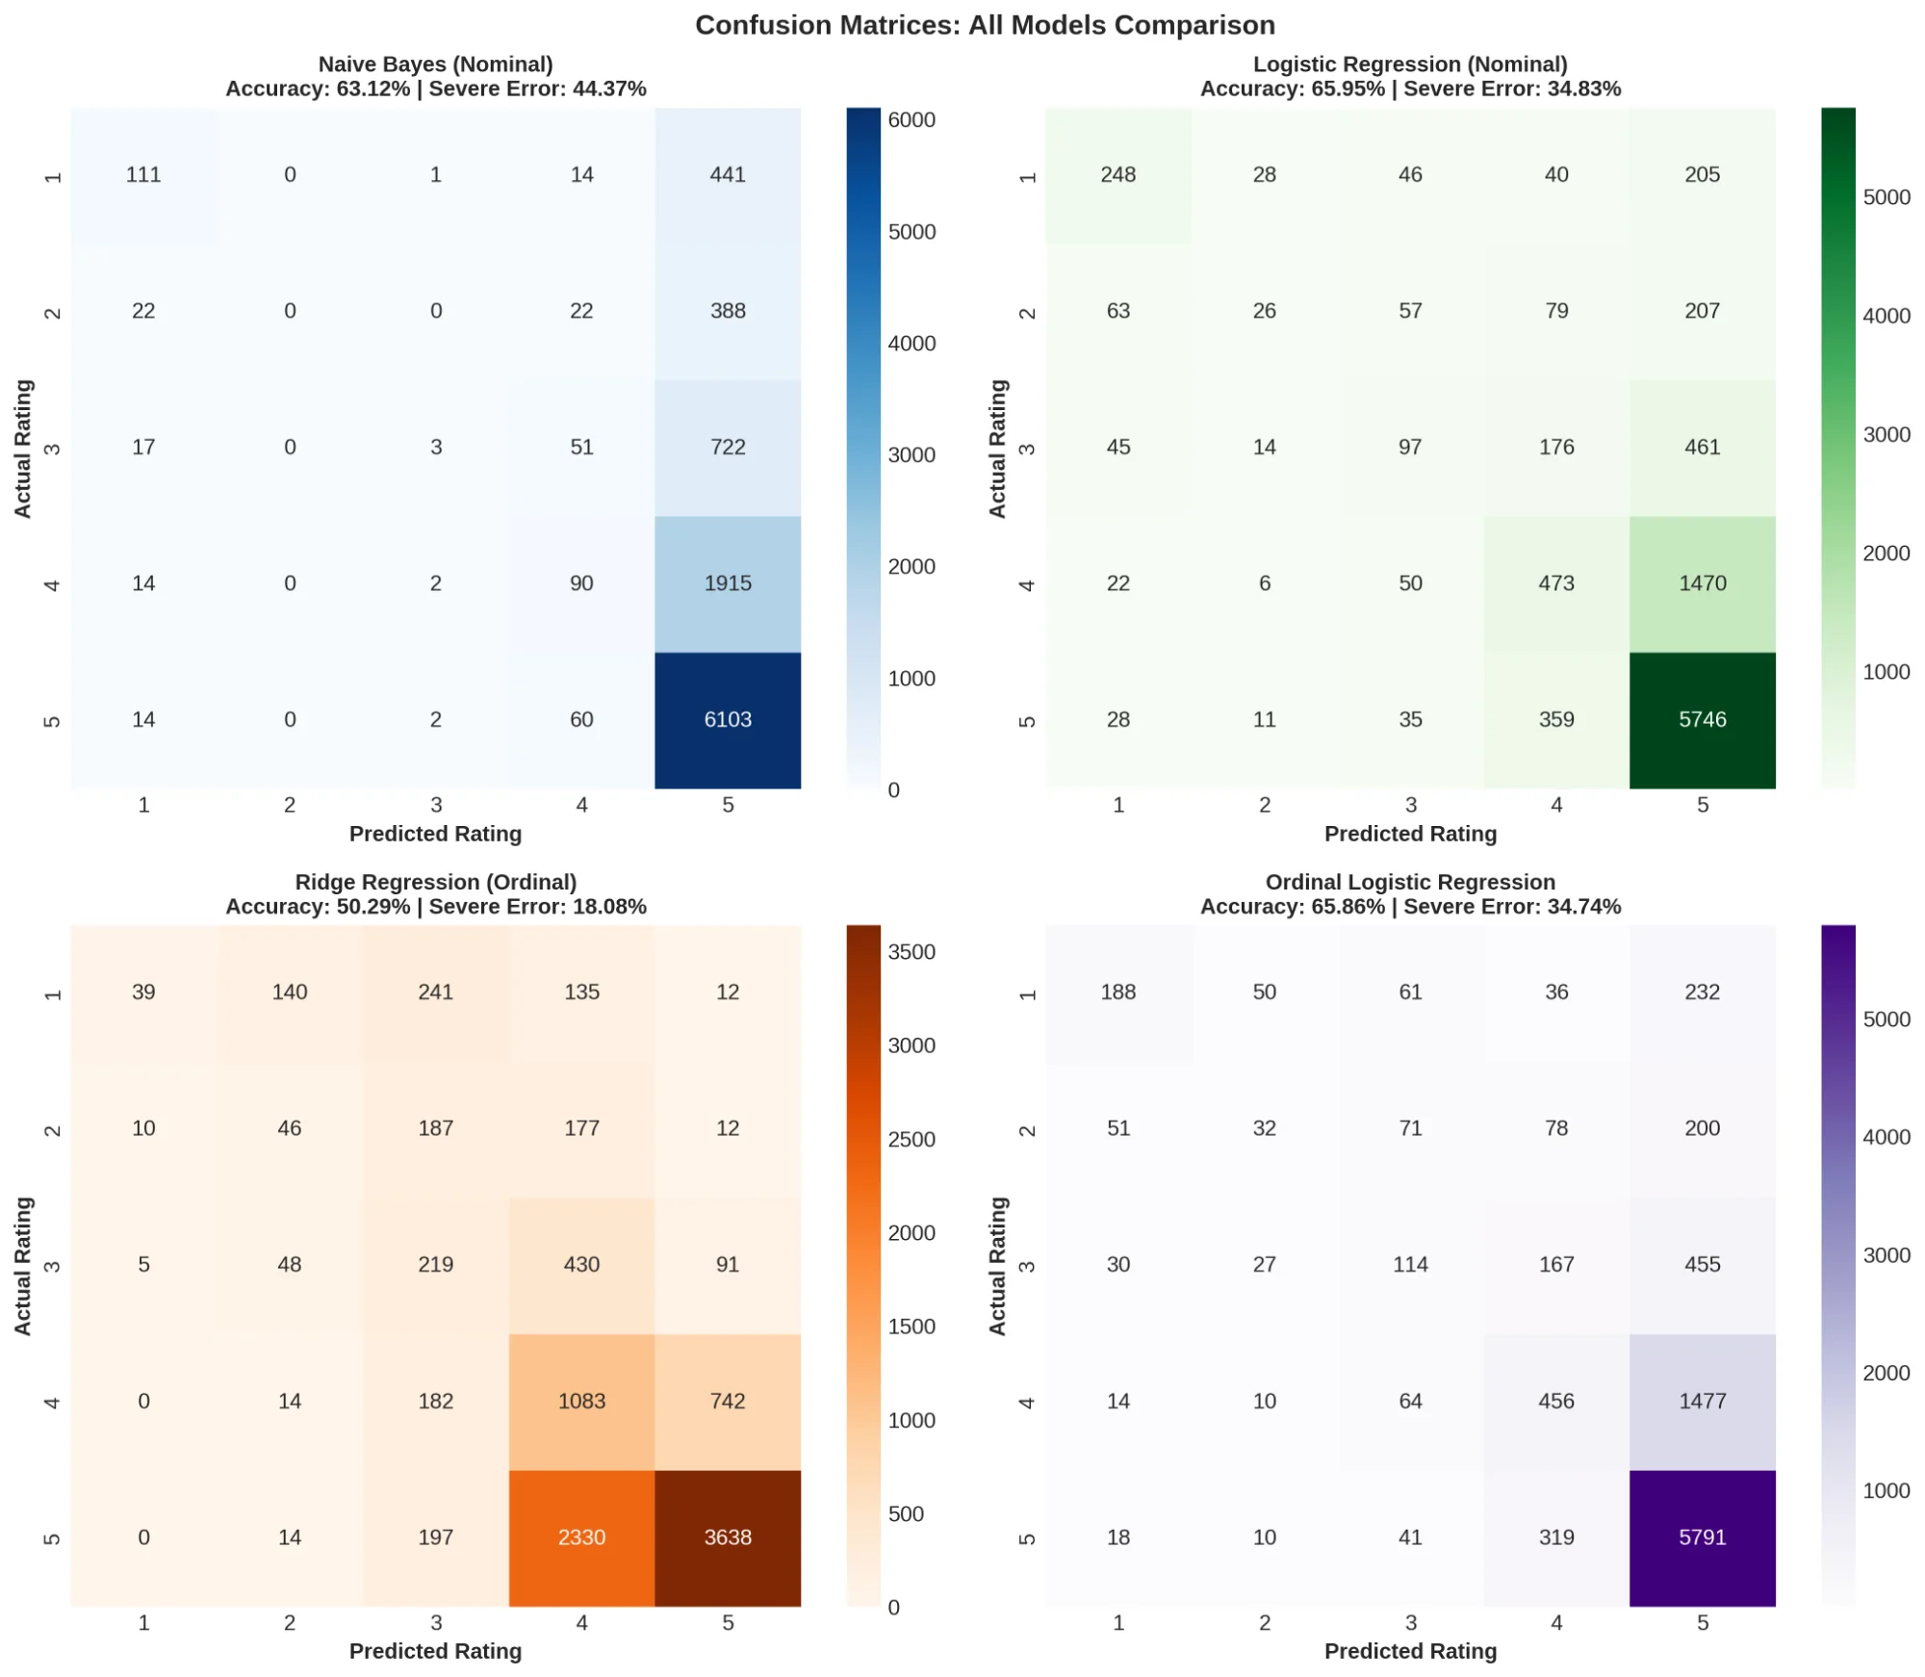
Results: Model Performance Comparison
Model | Acc | Severe
Naive Bayes | 63.1% | 44.4%
Logistic Reg | 66.0% | 34.8%
Ridge Reg | 50.3% | 18.1%
Ordinal LR | 65.9% | 34.7%
📊 Why LR Wins Accuracy
Softmax optimizes exact match; benefits from clear vocabulary differences
📊 Why Ridge Wins Severe
Squared error penalizes distant predictions; errors cluster near diagonal
⚠️ Severe Error = predictions ±2+ classes (catastrophic)

Slide 9
KEY FINDING
48% Reduction
in Severe Misclassifications
NOMINAL AVERAGE
RIDGE REGRESSION
39.6%
→
18.1%
severe error rate
severe error rate
Ordinal encoding teaches the model that adjacent ratings are more similar.
When it makes mistakes, they're "close misses" rather than catastrophic errors.

Slide 10
What We Learned From This Project
1. Ordinal Structure Matters
2. Accuracy ≠ Best Metric
Star ratings have inherent order that standard classifiers ignore. Ordinal methods reduce severe errors by 48% — significant for customer-facing applications.
High accuracy can hide catastrophic errors. Logistic Regression (65.95% acc) still makes 34.83% severe errors. Always evaluate error severity for ordinal tasks.
3. Class Imbalance Is Challenging
4. Trade-offs Require Context
14.3:1 imbalance severely hurts minority class performance. All models struggle with 2★ and 3★ reviews (F1 < 0.20). Future: SMOTE, cost-sensitive learning.
No single best model — choose based on application. Ridge for error tolerance, Logistic for exact classification needs.
Research Question: "Do ordinal methods justify their complexity?"
✓ YES — when minimizing
severe errors is priority

Slide 11
Thank You
49,953
4
48%
Reviews Analyzed
Models Compared
Error Reduction
Atharv Chaudhary · Kien Nguyen · Zijie Liu
Questions?

