Slide 1

Project Title – Seasonal Agriculture Performance Analysis
Student Name – Atharv Ajay Gujar
College Name - Dr. D.Y.Patil Pratishthan's College of Engineering Salokhenagar, Kolhapur - 416007
AICTE STU ID : STU6786604586f2f1736859717

Slide 2

PROBLEM STATEMENT
Agricultural activities are influenced by seasonal variations in environmental conditions, farming practices, resource availability and market conditions. As a result, agricultural performance may differ from one season to another. However, raw agricultural data does not clearly explain how agricultural performance changes across seasons or what patterns can be observed in different seasonal conditions. The problem is to analyze the given agricultural dataset and investigate seasonal differences in agricultural performance by identifying meaningful patterns, trends, relationships and variations within the available data.

Slide 3
Project Description
This project analyzes a seasonal agriculture dataset covering 4,000 farm records across three growing seasons — Kharif, Rabi, and Zaid — to uncover how agricultural performance shifts with the seasons.
It Handle missing values, validate cost/revenue consistency, and engineer per-hectare metrics.
Compares productivity, economic, resource-efficiency and risk metrics across Kharif, Rabi, and Zaid.
Links environmental drivers (rainfall, temperature, disease risk) to performance differences using correlation analysis.

Slide 4

WHO ARE THE END USERS?
1. Farmers
2. Agricultural Policymakers
3. Agri-Finance and Insurance
4. Agri-Tech Companies
5. Researchers and Agronomists
6. Water and Resource Boards

Slide 5

Technology Used
  1. Python
  2. Matplotlib and Seaborn
  3. Pandas and Numpy
  4. Jupyter Notebook

Slide 6
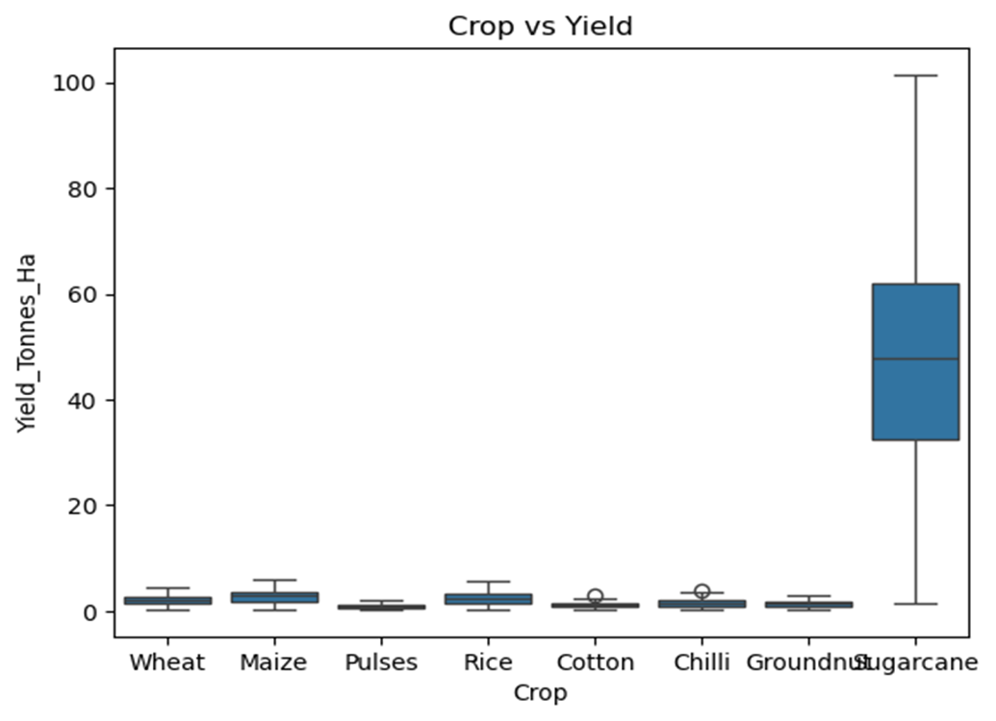
Result: Crop Type Drives Yield
Sugarcane yields (30–100+ t/ha) dwarf every other crop, which averages under 6 t/ha.
Crop type — not season — is the single largest driver of raw yield values.
Sugarcane must be analyzed separately (or excluded) before making fair seasonal comparisons.

Slide 7
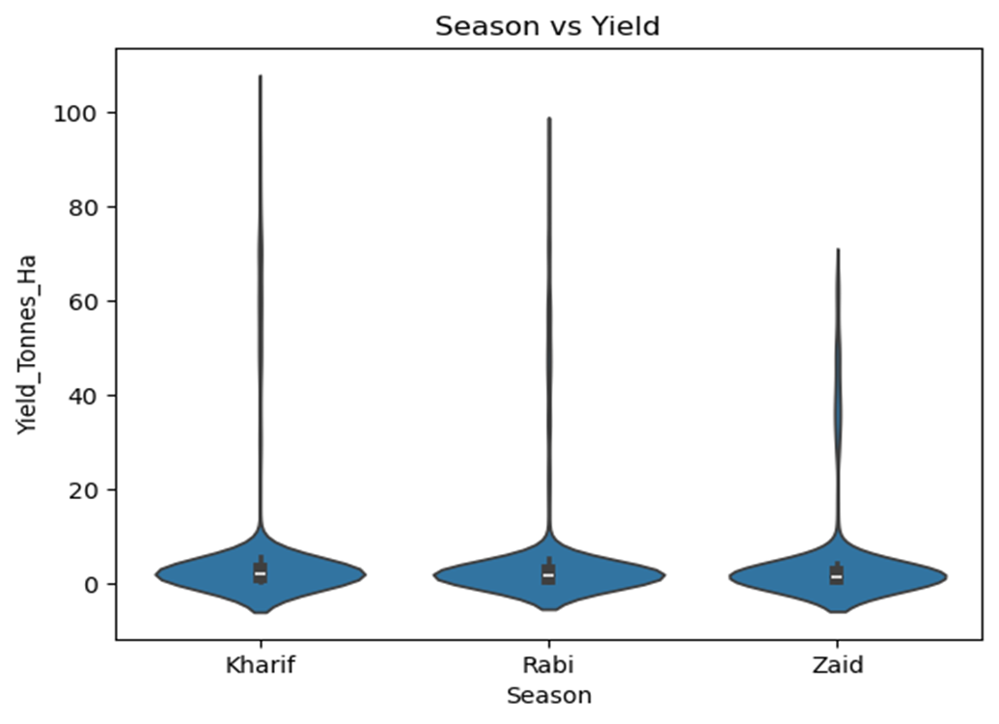
Result: Yield Distribution by Season
[Add screen shots of your code ]
Median yield ranks Kharif > Rabi > Zaid, consistent with and without sugarcane included.
All three seasons show heavy right-skew — median, not mean, is the trustworthy summary statistic.
Kharif's long upper tail reflects high-value crops concentrated in the monsoon season.

Slide 8
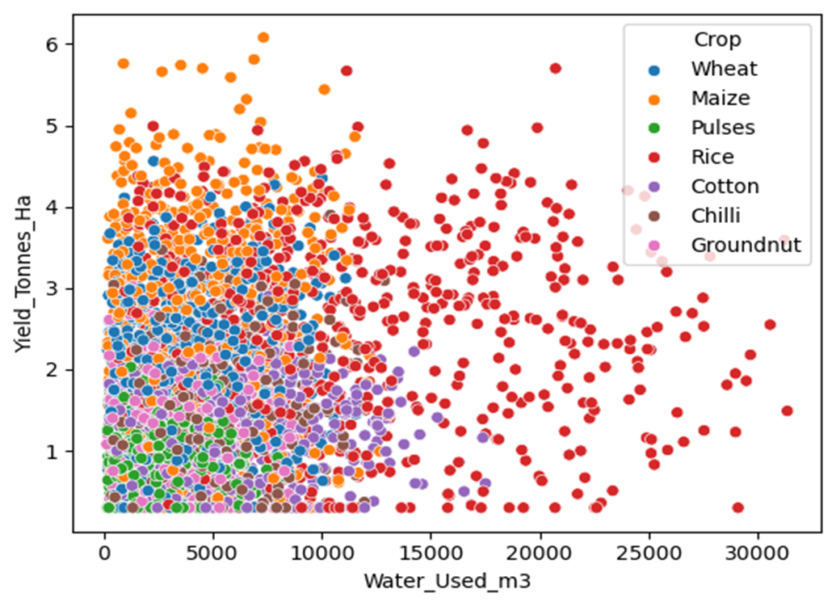
Result: Fertilizer Is Not the Limiting Factor
[Add screen shots of your code ]
Even within individual crops, higher fertilizer/water use shows no clear upward trend in yield.
Yield bands separate cleanly by crop (Maize & Rice highest, Pulses lowest) regardless of input level.
Environmental conditions and crop choice outweigh input quantity as yield drivers.

Slide 9
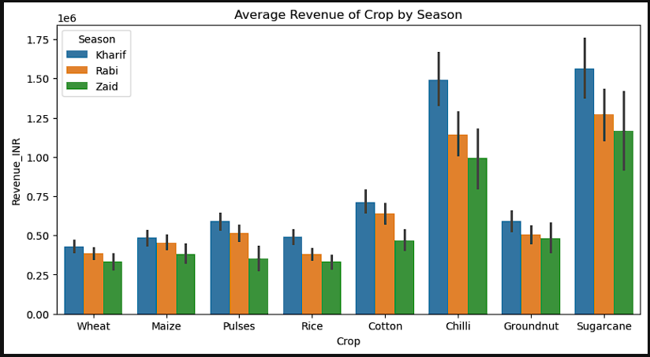
Result: Zaid Season Runs at a Loss
[Add screen shots of your code ]
Sugarcane and Chilli generate by far the highest revenue across all seasons.
Kharif consistently earns the most revenue within almost every crop.
Zaid is the weakest season for nearly every crop..

Slide 10
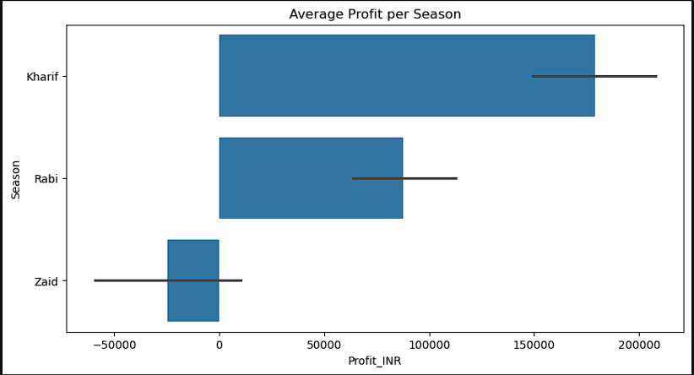
Result: Zaid Season Runs at a Loss
[Add screen shots of your code ]
Kharif has the highest average profit, Rabi is moderate, and Zaid is the only season with a negative average profit.
The error bar (confidence interval) for Zaid crosses zero widely, meaning there's real uncertainty — some Zaid farms are profitable, but the average tips negative.

Slide 11
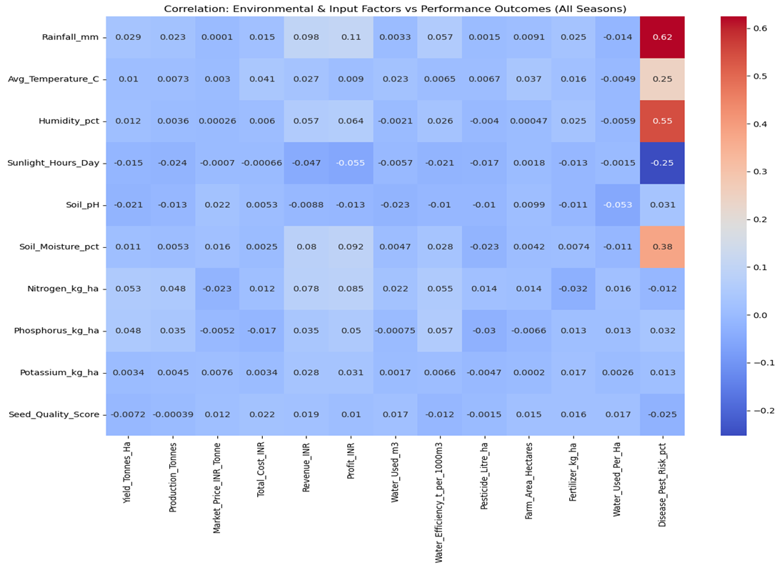
Result: Environmental Drivers of Performance
Rainfall (0.62), Humidity (0.55) and Soil Moisture (0.38) correlate strongly with Disease/Pest Risk.
Sunlight Hours shows a negative relationship (–0.25) with disease risk.
Input variables (Nitrogen, Phosphorus, Fertilizer) show near-zero correlation with every outcome — confirming inputs are applied uniformly, not adapted to season.
[Add screen shots of your code ]

Slide 12
Future scope
Crop Recommendation System
Use the season – environment – performance relationships found in this analysis to recommend the best crop for a farmer's location, season, soil, and rainfall forecast — turning descriptive insight into a predictive, actionable tool.
Predictive models estimating yield/profit from weather forecasts and planned inputs.
Recommend irrigation method and schedule to close Zaid's water-efficiency gap.
Deliver season-specific alerts on disease/pest risk directly to farmers.

Slide 13
GitHub Link

Slide 14
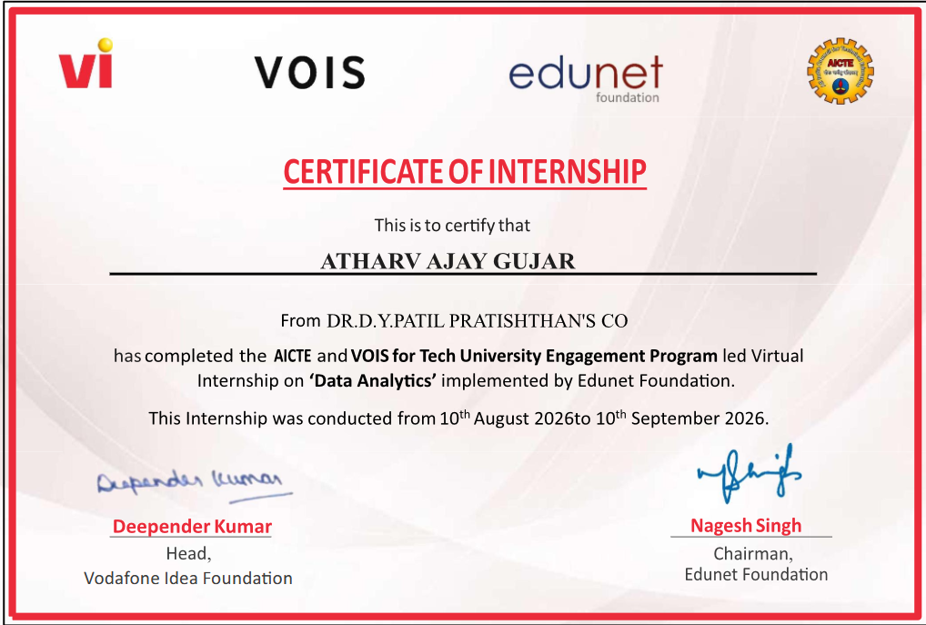
VOIS Course completion certificate -
Course name- Data Visualization

Slide 15
Thank you
.
.

