Slide 1



Solar Energy Production Forecasting System Using Machine Learning

Slide 2

Learning Objectives
Optimize solar energy management and grid planning through reliable forecasts
Enable better decision-making for renewable energy operations
Accurately predict solar energy production based on environmental and temporal factors
Reduce dependency on traditional energy sources by improving solar utilization
Support sustainable energy initiatives with data-driven predictions
GOAL
Source :
www.freepik.com/

Slide 3
Tools and Technology used
Development Environment: Jupyter Notebook/Python IDE
Programming Language: Python 3.x
Data Processing: Pandas, NumPy
Visualization: Matplotlib, Seaborn
Machine Learning Libraries: Scikit-learn, XGBoost, LightGBM
Model Optimization: RandomizedSearchCV, TimeSeriesSplit
Data Scaling: StandardScaler
Model Persistence: Pickle

Slide 4
Methodology
Data collection and loading from CSV format
Exploratory Data Analysis (EDA) with time-series visualization
Cyclical encoding for periodic patterns (sine/cosine transformations)
Feature engineering including temporal features (hour, day, month, season)
Lag features creation (1h to 168h historical data)
Rolling window statistics for trend analysis (3h to 48h windows)
Interaction features between radiation, sunshine, and temperature
Time-based train-test split (80-20 ratio) for model validation
Feature scaling using StandardScaler
Model training with multiple algorithms (LightGBM, XGBoost, Random Forest)
Hyperparameter tuning using RandomizedSearchCV with Time Series Cross-Validation
Ensemble learning through Voting Regressor
Performance evaluation using R², RMSE, and MAE metrics
Feature importance analysis for model interpretability

Slide 5
Problem Statement:
Solar energy production is highly variable and dependent on weather conditions
Unpredictable energy output creates challenges for grid management and planning
Lack of accurate forecasting tools leads to inefficient energy utilization
Traditional methods fail to capture complex patterns in time-series solar data
Need for reliable predictions to optimize energy storage and distribution
Difficulty in balancing energy supply and demand without accurate forecasts
Limited understanding of which factors most significantly impact solar production

Slide 6
Solution:
Implemented comprehensive feature engineering with 50+ features including temporal patterns, lag variables, and rolling statistics
Applied multiple state-of-the-art algorithms: LightGBM, XGBoost, and Random Forest
Used Time Series Cross-Validation for robust model evaluation
Optimized hyperparameters through RandomizedSearchCV for improved accuracy
Created Voting Ensemble combining best models with weighted predictions
Achieved high accuracy with R² score evaluation and low error metrics (RMSE, MAE)
Generated interpretable results through feature importance analysis
Developed automated pipeline for data preprocessing, training, and prediction
Implemented model persistence for deployment and real-time predictions
Created visualizations for performance monitoring and insights
Developed advanced machine learning pipeline for solar production forecasting

Slide 7
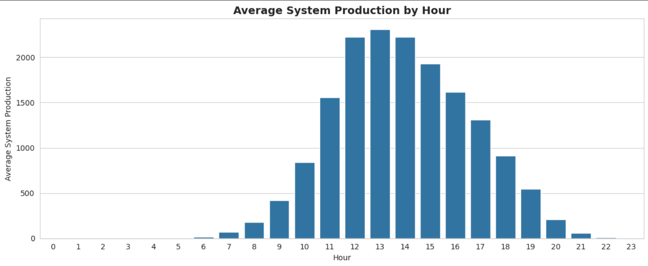
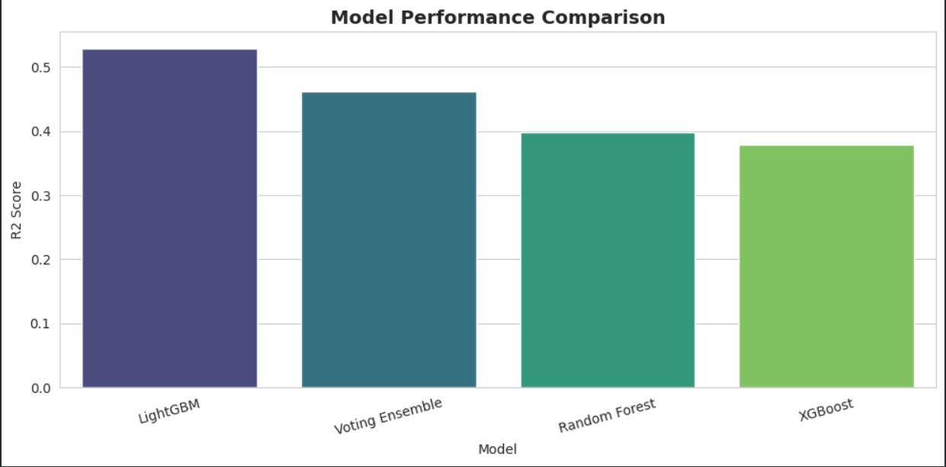
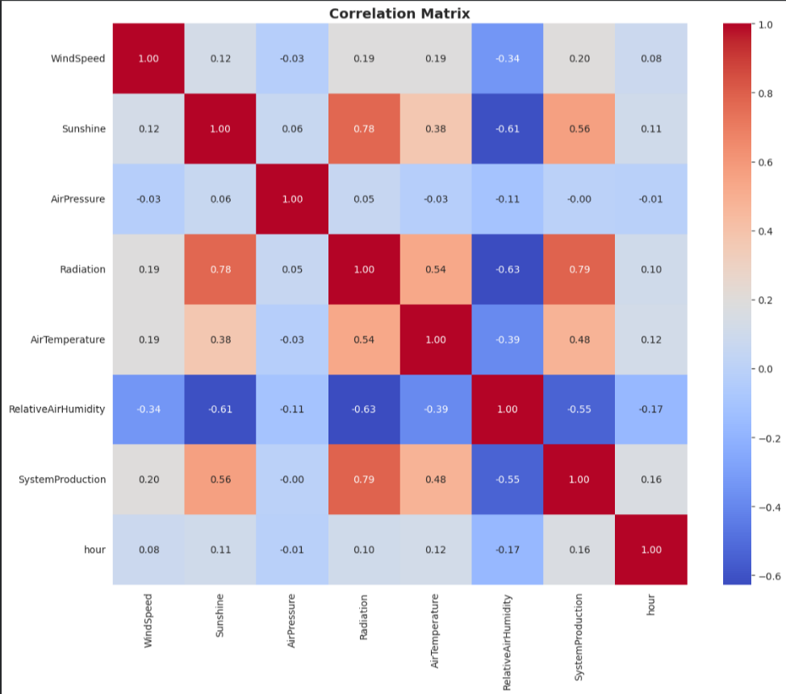
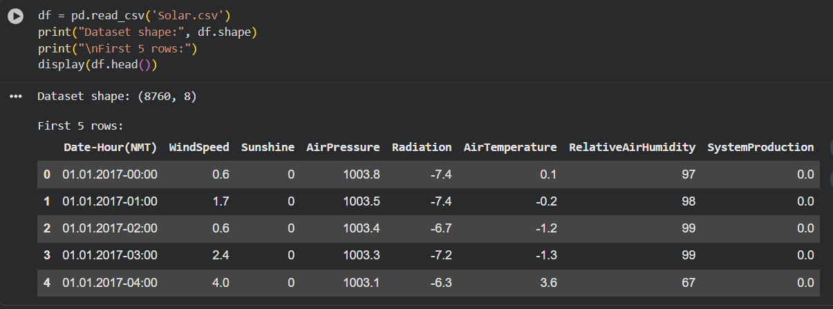
Screenshot of Output:

Slide 8
Conclusion:
The Voting Ensemble model demonstrated superior performance across all evaluation metrics
Feature engineering significantly improved model accuracy by capturing temporal and weather patterns
Radiation, sunshine duration, and temperature emerged as the most critical predictive factors
Time-series cross-validation ensured model reliability for real-world deployment
The system enables proactive energy management and efficient grid operations
Automated pipeline facilitates easy integration into existing solar energy systems
Model interpretability through feature importance helps understand solar production dynamics
Solution supports the transition to sustainable renewable energy sources
Future enhancements can include real-time weather API integration and deep learning models
The project demonstrates the effectiveness of ML in solving renewable energy challenges
Successfully built an accurate solar production prediction system using ensemble machine learning

