Slide 1




HACKARENA’26
Problem Statement ID: –PS-02
Problem Statement Title:- SecureLocker ESP32
Theme:- IoT & Smart Infrastructure
Team Name- Code Scorers
HACKARENA’26

Slide 2
SecureLocker – ESP32 Based Smart Locker
Alert System
Concept:-
SecureLocker transforms traditional lockers into intelligent, connected security systems using the power of IoT and the ESP32. It enables real-time monitoring and instant alerts for unauthorized access or unattended open states.
Implementation:-
• ESP32 + Magnetic Reed Switch + Vibration
Sensor(SW-420)
• WiFi connectivity with HTTPS
• Cloud integration (Firebase)
• Mobile push notification system thrugh Emails
How it solves the problem:-
• Detects tampering instantly
• Alerts user if locker remains open
• Provides real-time notifications
• Maintains digital activity logs
• Enhances security in shared spaces
HACKARENA’26

Slide 3

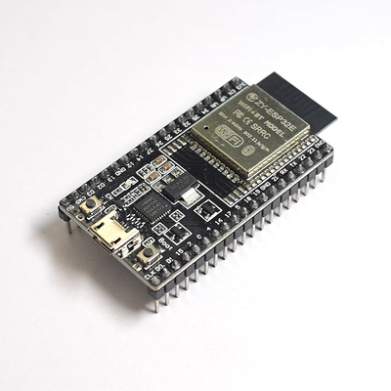
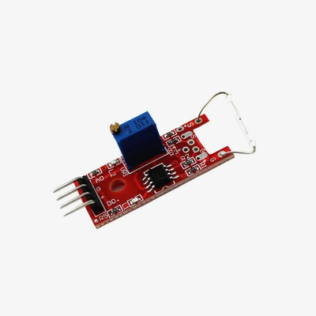
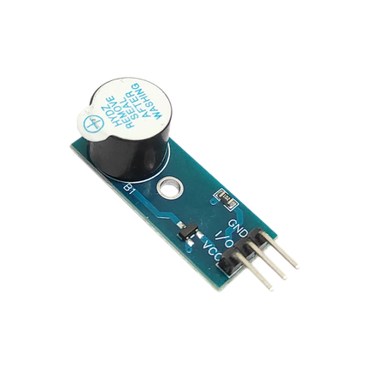
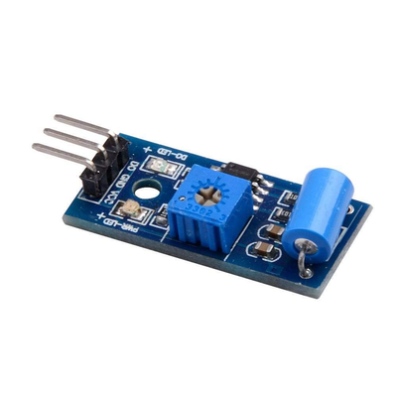
TECHNICAL APPROACH
Security Layer
HTTPS, Firebase
Authentication, and
token-based
authentication.
Sufficient protection for
prototypes.
Hardware Layer
ESP32 board, reed
switch, vibration sensor,
buzzer, and power
supply. Low-cost and
easily available.
WEB App
React Native framework,
login, dashboard, alert,
and history screens.
.
ESP32-DevkitC-32E V4 -
Latest ESP32
Development board
FLUX Magnetic Reed
Switch (Door sensor)
B100076
Embedded
Programming
Arduino IDE, C/C++, WiFi
library, and HTTP client
library. Simple coding
and fast debugging.
Cloud Backend
Firebase Realtime
Database, Cloud
Messaging,
Authentication, and
Hosting. Serverless
backend with real-time
data.
Project Components
Vibration Sensor
module
Buzzer module
Made with Napkin
HACKARENA’26

Slide 4
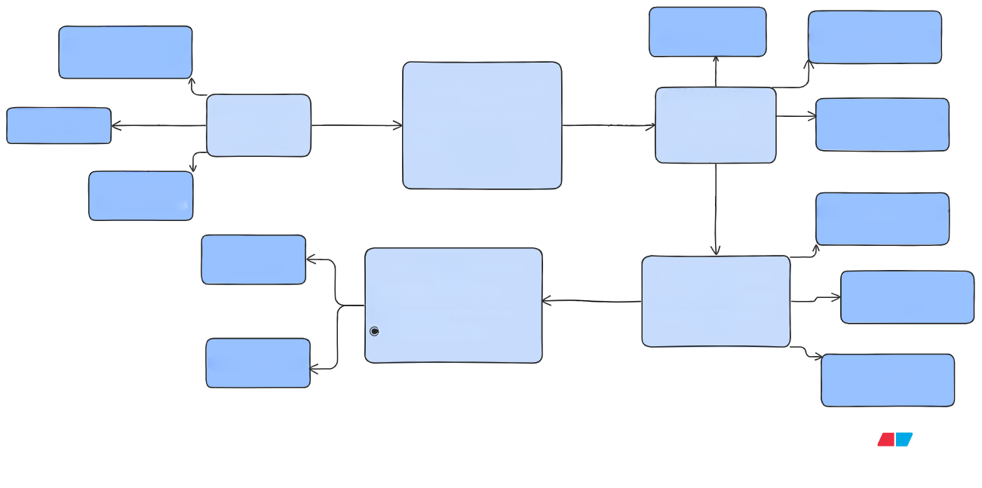






WORKFLOW AND SYSTEM ARCHITECTURE
Sensors
WIFI
CONNECTIVITY
Magnetic Reed Switch
Vibrational Sensors
HTTPS Encryption
EDGE PROCESSING LAYER
Microcontroller
Data
Generation
ESP32
Data
COMMUNICATION
LAYER
DEVICE LAYER
(Locker
Hardware)
Continuous sensor monitoring Enterpretation_
Data Transmission to
Cloud
ESP32
Event detection logic
Timer for open-door condition
Data encryption
Packet creation
Protocols:-
HTTP AI
ALERT
Buzzer Alert
Data Transmission
Light Blink Alert
Firebase Broker
Forced Entry
Detected
WEB APP INTERFACE(USER
SIDE)
Processed
information +
CLOUD/BACKEND
LAYER
Receives locker events
Stores history Triggers
alerts
Real-time notifications
Alerts
DataBase Activity
LOGS
Locker status monitoring
Alert history
User authentication
Locker Left Open
Push Notification
Service
HACKARENA’26

Slide 5
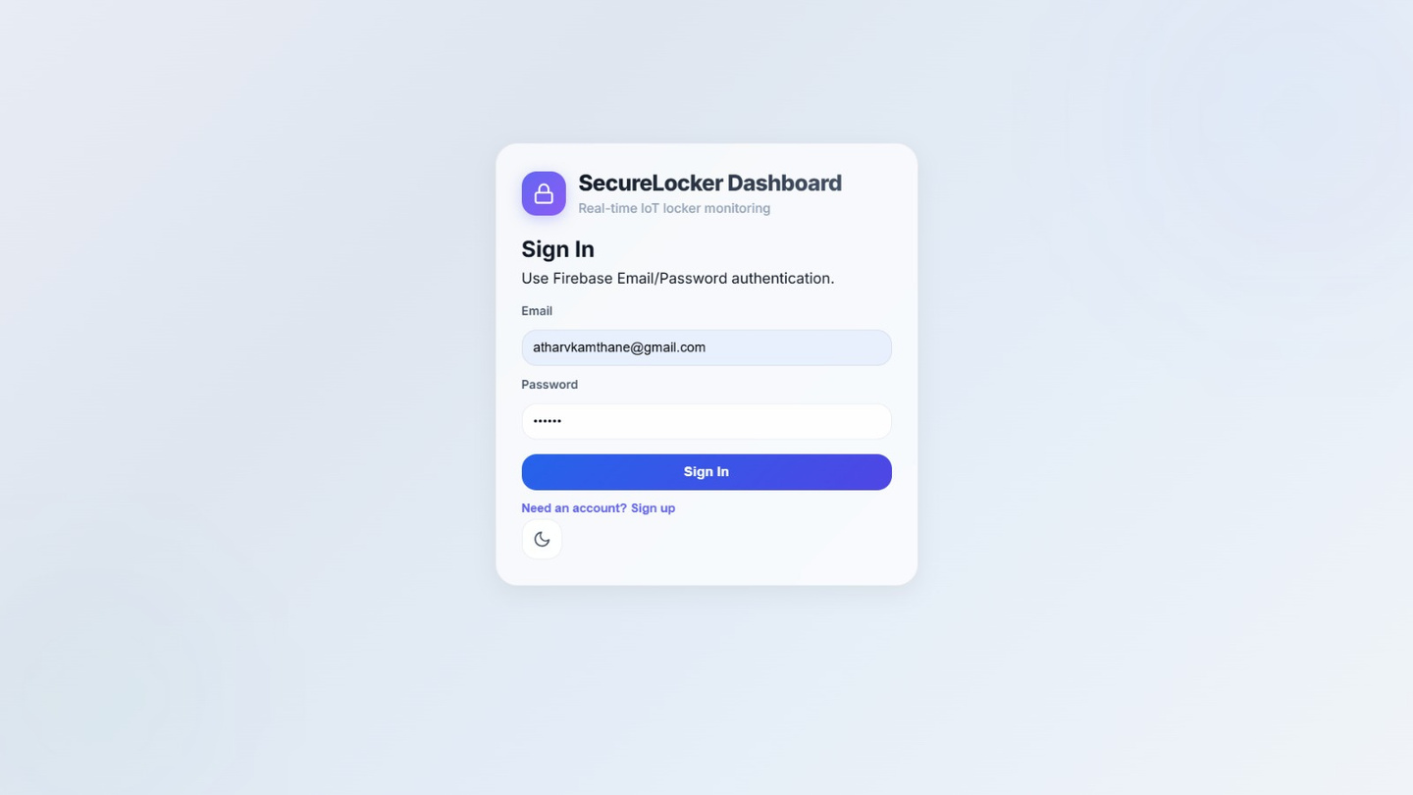
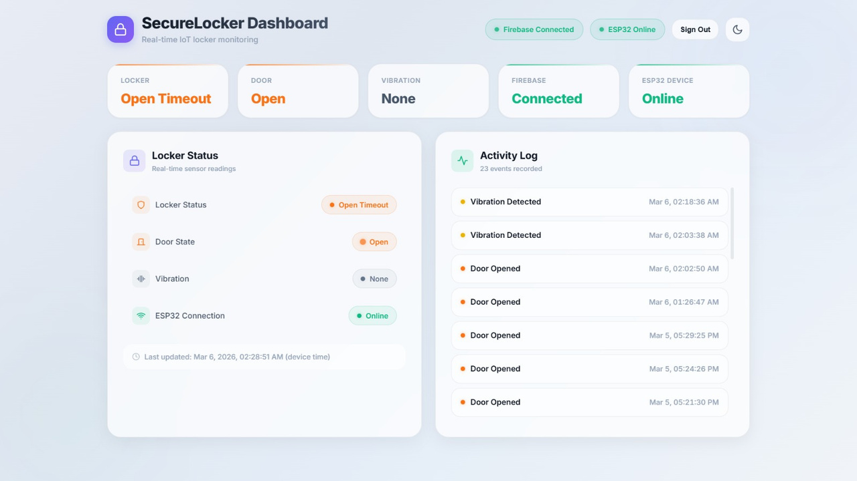
MOCK APP UI
Made with Napkin
User Login
Dashboard
Activity Log
HACKARENA’26

Slide 6
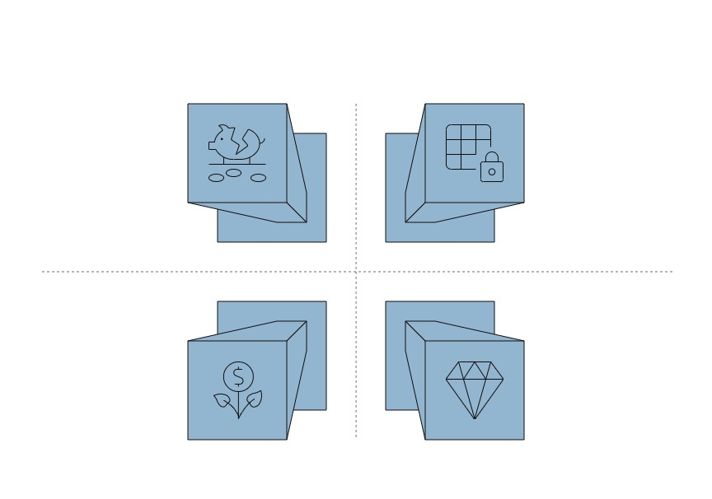
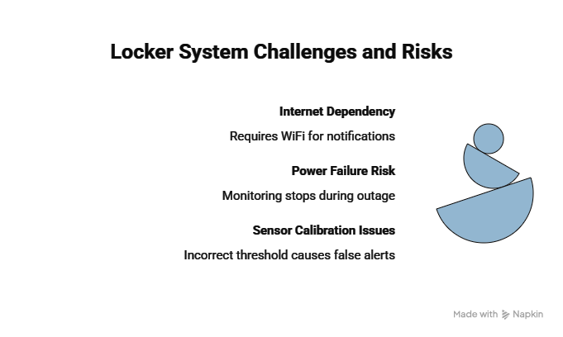

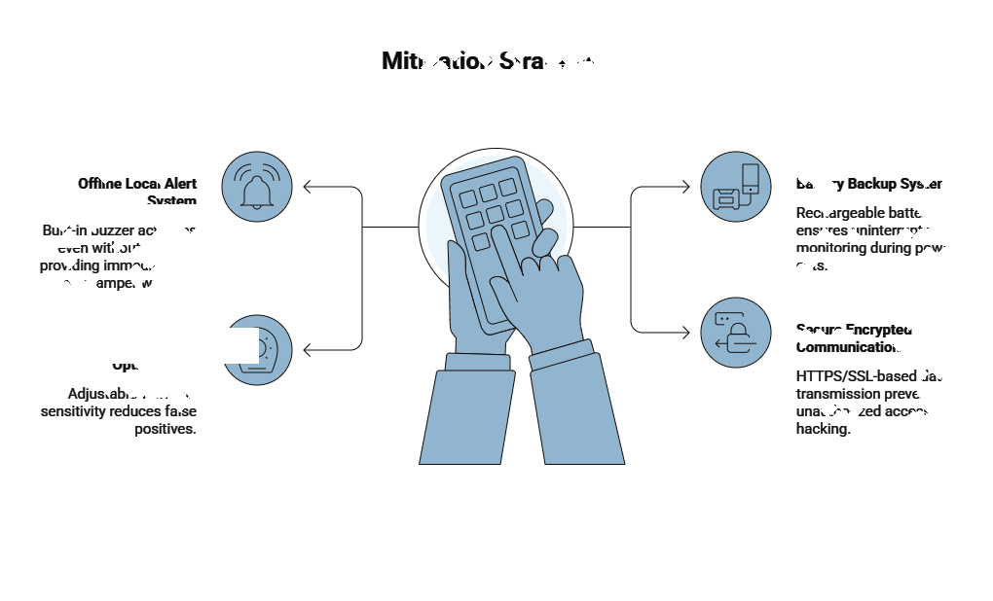


FEASIBILITY AND VIABILITY
Optimize Locker Solutions
Time Saving
Accessibility
WEB app based
monitoring
No need for manual Inspection
Affordable & Easy
Improved User Experience
Low cost, easy setup
Give instant awareness
Mitigation Strategies
Offline Local Alert
System
Built-in buzzer activates
even without internet,
providing immediate on-
site tamper warning.
Battery Backup System
Rechargeable battery
ensures uninterrupted
monitoring during power
Secure Encrypted
Communication
HTTPS-based data
transmission prevents
unauthorized access or
hacking.
Accessibility
WEB app-based monitoring
HACKARENA’26

Slide 7
IMPACTS & BENEFITS
Improved User Experience
Social Benefits
Real-time mobile alerts give instant awareness.
Users don’t need to physically check locker status.
Peace of mind even when away from locker.
Improves personal safety.
Builds trust in shared communities.
Reduces conflicts related to theft or damage.
Economic Benefits
Accessibility
WEB app based monitoring (anytime, anywhere).
Simple notification interface – easy to use.
Suitable for students, professionals, hostel residents.
Low-cost IoT solution compared to full CCTV systems.
Reduces financial losses due to theft.
Adds value to co-working businesses.
Increased Safety &Security
Immediate alert in case of tampering.
Reduced chances of theft.
Digital monitoring instead of blind trust on keys.
Environmental Benefits
Low power consumption (ESP32 is energy efficient).
Reduces need for heavy security infrastructure.
Minimal hardware footprint.
TimeSaving
Community-Level Advantages
No need for manual inspection by staff.
Automated monitoring system.
Smart infrastructure upgrade.
Encourages IoT adoption.
Creates safer shared environments.
Better Trust in Shared Spaces
Users feel secure keeping valuables.
Co-working spaces gain better reputation.
HACKARENA’26

