Slide 1
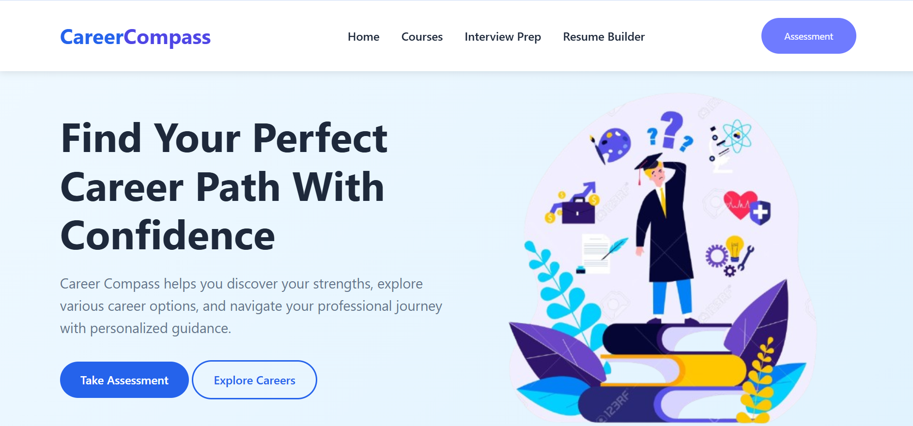
Find Your Perfect Career Path

Slide 2
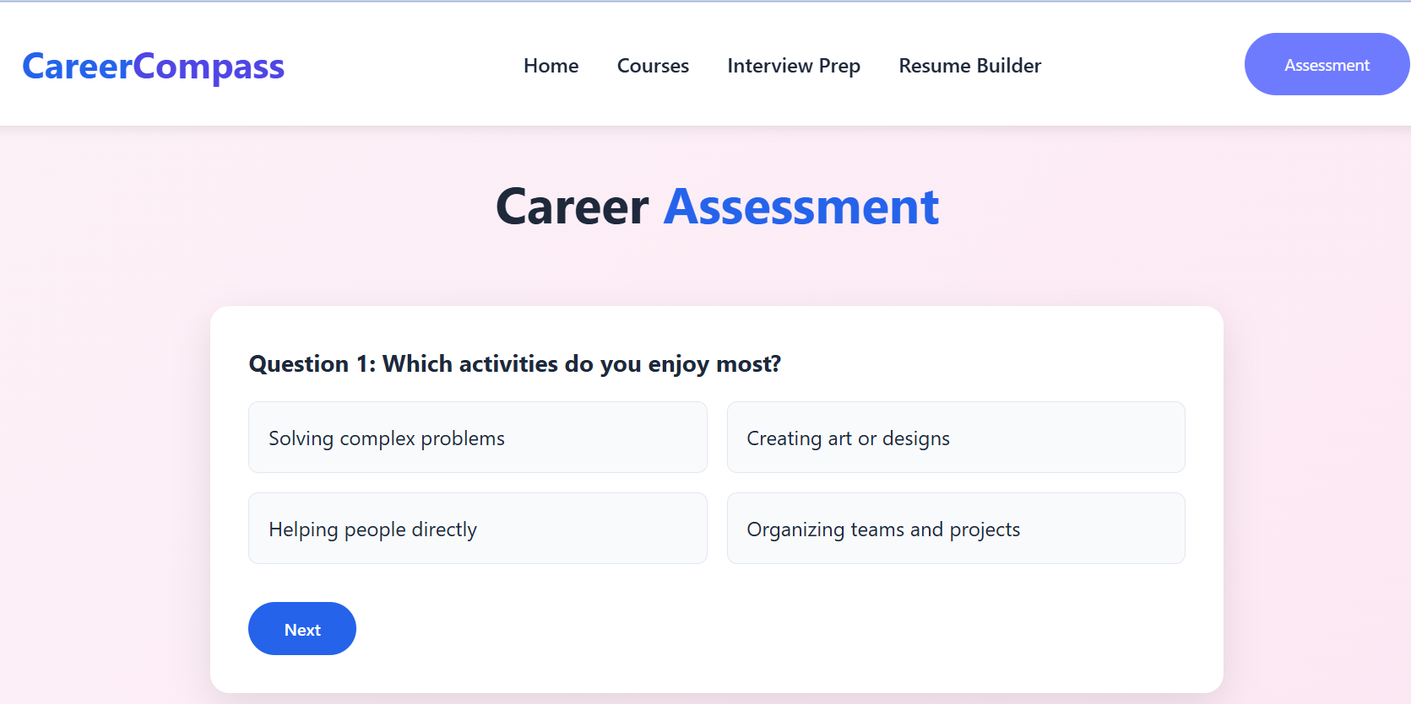
Take Personality Test.
Find Perfect Career Path

Slide 3
CAREER
PATH
Frontend Developer
Mobile Developer
Data Scientist
Career
Paths
Cloud Engineer
Cybersecurity Analyst
UX/UI Designer

Slide 4

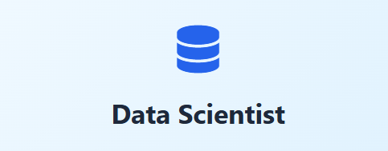




FREE COURSESE
For Learning

Slide 5
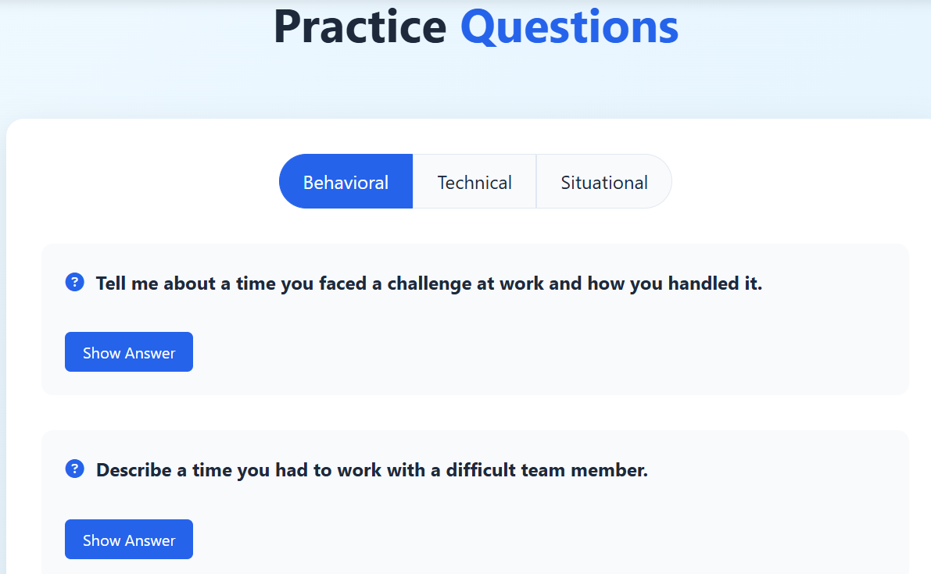
INTERVIEW PREPARATION
Interview Question Practice

Slide 6

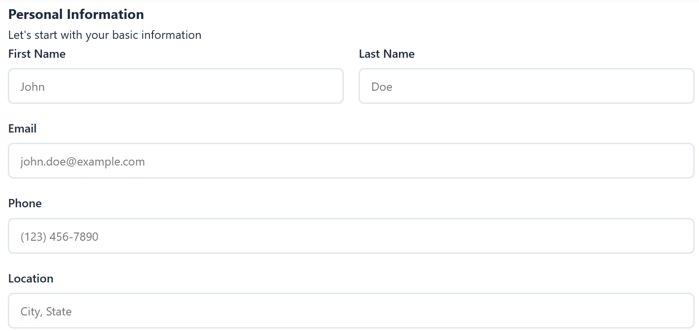
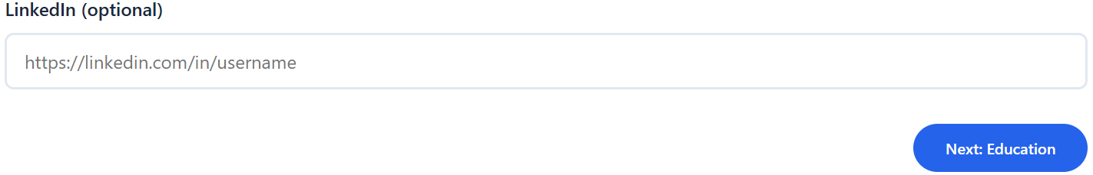

Slide 7

Contac No.
7028158013
Email: atharvrudrawar28@gmail.com

