Slide 1
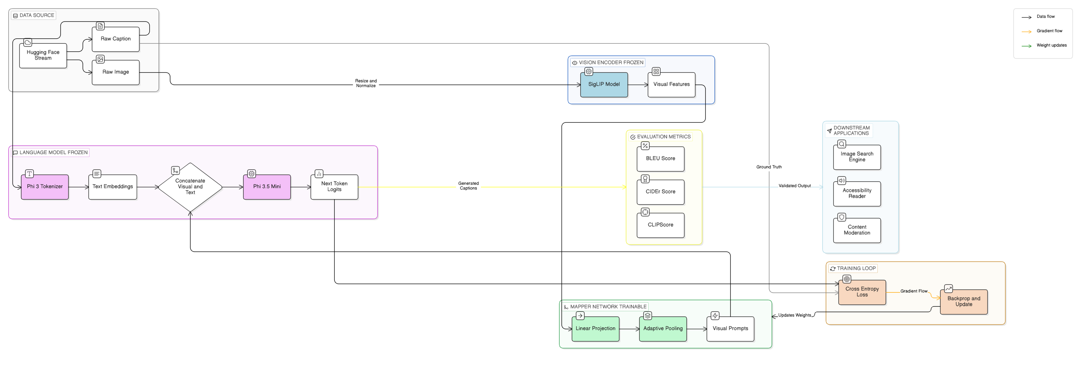
Architecture of SigLIP + Phi-3.5 pipeline

Slide 2
Alternatives for Multimodal Pipelines
Component Type | Model | Key Advantage | Best Use Case
Vision Encoder | DINOv2 (Meta) | Self-supervised learning; superior spatial, depth, and geometric awareness. | Captions requiring precise object positioning and sizing.
Vision Encoder | SigLIP (Google) | Uses Sigmoid loss for better efficiency and zero-shot performance than CLIP. | A high-performance, direct "drop-in" replacement for CLIP.
Vision Encoder | EVA-02 | Masked image patch pre-training for deep texture and fine-detail understanding. | High-fidelity image analysis and detailed feature extraction.
Text Decoder | Phi-3.5 Mini | Trained on high-quality "textbook" data; exceptional logical reasoning. | Professional, factually accurate, and logical descriptions.
Text Decoder | Llama 3.2 (1B/3B) | Modern "mobile-sized" SLM; vastly smarter than GPT-2 at similar sizes. | Natural, conversational, and storytelling-style captions.
Text Decoder | Mistral-7B | Gold standard for efficiency; maintains coherence in long-form generation. | Long, detailed captions requiring high linguistic consistency.

