Slide 1
Financial (Expense) Management Application
By: Group 20
Members:
Atharv Bisht (25BCE10596)
Aditya Uday Hota (25BCE11176)
Arya Bhagwat (25BAI11273)
Indrajith Sen (25BET10015)
Thiru Selvi (25MEI10025)

Slide 2
Problem Statement & Objective
Managing personal finances is a common challenge faced by individuals.
Our application helps users record their daily income and expenses, categorize them, and analyze their financial balance.
💡 Objective: To promote awareness of spending habits and better savings management.

Slide 3
Project Features
Add, update, and delete income/expense records
Categorize transactions (Food, Travel, Rent, etc.)
View summaries and reports (Income, Expenses, Balance)
Persistent data storage using CSV file
Search by date or category
✅ Completed: Add, View, Report, Storage
🟡 In Progress: Update, Delete, Search

Slide 4
Technologies Used
🖥 Programming Language: Python
📂 File Storage: CSV file
🧠 Interface Type: Console-based Application
Libraries Used:
csv — for data storage

Slide 5
System Design
Modules:
Input Module — Takes user data (income/expense)
Storage Module — Saves data in CSV
Report Module — Calculates and displays summary
UI Module — Console-based user interface
🧩 Flow:
[User] → [Input Module] → [CSV Storage] → [Report Module] → [Display Output]

Slide 6
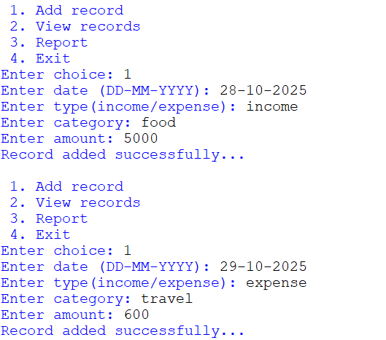
Sample Input
Here, we have taken two inputs.
The first input is “income” and the second is “expense”

Slide 7
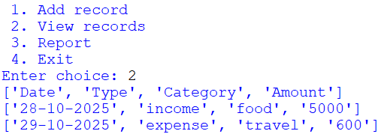
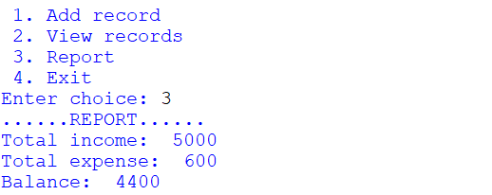
View records and report
View Records:
View Report:

Slide 8
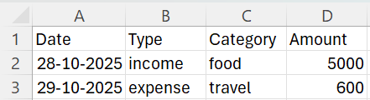

Data stored in csv file
A csv file named “finance” will be saved on the device which stores the entered data.

Slide 9
Current Progress
✔ Code Modules Completed: Add, View, Report
✔ Data Storage: Implemented via CSV
✔ UI: Console-based interactive menu
✔ Working Demo: Fully functional
Next Steps:
Implement update/delete functionality

Slide 10
THANK YOU

