Slide 1


Presentation on
Missing Person & Lost Item Tracker
Guided By: Presented By:
Prof. (Dr.) Nitin Kulkarni Atharv Sharma
Khushi Agrawal
Harshita Sultanpura
Dali Vaishnav

Slide 2
Contents
Introduction
  1.1 Overview
  1.2 Purpose
Requirement Engineering
  2.1 Requirement Collection
  2.2 Functional Requirements
  2.3 Non Functional Requirements
  2.4 Use Case Diagram
Technical Design
  3.1 Technical Architecture
  3.2 Sequence Diagram
  3.3 Class Diagram
  3.4 DFD
User Interface Design
Data Design
  5.1 Schema Design
  5.2 E-R Diagram
REFERENCES

Slide 3
1. Introduction
1.1 Overview
  An AI-powered digital platform designed to help locate missing persons and recover lost belongings.
  Bridges the gap between the public, law-enforcement agencies, and reporting individuals through a single, centralized system.
  Uses facial recognition, object detection, and geolocation services to match new reports with existing data in real time.
  Provides a secure, user-friendly interface for reporting, searching, and tracking incidents.
1.2 Purpose
  Centralized Reporting: Offer one reliable platform for quick submission of missing-person or lost-item cases.
  Real-Time Alerts: Send instant notifications and location updates to nearby users and authorities, ensuring faster action.
  Community Participation: Encourage the public to assist by sharing sightings and matching reports, strengthening civic safety.

Slide 4
2. Requirement Engineering
2.1 Requirement Collection
Conducted surveys and interviews with police officers, NGO workers, and general public to understand real-world challenges in missing person and lost item tracking.
Collected functional and non-functional requirements through questionnaires focusing on user expectations and system usability.
Analyzed existing systems such as government missing-person portals, social media reports, and community apps to identify gaps and pain points.
Gathered technical requirements by consulting developers and AI experts to determine suitable technologies like facial recognition, object detection, and geolocation services.
Documented findings in a Software Requirement Specification (SRS) for validation by team members and project guide.

Slide 5
2.2 Function Requirements
User Registration & Authentication: Users can create accounts, log in securely, and manage their profiles.
Report Submission: Allows users to register missing persons or lost items by uploading images, descriptions, and last-known locations.
AI-Based Matching: System automatically compares uploaded images using facial recognition (for persons) and object detection (for items) to find potential matches.
Real-Time Alerts: Sends instant notifications via Firebase or Twilio to nearby users and authorities when a probable match is found.
Search & Filter: Users can search existing reports using keywords, category, or location filters.
Admin Dashboard: Admins and authorized personnel (like police or NGOs) can verify reports, update case statuses, and close resolved cases.
Location Tracking: Integrates with Google Maps API to visualize last-seen locations and possible matches on a map interface.
Community Reporting: Enables the public to submit sightings or related information to assist in ongoing cases.

Slide 6
2.2 Non Functional Requirements
Performance: The system should process image comparisons and send alerts within 3–5 seconds to ensure timely responses.
Scalability: Must handle increasing user traffic and large datasets efficiently across cities or institutions.
Security: All user data, images, and locations should be encrypted using SSL/TLS to protect privacy and prevent unauthorized access.
Reliability: The platform should maintain 99% uptime with proper error handling and data backup mechanisms using Firebase Cloud Storage.
Usability: The interface should be intuitive, user-friendly, and accessible to non-technical users on both web and mobile devices.
Maintainability: The modular design using Spring Boot and ReactJS ensures easy maintenance, updates, and feature scalability.
Compatibility: Compatible with major browsers and operating systems (Windows, macOS, Android, iOS).
Accuracy: AI models (Facial Recognition and Object Detection) should achieve at least 90% accuracy for reliable matching results.

Slide 7
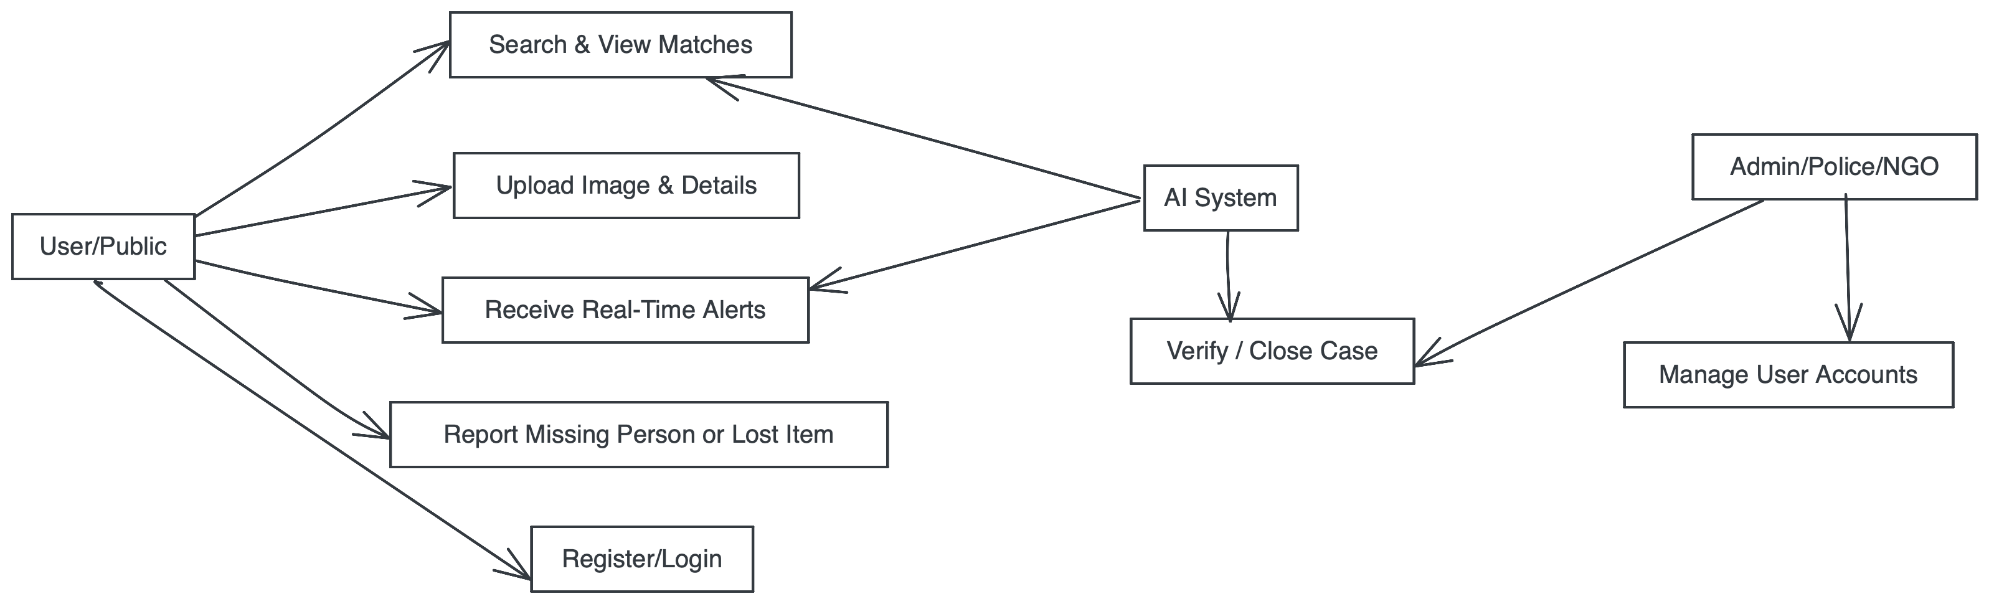
2.3 Use Case Diagram
System Use Case Diagram

Slide 8
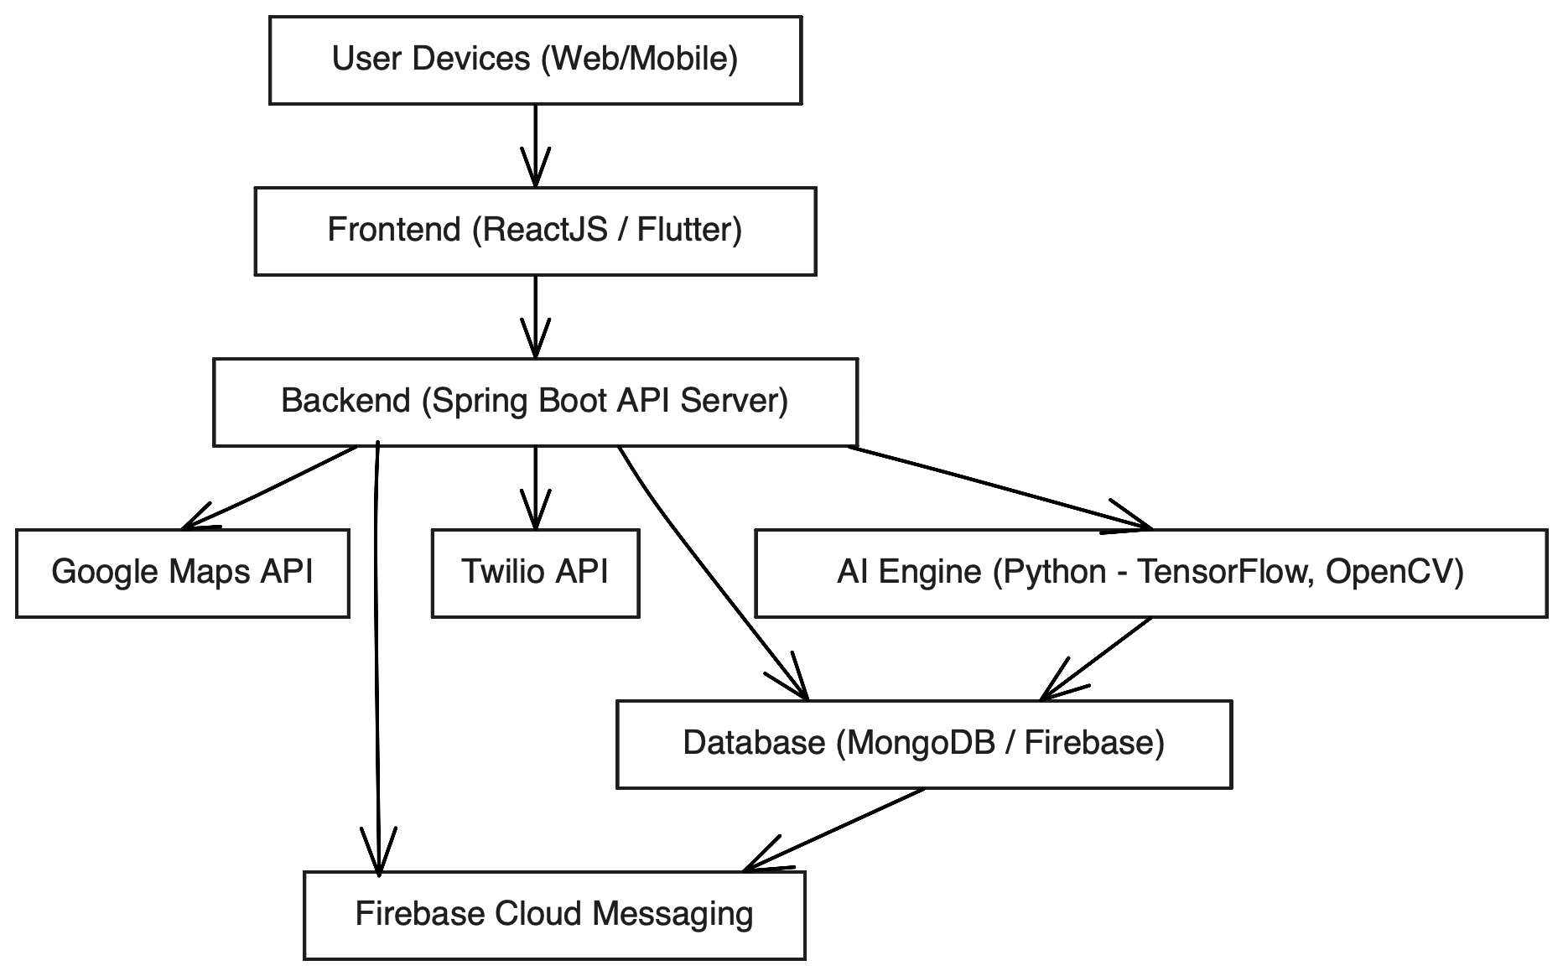
3. Technical Design
3.1 Technical Architecture
System Architecture Diagram

Slide 9
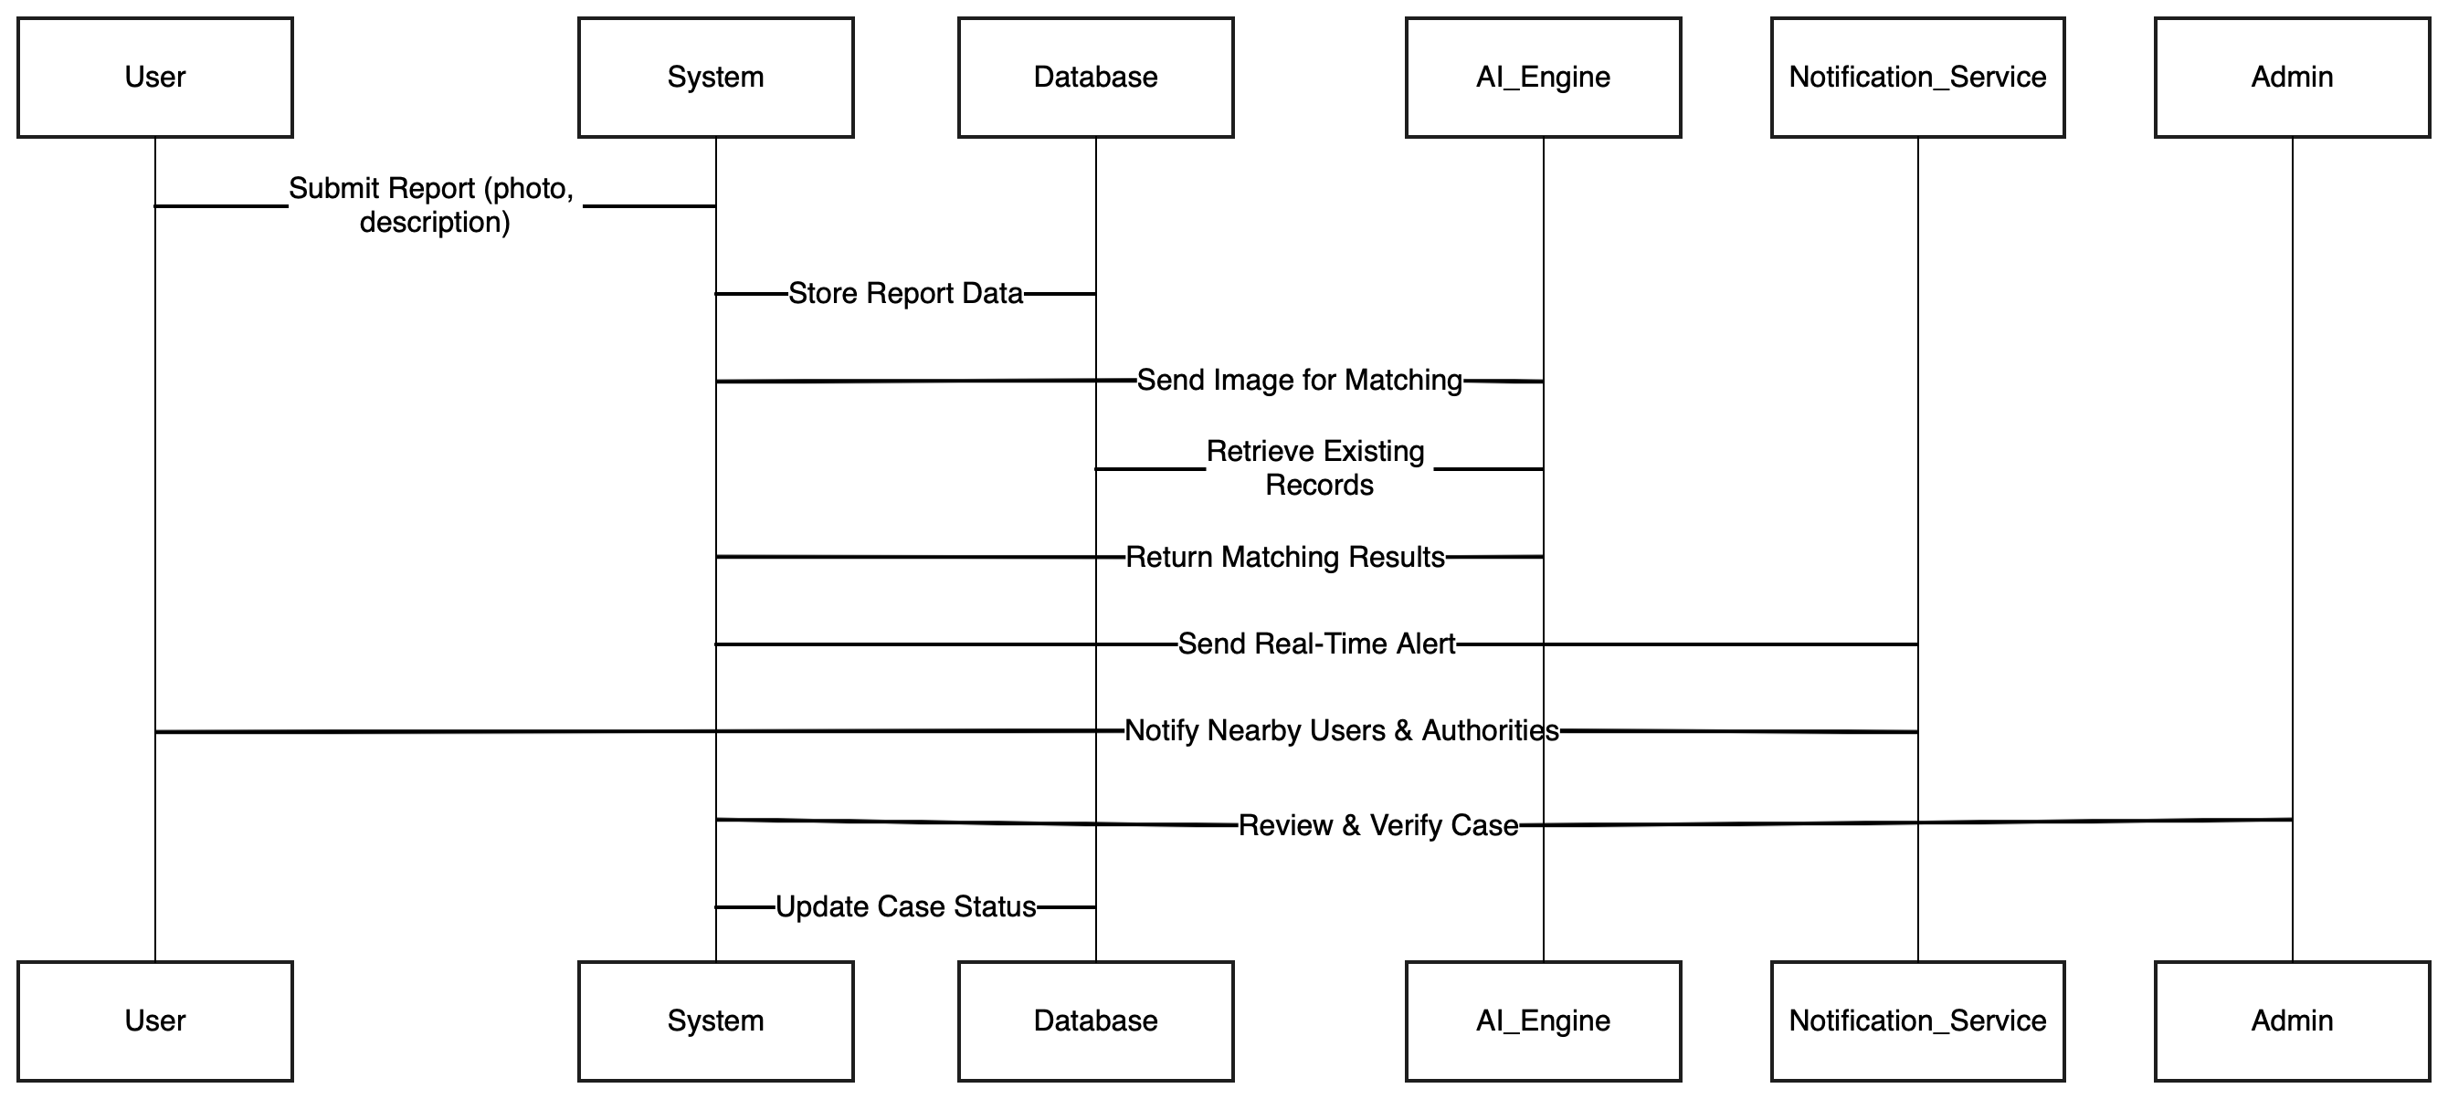
3.2 Sequence Diagram
System Sequence Diagram

Slide 10
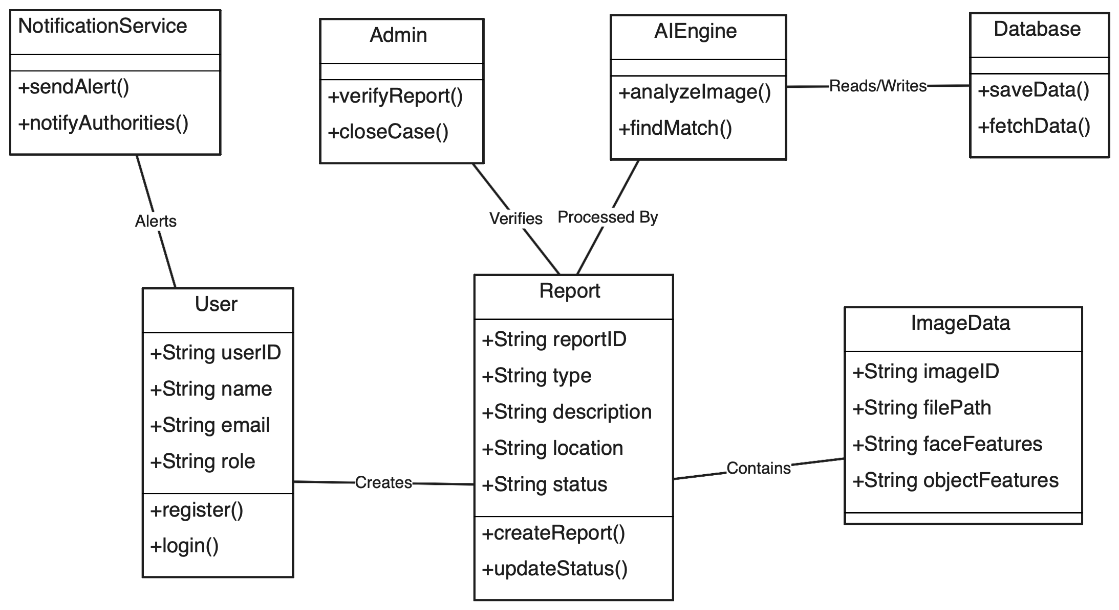
3.3 Class Diagram
System Class Diagram

Slide 11
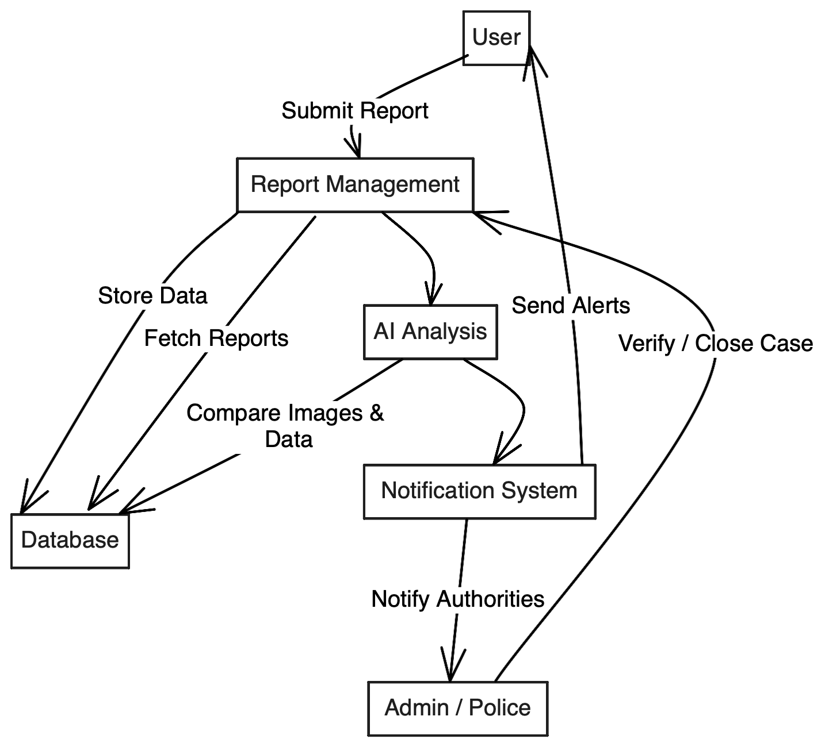
3.4 DFD
DFD Diagram

Slide 12
4. User Inface Design
(Note: Need to show the Working UI during the presentation and Attach Screen Shots of working UI here)

Slide 13
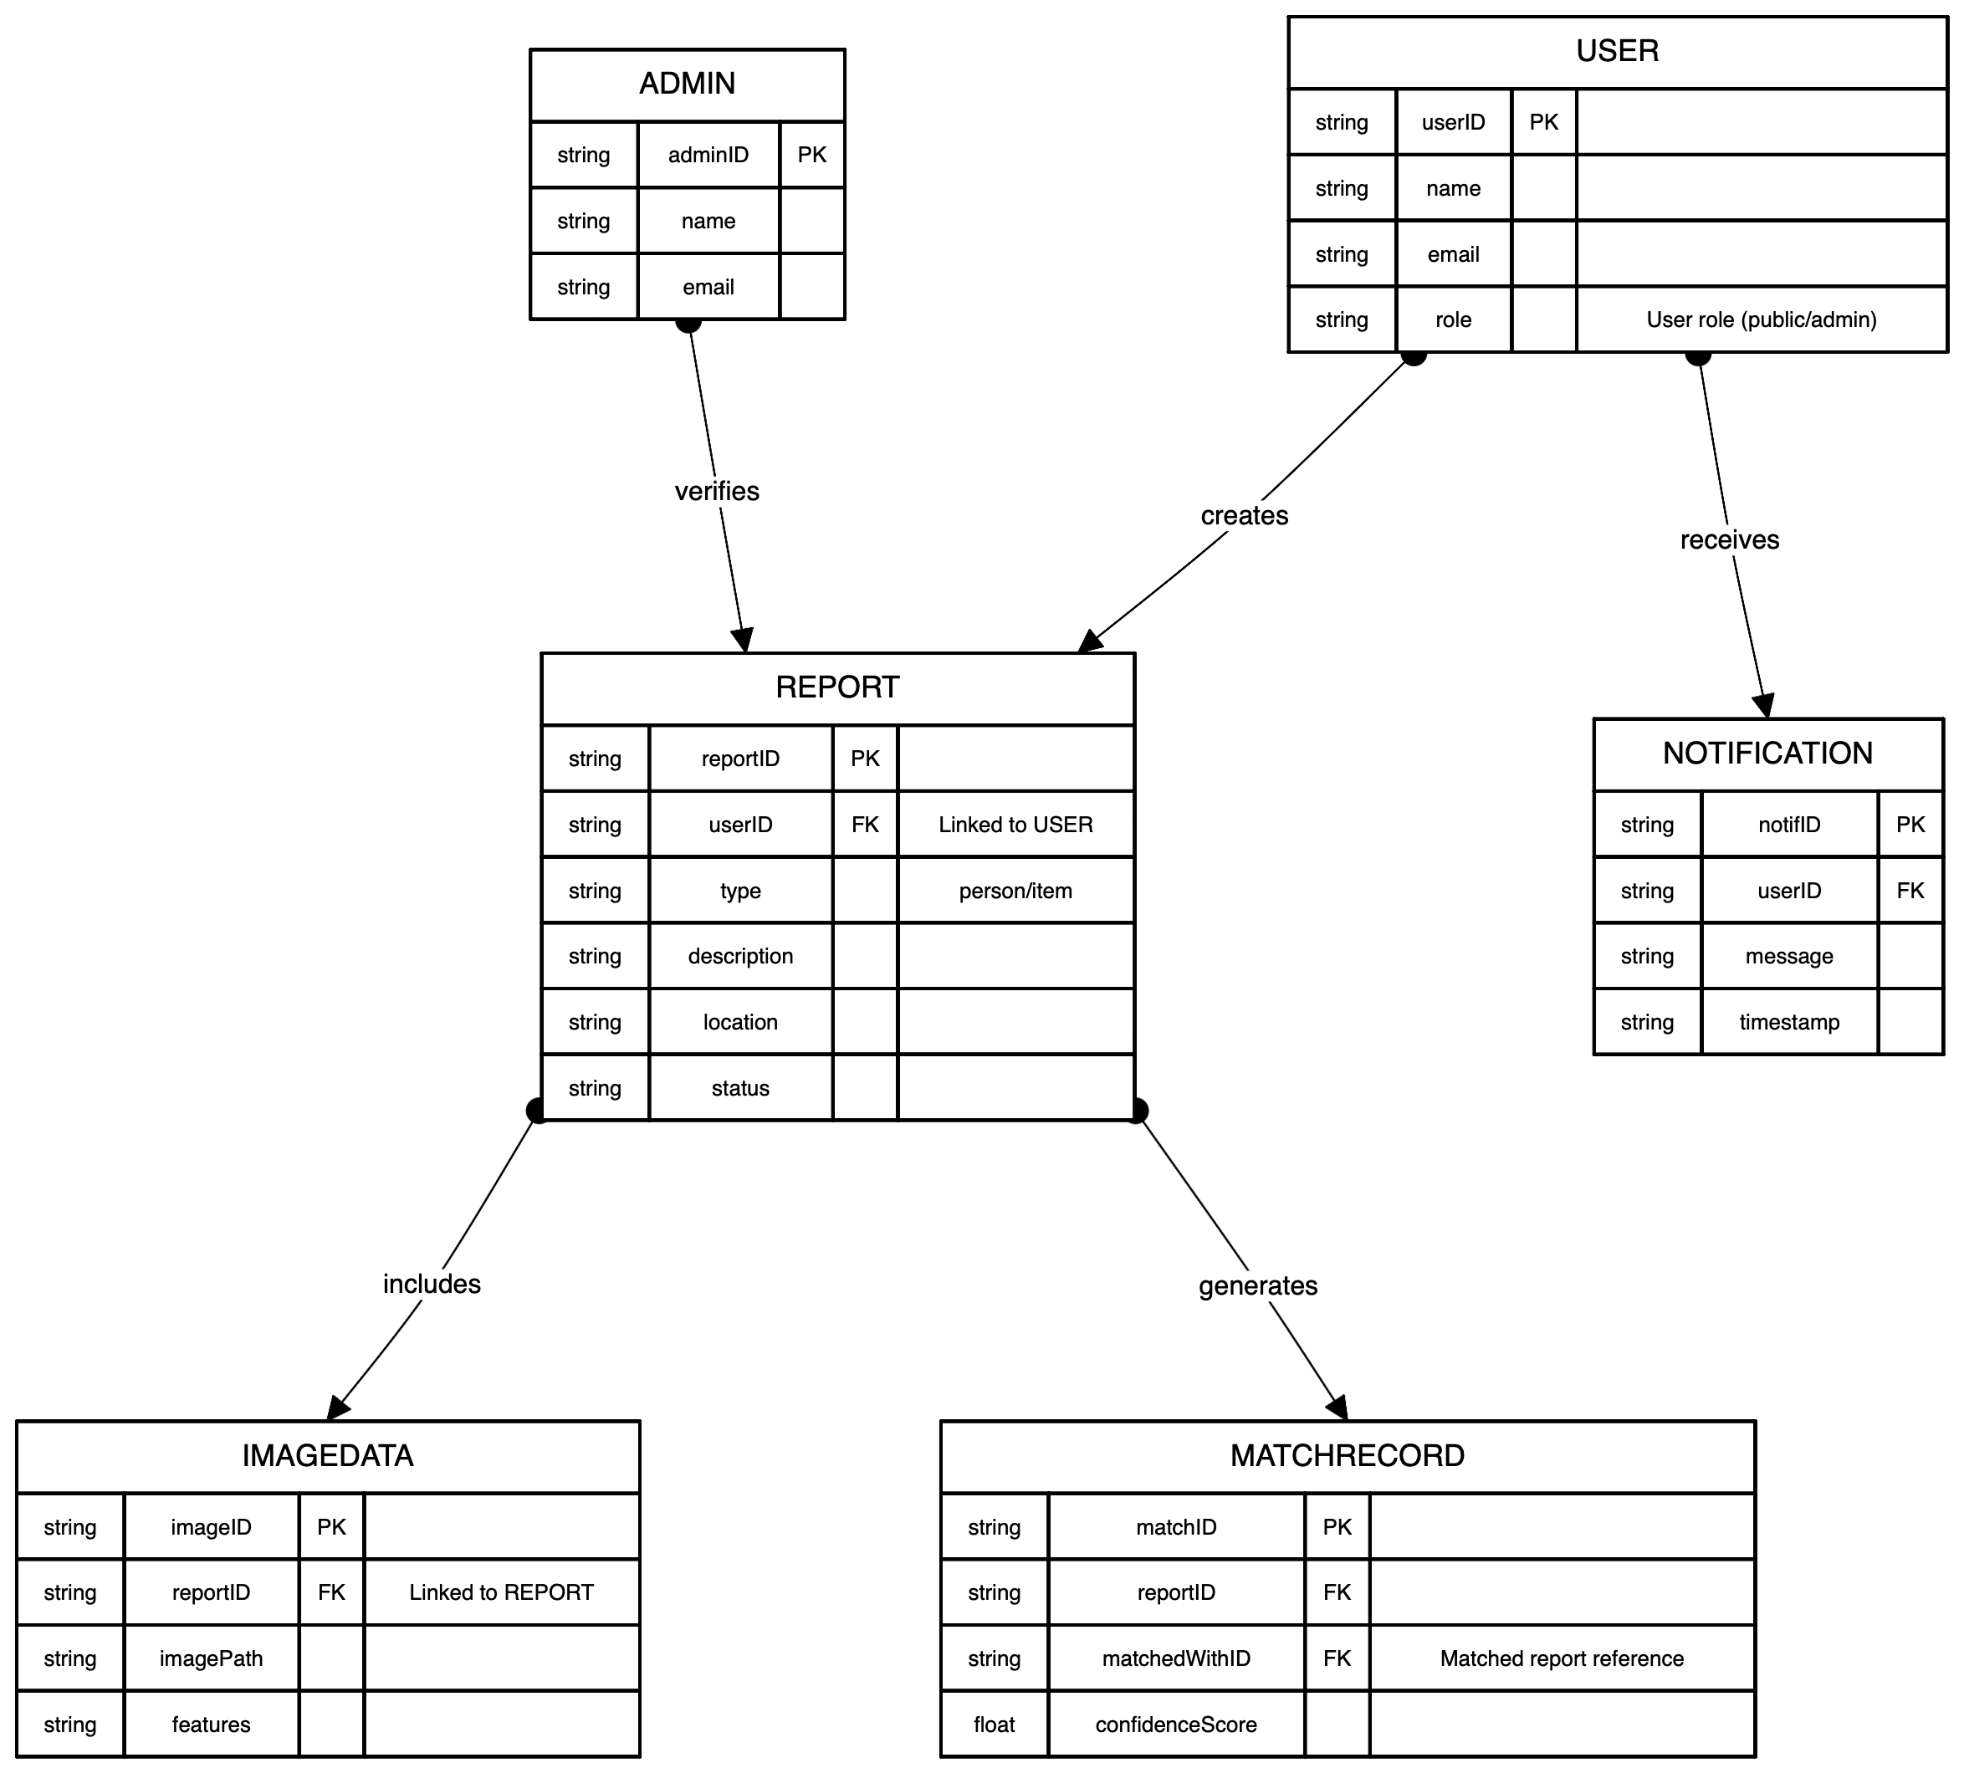
4. Data Design
4.1 Schema Definition
Complete Database Design.

Slide 14
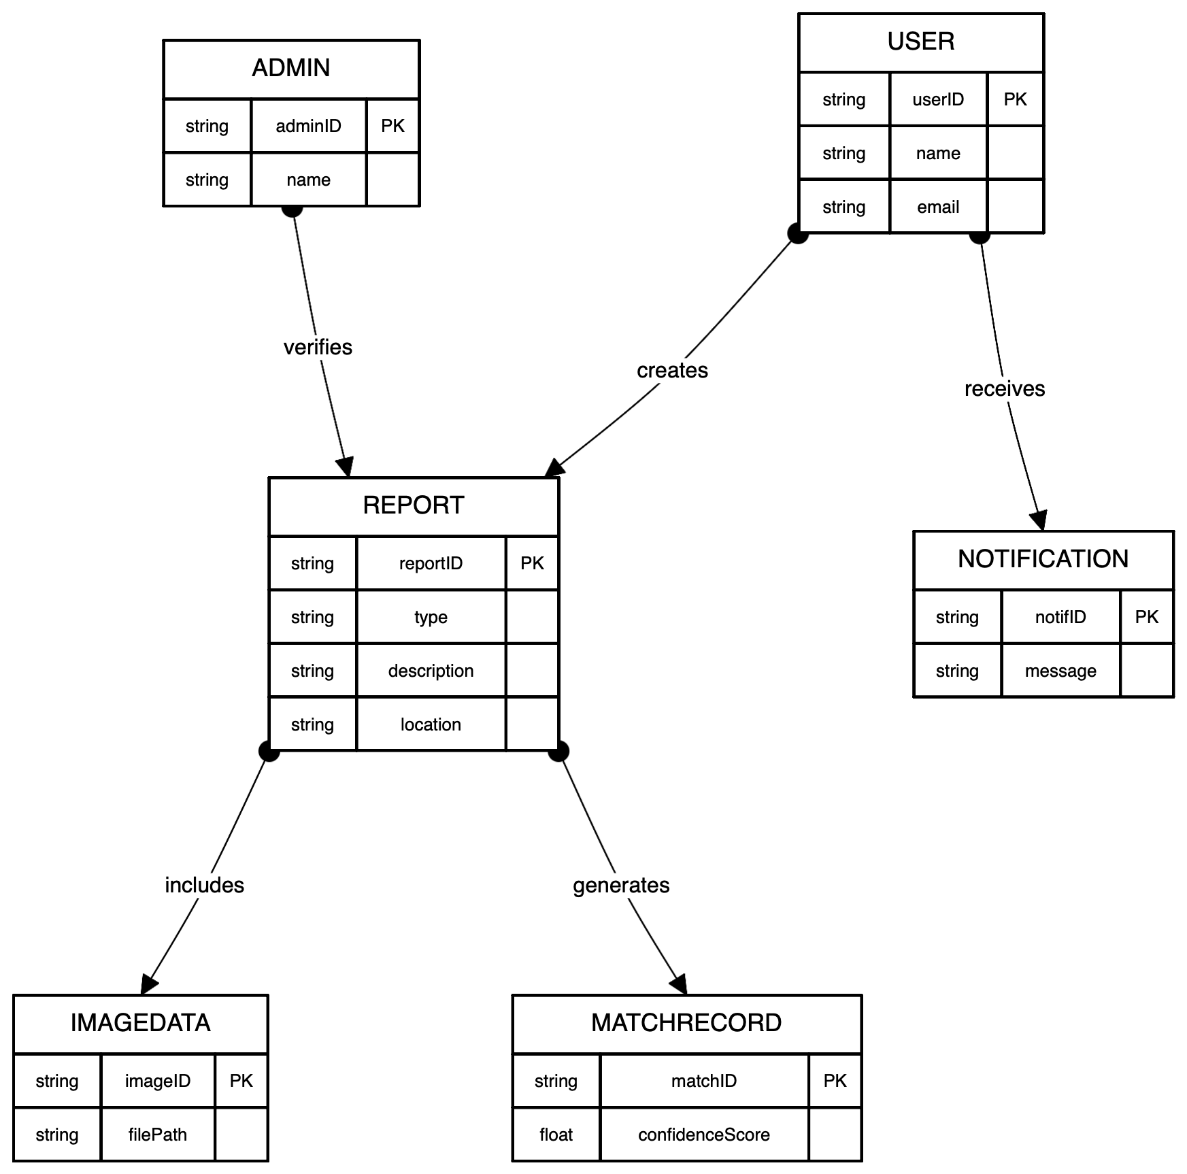
4.2 E-R Diagram
System E-R Diagram

Slide 15
GitHub Link
https://github.com/Atharv9406/Lost-Found-Person

Slide 16
REFERENCES
Write the references used in the study(in given format only).

Slide 17
Thank You
Queries ?

