Slide 1

School of Computer Science Engineering (SCOPE) B. Tech – Computer Science and Engineering (Data Science)
Web Programming BCSE203E
G1 - (L31+L32+L55+L56)
Digital Assignment 1
Submitted to: Dr. R. Sendhil (Scope)
Date: 13/02/2025

Slide 2
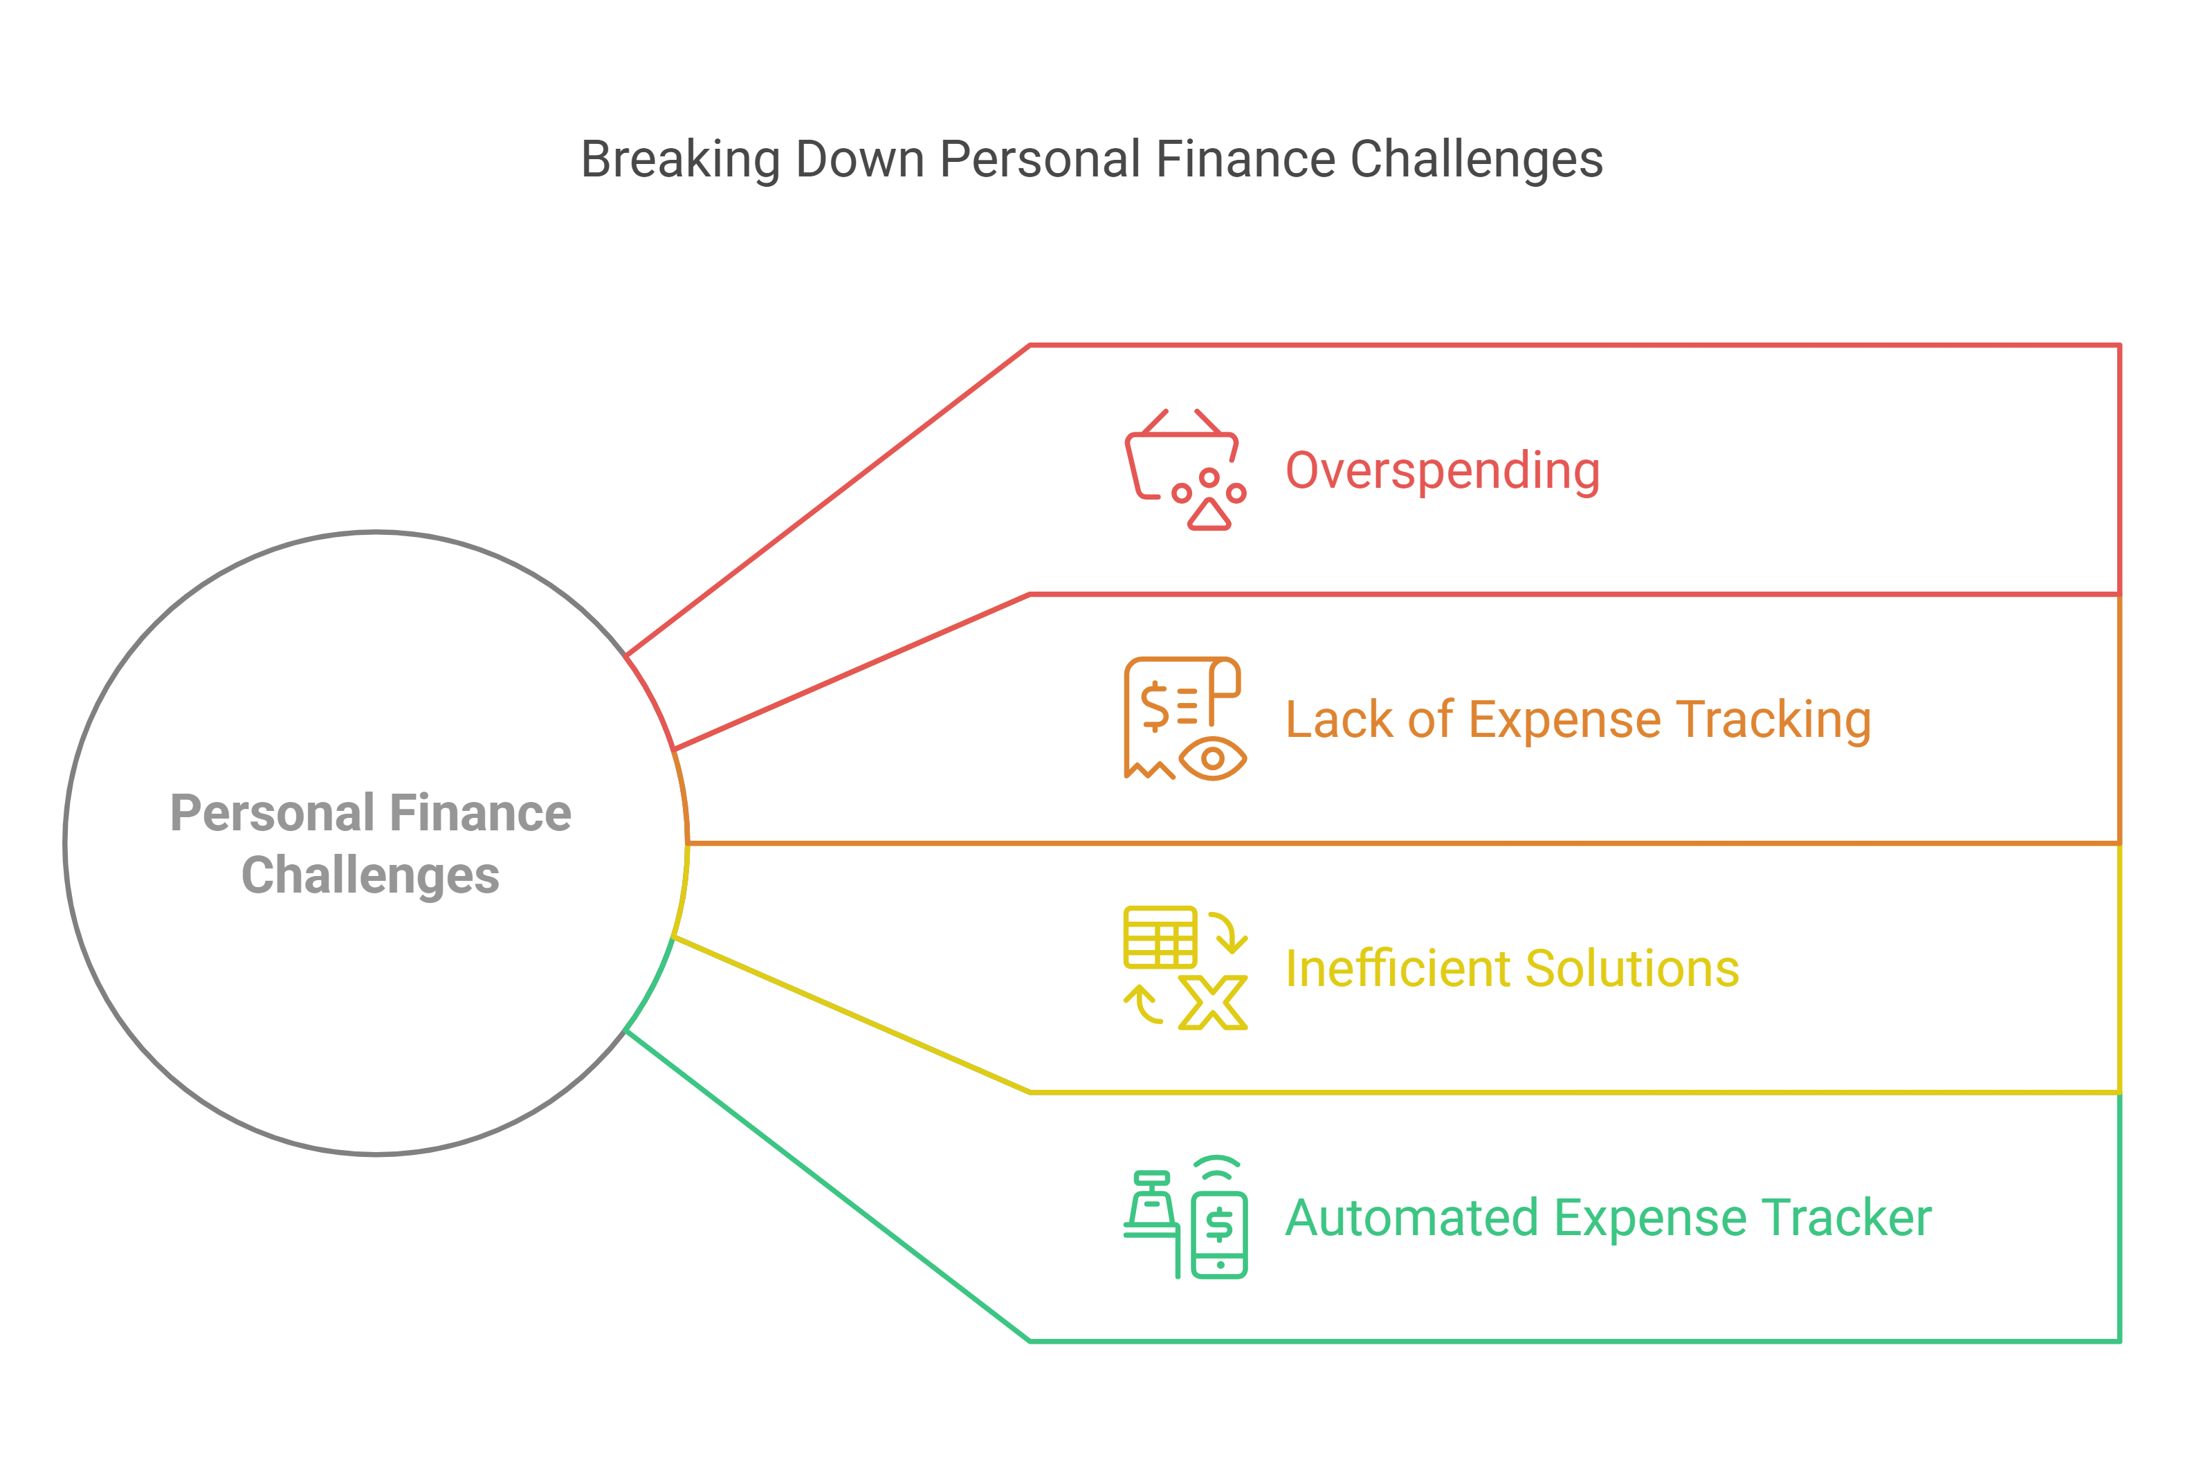
Team Members :
“Expense Tracker” –
A Smart Web Financial Management System
Atharv (23BDS1173)
Subal (23BRS1393)

Slide 3
Abstract
Effective financial management is essential for individuals to achieve stability and financial independence. However, many people struggle to keep track of their daily expenses, leading to overspending and poor savings.
The Expense Tracker is a web-based application designed to help users record, categorize, and analyze their expenses efficiently. This project integrates modern web technologies to provide an intuitive and automated solution for managing personal finances.
By enabling real-time tracking, visual analytics, and budget alerts, the Expense Tracker empowers users to develop responsible spending habits and make informed financial decisions.

Slide 4
Introduction
In today’s fast-paced world, financial awareness and budgeting are crucial for maintaining financial security.
Despite the availability of various financial management tools, 67% of individuals still struggle with managing their expenses efficiently (National Financial Education Council, 2023).
Many rely on manual tracking methods, which are time-consuming and prone to errors.
The Expense Tracker aims to solve this problem by providing an interactive platform that simplifies financial monitoring.
It enables users to input expenses, categorize them, and receive insights into their spending patterns. With automation, real-time updates, and visual representations of financial data, this project bridges the gap between financial planning and user convenience.

Slide 5
Problem Statement
Managing personal finances effectively remains a challenge for many individuals due to unorganized expense tracking and poor budgeting habits. According to a 2023 survey by the National Financial Education Council, 67% of people struggle with overspending, while 45% admit they do not track their daily expenses.
Many existing solutions, such as spreadsheets and manual record-keeping, are inefficient and time-consuming.
To address these issues, automated, and visually appealing Expense Tracker is needed.
This web-based tool will enable users to record, categorize, and analyze their expenses effortlessly, offering features like real-time updates, budget alerts, and financial insights. By implementing such a system, individuals can gain better control over their finances, reduce unnecessary expenses, and work towards long-term financial stability.

Slide 6
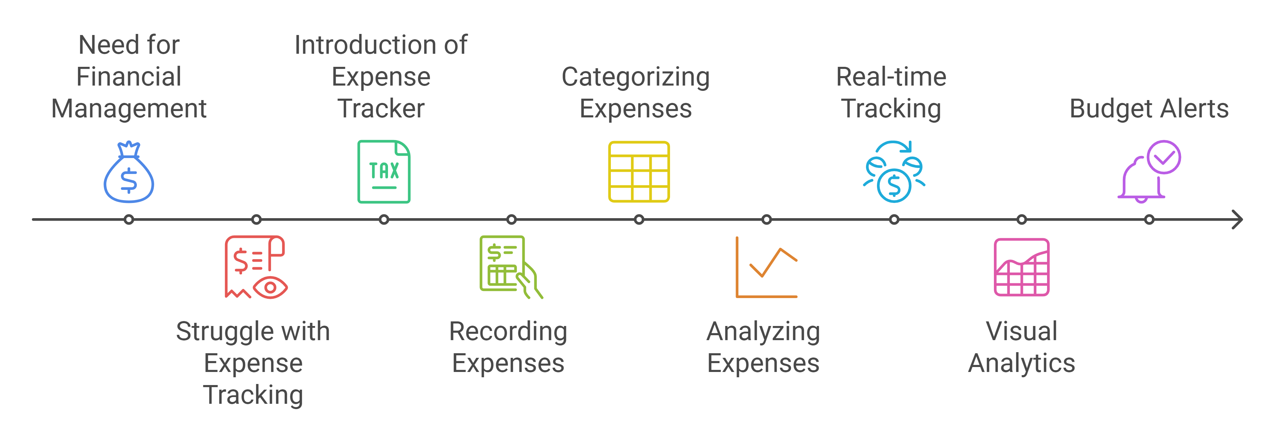
What we are?

Slide 7
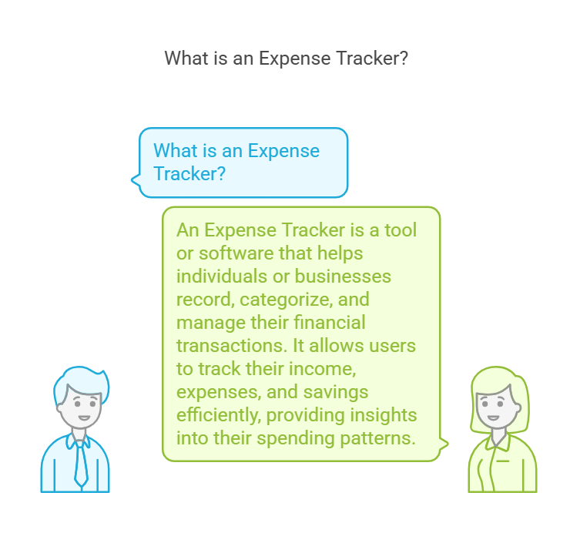
What is an Expense Tracker? An Expense Tracker is a tool or software that helps individuals or businesses record, categorize, and manage their financial transactions. It allows users to track their income, expenses, and savings efficiently, providing insights into their spending patterns.

Slide 8
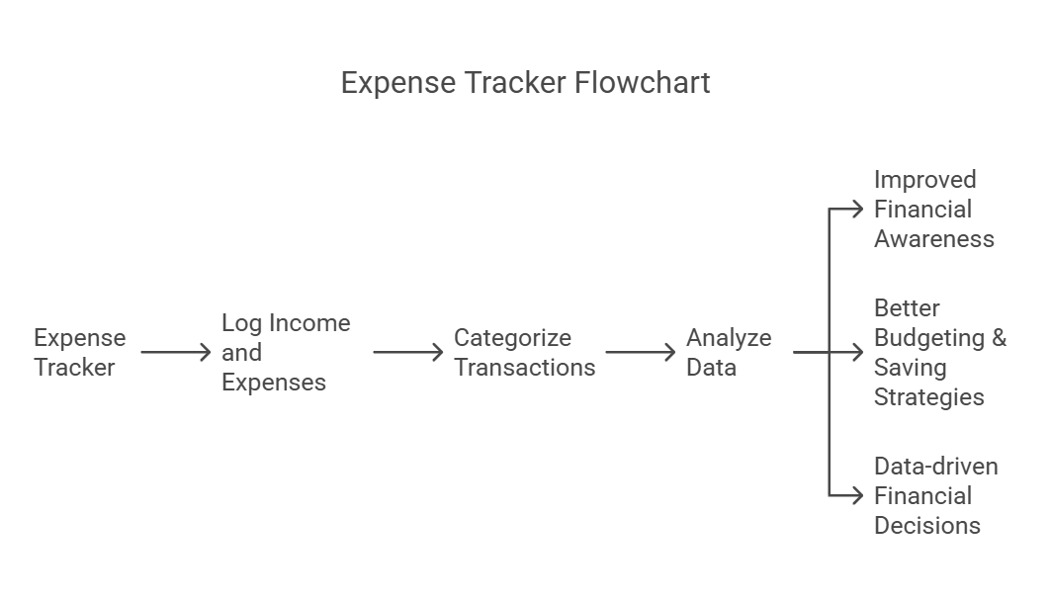

Slide 9
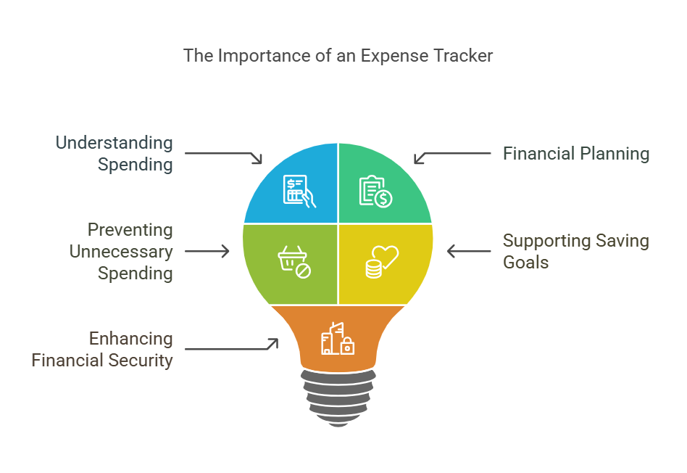
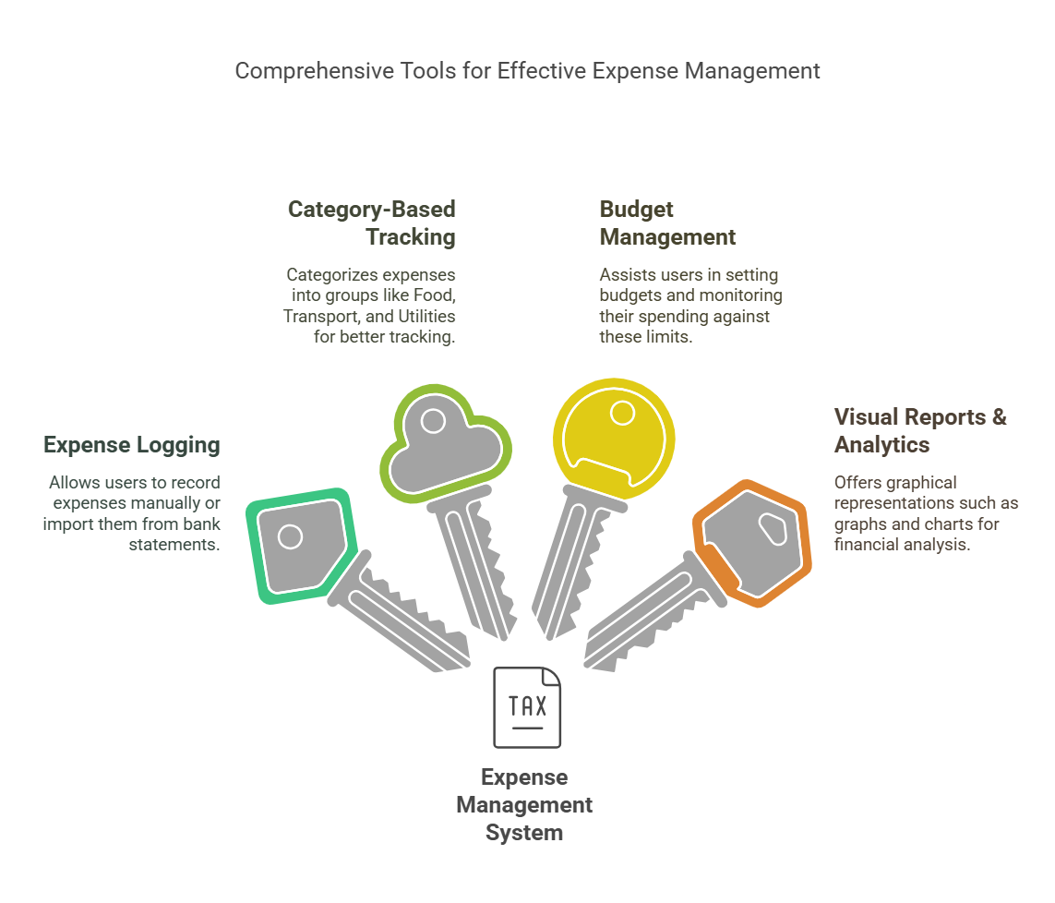
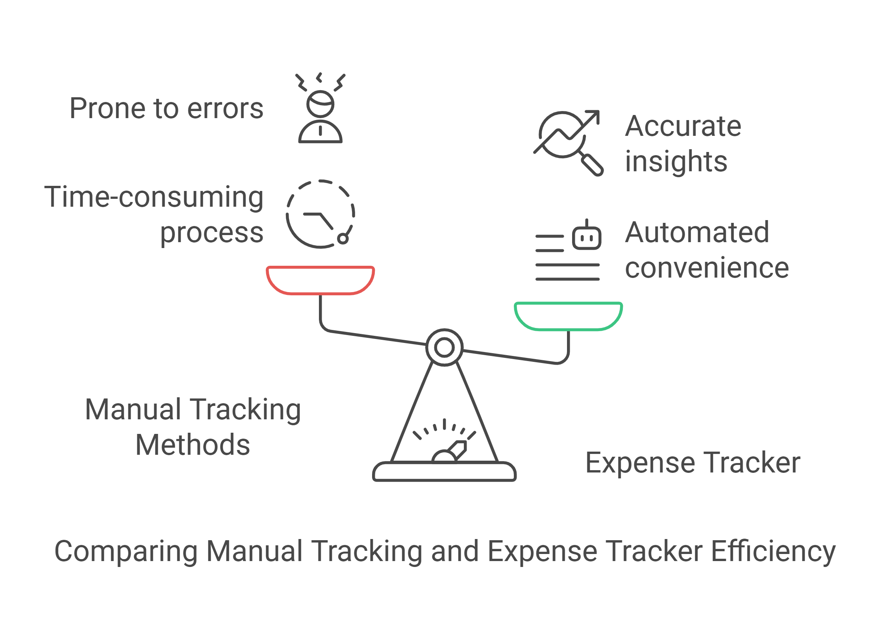

Slide 10
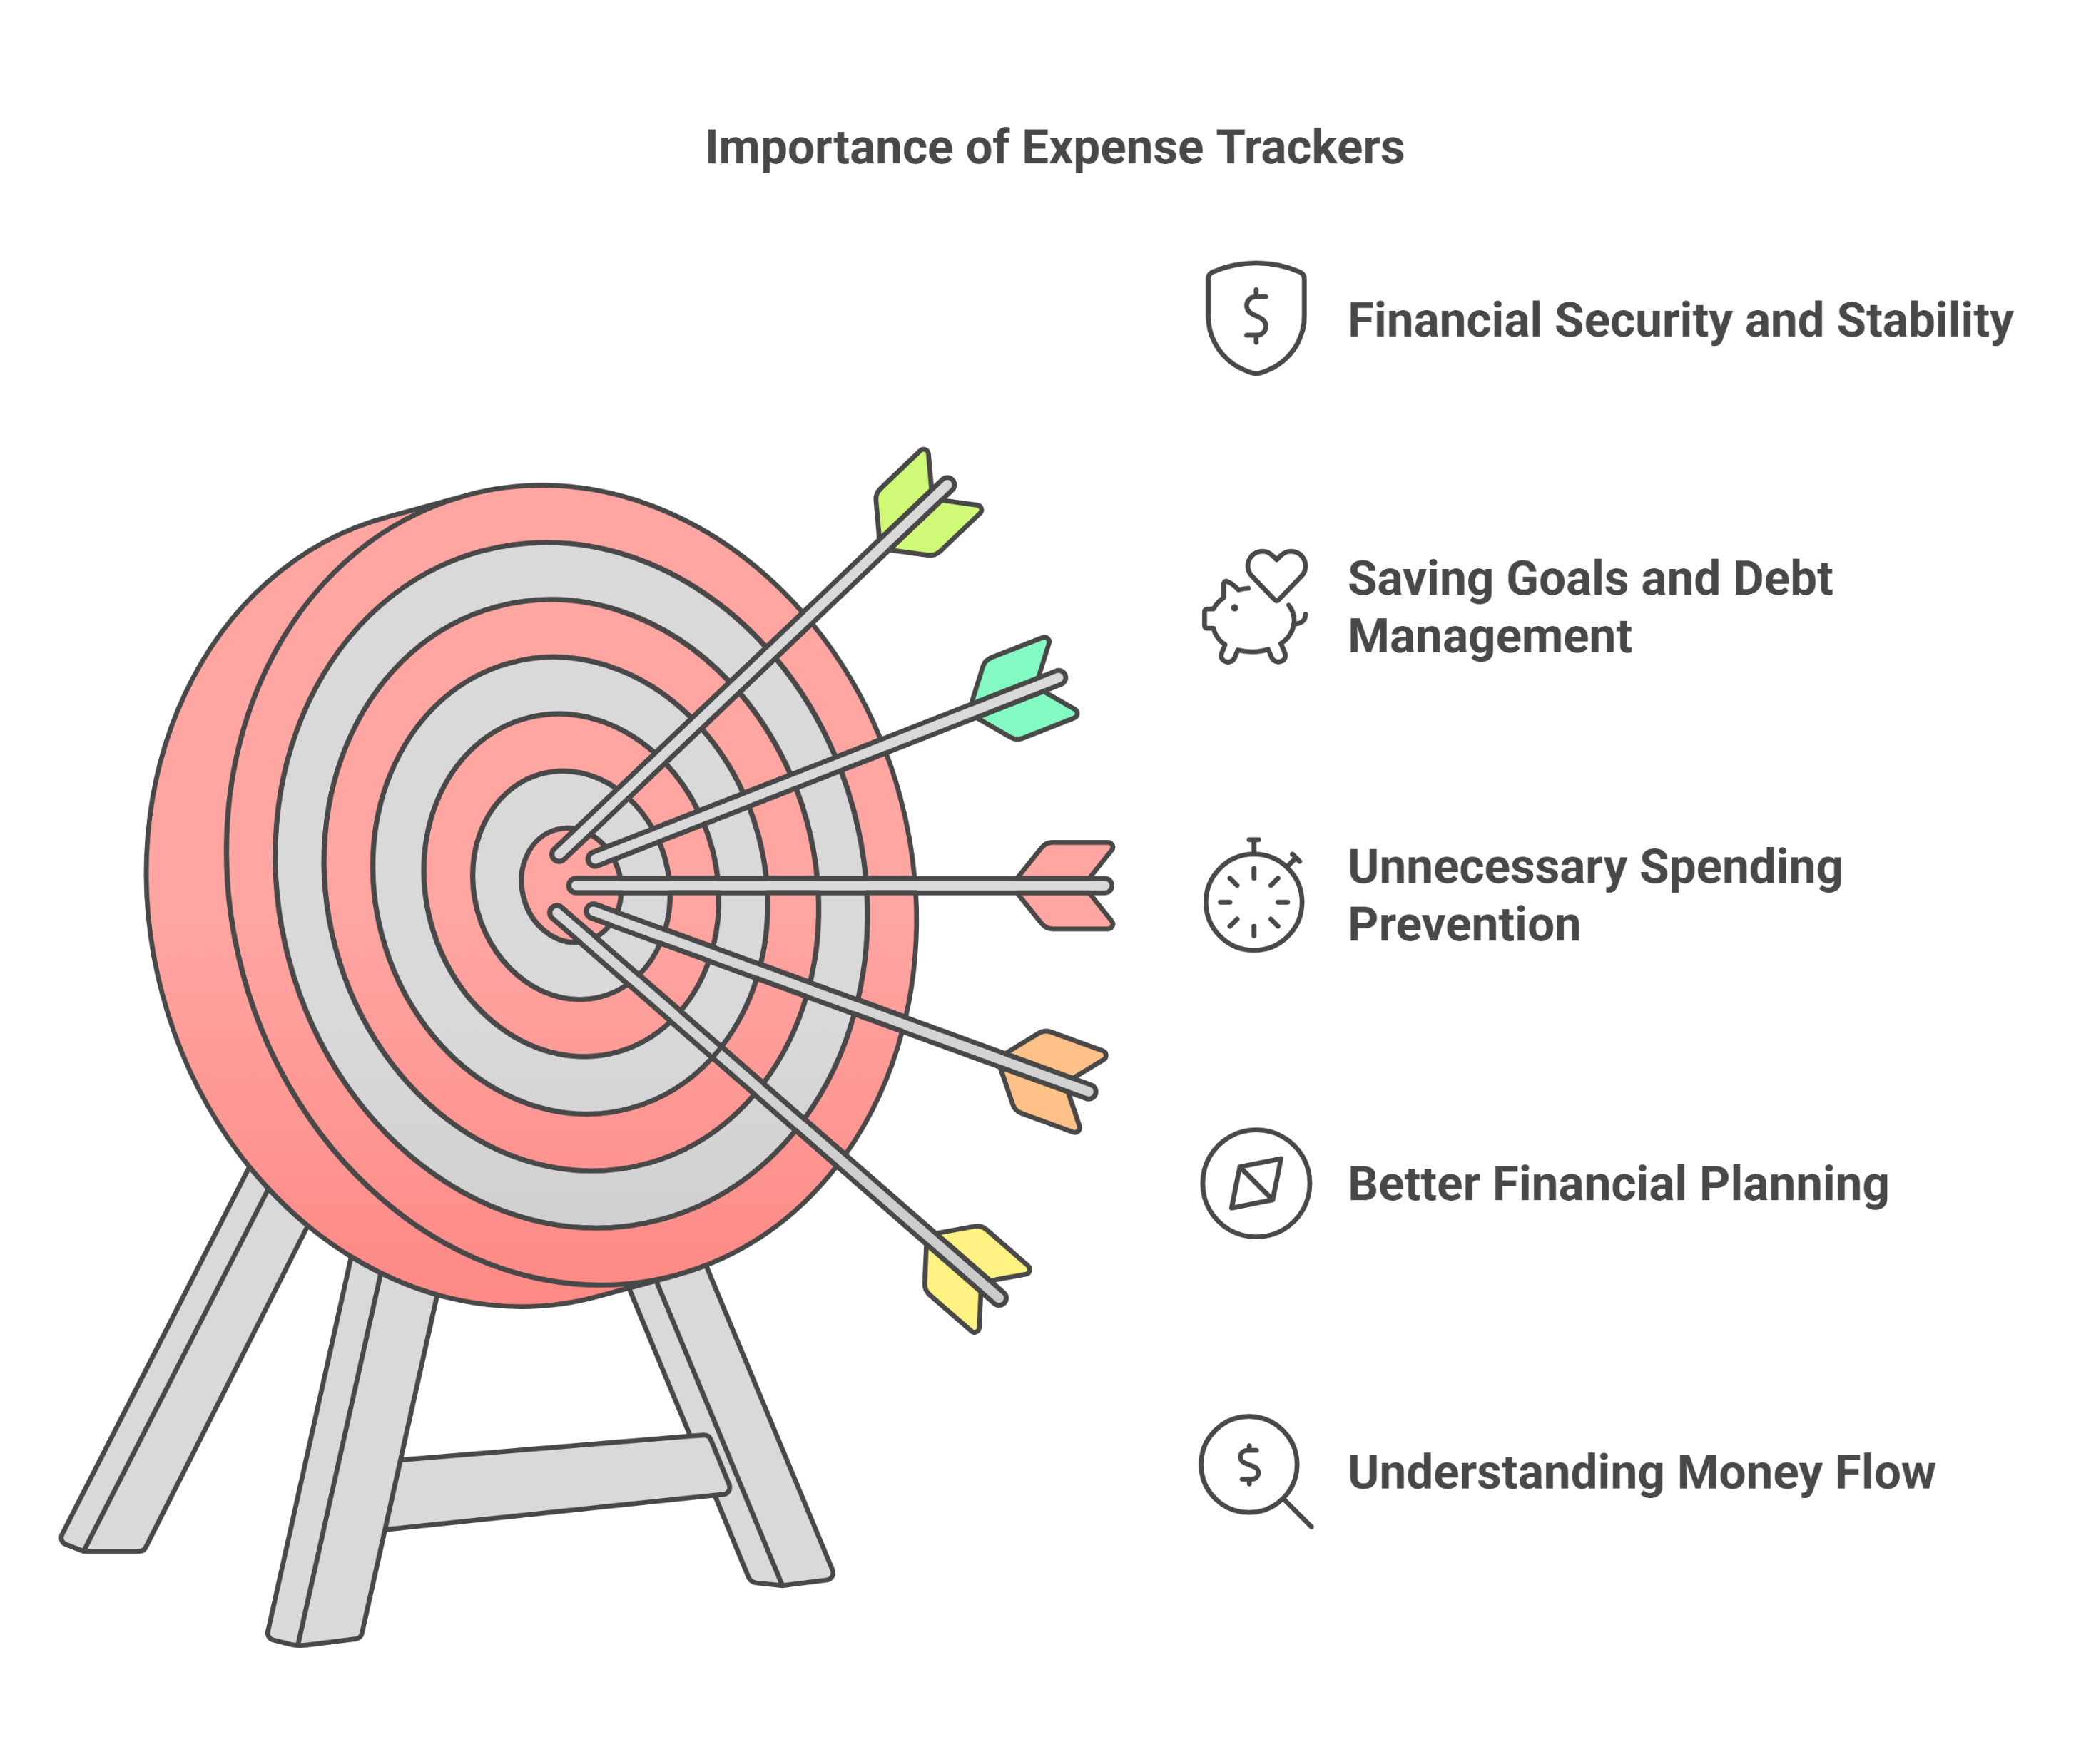
Motivation
The motivation behind this project stems from the growing financial stress faced by individuals due to uncontrolled spending and lack of expense tracking.
Studies show that 70% of financial problems arise due to poor money management habits (Financial Wellness Survey, 2023).
Additionally, the rise of digital payments has made it easier to spend money impulsively without proper tracking.
Our project aims to provide a digital-first, automated, and intuitive solution to help users regulate their finances, monitor their transactions, and visualize their financial health.
By integrating real-time tracking, category-based insights, and a user-friendly interface, we seek to encourage financial discipline and empower users to take control of their expenses.

Slide 11
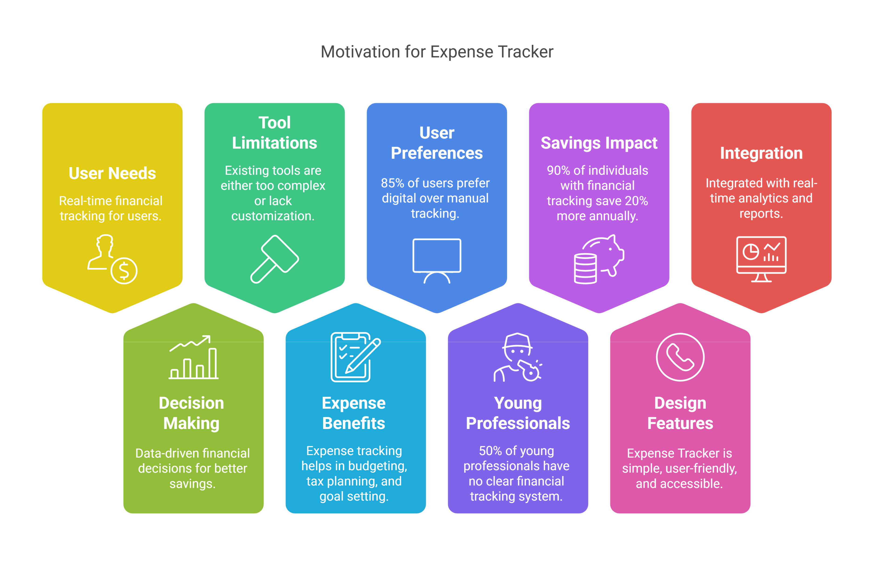

Slide 12
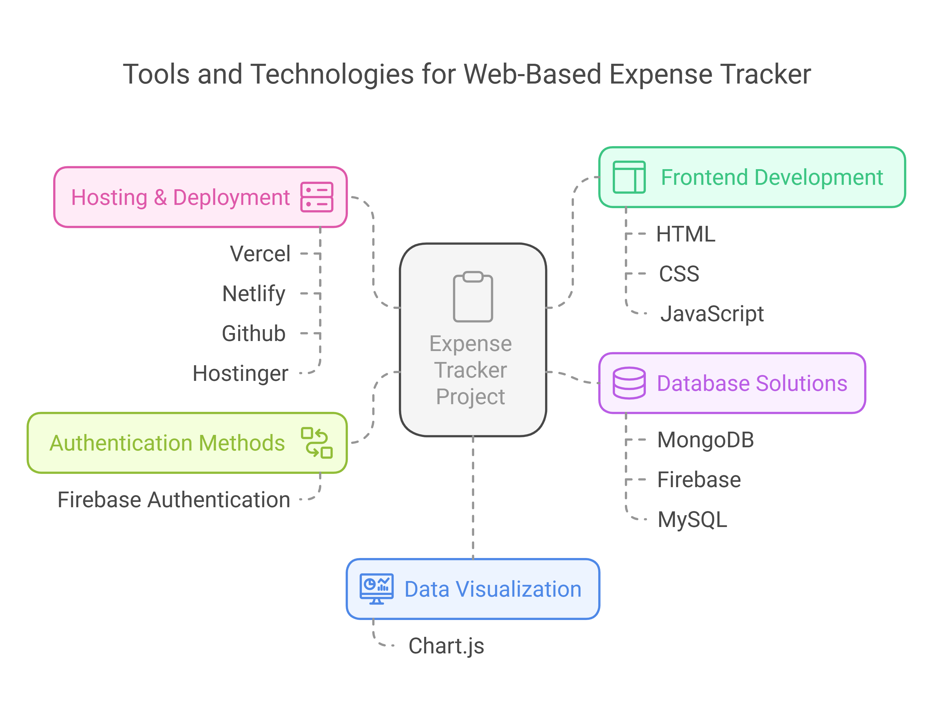
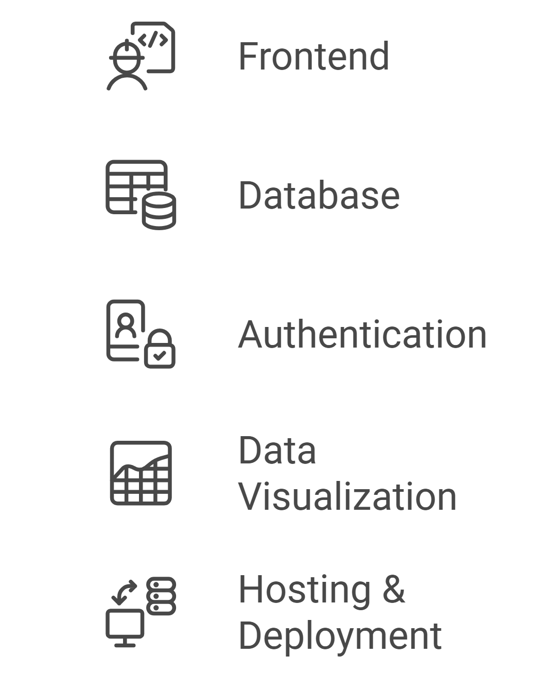
Tools and Technology Used
HTML, CSS, JavaScript, React
MongoDB / Firebase / MySQL (Not used)
Firebase Authentication
Chart.js (Used)
Vercel / Netlify / Github

Slide 13
Screenshots

Slide 14
Sample Codes

Slide 15
Team Members :
Thank you!!
Atharv (23BDS1173)
Subal (23BRS1393)

