Slide 1
BCA · ACADEMIC PROJECT
Machine Learning IV
Complete Assignment Project
Atharv M Bennur
Roll Number 224010
CLASSIFICATION REGRESSION CLUSTERING PREDICTION
ATHARV M BENNUR | 224010 · MACHINE LEARNING IV
01

Slide 2
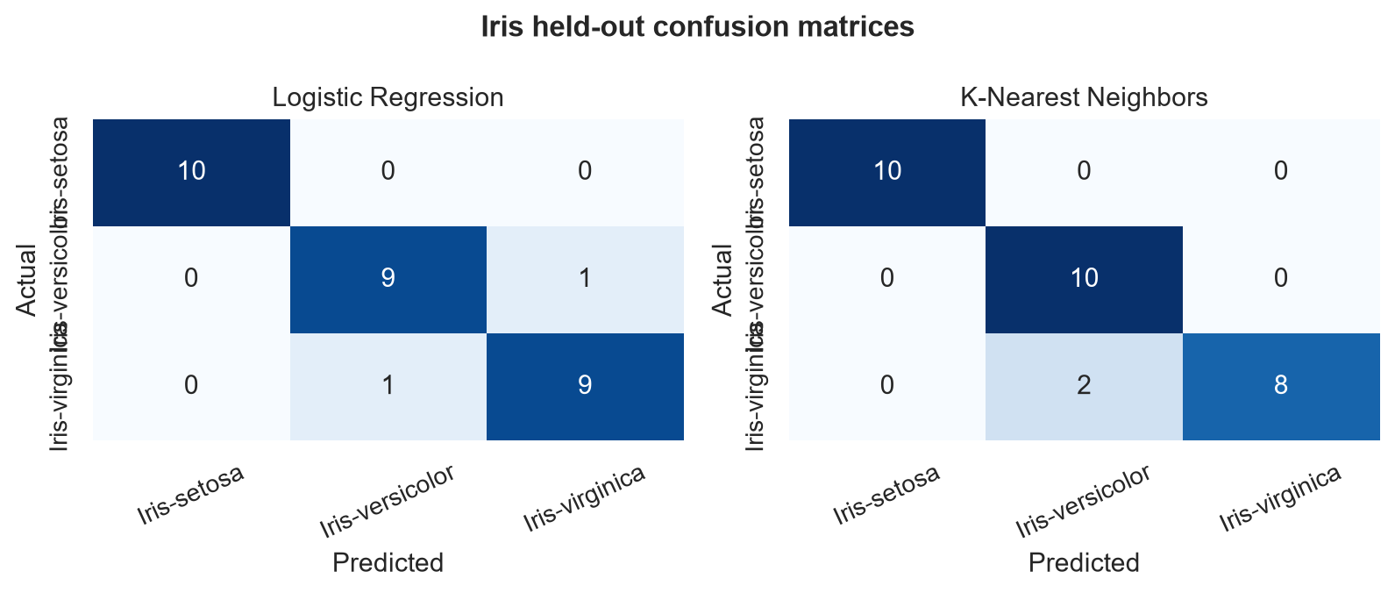
PART 1 · GROUP A · C1
Iris Classification
OBJECTIVE & DATASET
Classify iris species using four flower measurements.
Iris.csv · 150 rows · 4 measurement features · Species target
HELD-OUT TEST RESULTS
Logistic Regression | Accuracy 93.3% · F1 0.933
KNN (k=3) | Accuracy 93.3% · F1 0.933
93% accuracy target: MET
MODEL COMPARISON
1. Logistic Regression training CV accuracy: 95.8%.
2. Tuned KNN training CV accuracy: 96.7%.
3. K-Nearest Neighbors selected using training-only CV; the test set was reserved for final evaluation.
ATHARV M BENNUR | 224010 · MACHINE LEARNING IV
02

Slide 3
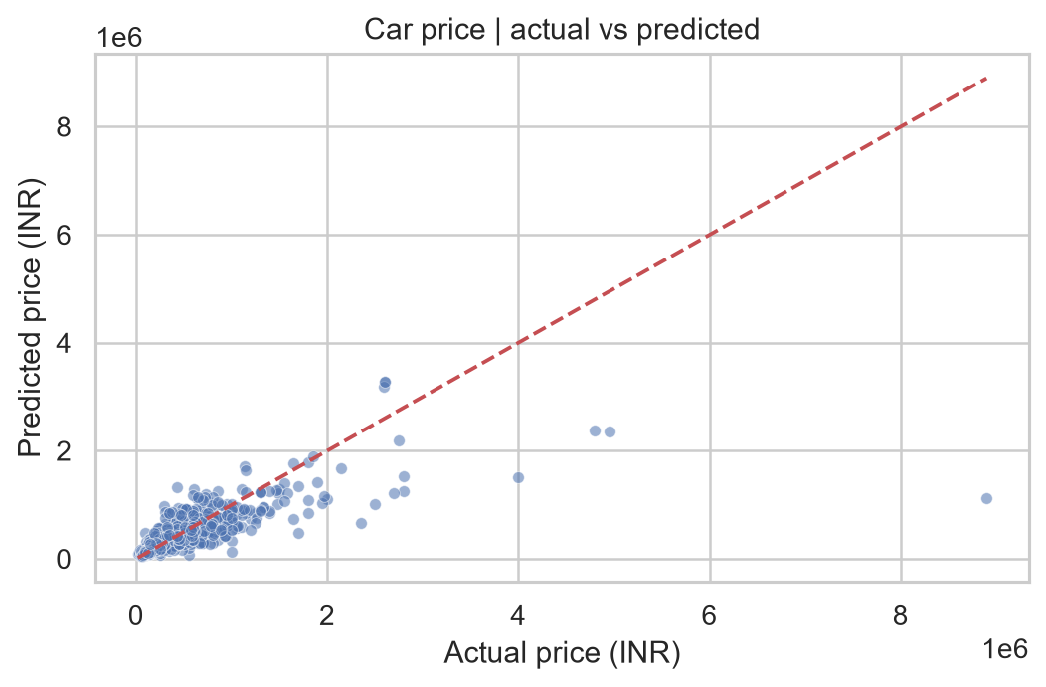
PART 1 · GROUP B · R3
Car Price Regression
OBJECTIVE & METHOD
Predict selling price from vehicle age, kilometres, model identity, and categories.
Car Dekho · 4,340 raw → 3,577 unique rows · Linear, Ridge, Lasso, and Extra Trees
FINAL TEST METRICS
Selected by 5-fold training CV: Lasso Regression (log target; alpha=0.0001)
CV R² 0.782 | Test MAE ₹95,395 | RMSE ₹270,981
Test MSE ₹73,430,608,649 | Test R² 0.772
R² ≥ 0.75 target: MET
LIMITATION
Original notebook baseline: R² ≈ 0.519 (duplicates retained, simpler features); preserved as historical and not directly comparable.
Condition, trim, accident history, and location are missing and can strongly affect price.
ATHARV M BENNUR | 224010 · MACHINE LEARNING IV
03

Slide 4
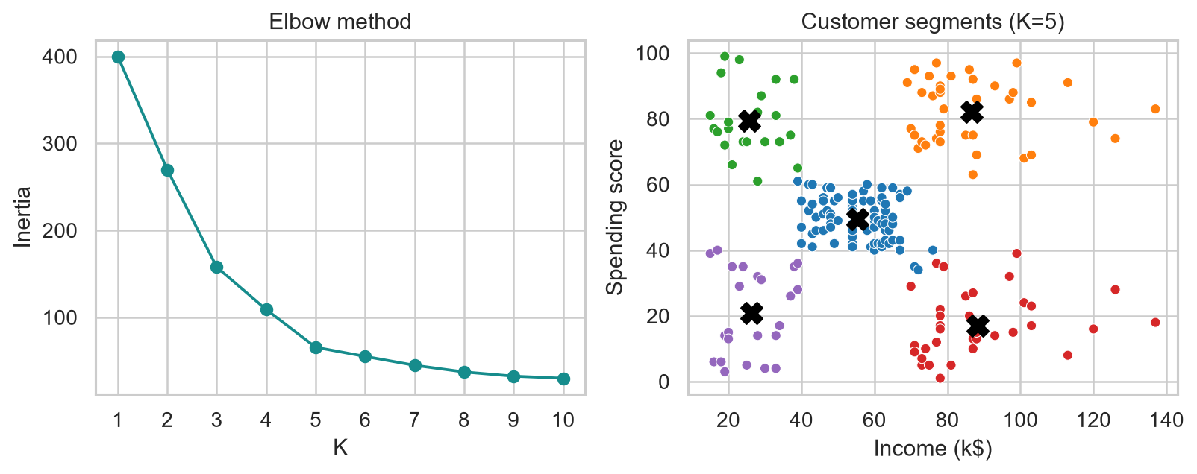
PART 1 · GROUP C · K2
Mall Customer Clustering
OBJECTIVE & METHOD
Segment 200 customers using income and spending score only.
StandardScaler + K-Means (K=5) · Elbow K=5 inertia 65.57
SILHOUETTE & SEGMENT SIZES
K=5 silhouette score: 0.555
• High income, high spending: 39
• High income, low spending: 35
• Low income, high spending: 22
• Low income, low spending: 23
• Medium income, moderate spending: 81
ATHARV M BENNUR | 224010 · MACHINE LEARNING IV
04

Slide 5
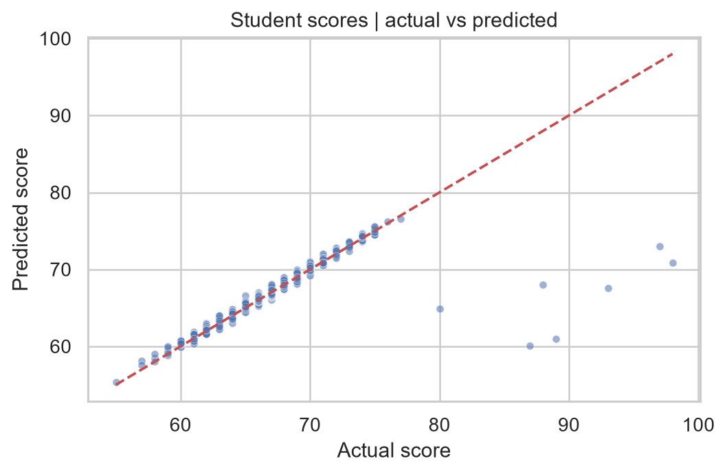
PART 2 · REGRESSION PROJECT
Student Performance Prediction
PROBLEM & DATASET
Estimate Exam_Score from study habits and contextual factors to inform support planning.
StudentPerformanceFactors.csv · 6,607 rows · 19 predictors
HELD-OUT METRICS
Model | MAE | MSE | RMSE | R²
Linear Regression | 0.45 | 3.26 | 1.80 | 0.770
Random Forest | 1.06 | 4.49 | 2.12 | 0.682
SELECTION & NEW-EXAMPLE ESTIMATES
Selected by training-only CV: Linear Regression
Three predicted scores: 78.7 · 60.4 · 70.1
Improvement: collect representative student/classroom context. Predictions are estimates, not guaranteed results.
ATHARV M BENNUR | 224010 · MACHINE LEARNING IV
05

