Slide 1
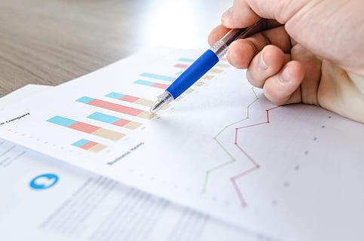

Report
for
OPEN SOURCE DATA VISUALIZATION
Leap Academy
Presented by Tribe-H Directed by Dinesh Behra

Slide 2
Tribe-H Member Name
Leap Academy
Akashata Pujari
Atharv Joshi
Bhagyalaxmi Malipatil
Bhanudas Kajale
Chintamani Shidli
Krishna Koustub bs
Mallamma
Nagraj Yache
Pooja
Poornima M
Praveen Kumar
Sagar Bomble
Salinee Nayak
Sarika Swami
Shilpa Arvind
Shivani singade
Aks6
2

Slide 3
Abstract
Leap Academy
Data visualization is the graphical representation of information and data. By using visual elements like charts, graphs and maps. Data visualization tools provide an accessible way to see and understand trends, outliers and patterns in data.
In the world of Big Data, data visualization tools and technologies are essential to analyze massive amounts of information and make data-driven decisions.
It can be used by teachers to display student test results, by computer scientists exploring advancements in artificial intelligence(AI) or by executives looking to share information with stakeholders.

Slide 4
Problem Statement
Leap Academy
Create a Data visualization system using open source services and methods, where users can upload an file and expects different charts or graphs based on the data.
Misleading Color Contrast:In data visualization, high degrees of color contrast may cause viewers to believe that value disparities are greater than they really are.
When data visualizations include too much data, information overwhelms, and data melts into a graphic soup that most viewers can’t stomach.
Omitting Baseline and Truncating Scale.

Slide 5
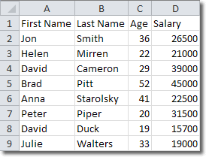
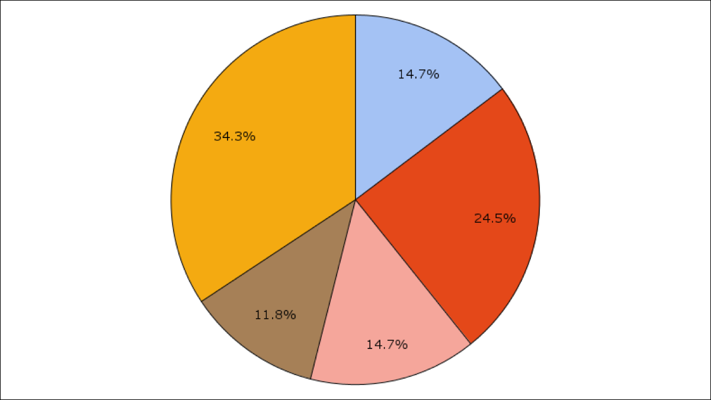
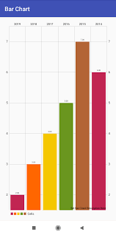
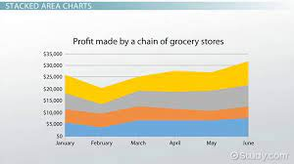
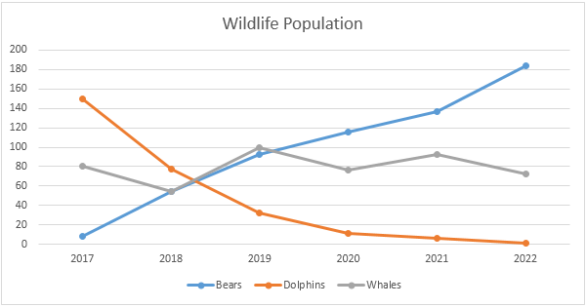
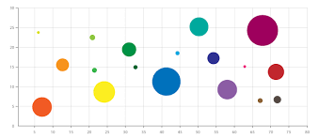
What is Data Visualization ?
Leap Academy
Data visualization is the practice of translating information into a visual context, such as a map or graph, to make data easier for the human brain to understand and pull insights from. It is important for almost every career. Below are the few examples
Data
Pie chart
Bar graph
Line chart
Bubble chart
Area chart

Slide 6
Examples of Data visualization
Leap Academy
In the early days of visualization, the most common visualization technique was using a Microsoft Excel spreadsheet to transform the information into a table, bar graph or pie chart. While these visualization methods are still commonly used, more are still commonly used, more intricate technique are now available, including the following:
Area Charts
Bubble Chart
Line Chart
Population Pyramid
Data visualization
Treemap Chart
Bar Graph
Column Chart
Stock Chart

Slide 7


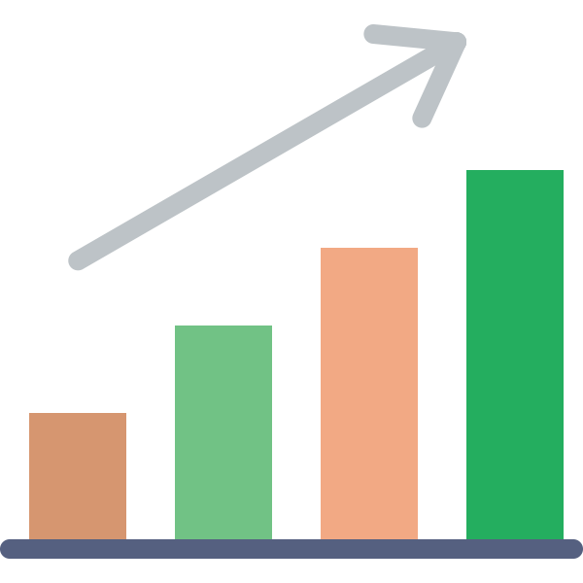
Internal Workflow
Leap Academy
1
excel file
Upload
file
Controller
.csv file
Validator
.csv file
File reader
2
3
4
Dashboard
Csv data
5
Graphs & Charts
Charts
Graph generator
6
Dashboard

Slide 8
Flow:
The user will provide a file in the dashboard,
Triggers the controller.
Controller will send the file to the validator.
Validator checks the file and sends the request to the file reader.
FileReader reads the data from the excel file and sends the data to the graph generator for generating the graph.
By using the data, the Graph generator creates Charts, the Chart will shown in the dashboard.

Slide 9
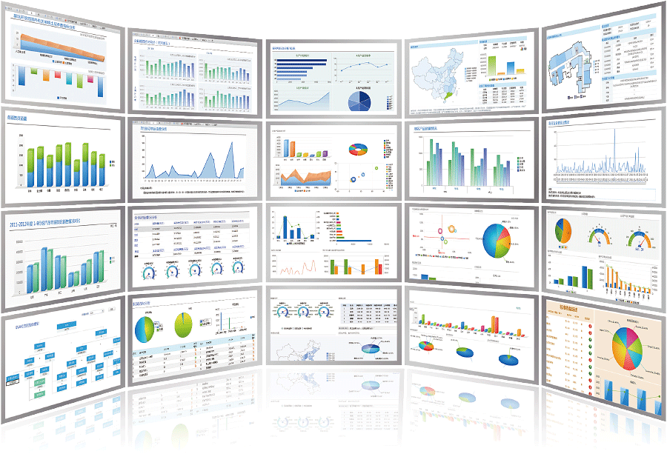
Why is Data Visualization Important?
Leap Academy
Simple and fast way to transmit and interpret information
Process optimization and decision-making based on facts
Better understanding of operational performance and business activities
Analysis of patterns and understanding the impact of strategies implemented
Significant interpretation
Of a large volume of data
Rapid identification of trends and areas that need attention.

Slide 10
Technical Specification
OS | Windows, Linux, MacOs
Server | Apache Tomcat
Client | Google chrome, Firefox
Language | Python
Libraries | Pandas , dash , plotly
IDE | Pycharm Community 3.10.5
Documentation Tools | Google sheet, Google doc, Google slides, Powerpoint
Version Control | Github
Leap Academy

Slide 11
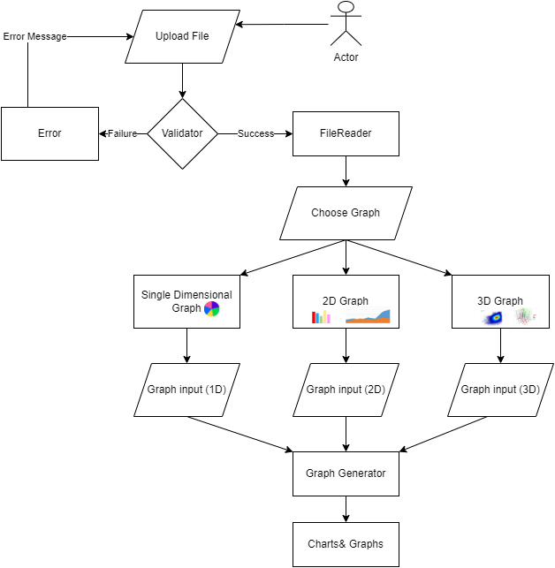

Slide 12
Live Demo

Slide 13
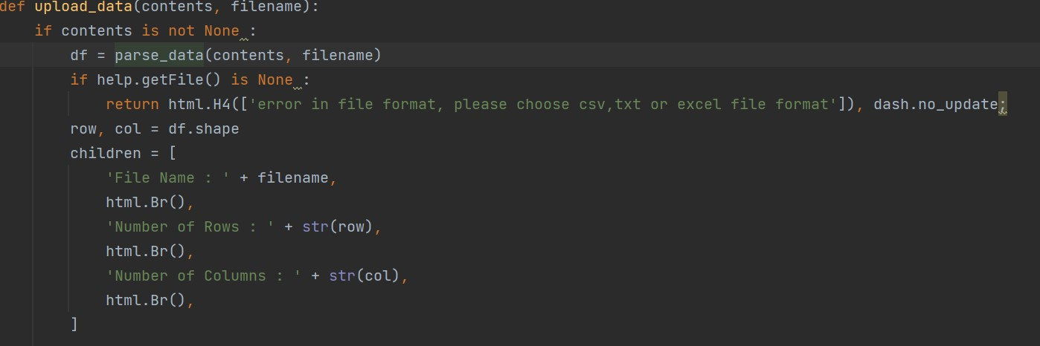
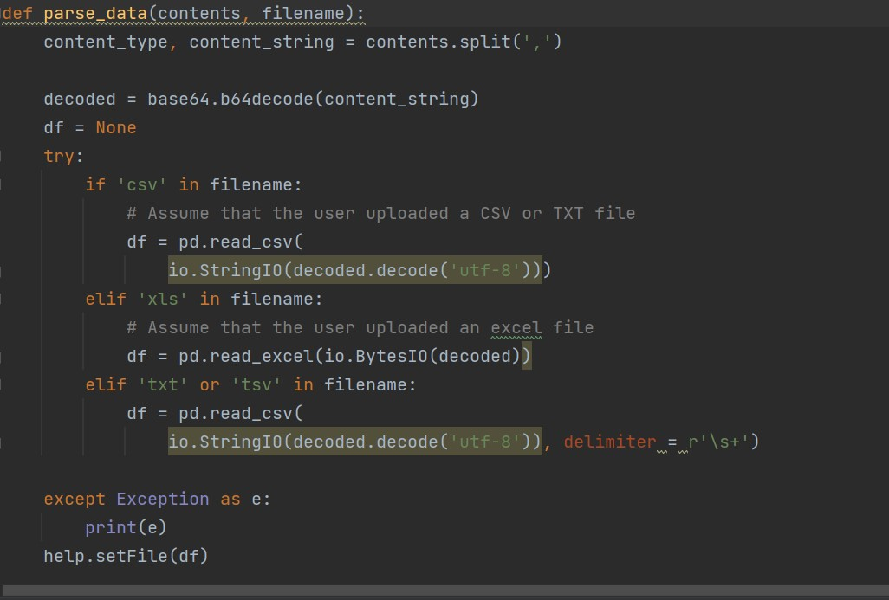
Snap of project code
Upload file and check

Slide 14
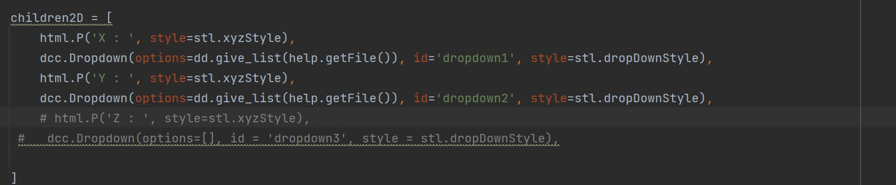

Slide 15
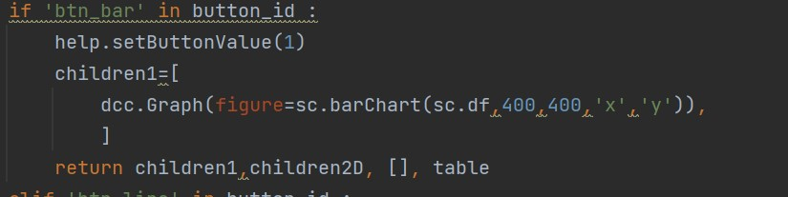
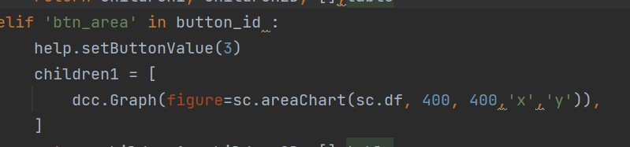
Code for bar_chart and Line_chart

Slide 16
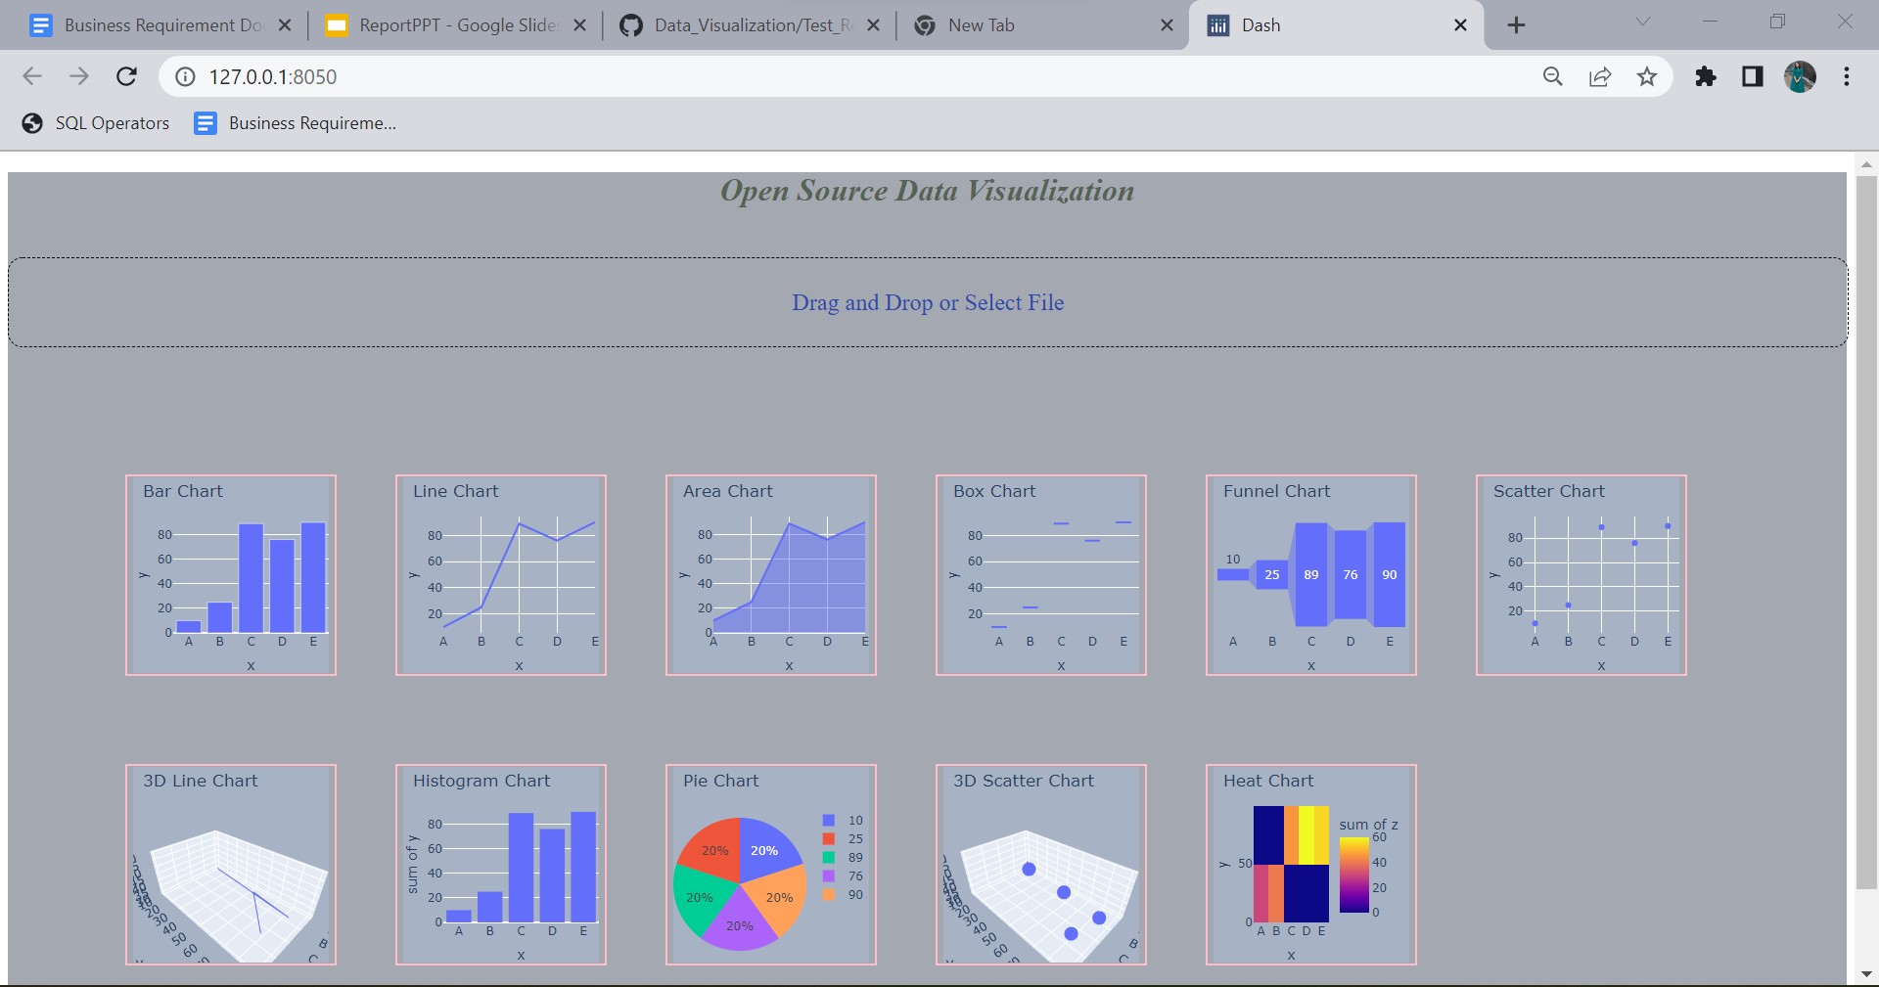


Slide 17
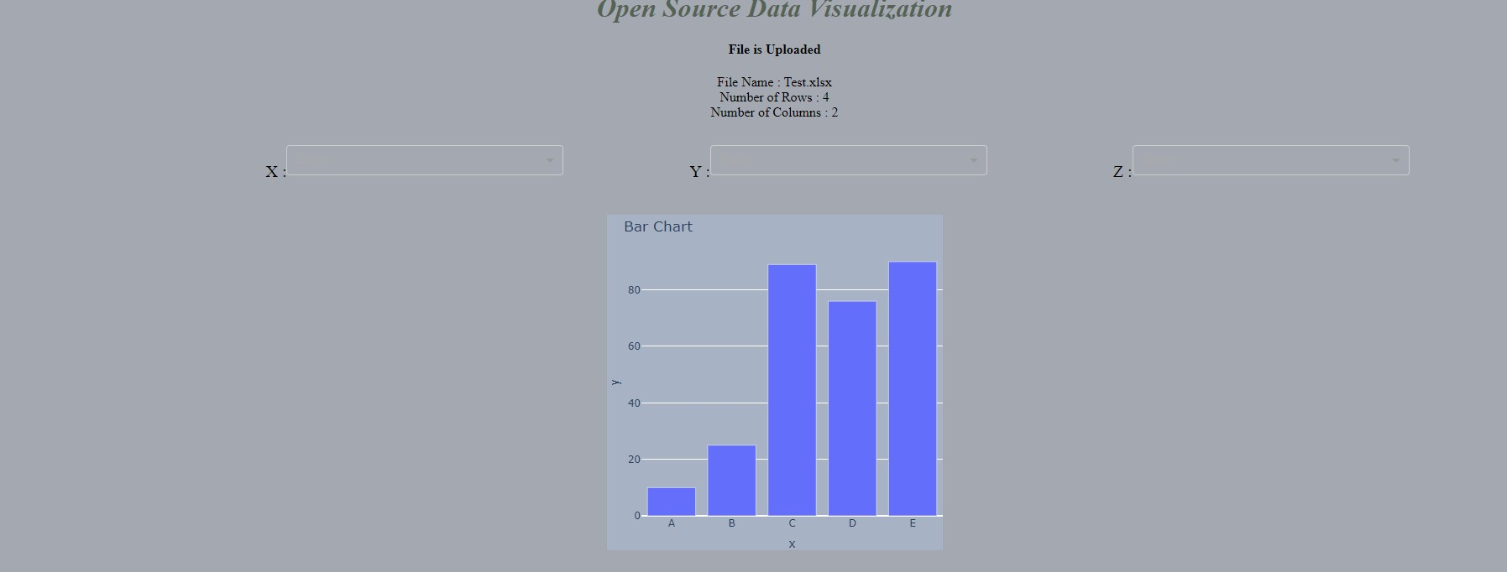
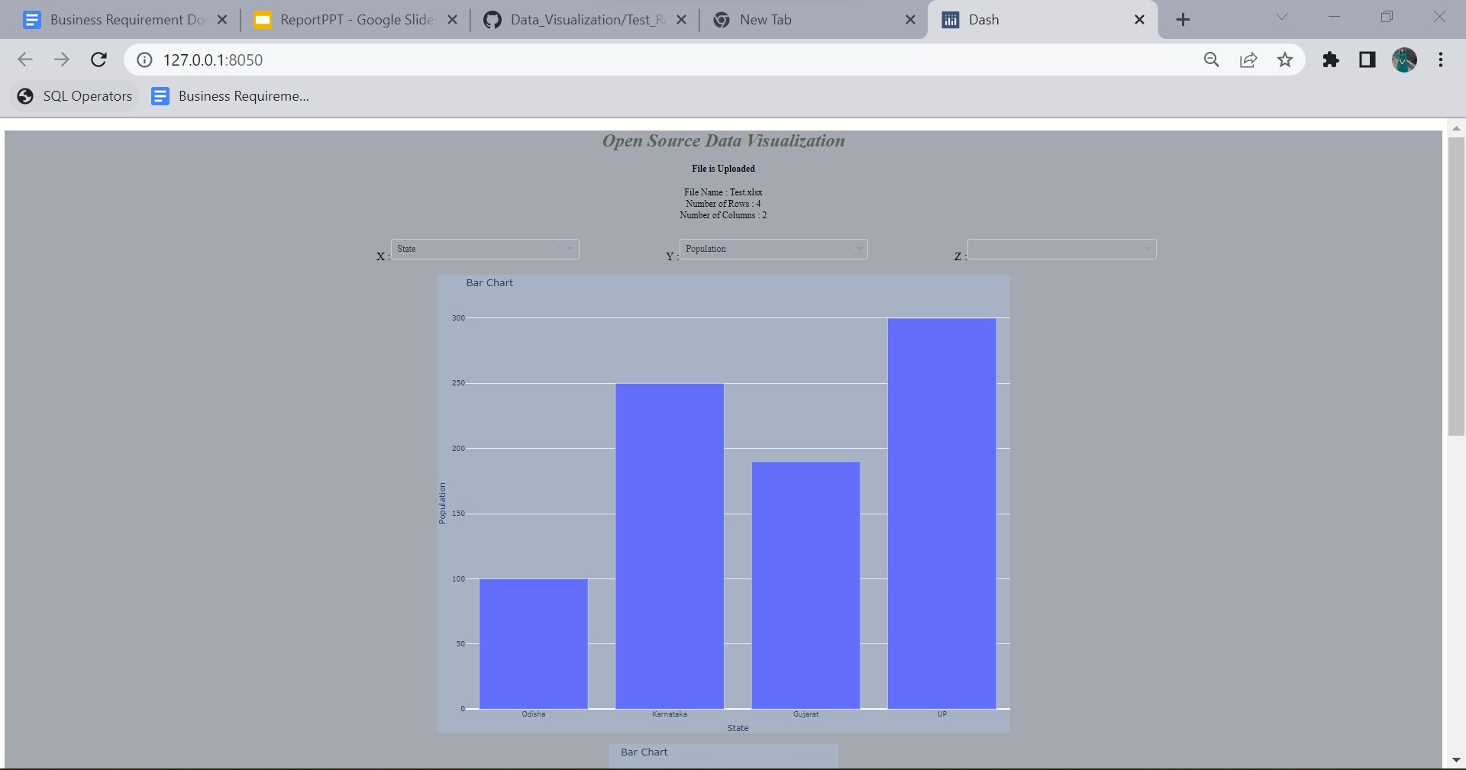

Slide 18
Conclusion
Leap Academy
We have chosen the above design because it is easy to understand and start the work.
We can always enhance the experience by adding new features.

Slide 19
References
Leap Academy
https://rawgraphs.io/
https://www.tableau.com/
https://www.wikipedia.org/
https://visme.co/blog/types-of-graphs/#business.
https://www.slideshare.net/qlik_arg/5-datavisualization-pitfalls
https://www.gooddata.com/blog/8-ways-turn-good-data-great-visualizations.
https://www.datapine.com/blog/financial-graphs-and-charts-examples/.

Slide 20


