Slide 1




OPEN SOURCE DATA VISUALIZATION
Presented by Tribe-H
Leap Academy

Slide 2
Open Source Data Visualization
Tribe-H
Your data to what you like
1. Akashata Pujari
2. Atharv Joshi (Leader)
3. Bhagyalaxmi Malipatil
4. Bhanudas Kajale
5. Chintamani Shidli
6. Krishna Koustub bs
7. Mallamma
8. Nagraj Yache
9.Shweta Patil
Aks6
10. Pooja
11. Poornima M
12. Praveen Kumar
13. Sagar Bomble
14. Salinee Nayak (co-Leader)
15. Sarika Swami
16. Shilpa Arvind
17. Shivani singade
Aks6
2

Slide 3
Abstract
Data visualization is the graphical representation of information and data. By using visual elements like charts, graphs and maps. Data visualization tools provide an accessible way to see and understand trends, outliers and patterns in data.
In the world of Big Data, data visualization tools and technologies are essential to analyze massive amounts of information and make data-driven decisions.
It can be used by teachers to display student test results, by computer scientists exploring advancements in artificial intelligence(AI) or by executives looking to share information with stakeholders.

Slide 4
Problem Statement
Create a Data visualization system using open source services and methods, where users can upload an file and expects different charts or graphs based on the data.
Misleading Color Contrast:In data visualization, high degrees of color contrast may cause viewers to believe that value disparities are greater than they really are.
When data visualizations include too much data, information overwhelms, and data melts into a graphic soup that most viewers can’t stomach.
Omitting Baseline and Truncating Scale.

Slide 5
What is Data Visualization ?
Data visualization is the practice of translating information into a visual context, such as a map or graph, to make data easier for the human brain to understand and pull insights from. It is important for almost every career.
Area Charts
Bubble Chart
Line Chart
Population Pyramid
Data visualization
Treemap Chart
Bar Graph
Column Chart
Stock Chart

Slide 6
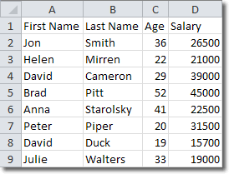
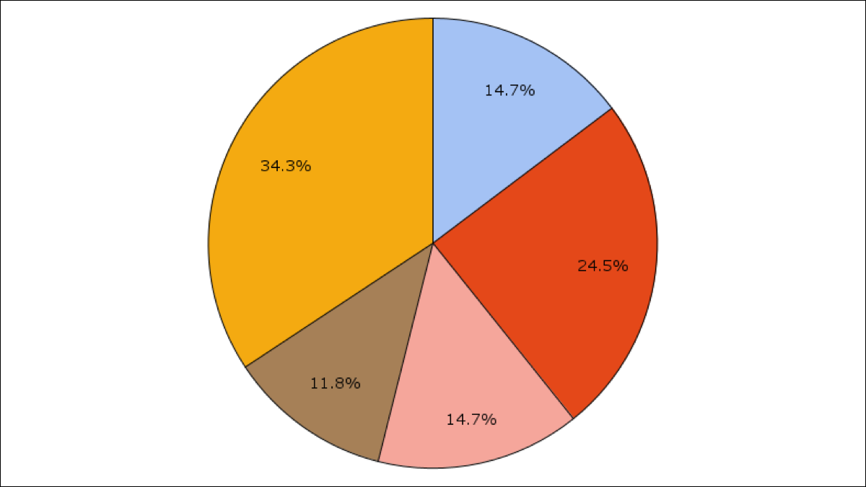
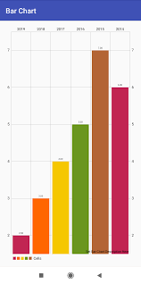
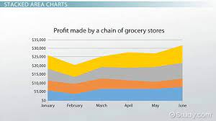
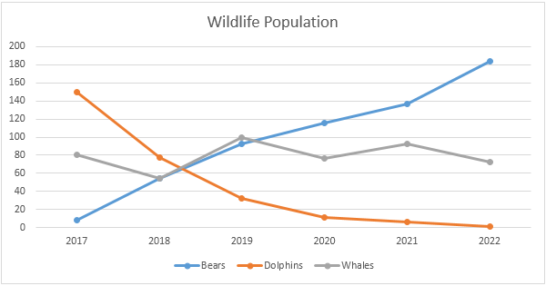
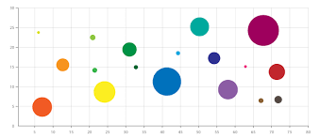
Examples of Data visualization
In the early days of visualization, the most common visualization technique was using a Microsoft Excel spreadsheet to transform the information into a table, bar graph or pie chart. While these visualization methods are still commonly used, more are still commonly used, more intricate technique are now available, including the following:
Data
Pie chart
Bar graph
Line chart
Bubble chart
Area chart

Slide 7
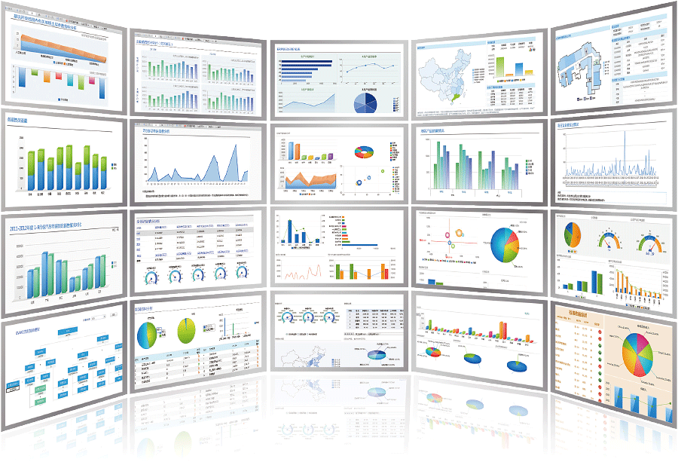
Why is Data Visualization Important?
Simple and fast way to transmit and interpret information
Process optimization and decision-making based on facts
Better understanding of operational performance and business activities
Analysis of patterns and understanding the impact of strategies implemented
Significant interpretation
Of a large volume of data
Rapid identification of trends and areas that need attention.

Slide 8


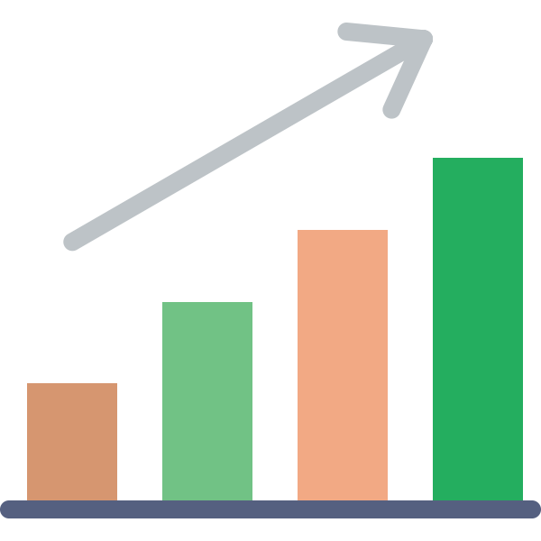
Internal Workflow
End User
exce,csv,txt
1
Upload
file
Controller
Validator
File reader
2
3
4
Dashboard
Csv data
5
Graphs & Charts
Charts
Graph generator
6
Dashboard

Slide 9
Flow:
The user will provide a file in the dashboard,
Triggers the controller.
Controller will send the file to the validator.
Validator checks the file and sends the request to the file reader.
FileReader reads the data from the excel file and sends the data to the graph generator for generating the graph.
By using the data, the Graph generator creates Charts, the Chart will shown in the dashboard.

Slide 10
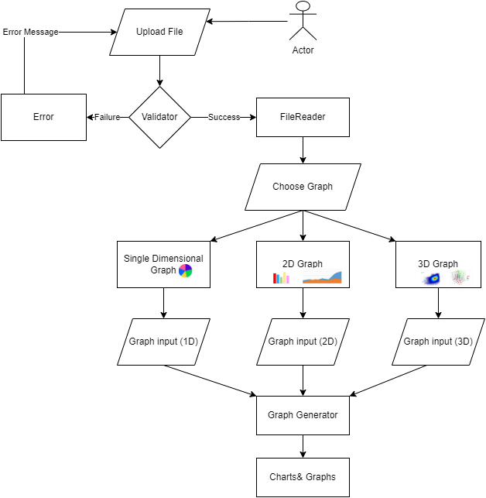

Slide 11
Technical Specification
OS | Windows, Linux, MacOs
Server | Apache Tomcat
Client | Google chrome, Firefox
Language | Python
Libraries | Pandas , dash , plotly
IDE | Pycharm Community 3.10.5
Documentation Tools | Google sheet, Google doc, Google slides, Powerpoint
Version Control | Github

Slide 12
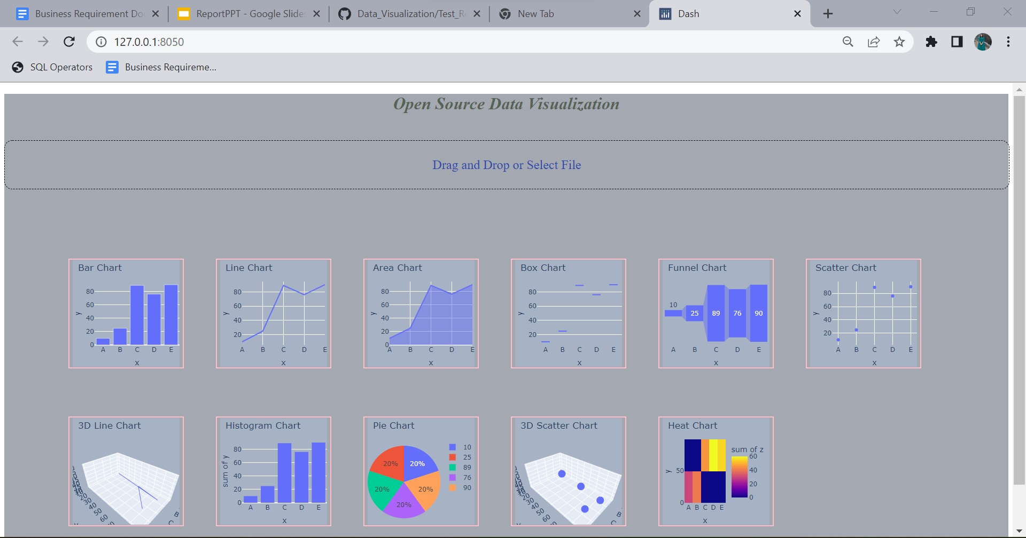
User Interface :

Slide 13


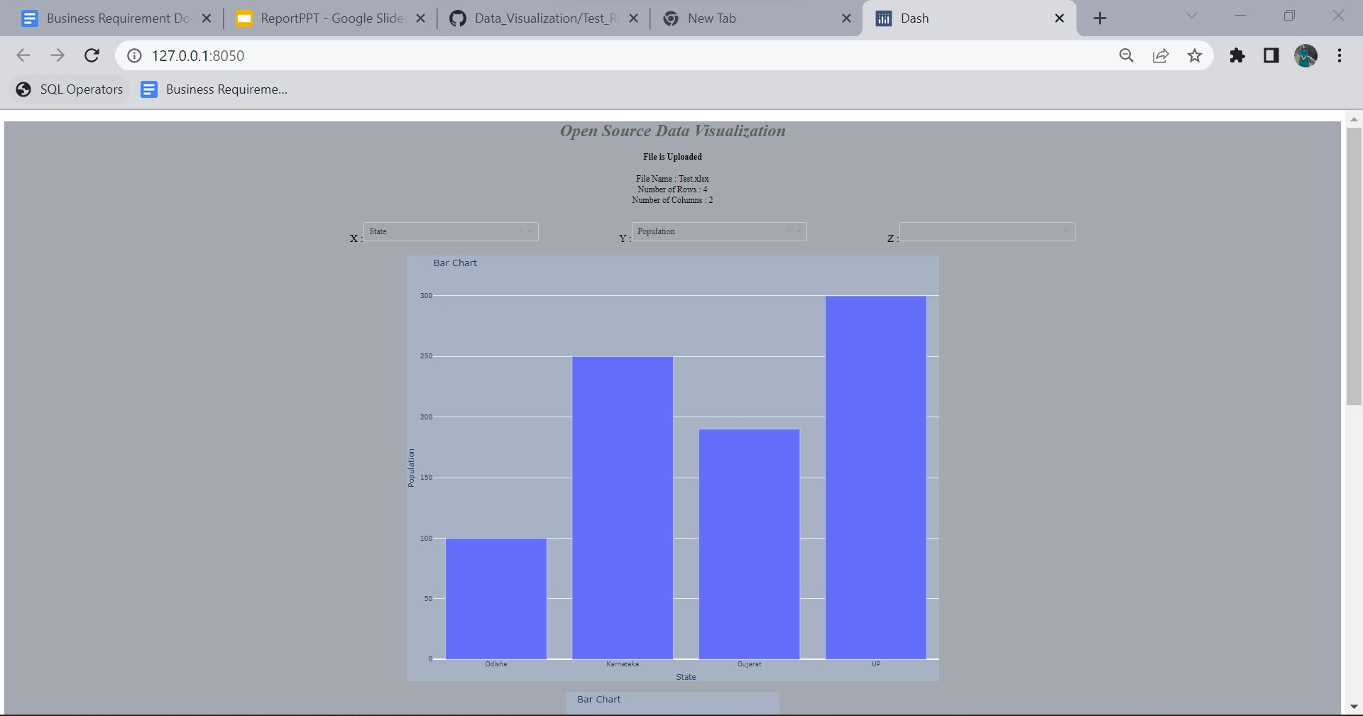

Slide 14
Conclusion
We have chosen the above design because it is easy to understand and start the work.
We can always enhance the experience by adding new features.

Slide 15
References
https://rawgraphs.io/
https://www.tableau.com/
https://www.wikipedia.org/
https://visme.co/blog/types-of-graphs/#business.
https://www.slideshare.net/qlik_arg/5-datavisualization-pitfalls
https://www.gooddata.com/blog/8-ways-turn-good-data-great-visualizations.
https://www.datapine.com/blog/financial-graphs-and-charts-examples/.

Slide 16
Thank You For Your Time
Have a nice day

