Slide 1
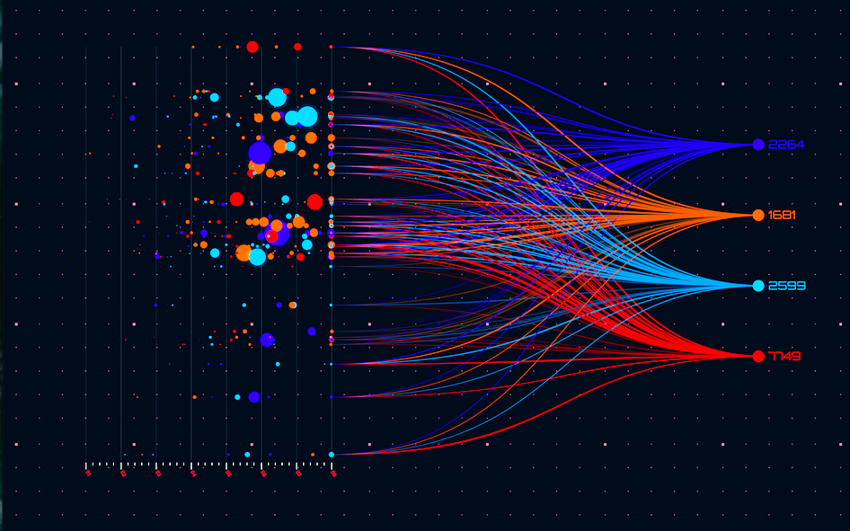

TEAM HIGH-FLYERS
Project Topic OPEN SOURCE DATA VISUALIZATION

Slide 2
TRIBE MEMBERS
AKASHATA
ATHARV
BHAGYALAXMI
BHANUDAS
CHINTAMANI
KRISHNA
MALLAMMA
NAGRAJ
POOJA
POORNIMA
SHWETA
SAGAR
PRAVEEN
SALINEE
SARIKA
SHILPA
SHIVANI

Slide 3
Table Of Contents
Problem Statement
Data Visualization Advantages
Approach And Tech-stack
Process Flow
User Interface
What Next?
Feedback/Queries?

Slide 4
Problem Statement
Data visualization is the practice of translating information into a visual context, such as a map or graph, to make data easier for the human brain to understand and pull insights from. It is important for almost every career.
Create a Data visualization system using open source services and methods, where users can upload an file and expects different charts or graphs based on the data.
Misleading Color Contrast:In data visualization, high degrees of color contrast may cause viewers to believe that value disparities are greater than they really are.
When data visualizations include too much data, information overwhelms, and data melts into a graphic soup that most viewers can’t stomach.
What is Data Visualization?

Slide 5
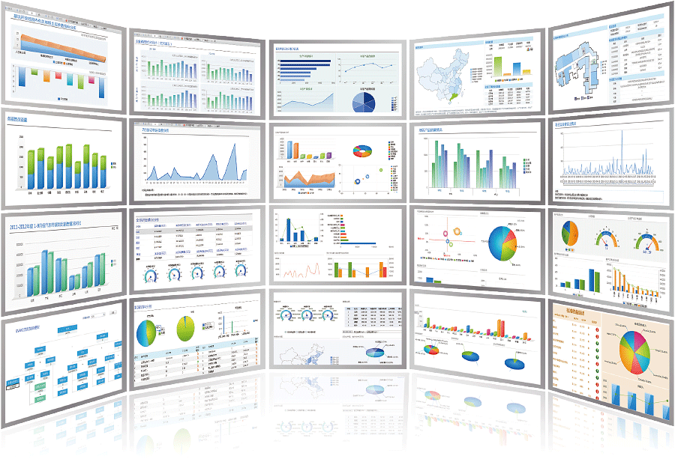
WHY DATA VISUALIZATION ?
Simple and fast way to transmit and interpret information
Process optimization and decision-making based on facts
Better understanding of operational performance and business activities
Analysis of patterns and understanding the impact of strategies implemented
Significant interpretation
Of a large volume of data
Rapid identification of trends and areas that need attention.

Slide 6

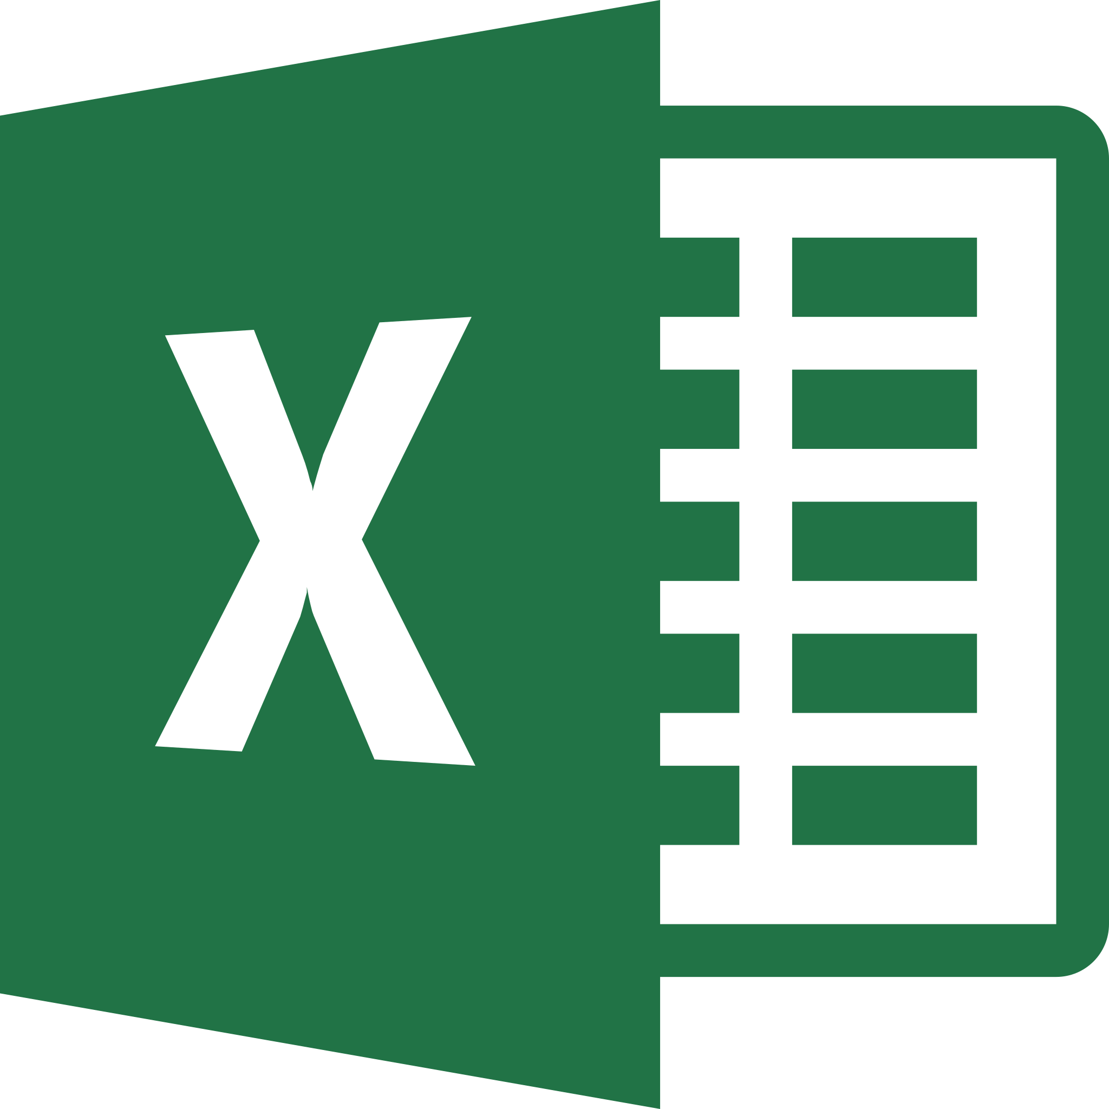
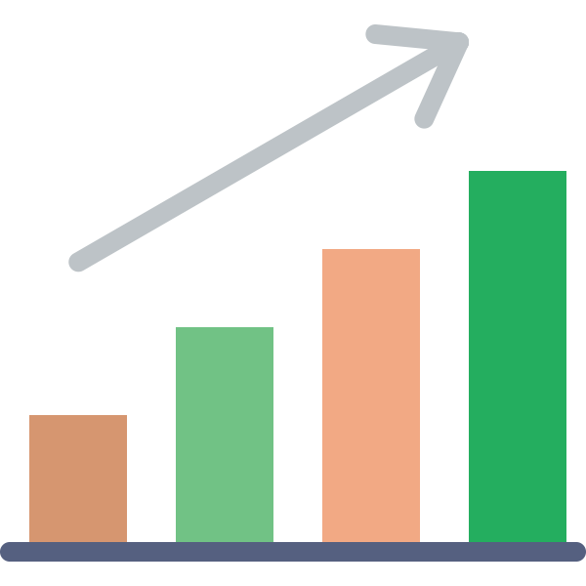
Approach And Tech-stack
Windows(OS)
End User
Python (Language)
exce,csv,txt
Pandas (Library)
1
Upload
file
Controller
Validator
File reader
Dash (Library)
2
3
4
Dashboard
Plotly (Library)
5
Graphs & Charts
Charts
Graph generator
Pycharm Community (SDK)
6
Dashboard
Github

Slide 7
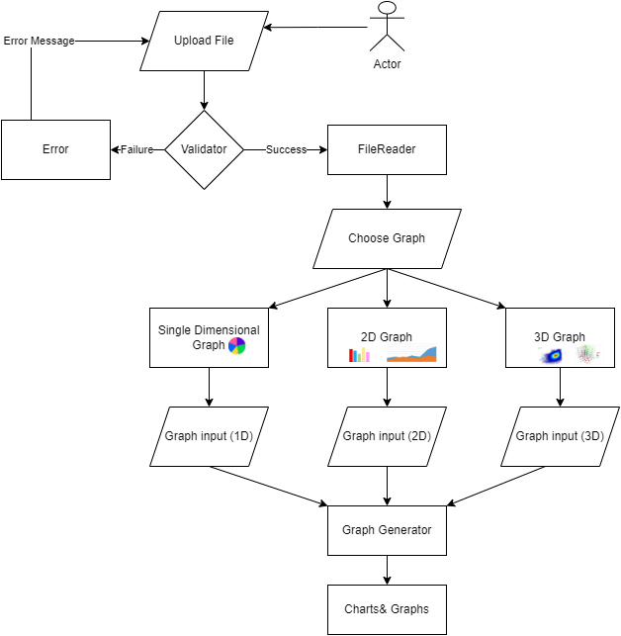
Process Flow
The user will provide a file in the dashboard,
Triggers the controller.
Controller will send the file to the validator.
Validator checks the file and sends the request to the file reader.
FileReader reads the data from the excel file and sends the data to the graph generator for generating the graph.
By using the data, the Graph generator creates Charts, the Chart will shown in the dashboard.

Slide 8
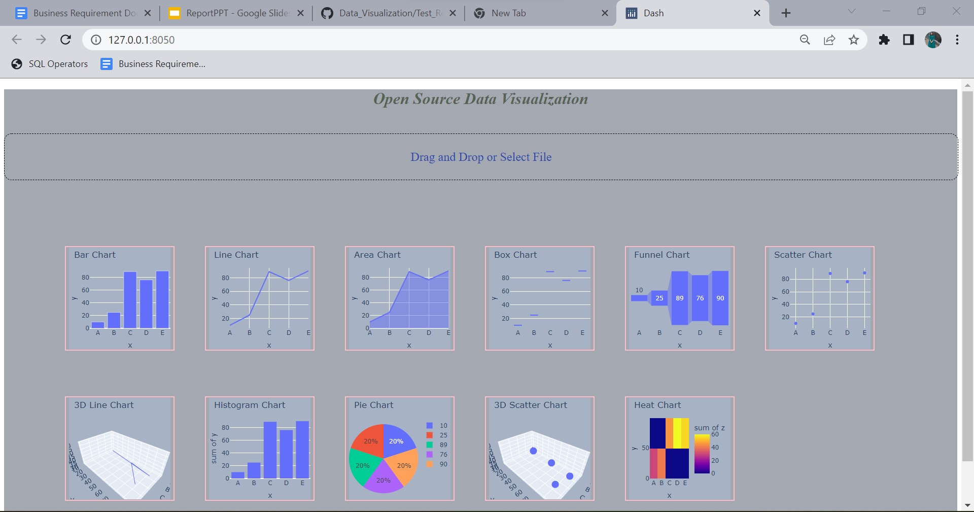

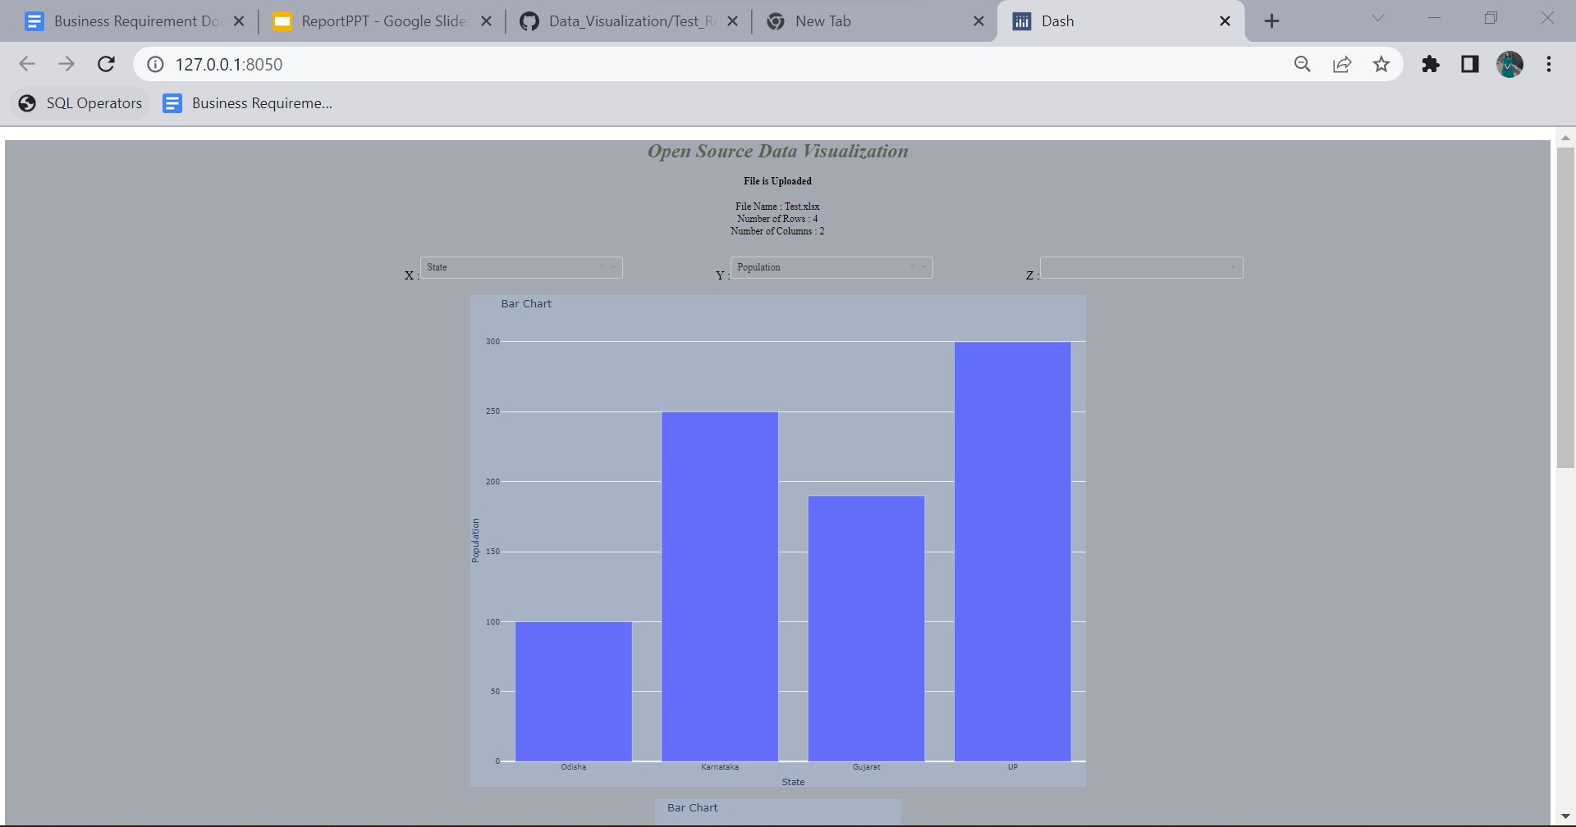
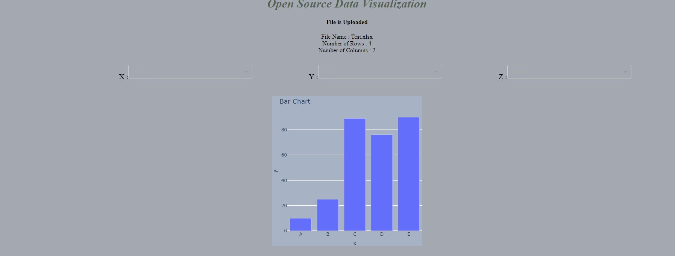
User Interface

Slide 9
Whats Next (Next Phase)
Improving User Interaction and UI
Addition of more variety of charts in future
References
https://rawgraphs.io/
https://www.tableau.com/
https://www.wikipedia.org/
https://visme.co/blog/types-of-graphs/#business.
https://www.slideshare.net/qlik_arg/5-datavisualization-pitfalls
https://www.gooddata.com/blog/8-ways-turn-good-data-great-visualizations.
https://www.datapine.com/blog/financial-graphs-and-charts-examples/.
Adding more Functionalities to Data and Charts
Expanding Reach

Slide 10

Feedback/Queries?

Slide 11


