Slide 1

Data Analysis of Superstore Sales for Strategic Insights
ATHARV SANDIPRAO KHAWALE
AICTE ID: 172717024366f286c3ec768
P. R. Pote Patil College of Engineering and Management, Amravati
Artificial Intelligence and Data Science
3rd Year

Slide 2

PROBLEM STATEMENT
Retail Businesses are able to generate a extensive sales data but often struggle to extract actionable insights which could have helped to improve decision making.
This project aims to do analysis of superstore sales data to identify trends, understand what customer wants, and evaluate performance on the basis of region, which in last will provide insights for enhancing sales strategies and operational efficiency,

Slide 3
Project Description
This project’s primary focus is on analysing the superstore’s data to understand trend in sale, products preferences, and regional performance.
The analysis includes exploring key insights such as sales, profit, discounts, and quantities sold across various customer segments, product categories, and geographic regions.
Through data visualization and statistical analysis, the project aim to identify patterns, highlight growth opportunities, and detect areas where profitability can be improved.

Slide 4

WHO ARE THE END USERS?
Business Analysts: It can be useful to business analysts to derive insights into performance of sales and profit drivers.
Retail Managers: It can be vital to Retail Managers to understand what sales trends are product and region-wise.
Data Enthusiasts: It can be important for educating purposes in data analysis and data visualization.

Slide 5

Technology Used
Programming Language: Python
Python Libraries:
Pandas: For Data Cleaning and Manipulation
Matlplotlib : For Data Visualization
IDE used: VS Code (jupyter notebook)

Slide 6
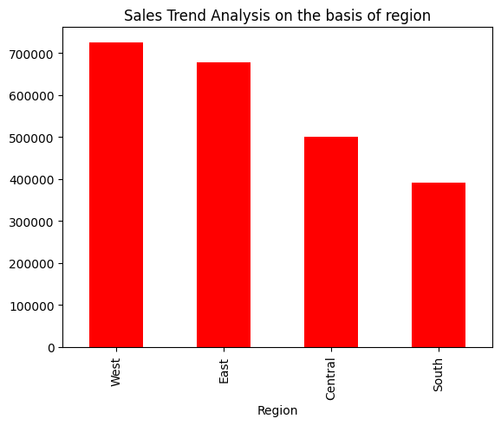
RESULTS
Sales Trend Analysis on the Basis of Region:
According to this bar graph we can say that west has highest number of sales that is above 700000.
East and Central Region have less than 700000 and more than 400000 sales.
South has the lowest which is below 400000.
Demo Link

Slide 7
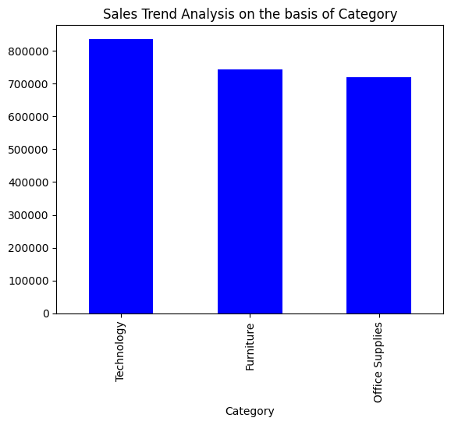
RESULTS
Sales Trend Analysis on the Basis of Category:
According to this bar graph the technology category has highest number of sales.
Furniture is second in three and office supplies being the last and bottom.
Demo Link

Slide 8
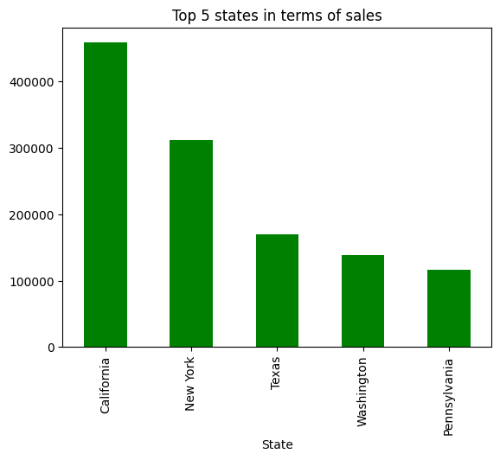
RESULTS
Top 5 states in terms of sales:
According to above data we can say that California has highest sales and New York has second highest sales
And then Texas has third highest sales and Washington has fourth highest sales
After all Pennsylvania has fifth highest sales
This helps us to understand the sales trend in different states
Demo Link

Slide 9
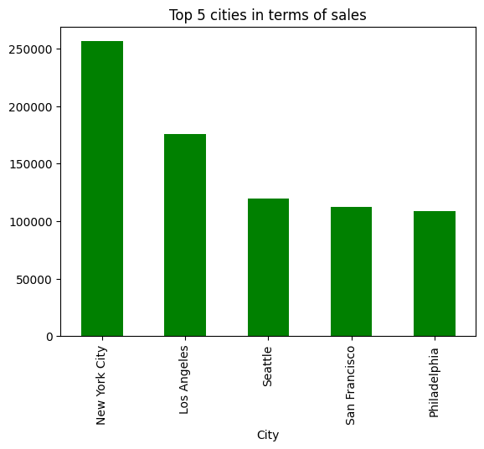
RESULTS
Top 5 cities in terms of sales:
The above data give us understanding that New York City is on top in terms of sales.
Then comes Losangeles , Seattle and San Francisco on the position of 2nd , 3rd and 4th respectively.
At last at 5th position comes Philadelphia.
Demo Link

Slide 10
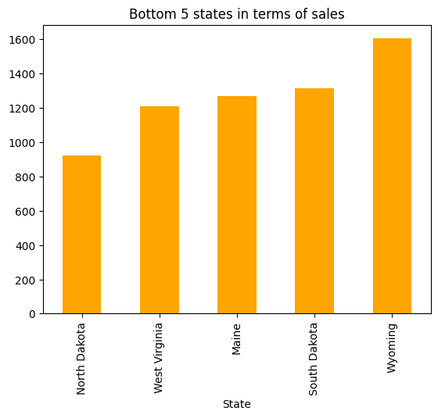
RESULTS
Bottom 5 states in terms of sales:
The state with least amount of sales is North Dakota.
Then comes West Virginia being the second least and Maine being third least.
And then comes Wyoming with somewhat better than rest of all.
Demo Link

Slide 11
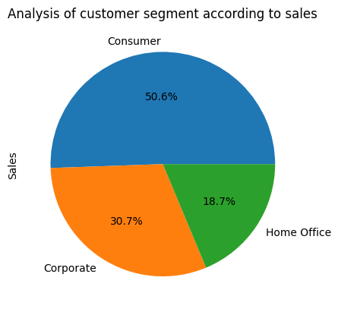
RESULTS
Analysis of Customer Segment (Sales):
This pie chart presents the distribution of sales across three customer segments: Consumer, Corporate, and Home Office.
The Consumer segment leads with 50.6% of the total sales, indicating the highest revenue contribution.
The Corporate segment accounts for 30.7% of sales, while the Home Office segment contributes 18.7%, showing a smaller but notable share.
Deo Link

Slide 12
RESULTS
Analysis of Customer Segment (Profit):
This pie chart illustrates the distribution of profit across three customer segments: Consumer, Corporate, and Home Office.
The Consumer segment contributes the most to profits, with 46.8% of the total.
The Corporate segment follows, accounting for 32.1% of profits, while the Home Office segment makes up 21.1%, reflecting a smaller but significant share.
Demo Link

Slide 13
Thank you
.
.

