Slide 1

Student Dropout Prediction System Using AI
Guided By: Veena Mali Mam Department of CSE(Artificial Intelligence and Machine Learning) DKTE Society’s Textile and Engineering Institute, Ichalkaranji
Presented By :
24UAM307 Saklen Mushtak Manjire
24UAM310 Atharv Anil Niprul
24UAM311 Arya Bharat Patil
24UAM315 Om Narayan Sutar
24UAM317 Shravani Sachin Patil
Course : TY CSE(AIML)

Slide 2
Introduction to the Domain
Artificial Intelligence (AI) has transformed various sectors including education. In the educational domain, AI enables predictive analytics to analyze student data and derive meaningful insights. The integration of Large Language Models (LLMs) such as Google Gemini with messaging platforms has enabled development of intelligent chatbots that understand context and provide helpful responses.
Educational Data Mining uses machine learning techniques to predict student performance and identify at-risk students. These predictions help institutions take timely action to support struggling students before they drop out.

Slide 3
Problem Domain & Motivation
Student dropout is a major challenge in higher education:
• Many students leave education due to academic stress, financial issues, and low motivation
• Traditional systems detect dropout risk too late
• Manual counseling is reactive, not proactive
• Institutions lack continuous behavioral monitoring
Impact of Dropout:
For Students → Career loss, low confidence, financial burden
For Colleges → Lower reputation, poor outcomes, reduced retention
For Society → Skill gap and reduced employability
Need of the Hour:
Early detection + Continuous engagement + Timely intervention

Slide 4
Literature Review
Key findings from existing research:
• Machine Learning models such as Decision Tree, Random Forest, and SVM are widely used for dropout prediction
• Academic indicators like attendance, marks, and assignments are the most commonly used features
• Some studies include socio-economic and demographic factors
• Most systems focus only on prediction, not intervention
• Very few systems integrate conversational AI for continuous student engagement
Research Insight:
Prediction alone is not enough — intervention is equally important.

Slide 5
Research Gaps
Despite existing research, major gaps still remain:
• Most systems rely only on academic data
• Behavioral and emotional student signals are rarely considered
• No continuous communication channel with students
• Existing solutions stop at prediction and do not support intervention
• Lack of mentor-facing tools for follow-up and support
• Limited use of Large Language Models for student engagement
Research Gap:
There is no unified system that predicts, communicates, and supports students in real time.

Slide 6
PROBLEM STATEMENT & OBJECTIVES
Problem Statement:
Educational institutions struggle to identify students at risk of dropout at an early stage because existing systems rely mainly on academic data and fail to capture behavioral signals or provide proactive support.
Project Objectives:
• To achieve at least 80% dropout prediction accuracy using a Random Forest model combining academic and behavioral features
• To develop a WhatsApp chatbot using LangChain and Google Gemini API for student interaction and behavioral data collection
• To design an Admin Dashboard and Mentor Portal using React.js for monitoring students and supporting at-risk learners

Slide 7
Proposed Solution Overview
We propose an AI-powered Student Dropout Prediction System
that combines machine learning, conversational AI, and mentor support tools.
The system works in four major stages:
1. Collect student academic data from institutional records
2. Interact with students through a WhatsApp chatbot to gather behavioral signals
3. Predict dropout risk using a Random Forest machine learning model
4. Provide alerts, insights, and intervention support through Admin and Mentor dashboards
Core Idea:
Predict early → Engage continuously → Intervene proactively

Slide 8
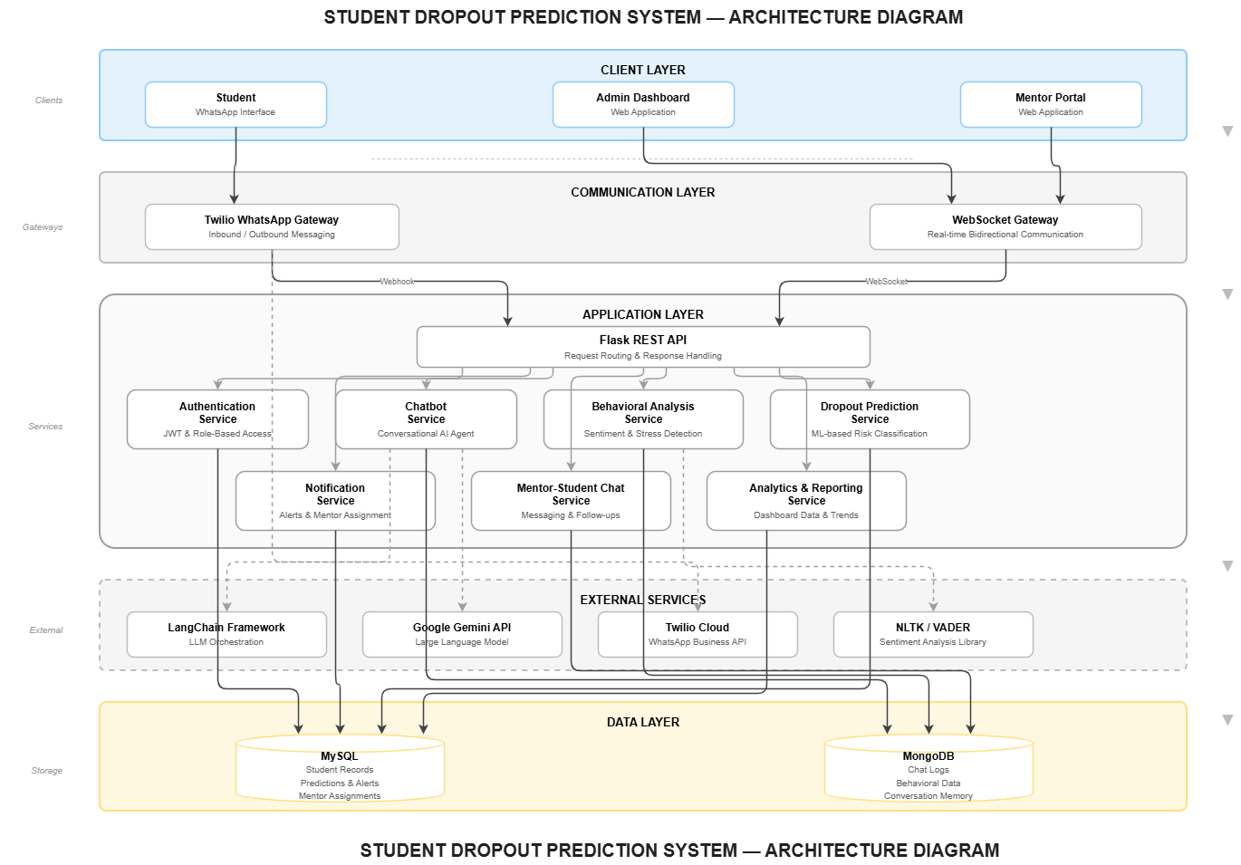
System Architecture

Slide 9
MODULE-BY-MODULE EXPLANATION
Our system is divided into five major modules:
1. Student Data Collection Module
Collects academic and personal student records from institutional sources
2. WhatsApp Chatbot Module
Interacts with students and gathers behavioral and emotional signals
3. Behavioral Analysis Module
Analyzes chatbot responses to extract student engagement indicators
4. Dropout Prediction Module
Predicts dropout risk using academic + behavioral data with Random Forest
5. Admin & Mentor Dashboard Module
Displays student risk levels, insights, alerts, and intervention tools

Slide 10
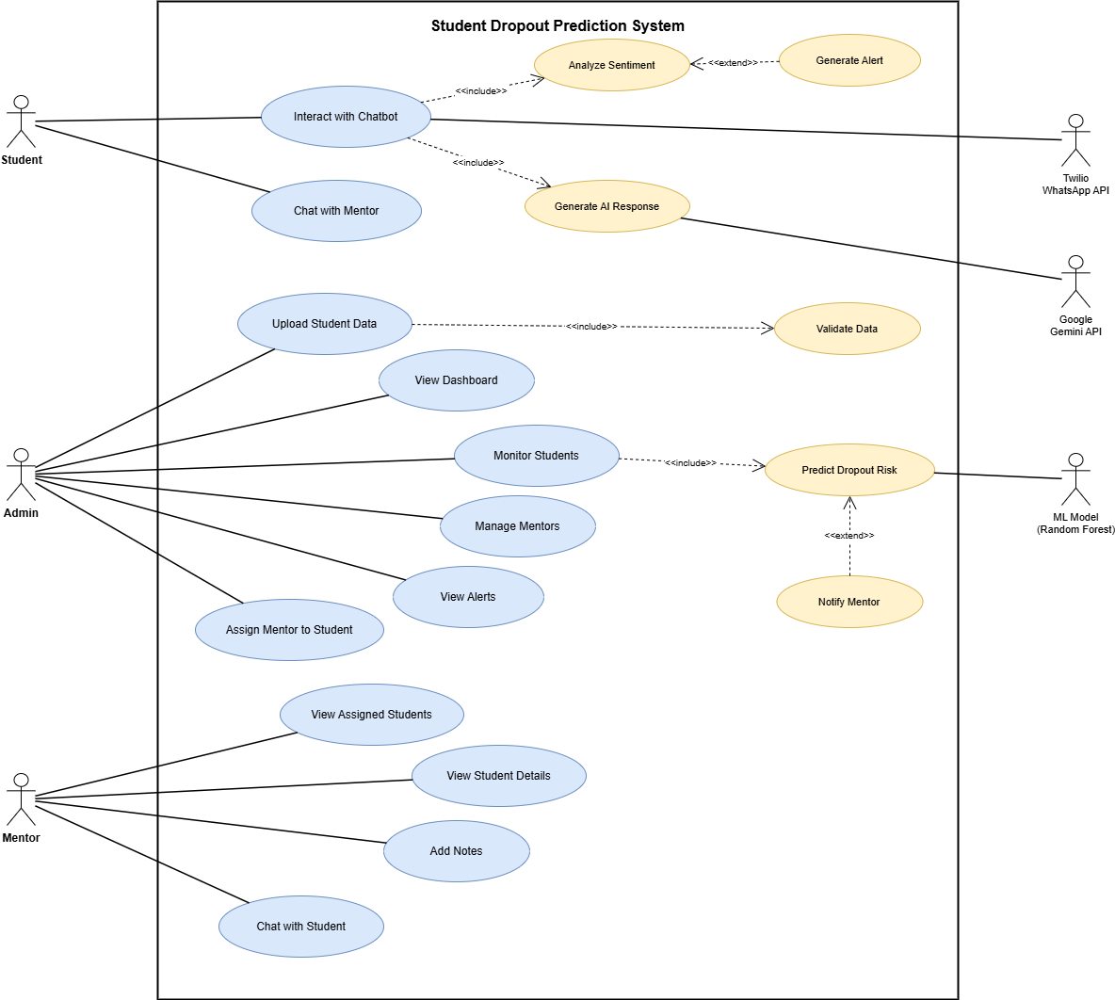

Slide 16
Software Design (Block Diagram )

Slide 17
Software Design (Block Diagram )

Slide 18
LEVEL-0
LEVEL-1

Slide 21
Performance & Security
Performance Focus:
• Fast response time for chatbot interactions
• Real-time student risk prediction and dashboard updates
• Scalable backend architecture using Flask APIs
• Efficient model inference with optimized Random Forest classifier
Security Measures:
• JWT-based secure authentication
• Role-based access for Admin and Mentor users
• Encrypted API communication using HTTPS
• Secure password storage using hashing
• Protected student records with access control

Slide 22
TECHNOLOGY STACK
Frontend:
• React.js
Chosen for fast, responsive, and component-based UI development
Backend:
• Flask
Lightweight and efficient for REST API development
Database:
• MySQL
Reliable relational database for structured student records
AI / NLP:
• LangChain + Google Gemini API
Enables conversational AI and intelligent student interaction
Machine Learning:
• Random Forest
Selected for accurate and interpretable dropout prediction

Slide 23
Comparison with Existing Systems
Feature | Existing Systems | Proposed System
Academic Performance Tracking | Yes | Yes
Behavioral Signal Analysis | No | Yes
WhatsApp-Based Interaction | No | Yes
Real-Time Student Engagement | No | Yes
Mentor Support Dashboard | Limited | Yes
AI-Based Intervention Support | No | Yes
Dropout Prediction | Yes | Yes

Slide 24
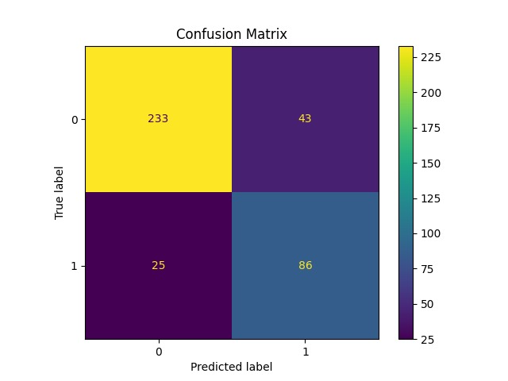
Result Analysis
Early identification of at-risk students

Slide 25
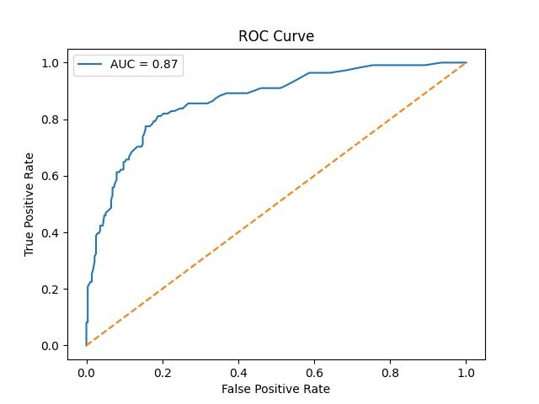
Result Analysis
• Improved dropout prediction accuracy (≥ 80%)

Slide 26
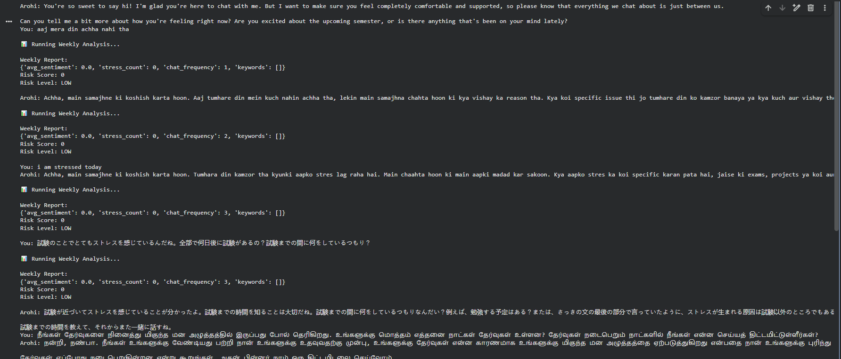
Result Analysis
• Better student engagement through continuous chatbot interaction

Slide 27
REFERENCES
[1] D. Andrade-Girón et al., “Predicting Student Dropout using ML and DL: A Systematic Review,” EAI Transactions, 2023.
[2] F. Del Bonifro, M. Gabrielli, G. Lisanti, and S. P. Zingaro, “Student Dropout Prediction,” in Artificial Intelligence in Education, Springer, 2020, pp. 129–140.
[3] C. J. Hutto and E. Gilbert, “VADER: A Parsimonious Rule-Based Model for Sentiment Analysis,” ICWSM, 2014.
[4] LangChain Documentation, Available: LangChain Documentation
[5] Google Gemini API Documentation, Available: https://ai.google.dev/docs
[6] Twilio WhatsApp API Documentation, Available: https://www.twilio.com/docs/whatsapp
[7] F. Pedregosa et al., “Scikit-learn: Machine Learning in Python,” Journal of Machine Learning Research (JMLR), vol. 12, 2011.
[8] IEEE Standard 830-1998, IEEE Recommended Practice for Software Requirements Specifications, IEEE, 1998.

