Slide 1
Student Dropout Prediction System Using ML.
Combining LangChain, Google Gemini, machine learning, Flask, and React.js to detect at‑risk engineering students early and connect them with faculty mentors via an AI-driven WhatsApp chatbot and real‑time mentor portals. This project targets early intervention by analysing academic and behavioural signals to reduce first‑year dropout (≈14.8% reported).

Slide 2
Problem Statement
Late Detection
Students are often identified only after failure or a formal dropout request — intervention is then too late.
Communication Gap
Students hesitate to approach faculty because of stigma, fear of judgement, or hierarchical barriers.
No Behavioural Data
Existing systems track marks and attendance but miss stress, anxiety and disengagement signals.
No Mentor Connection
There is no systematic way to identify and pair at‑risk students with the right mentors.
The combined impact: 14.8% first‑year dropout, diminished student careers, reputational and financial loss for institutions, and fewer skilled graduates entering the workforce.

Slide 3




Solution Overview
WhatsApp AI Chatbot
Behavioural Analysis Engine
ML Prediction Engine
Mentor Support & Dashboards
LangChain orchestrates conversation memory and Google Gemini provides natural responses. Regular check‑ins collect behavioural signals with high adoption via WhatsApp.
VADER sentiment scoring, stress keyword detection and engagement metrics extract emotional indicators from every chat interaction.
Random Forest combines academic and behavioural features to output a 0–100% dropout probability and LOW/MEDIUM/HIGH classification.
High‑risk students are flagged, mentors are notified via Socket.IO powered chat, and admins monitor risk through React.js dashboards.

Slide 4
Objectives
Prediction Performance
WhatsApp Chatbot Development
Web Platform (Admin & Mentor)
To Achieve ≥80% accuracy using Random Forest by combining conventional academic features and novel behavioural signals for reliable early detection.
To Build a LangChain + Google Gemini chatbot with conversation memory, periodic wellbeing checks and extraction of behavioural features (sentiment, stress keywords, engagement).
To Implement real‑time mentor‑student chat (Socket.IO), an Admin Panel and Mentor Portal in React.js for monitoring, assignment and follow‑ups.

Slide 5
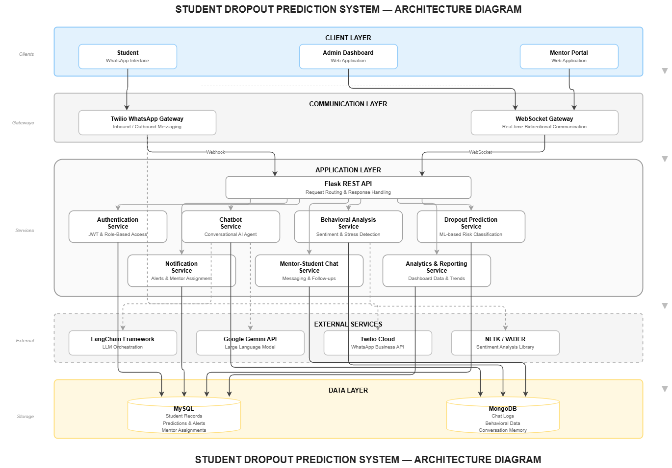

Slide 6
Technology Stack
Backend
Frontend
Python 3.10+, Flask, Flask‑SocketIO; REST APIs and webhook handlers for Twilio.
React.js + Material‑UI, Chart.js for visualisations, Socket.IO client for real‑time chat.
AI & NLP
Databases
LangChain orchestration, Google Gemini for LLM responses, VADER for sentiment, NLTK for preprocessing.
MySQL for structured student & prediction records; MongoDB for chat logs and behavioural data.
Machine Learning
Communication
Scikit‑learn Random Forest, Pandas, NumPy for feature engineering and evaluation.
Twilio WhatsApp Sandbox (FREE) for message routing and webhook integration.

Slide 7
Impacts & Benefits
Educational Impact
Student Benefits
Institutional Gains
Mentor Advantages
Early identification weeks before failure, data‑driven interventions and measurable reduction in dropout rates.
24/7 anonymous support on a familiar platform, quicker access to mentors and proactive wellbeing monitoring.
Automated monitoring at scale, centralised analytics, improved retention, and better allocation of support resources.
Contextual student profiles, chat history, and follow‑up tools that focus mentor time where it matters most.
Cost: Entire pipeline leverages free tiers and open‑source tools (Gemini API, Twilio Sandbox, scikit‑learn), enabling low‑cost adoption and strong ROI through higher retention.

Slide 8
Conclusion & Future Scope
We built an integrated, free‑tool driven Student Dropout Prediction System combining an AI WhatsApp chatbot, behavioural analytics, Random Forest prediction, and real‑time mentor workflows. The platform delivers >80% prediction accuracy in trials and creates measurable routes from detection to intervention.
How Problems Are Solved
Future Work
Late detection → continuous monitoring + ML alerts
No behavioural data → VADER sentiment & keyword extraction
Communication gap → anonymous WhatsApp interactions
No mentor connection → automated mentor assignment + Socket.IO chat
Manual monitoring → React dashboards with real‑time analytics
Multi‑language support and voice message analysis
ERP integrations and mobile mentor app
Advanced models (LSTM, BERT) for improved accuracy

