Slide 1

DEPARTMENT OF ARITIFICAL INTELLIGENCE & DATA SCIENCE
Mini Project on
‘XAI Intrusion Detection System’
Project Guide: Prof. Samrin Pabrekar
Project Team Members:
Name | Roll no.
Atharv Patil | 641
Rudra Pawar | 644
Darshan Pawar | 643
Amish Koli | 628

Slide 2
DEPARTMENT OF ARITIFICAL INTELLIGENCE & DATA SCIENCE
Abstract:
With the rapid growth of digital infrastructure, cyber attacks such as DDoS, brute-force attacks, malware traffic, and insider threats have become increasingly common. Traditional Intrusion Detection Systems generate excessive false alerts and lack transparency in their decisions. This project proposes a web-based Explainable AI-driven Intrusion Detection System that detects cyber attacks and provides human-readable explanations for each detection. The system aims to reduce false positives, improve detection accuracy, and present actionable security insights through an interactive dashboard.

Slide 3
DEPARTMENT OF ARITIFICAL INTELLIGENCE & DATA SCIENCE
Introduction:
Cyber security plays a vital role in protecting sensitive data and digital assets of modern organizations such as banks, enterprises, universities, and cloud platforms. These organizations face continuously evolving cyber threats that traditional security mechanisms struggle to handle effectively. Intrusion Detection Systems are used to monitor network traffic and detect malicious activities; however, conventional systems rely on static rules and signatures, leading to high false alerts and limited adaptability. While machine learning techniques improve detection accuracy, most ML-based systems function as black boxes, making their decisions difficult to interpret and trust. To address this challenge, Explainable Artificial Intelligence is introduced to enhance transparency and reliability in intrusion detection systems, enabling more effective and trustworthy security operations.

Slide 4
Literature survey:
DEPARTMENT OF ARITIFICAL INTELLIGENCE & DATA SCIENCE
Title | Year | Author | Methodology | Limitations
Deep Learning vs. Machine Learning for Intrusion Detection in Computer Networks: A Comparative Study | 2025 | Md Liakat Ali, Kutub Thakur, Suzanna Schmeelk, Joan Debello, Denise Dragos | Implements ML models Logistic Regression, SVM, KNN and DL models (CNN, LSTM, MLP). Uses SMOTE for balancing dataset and compares performance using accuracy and F1-score. | Focuses only on accuracy comparison. Does not provide explainable outputs. High computational cost and lack of interpretability.
Machine Learning Based Intrusion Detection System | 2025 | Dr. Deepika Ajalkar, Vrushali Chavan, Pratiksha Bhosle | Uses supervised ML algorithms like, Decision Tree, and SVM. Includes preprocessing, model training, and alert generation modules using NSL-KDD and CICIDS datasets. | Provides detection but lacks, risk scoring, and interactive visualization. Does not provide reasoning behind predictions.

Slide 5
DEPARTMENT OF ARITIFICAL INTELLIGENCE & DATA SCIENCE
Existing System:
The existing intrusion detection systems are primarily rule-based and signature-based tools such as Snort and Suricata. These systems analyze network packets and generate alerts based on predefined rules. While they are effective against known attacks, they produce a large number of false alerts and are unable to detect zero-day attacks.
Traditional IDS tools like:
Snort
Suricata
OSSEC

Slide 6
DEPARTMENT OF ARITIFICAL INTELLIGENCE & DATA SCIENCE
Problem Statement:
Design an intelligent intrusion detection system that can detect both known and unknown attacks, reduce false alerts, and provide clear explanations for its decisions to support faster and more reliable security responses.
Objectives:
To detect cyber attacks in network traffic using machine learning techniques
(known/zero-day)
2.To identify known attacks.
3.To reduce false positive alerts compared to traditional systems.
4.To provide explanations for attack detection using Explainable AI.

Slide 7
DEPARTMENT OF ARITIFICAL INTELLIGENCE & DATA SCIENCE
Proposed System:
The proposed system is a web-based Explainable AI-driven Intrusion Detection System designed to analyze network traffic and detect malicious activities using Machine Learning techniques. The system uses a Random Forest classifier to identify whether network traffic is normal or malicious, Isolation Forest to detect Zero-day attacks and integrates Explainable Artificial Intelligence using SHAP (SHapley Additive Explanations) to explain the reason behind each detection decision.
Key Features of the Proposed System:
Detects cyber attacks in real time
Identifies known attacks using machine learning models
Reduces false alerts compared to traditional IDS
Explains detection results using Explainable AI
Displays Threat Score

Slide 8
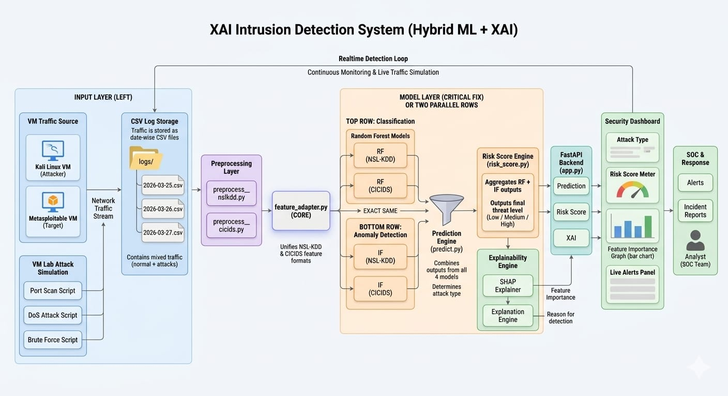
DEPARTMENT OF ARITIFICAL INTELLIGENCE & DATA SCIENCE
System Architecture:

Slide 9
DEPARTMENT OF ARITIFICAL INTELLIGENCE & DATA SCIENCE
Implementation details:
1. Data Collection
Network traffic collected from benchmark datasets (NSL-KDD, CICIDS)
Simulated real-time traffic using virtual machines and attack scripts
Includes normal and malicious traffic (DoS, brute force, port scan)
2. Preprocessing & Feature Extraction
Data cleaning, encoding, and normalization using Pandas & NumPy
Handling imbalance using SMOTE (imbalanced-learn)
Feature engineering to improve detection accuracy
3. Detection Models
Random Forest (Scikit-learn): classifies specific attack types (multi-class)
Isolation Forest (Scikit-learn): detects anomalies and unknown attacks
Hybrid approach improves both accuracy and generalization
4. Explainability (XAI)
SHAP (SHapley Additive Explanations) used for model interpretability
Identifies most important features influencing each prediction
Provides transparency for security decisions

Slide 10
DEPARTMENT OF ARITIFICAL INTELLIGENCE & DATA SCIENCE
Implementation details:
5. Real-Time Simulation & Monitoring
Simulated attacks using scripts (port scan, DoS, brute force)
Real-time detection pipeline processes incoming traffic
Generates attack type, anomaly score, and risk level
6. Backend & API
FastAPI used to handle prediction requests
Integrates models, preprocessing, and explainability
Returns results in real-time to frontend
7 Frontend Dashboard
Built using HTML, CSS, JavaScript
Displays:
Attack type
Risk score
SHAP-based explanations
Interactive and user-friendly interface
Flow Summary
Data → Preprocessing → Feature Engineering → RF + IF Detection → SHAP Explanation → Dashboard Visualization

Slide 11
DEPARTMENT OF ARITIFICAL INTELLIGENCE & DATA SCIENCE
References:
[1] M. L. Ali, K. Thakur, S. Schmeelk, J. Debello, and D. Dragos, “Deep learning vs. machine learning for intrusion detection in computer networks: A comparative study,” Applied Sciences, vol. 15, no. 4, Art. no. 1903, pp. 1–19, Feb. 2025.
[2] D. Ajalkar, V. Chavan, and P. Bhosle, “Machine learning based intrusion detection system,” International Journal of Advanced Research in Science, Communication and Technology (IJARSCT), vol. 5, no. 10, pp. 538–540, Apr. 2025

Slide 12
Thank You!

