Slide 1
Republic Day Coding
Competition
SUBJECT :- IT VEDANT STUDENT PORTAL
Guidance : Mr. Shirish Patil Sir
Student : Atharv Ratnaparkhi

Slide 2

Why this webpage ????????????????
It Vedant Student portal is fountain of knowledge and since I’m using it since last 3 months I think that it helps student to improve the knowledge in very wider way.
According to me that student portal will get more engagement as a student and also enhance knowledge of student if there is a practice section attach on website only.
This is the reason of mine making this solution.
So…….Let’s Check it Out………….

Slide 3
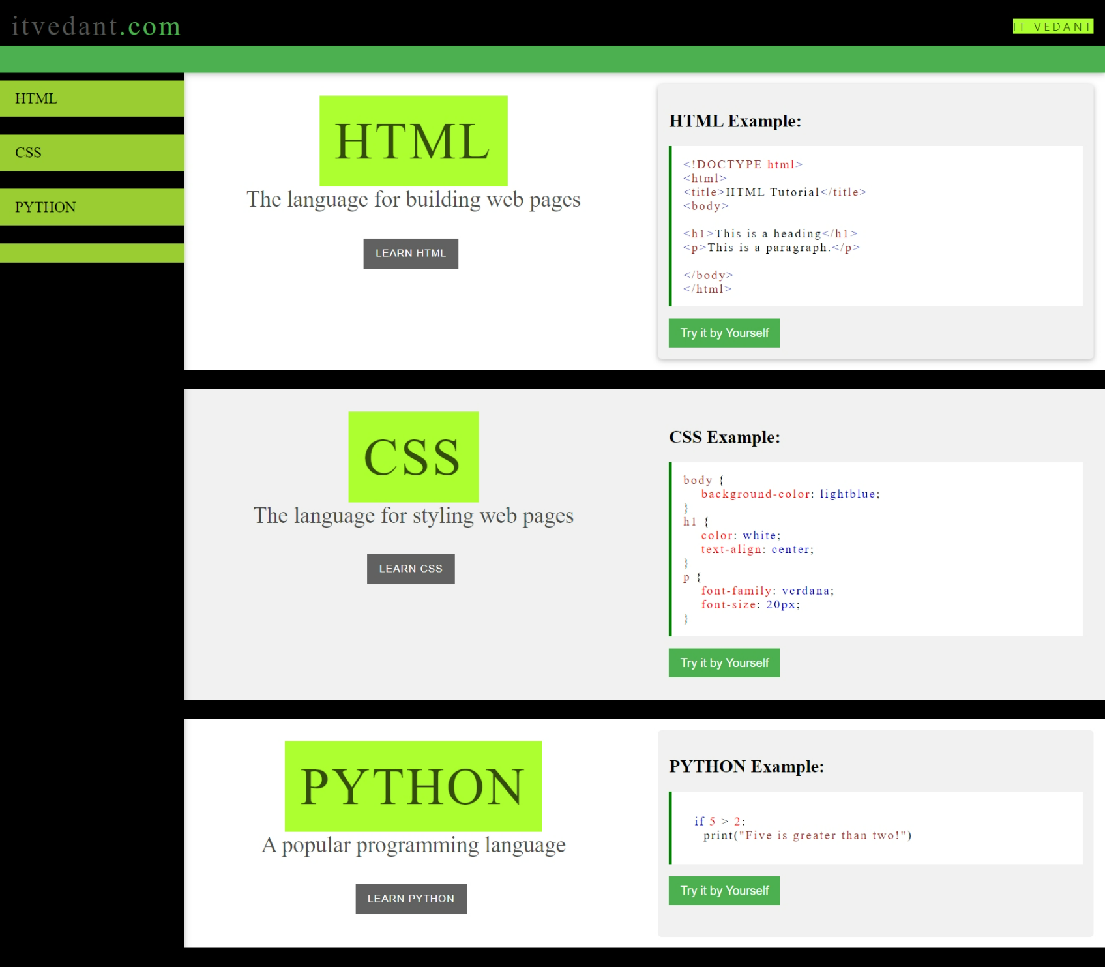
As We can see here this is the homepage of this website.
It is very convenient and user friendly for student.
As you can see here Student can have HTML/CSS/PYTHON topics on left vertical sidebar as well as on main page.
Student Can click on Try it by Yourself and directly go to editor if he don’t want to read notes and practice without reading.
If student feels first he want to read and then use editor to practice he can click on Learn button or he can also use vertical sidebar.
On the next 2 pages you will se Try it by yourself editor page and then Learn Button page.

Slide 4
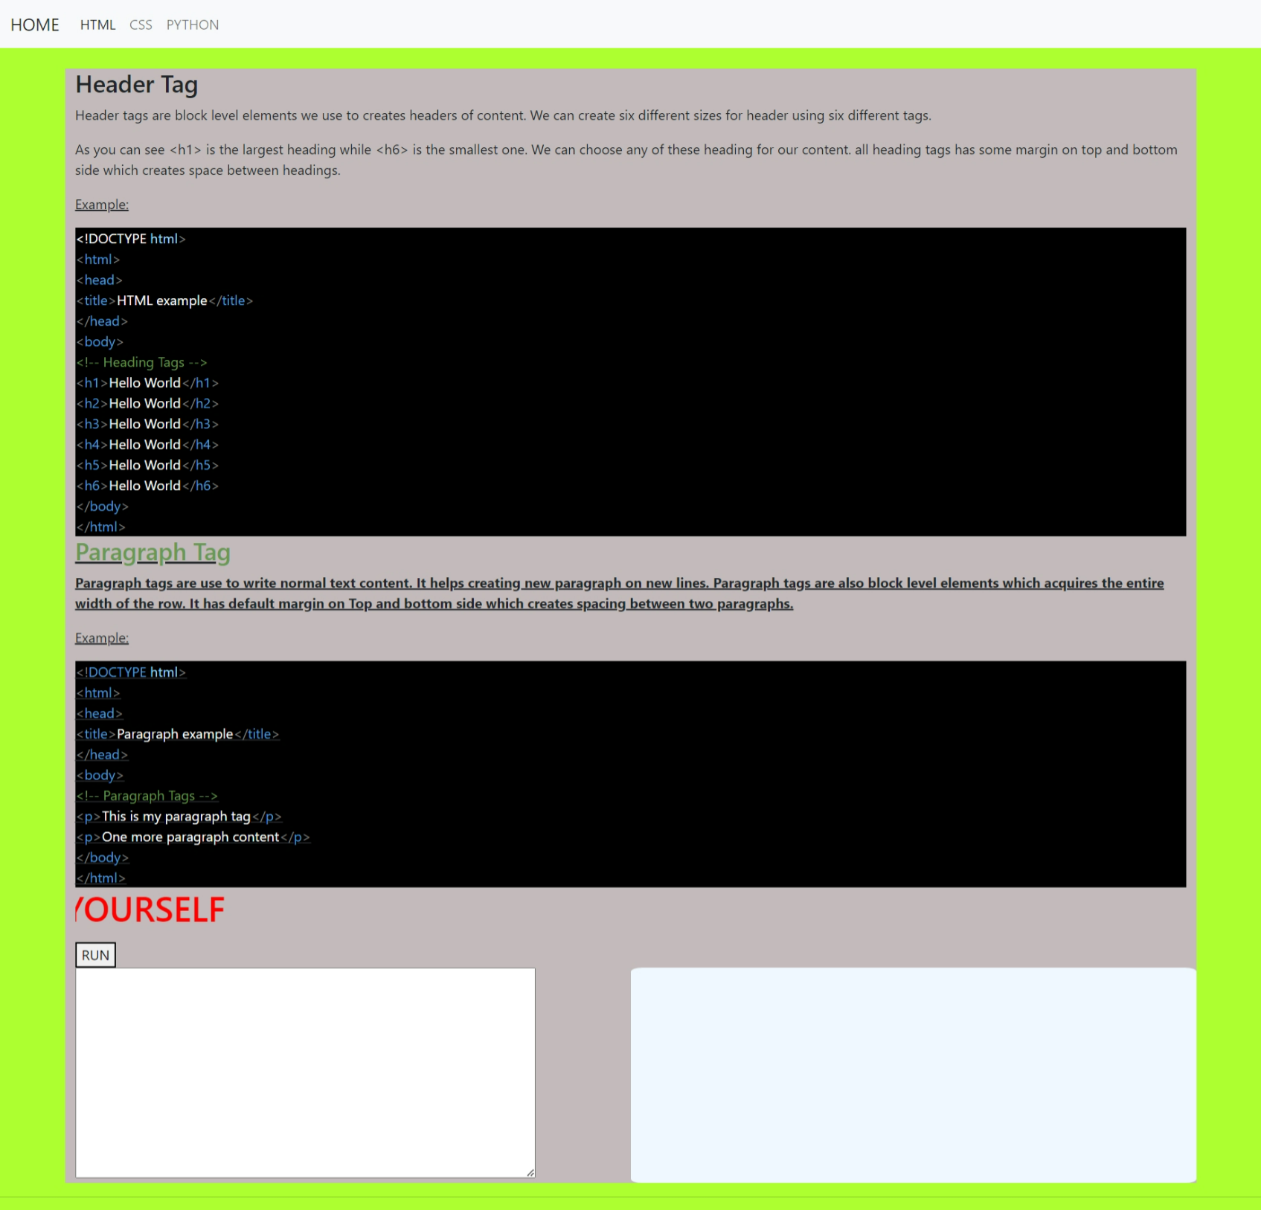
Learn Button :-
Once you click on learn button you will be directed to the page given here.
You can Learn Different topics here and also make use of the information right there only.
As the screenshot shows Header Tag information is given so student can read it understand it and then below the information small editor box is present where student can practice code.
Learn button is also available on Home page vertical sidebar also.
Once you click on Learn page of html and you want to learn CSS or PYTHON now then navbar is there to switch it from there only.

Slide 5
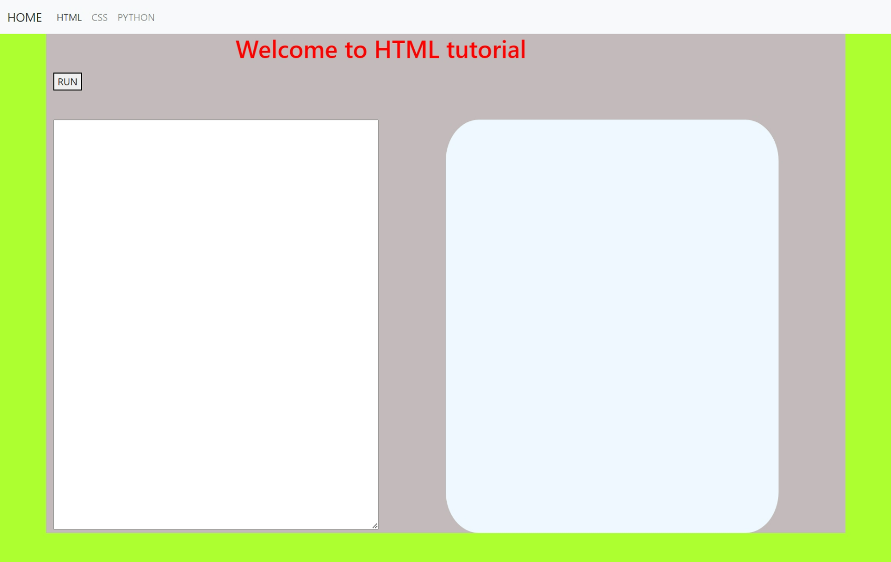
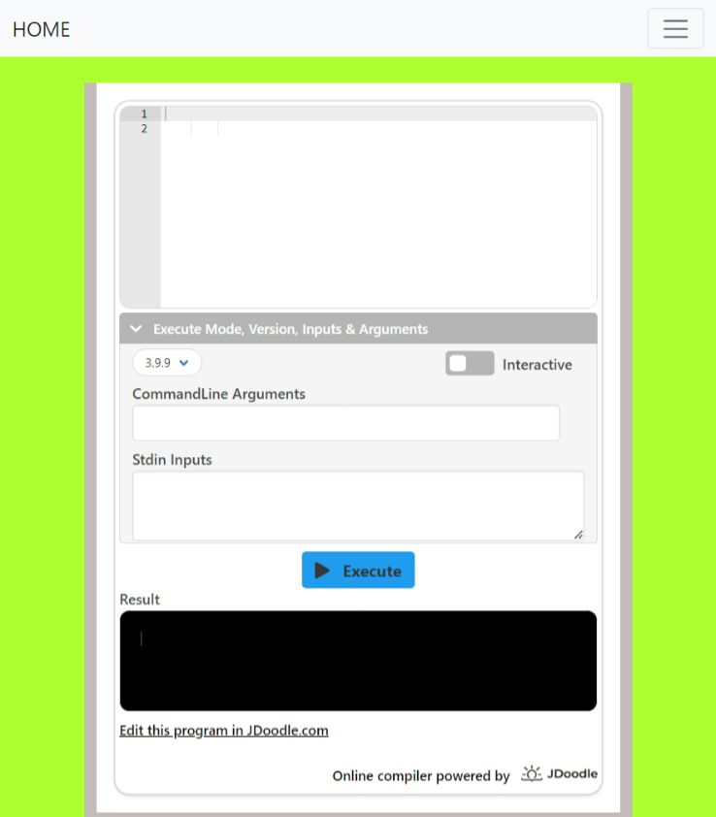
HTML/CSS EDITOR :-
PYTHON EDITOR :-

Slide 6






Sources:
Django
HTML
CSS
BOOTSTRAP
JavaScript
COLPILER BY Jdoodle for PYTHON

Slide 7
THANK YOU SO MUCH
EVERYONE…..

