Slide 1
Leveraging User Context Prediction for
Adaptive Memory Management in
AI-Heavy Mobile Environments
Capstone Project — Project-I Review
Presented By:
[Atharv Sinha] — [23BLC1281]
[Aviral Khandelwal] — [23BLC1214]
[Devashish Sharma] — [23BLC1228]
Guide:[Dr. Shivani Gupta], [Scope]
[Vellore Institute of Technology], [Chennai]
August 2026
1

Slide 2
1. The Problem — Why Current Phones Struggle
Modern phones have 4–8 GB RAM but run AI-heavy apps (camera AI, translation, LLMs) alongside regular apps.
Current memory management is reactive — it only acts AFTER memory is already full, not BEFORE.
How Android Does It Now
What Goes Wrong
LRU (Least Recently Used): removes whichever app you haven't touched the longest — even if you're about to use it in 2 minutes
LMKD (Low Memory Killer): kills apps only when RAM is critically low — by then it's already too late, you see the lag
App Standby Buckets: groups apps as active/rare but updates only once per hour — too slow to react
Cold Start: app was removed → must reload from disk → 1–3 seconds of waiting
AI App Cold Start: even worse → 3–6 seconds because AI models are 300 MB – 4 GB each
Memory Thrashing: phone keeps removing and reloading the same apps in a loop
Battery Drain: 8–15% extra battery wasted on redundant disk reads
The Opportunity
Users switch apps ~65 times/day. Each switch is a chance for the phone to make a wrong eviction decision.
On-device AI market is $46.7B by 2027 — AI apps are getting bigger and more common, making this worse.
Our Idea: What if the phone could PREDICT which app you'll open next, and keep it ready in memory?
How: Use an ML model (XGBoost) that looks at time of day, which apps you used recently, battery, RAM — 19 signals total — and predicts the next app with 70–80% accuracy. Feed this prediction INTO the eviction scoring formula.
2

Slide 3
2. What Others Have Done — And What's Missing
App Prediction Research (Papers 1–5)
Memory Management Research (Papers 6–10)
Shin et al. (2012): predicted next app using Naive Bayes — 72% accuracy, but never used it for memory management
Xu et al. (2024): Graph Neural Networks — 78% accuracy, but needs GPU → too heavy for real-time mobile use
Zhao et al. (2023): LSTM with context — 74%, but deep learning overhead makes it slow (~15ms per prediction)
Pan et al. (2023): multi-task learning — good accuracy but impossible to train on-device
Gap: Good prediction exists, but nobody connected it to memory management decisions
Android LMKD (2024): PSI + priority scores — reactive only, no prediction at all
Samsung SWAM (2023): improved OOM killer — but uses static costs, no ML
Chen et al. (2024): frequency-based caching — 22% fewer cold starts, but ignores context
Park et al. (2023): RL-based approach — needs online interaction, fragile in practice
Gap: Memory research is stuck on reactive or simple frequency-based approaches
ML for Systems (Papers 11–14)
On-Device AI (Papers 15–18)
XGBoost (2016): fast, interpretable, no GPU — our chosen model framework
Ipek et al. (2008): RL for DRAM scheduling — hardware-level, not app-level
Hashemi et al. (2018): LSTM for CPU cache prefetching — hardware L1/L2 only
Gap: ML is used for hardware caches but NOT for app-level process cache in mobile OS
MCUNet (2020): tiny ML for IoT — focuses on model architecture, not OS memory
He et al. (2025): LLM memory optimization — single model only, not multi-app
Dhakal et al. (2025): elastic LLM serving — complementary but single workload
THE GAP: Nobody combines ML prediction confidence as a factor in cache eviction + preload gating + thrashing detection — all together for AI-heavy mobile environments
3

Slide 4
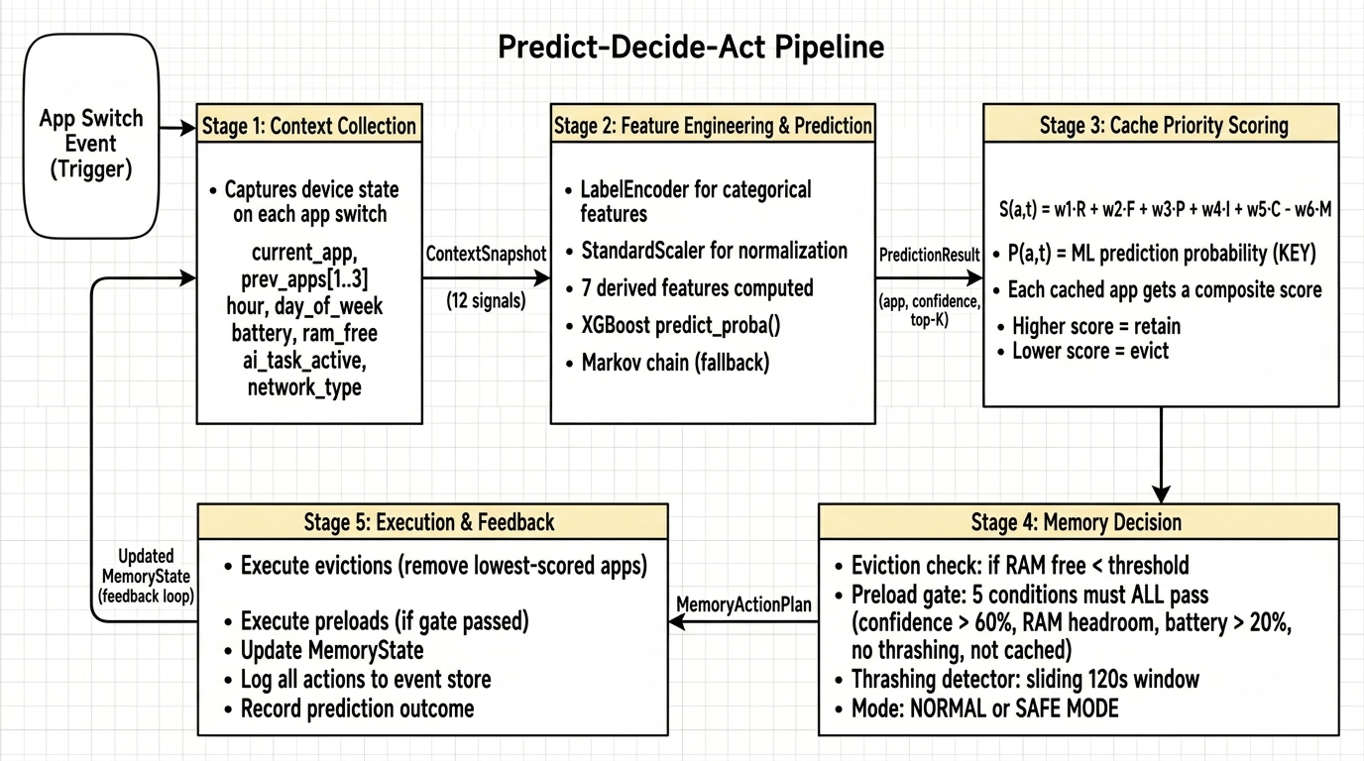
3. Our Approach — Predict, Decide, Act
Every time the user switches apps, our system runs a 5-stage pipeline in under 5 milliseconds:
4

Slide 5
4. How We Decide What to Keep — The Scoring Formula
Every cached app gets a "keep score". Higher score = keep in memory. Lowest score = evict first.
S(a, t) = 0.25 × Recency + 0.20 × Frequency + 0.25 × Prediction + 0.15 × Importance + 0.15 × Context − 0.30 × MemoryPressure
What Each Factor Means
5-Gate Preload Safety Check
Recency (R) — weight 0.25
Did you use this app recently? Uses exponential decay: more recent = higher score
Frequency (F) — weight 0.20
How often do you use this app? Normalized count vs. most-used app
Prediction (P) — weight 0.25 ← OUR KEY INNOVATION
Does the ML model think you'll use this next? This makes eviction FORWARD-LOOKING, not just backward-looking
Importance (I) — weight 0.15
Category-based: WhatsApp/calls = 0.9, games = 0.3, camera AI = 0.85
Context (C) — weight 0.15
Does this app fit the current situation? Maps during commute hours = high
Memory Pressure (M) — penalty 0.30
When RAM is >70% full, this penalty increases — forces more aggressive eviction
ALL 5 must be true before pre-loading a predicted app:
1. ML confidence > 60% (we're fairly sure)
2. Enough free RAM (with 500 MB safety headroom)
3. Battery > 20% (don't waste power when low)
4. Thrashing score < 0.7 (system is stable)
5. App not already in memory (no point reloading)
Thrashing Detection & Safe Mode
The system watches for a BAD pattern: removing an app and immediately needing it back.
How: monitors evictions and reloads in a sliding 120-second window
Score > 0.7: enters Safe Mode → stops preloading, tightens eviction thresholds
Score < 0.3 for 60s: exits Safe Mode → back to normal operation
5

Slide 6
5. Why We Chose XGBoost (Not Deep Learning)
 | Markov Chain (Baseline) | XGBoost (Our Choice) | LSTM (Rejected)
Speed | Instant (<1 ms) | Very fast (~2 ms) | Slow (~15 ms)
What it knows | Only current app | 19 signals (time, battery, history...) | Same as XGBoost
Can we explain it? | Yes (transition matrix) | Yes (feature importance, SHAP) | No (black box)
Needs GPU? | No | No | Yes
Accuracy | 55–65% | 70–80% | 72–82%
Why NOT LSTM / Deep Learning?
• Only 2% more accurate than XGBoost
• But 7× slower (15ms vs 2ms per prediction)
• Requires GPU → drains battery, conflicts with user's AI tasks
• Black box → can't explain WHY it predicted something (bad for patent)
Why NOT just Markov Chain?
• Ignores everything except current app
• Doesn't know it's 8 AM (commute) or 10 PM (Netflix time)
• 55–65% accuracy is not good enough
Our 19 Features (12 raw + 7 derived)
Raw: current_app, prev_app_1, prev_app_2, prev_app_3,
hour_of_day, day_of_week, battery_level, is_charging,
ram_free_mb, network_type, ai_task_active, app_category
Derived: ram_utilization, is_peak_hour, is_weekend,
session_depth, time_since_last_switch, battery_bucket,
prev_app_category
Training: 5-fold cross-validation, 200 trees, max_depth=6
6

Slide 7
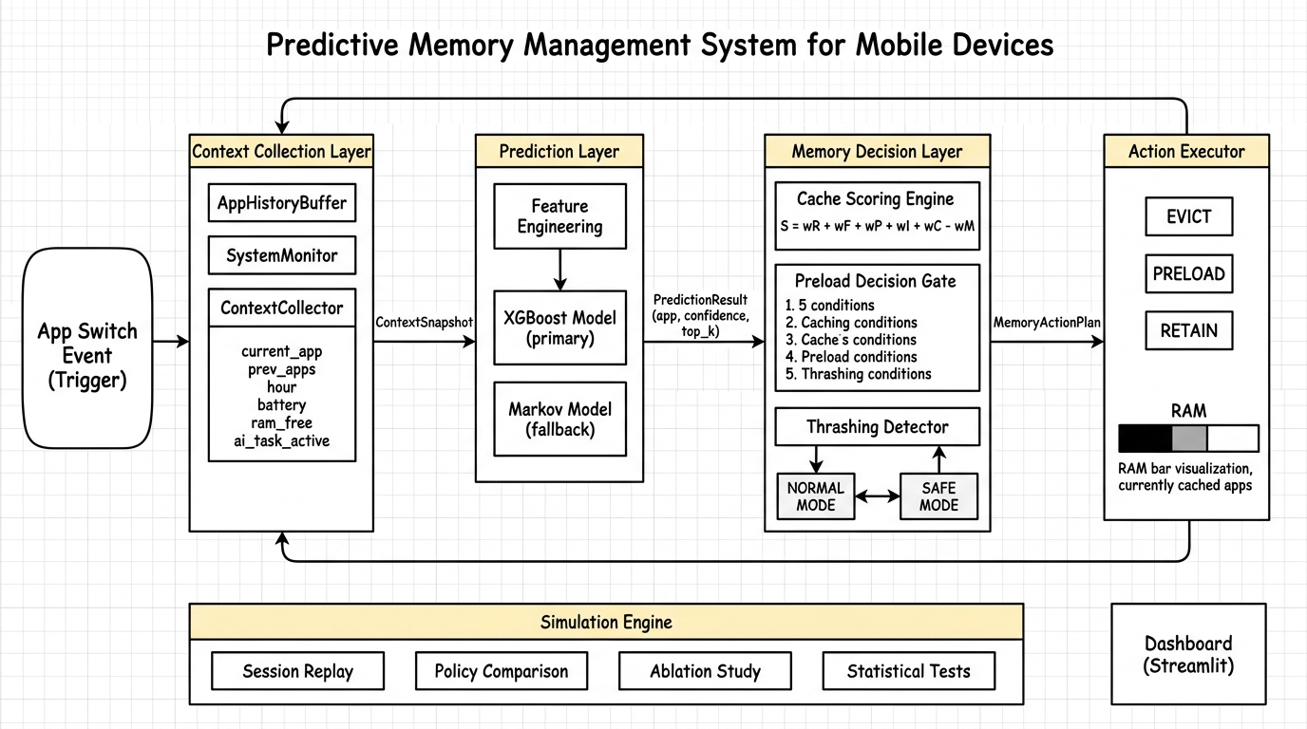
6. System Architecture — End-to-End Flow
Flow: App switch → Module 1 captures 12 signals → Module 2 predicts next app → Module 3 scores all cached apps & decides evict/preload → Module 4 executes → feeds back to Module 1
Module 5: Simulation Engine — replays 50,000 events to benchmark our system vs. baselines
Module 6: Streamlit Dashboard — real-time visualization of predictions, memory map, and metrics
7

Slide 8
8. How Our System Compares — And What Makes It Novel
Feature | No Optimization | LRU (Android) | Static Preload | Our System
Eviction logic | Remove oldest | Remove least recent | LRU + top-3 apps | ML-weighted 6-factor score
Knows what you'll use next? | No | No | Partially (top-3 only) | Yes (real-time ML prediction)
Adapts to context? | No | No | No | Yes (time, battery, AI state...)
Pre-loads apps? | No | No | Yes (but fixed list) | Yes (with 5 safety checks)
Catches bad decisions? | No | No | No | Yes (thrashing → Safe Mode)
Expected cache hit rate | ~40% | ~55% | ~62% | >75%
Expected app launch time | ~1200 ms | ~900 ms | ~750 ms | <400 ms
4 Novel Contributions (What Makes This Patent-Worthy):
1. Prediction IN the eviction formula: first system to use ML confidence as a weighted number in deciding what stays in memory
2. 5-condition preload gate: won't blindly preload — checks confidence, RAM, battery, stability, and cache status
3. Automatic thrashing recovery: detects when it's making things worse and degrades gracefully to Safe Mode
4. AI-workload awareness: gives extra protection to expensive AI model caches (camera AI, LLM weights)
9

Slide 9
9. How We Prove It Works — Evaluation Plan
Simulation Setup
What We Measure (5 KPIs)
Since we can't modify a real Android phone's kernel, we will build a simulator furst.
Data: 50,000 synthetic app-switch events across 5 user types (student, professional, casual, power user, developer)
Policies: NoOpt, LRU, StaticPreload, Proposed — tested under identical conditions
RAM configs: 4 GB, 6 GB, 8 GB — to test across device tiers
Repetitions: 30 runs per config for statistical significance
Total: 4 × 5 × 3 × 30 = 1,800 benchmark simulations
Stats: Paired t-test, p < 0.05 — proves the difference is real, not random
Cache Hit Rate: how often the app is already in memory → target >75%
Avg Launch Latency: mean time to open an app → target <400 ms
Thrashing Events: evict-then-reload-same-app cycles → target <3 per session
Preload Success: how often a preloaded app was actually used → target >60%
Prediction Accuracy: top-1 correct prediction → target >70%
These KPIs directly measure user experience improvement.
Ablation Study — Which Features Actually Matter?
We remove one feature group at a time to see how much accuracy drops. This proves which signals matter most.
Remove app history (prev_app_1/2/3): biggest drop expected (~10–15%) → proves sequential patterns are the #1 signal
Remove time features (hour, day, peak): ~5–8% drop → proves temporal context matters
Remove device state (battery, RAM): ~2–4% drop → resource state adds value but less than history
Remove categories: ~2–3% drop → minor but helps with unseen app transitions
Keep only current_app: drops to Markov baseline (~60%) → proves multi-feature approach is essential
Total ablation experiments: 6 × 5 × 3 × 30 = 2,700 simulations
10

Slide 10
10. Implementation Timeline & Tech Stack
Week | Phase | What We Build
1 | Foundation | Project setup, create 15–20 app profiles, generate 50K synthetic events
2 | ML Models | Feature converter, train Markov (baseline) + XGBoost (main), evaluate accuracy
3 | Memory Simulator | Memory state tracker, 3 baseline policies + our proposed system, initial results
4 | Benchmarking | Run 1,800 benchmarks + 2,700 ablation experiments, statistical validation
5 | Visualization | Publication-quality charts, Streamlit dashboard
6–7 | Patent Filing | Write patent spec, prior art search, file with Indian Patent Office
8–9 | IEEE Paper | 6-page LaTeX paper, capstone report, submit to conference
Component | Technology | Why This
Language | Python 3.10+ | Best ecosystem for ML and data science
ML Model | XGBoost + scikit-learn | Fast inference, no GPU, interpretable feature importance
Data Processing | pandas + numpy | Industry standard for tabular data
Statistics | scipy | Paired t-tests, p-value computation
Charts | matplotlib + seaborn + plotly | Publication-quality static + interactive figures
Dashboard | Streamlit | Rapid prototyping of interactive web apps
Database | SQLite | Lightweight, zero-config, single-file database
11

Slide 11
11. References
[1] C. Shin, J.-H. Hong, A. K. Dey, "Understanding and Prediction of Mobile Application Usage," ACM UbiComp, 2012. DOI: 10.1145/2370216.2370241
[2] Z. Huang, T. Li et al., "Predicting Mobile App Usage with Context-Aware Dynamic Hypergraphs," IEEE TMC, vol. 24, 2025. DOI: 10.1109/TMC.2024.3521876
[3] S. Zhao et al., "AppUsage2Vec: Modeling Smartphone App Usage for Prediction," IEEE ICDE, pp. 1322–1333, 2019. DOI: 10.1109/ICDE.2019.00120
[4] S. Zhao, J. Xu et al., "Context-Aware Mobile App Prediction via Deep Sequential Learning," ACM UbiComp, 2023. DOI: 10.1145/3594739.3610680
[5] H. Pan, C. Xu, Y. Zhang, "DeepApp: Predicting Personalized Smartphone App Usage," ACM TIST, vol. 14, 2023. DOI: 10.1145/3568684
[6] Google AOSP, "Low Memory Killer Daemon (lmkd)," 2024. source.android.com/docs/core/perf/lmkd
[7] S. Lee, J. Kim, H. Bahn, "SWAM: Revisiting Swap and OOM for Mobile," Samsung, MobiSys Workshop, 2023. DOI: 10.1145/3591197.3593422
[8] Y. Chen, L. Yang, W. Zhang, "Memory-Efficient Mobile App Mgmt. via Predictive Caching," IEEE Access, 2024. DOI: 10.1109/ACCESS.2024.3372104
[9] Android Developers, "App Standby Buckets," 2024. developer.android.com/…/appstandby
[10] J. Park, Y. Lee, S. Ha, "Learning-Based Memory Management for Mobile," IEEE/ACM MICRO, 2023. DOI: 10.1145/3613424.3614274
[11] T. Chen, C. Guestrin, "XGBoost: A Scalable Tree Boosting System," ACM SIGKDD, pp. 785–794, 2016. DOI: 10.1145/2939672.2939785
[12] E. Ipek, O. Mutlu, J. F. Martinez, "Self-Optimizing Memory Controllers: A RL Approach," IEEE/ACM ISCA, 2008. DOI: 10.1109/ISCA.2008.21
[13] Z. Shi, X. Huang, A. Jain, "Applying Deep Learning to Data Prefetching," IEEE/ACM MICRO, 2023. DOI: 10.1145/3613424.3614259
[14] M. Hashemi, K. Swersky et al., "Learning Memory Access Patterns," ICML, PMLR 80:1919–1928, 2018. arXiv: 1803.02329
[15] J. Lin, W.-M. Chen, S. Han, "MCUNet: Tiny Deep Learning on IoT Devices," NeurIPS, 2020. arXiv: 2007.10319
[16] S. Laskaridis et al., "Adaptive Inference through Early-Exit Networks," ACM MobiSys, 2024. DOI: 10.1145/3643832.3661880
[17] Q. He, Y. Chen et al., "On-Device LLM Inference: Memory Optimization for Mobile," IEEE Edge, 2025. DOI: 10.1109/SEC62691.2025.00032
[18] A. Dhakal, S. Kulkarni, I. Stoica, "mLLM: On-Device LLM Serving," USENIX OSDI, 2025. usenix.org/conference/osdi25
12
Thank You

Slide 12
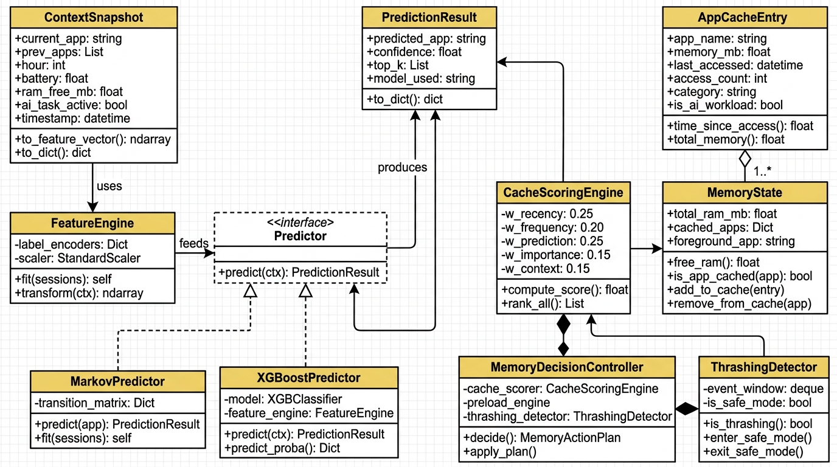
7. Class Design — How the Code Is Structured
ContextSnapshot: captures phone state (app, time, battery, RAM) → FeatureEngine: converts to numbers for ML
Predictor interface: common contract for MarkovPredictor (baseline) & XGBoostPredictor (primary) — swappable
MemoryDecisionController: the brain — uses CacheScoringEngine + PreloadGate + ThrashingDetector to produce a MemoryActionPlan
8

