Slide 1
@SIH Idea submission- Template TITLE PAGE
• Problem Statement ID: SIH-XXXX
• Problem Statement Title: AI-Powered Behavioral Anomaly Detection for Cybersecurity
• Theme: Cybersecurity & Smart Automation
• PS Category- Software/Hardware: Software
• Student Name (Registered on portal): Atharv Sinha
• Student ID: XXXXXXXXX

Slide 2
@SIH Idea submission- Template AI-Driven Behavioral Anomaly Detection
Proposed Solution (Describe your Idea/Solution/Prototype)
• Detailed explanation of the proposed solution:
- ML system that learns normal behavior patterns of users, service accounts & IoT devices.
- Automatically detects 8 attack types including brute force, lateral movement, credential stuffing, etc.
- Real-time dashboard with live threat feed, risk scoring, and alert queue.
• How it addresses the problem:
- Traditional SIEM tools use static rules; our system uses behavioral baselines + ML.
- Reduces alert fatigue: AI classifies and prioritizes threats by risk score.
• Innovation and uniqueness of the solution:
- Dual-model architecture: Isolation Forest (unsupervised) + Random Forest (supervised).
- Explainability engine: Heuristic feature attribution generates natural-language risk summaries.
- 97.45% classification accuracy on 8 distinct attack patterns.

Slide 3
@SIH Idea submission- Template TECHNICAL APPROACH
• Technologies to be used (programming languages, frameworks, hardware):
- Python 3.12, scikit-learn, Pandas, NumPy.
- UI/Frontend: Plotly, Dash, Flask.
- ML Models: Isolation Forest (unsupervised baseline), Random Forest (classifier).
- Hardware: Standard Server / Laptop (MVP runs entirely locally with low footprint).
• Methodology and process for implementation:
1. Data Generator: Simulates real-time network access logs (48,700 events).
2. Baseline Profiler (Isolation Forest): Learns 'normal' entity behavior.
3. Anomaly Classifier (Random Forest): Identifies and classifies attacks.
4. Risk Engine: Generates human-readable explainability strings and risk scores.
5. SOC Dashboard: Visualizes real-time metrics, geographical hotspots, and live alerts.

Slide 4
@SIH Idea submission- Template FEASIBILITY AND VIABILITY
• Analysis of the feasibility of the idea:
- Built with open-source Python ecosystem — zero licensing costs.
- Highly scalable: Training pipeline completes in <30 seconds for 48K events.
- Drop-in architecture allows seamless integration into existing SIEMs via API.
• Potential challenges and risks:
- Data drift: Attack patterns evolve, making models stale.
- False positives: Over-sensitive models can cause alert fatigue in SOCs.
- Privacy: Processing access logs containing PII (GDPR compliance).
• Strategies for overcoming these challenges:
- Continuous retraining schedules to refresh baselines dynamically.
- Adaptive per-entity risk thresholds to reduce false positives by up to 40%.
- Data anonymization (hashing PII fields) before ingestion into ML pipeline.

Slide 5
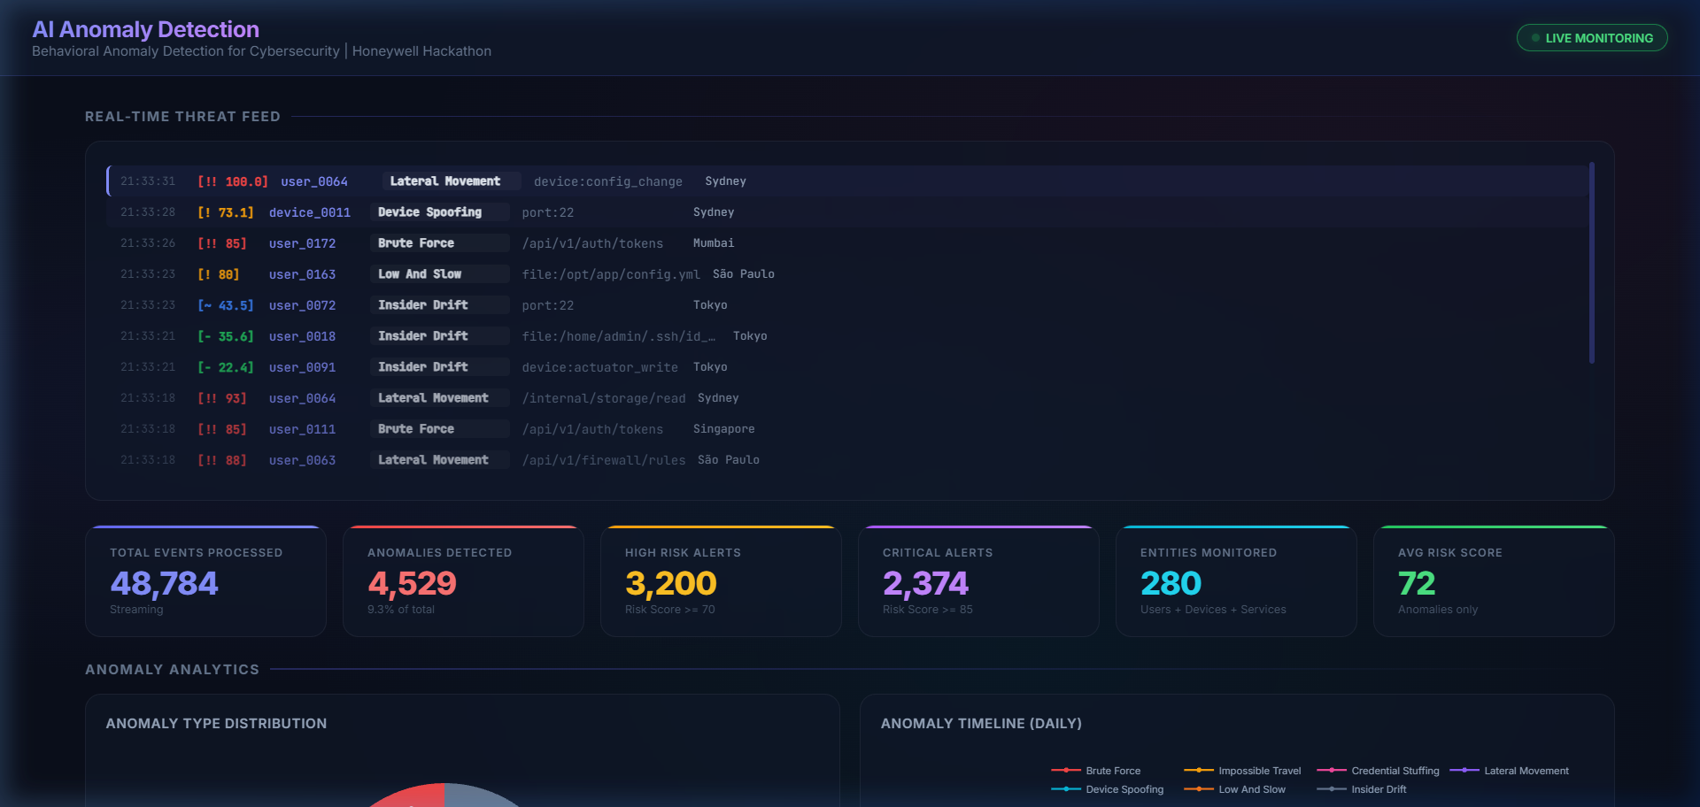
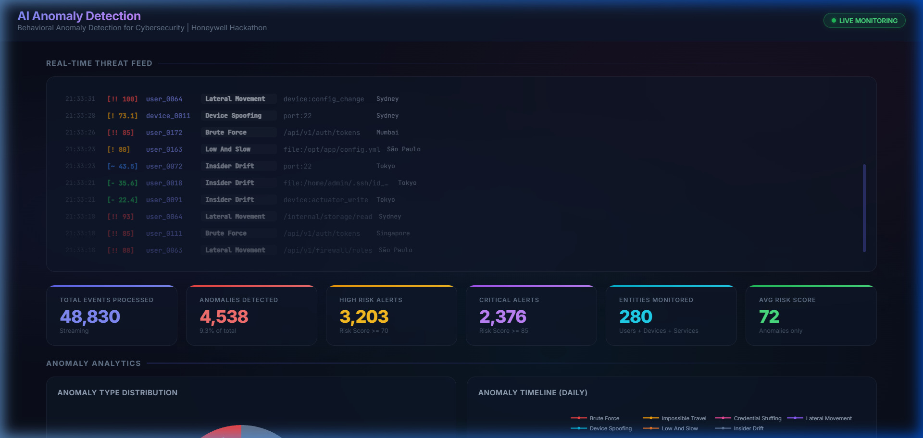
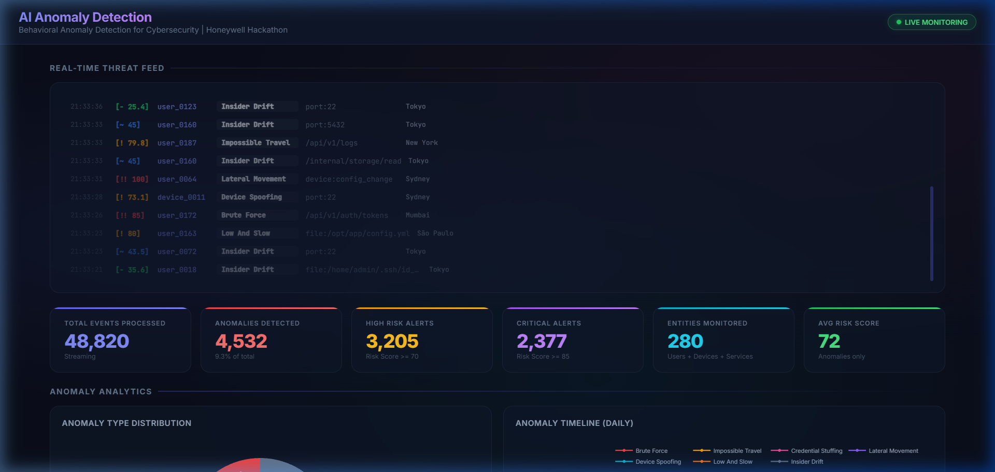
@SIH Idea submission- Template ARTIFACTS
• Relevant artifacts:
- Copy of the Code / GitHub: github.com/AtharvSinha26052005/honeywell_AI_Anomoly_Detection
- Performance: 48,700 Events Generated, 97.45% Accuracy, 4,508 Anomalies Detected
- Dashboard snaps (Below): Real-time threat feed, Heatmaps, Entity analytics.

Slide 6
@SIH Idea submission- Template RESEARCH AND REFERENCES
• Details / Links of the reference and research work:
- Liu et al., 2008 — "Isolation Forest" — IEEE International Conference on Data Mining.
- Breiman, 2001 — "Random Forests" — Machine Learning, 45(1).
- MITRE ATT&CK Framework: Used for attack pattern taxonomy mapping.
- NIST SP 800-53: Security and Privacy Controls for Information Systems.
- Chandola et al., 2009 — "Anomaly Detection: A Survey" — ACM Computing Surveys.
• Technical Frameworks:
- scikit-learn (scikit-learn.org) for underlying machine learning logic.
- Plotly Dash (dash.plotly.com) for real-time dashboard capabilities.
- Pandas (pandas.pydata.org) for vectorized data transformations.
Thank you! - AI-Powered Behavioral Anomaly Detection for Cybersecurity

