Slide 1
HONEYWELL HACKATHON 2026 TITLE PAGE
• Problem Statement ID: (Enter PS ID)
• Problem Statement Title: AI-Powered Behavioral Anomaly Detection
• Theme: Cybersecurity & Smart Automation
• PS Category: Software
• Student Name: Atharv Sinha
• Student ID: (Enter Student ID)

Slide 2
HONEYWELL HACKATHON 2026 AI-Driven Behavioral Anomaly Detection
Proposed Solution:
• Detailed explanation of the proposed solution:
- AI/ML system that models normal access behavior for users and IoT devices.
- Automatically detects and classifies 8 intrusion types (e.g., brute force, lateral movement).
- Provides explainable risk scores through an analyst-facing SOC dashboard.
• How it addresses the problem:
- Replaces rigid static rules with dynamic behavioral baselines.
- Mitigates alert fatigue by intelligently scoring and prioritizing threats.
• Innovation and uniqueness of the solution:
- Dual Pipeline: Isolation Forest (unsupervised profiling) + Random Forest (supervised multi-class).
- Explainability Engine: Translates ML decisions into human-readable alerts.
- Cold-start handling for new entities using statistical profiling fallbacks.

Slide 3
HONEYWELL HACKATHON 2026 TECHNICAL APPROACH
• Technologies to be used:
- Machine Learning: Python, scikit-learn, Pandas, NumPy.
- Visualization & UI: Plotly Dash, Flask, Bootstrap.
- Hardware: Standard Laptop/Server (Designed for lightweight, local execution).
• Methodology and process for implementation:
1. Data Generator Layer: Synthetic log generation simulating 50K+ events and 8 attack patterns.
2. ML Pipeline - Profiling: Isolation Forest isolates 'normal' entity behavior.
3. ML Pipeline - Classification: Random Forest determines specific attack types.
4. Explainability Layer: Feature attribution maps statistical anomalies to human-readable text.
5. Dashboard UI: Real-time Plotly Dash interface visualizes KPIs, geo-maps, and alert queues.

Slide 4
HONEYWELL HACKATHON 2026 FEASIBILITY AND VIABILITY
• Analysis of the feasibility of the idea:
- Cost-Effective: Built entirely on an open-source Python stack (No vendor lock-in).
- Highly Performant: The 50K event pipeline trains and infers in under 30 seconds.
- Extensible: Modular architecture easily integrates with standard SIEM APIs (Splunk, Elastic).
• Potential challenges and risks:
- Evolving Threats (Concept Drift): Attack patterns change over time.
- Alert Fatigue: Improperly tuned models can overwhelm SOC analysts with false positives.
- Big Data Scaling: Processing millions of logs daily requires distributed computing.
• Strategies for overcoming these challenges:
- Drift Mitigation: Implement continuous, scheduled model retraining.
- Analyst Feedback Loop: Tunable contamination thresholds per-entity to reduce noise.
- Scaling Roadmap: Transition MVP architecture to Apache Spark / Kafka for enterprise deployment.

Slide 5
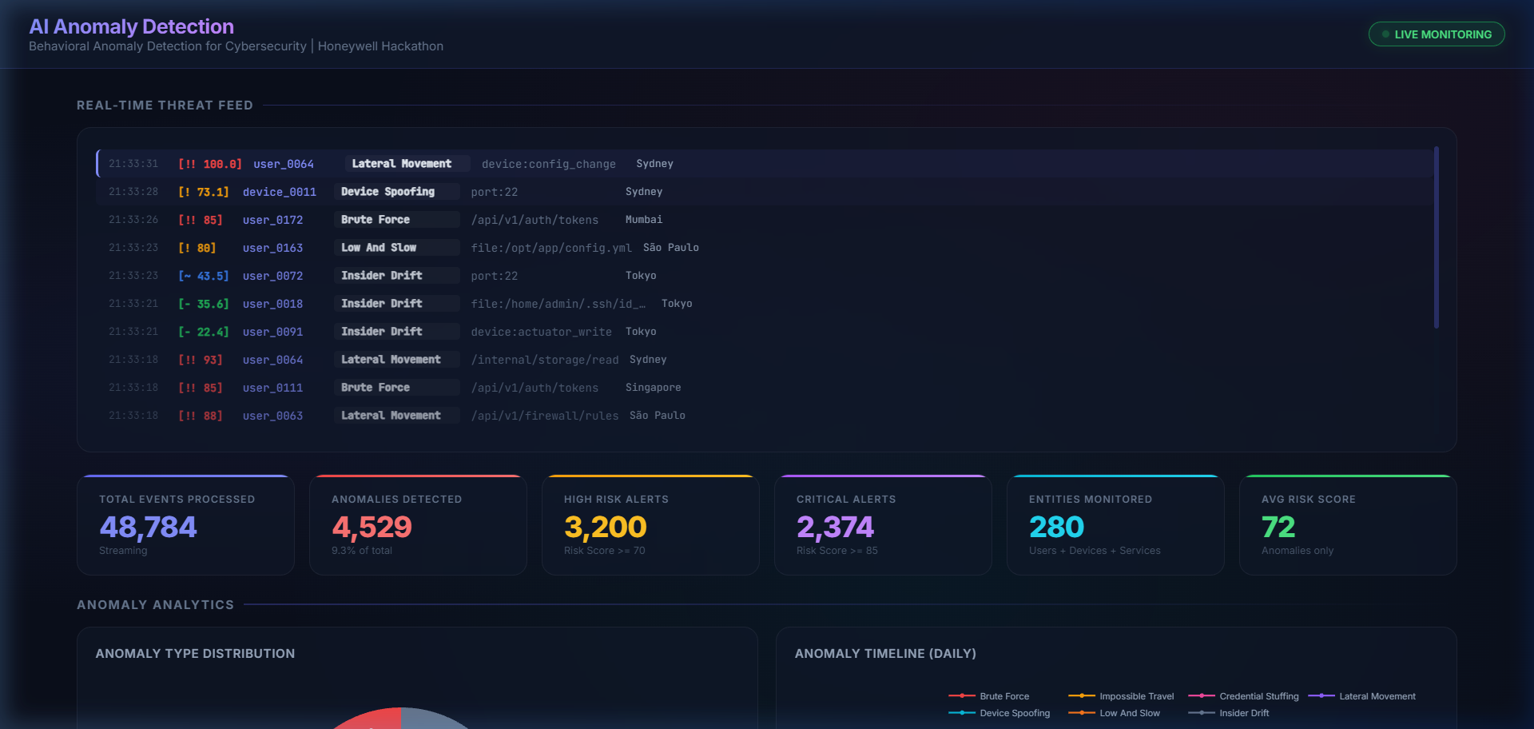
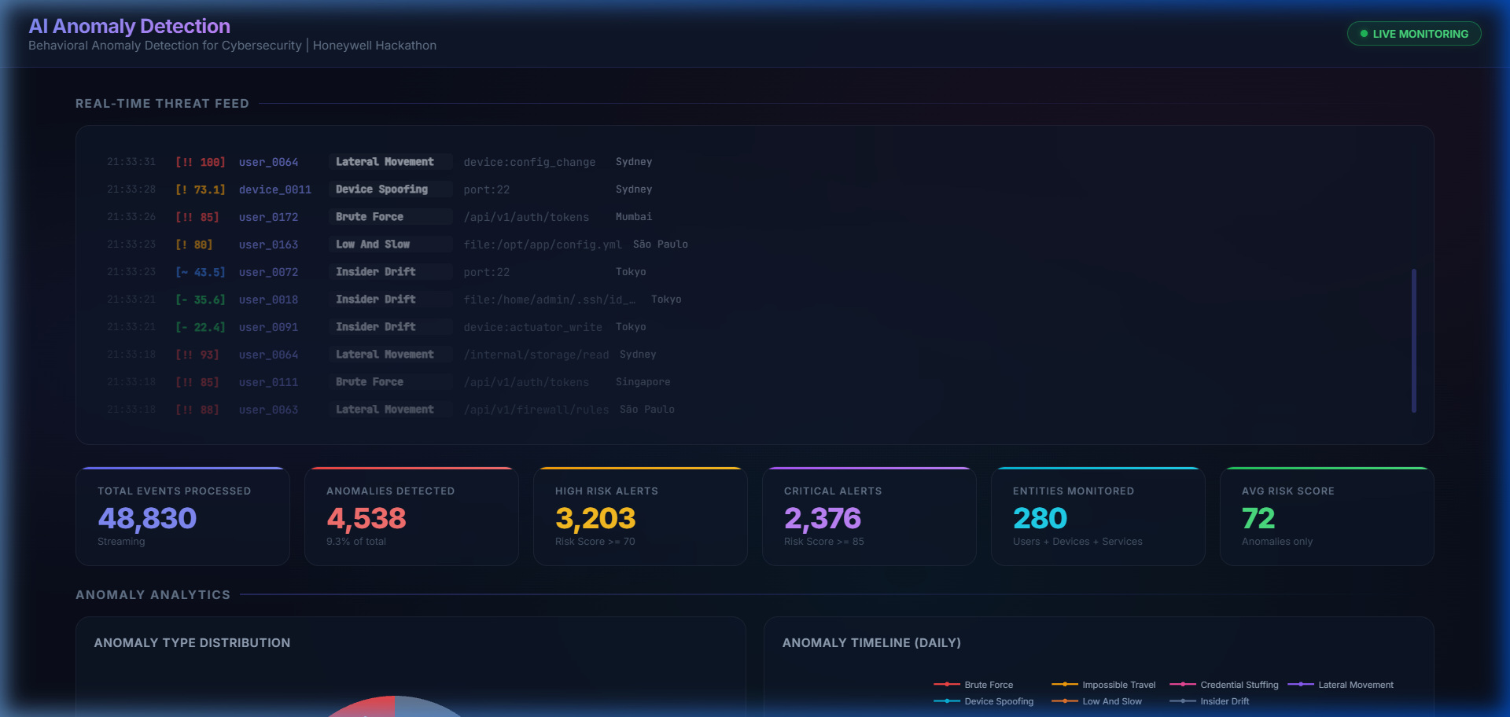
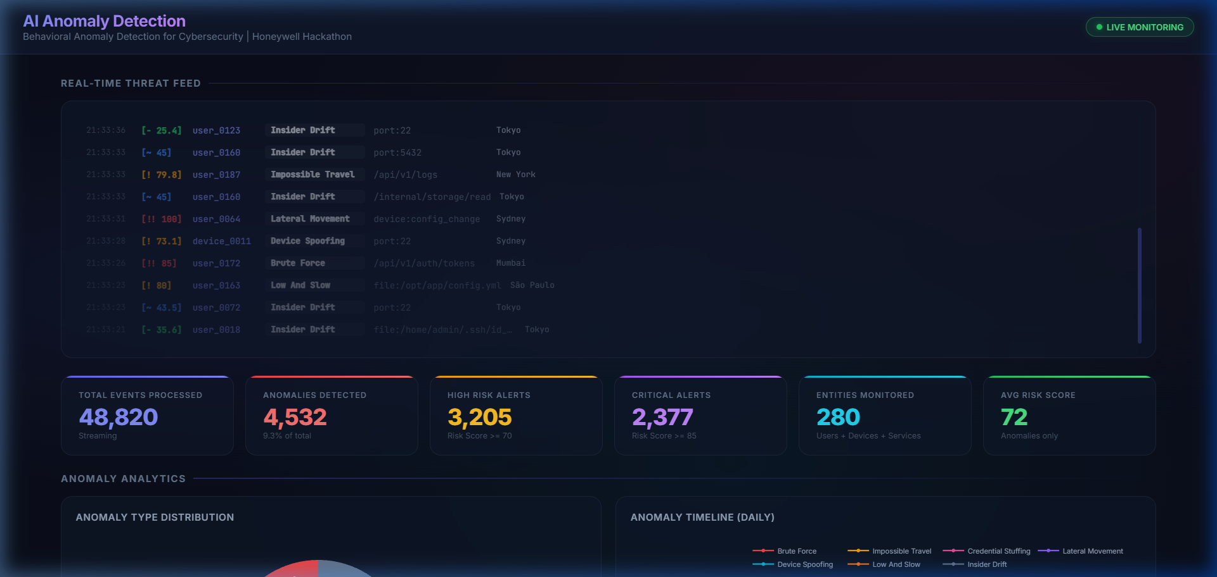
HONEYWELL HACKATHON 2026 ARTIFACTS
• Relevant artifacts:
- GitHub Repository: github.com/AtharvSinha26052005/honeywell_AI_Anomoly_Detection
- Prototype Output: 48,700 Events, 97.45% Accuracy across 8 attack patterns.
- Snaps of the Solution: Real-time dashboard components below.

Slide 6
HONEYWELL HACKATHON 2026 RESEARCH AND REFERENCES
• Details / Links of the reference and research work:
- Liu, F. T., et al. (2008). "Isolation Forest". IEEE International Conference on Data Mining.
- Breiman, L. (2001). "Random Forests". Machine Learning, 45(1).
- MITRE ATT&CK Framework: Utilized for taxonomy mapping of simulated attack patterns.
- NIST SP 800-53: Guidelines on Security and Privacy Controls.
• Technology Stack Documentation:
- scikit-learn (scikit-learn.org) - Core machine learning estimators.
- Plotly Dash (dash.plotly.com) - Real-time dashboard visualization.
- Pandas / NumPy (pandas.pydata.org) - Vectorized data pipeline transformations.
• Open Source Assets:
- Developed during Honeywell Hackathon 2026 (MIT Licensed codebase).

Slide 7
Thank You!
AI-Powered Behavioral Anomaly Detection for Cybersecurity Honeywell Hackathon 2026

