Slide 1
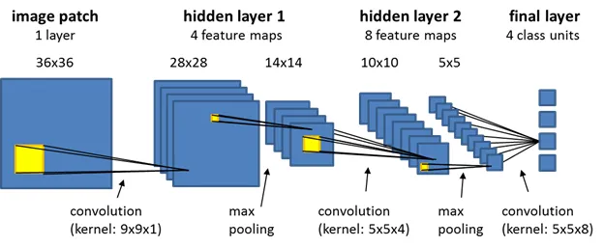
CNN Architecture
Sequential model with 5 Conv2D layers, each followed by MaxPooling and BatchNormalization.
Final layers include two Dense layers with L2 regularization and Dropout for reducing overfitting.
Output layer: Softmax for multi-class classification.

Slide 2
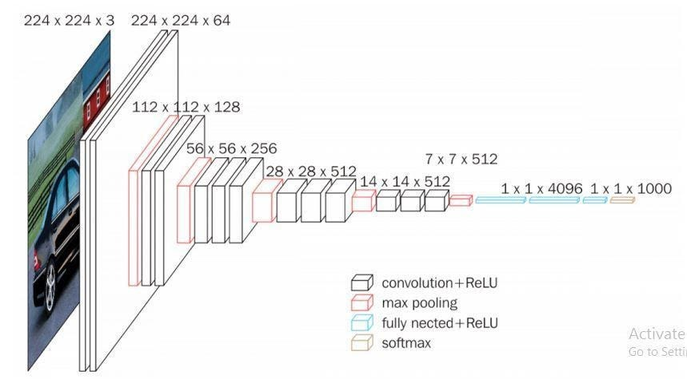
VGGNet (VGG16) Architecture
Base Model: Pre-trained VGG16 on ImageNet
Weights: Loaded with ImageNet weights
Top Layers: Excluded to add custom layers
Frozen Layers: Base model layers set to non-trainable to retain learned features
Custom Layers:
Flatten Layer: Converts feature map to a 1D array
Dense Layer: 1024 neurons with ReLU activation for learning complex patterns
Dropout Layer: 50% dropout to prevent overfitting
Output Layer: 21 neurons with Softmax activation for multi-class classification
Final Model: Combines frozen VGG16 with custom layers tailored to our 21-class dataset

