Slide 1
AUTONOMOUS INCIDENT TRIAGE
SnapTicket
Agent
Powered by Gemma 4
Bridging the gap between software crashes and engineering bug reports.

Slide 2

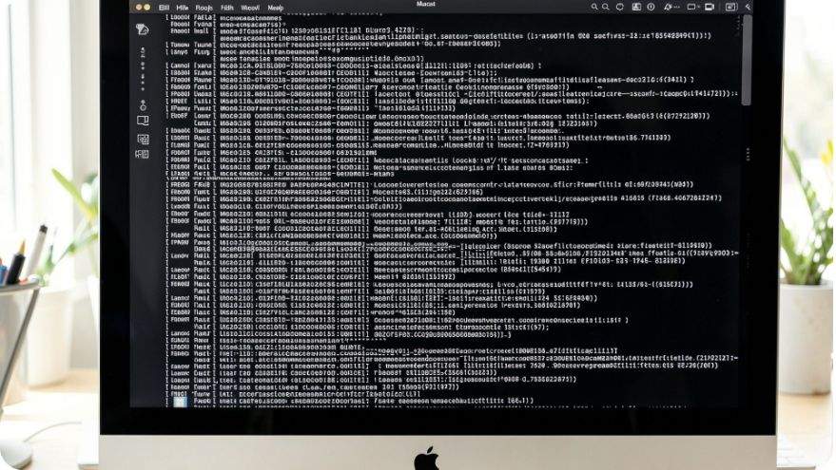
THE TRIAGE GAP
It crashed, but what actually happened?
Users send vague screenshots: “The screen froze.”
Mac crash logs (.ips files) hide deep in system folders and look like unreadable code.
Developers manually match screenshots to the right log lines.
“The screen froze.”
The .ips log

Slide 3



Scans the evidence
Scans local macOS diagnostic logs automatically.
THE CONNECTION LAYER
SnapTicket connects the clues
Accepts the screenshot
Accepts an error screenshot by drag and drop or paste.
One agent turns scattered evidence into a shared understanding of the crash.
Reads both together
Gemma 4 reads the screenshot and log together to understand what went wrong.

Slide 4
THE WORKFLOW
From crash to clean report
Four moves turn raw evidence into a report an engineer can use.
1
2
Detect telemetry
Drop the screenshot
Detect system crash telemetry instantly.
Drop an error screenshot into the web dashboard.
3
4
Generate the report
Choose privacy
Generate the root cause, title, and reproduction steps in Markdown.
Choose privacy settings: attach the screenshot or send text only.

Slide 5




CONTROL WHEN IT MATTERS
Private by default.
Ready to dispatch.
Privacy first
Run 100% locally on a Mac with Ollama, or use Google AI Studio in the cloud.
Smart dispatch
Assisted support
Create a live GitHub issue through the API.
Use an assisted browser co-pilot for web support portals.

Slide 6
THE PAYOFF
Turn 10 minutes of triage into 3 seconds
10
3
→
MINUTES
SECONDS
Manual triage
Clean incident report
Eliminates tedious bug reporting.
Turns messy crash evidence into a clean, actionable incident report.
Future: production-grade incident management across desktop apps.
SnapTicket removes the tedious work between a crash and an actionable incident report.

