Slide 1

Fundamentals Data Engineering Project Name: Tobacco Risk Analysis Professor - Faig Garayev TA - Sangamesh Awaradi
Group Members:
Atharva Bodhankar (Project Co-ordinator)
Swapnil Joijode
Purnima Mutyala
Girish Maligireddy
Yilan Peng

Slide 2
Project Overview
This project aimed to analyze the Behavioral Risk Factors data related to tobacco usage in the United States. The data was extracted from multiple sources, transformed using ELT processes, and loaded into staging and normalized tables for analysis. The analysis was conducted using Tableau to create insightful visualizations.
The project focused on three key areas: Response Statistics, Demographics, and Total Responses vs. Responses Recorded in a Survey. The first dashboard depicted the data count for various measures like Age, Sample Size, and Total Data by Year. The second dashboard provided an overview of responses based on States filtered by Year. The third dashboard demonstrated a butterfly chart to compare Total Responses vs. Responses actually recorded in a survey.

Slide 3
Project Overview
We found that age and gender were significant factors that affected tobacco usage. One of the important observation was to identify that the percentage of actual response of the smoking survey was very less then recorded sample data. These insights can help public health officials to develop targeted interventions to address these specific risk factors and prevent tobacco-related illnesses.
The insights gained from this analysis can help public health officials and policymakers to develop effective strategies to reduce tobacco usage and improve public health. Overall, the project provides a comprehensive understanding of the behavioral risk factors associated with tobacco usage in the United States.

Slide 4
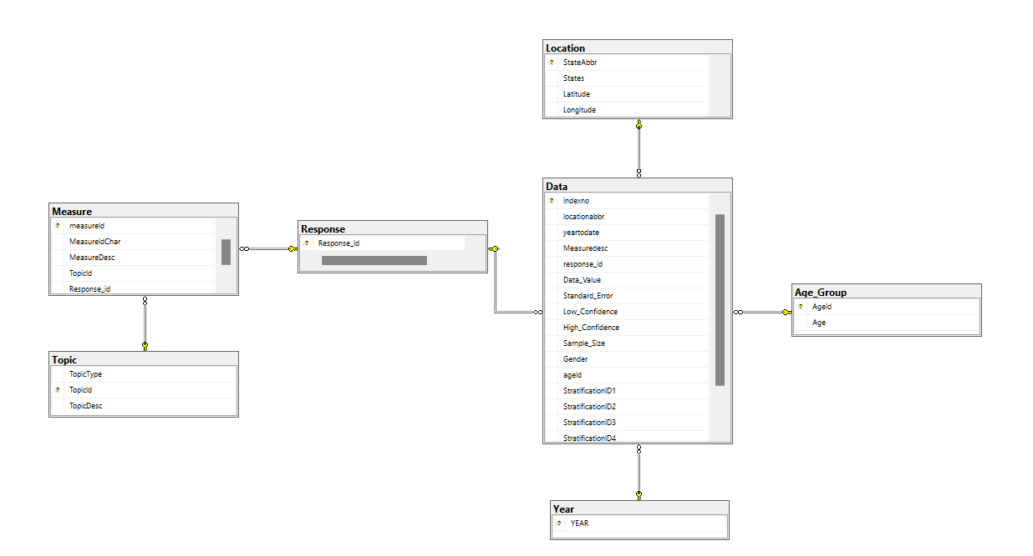
Physical Data Model

Slide 5
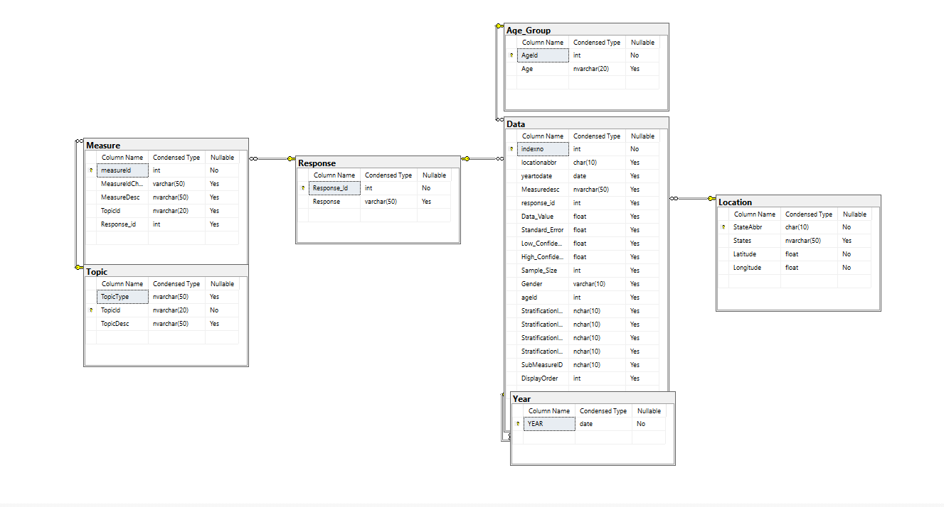
Logical Data Model

Slide 6
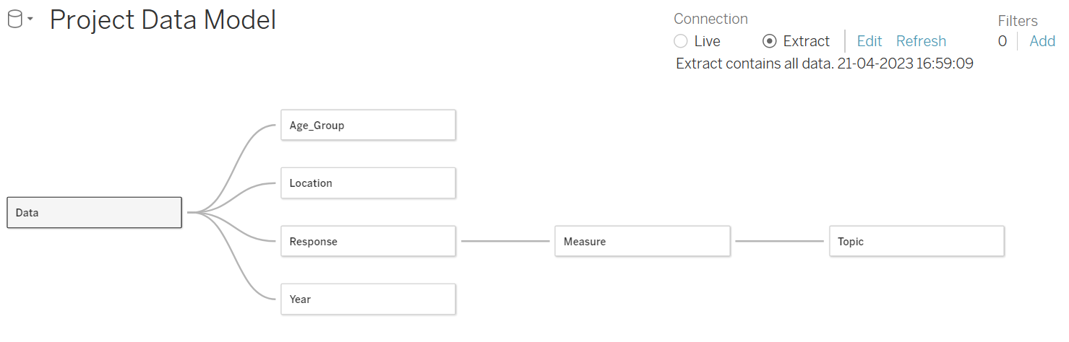
Data Source Diagram

Slide 7

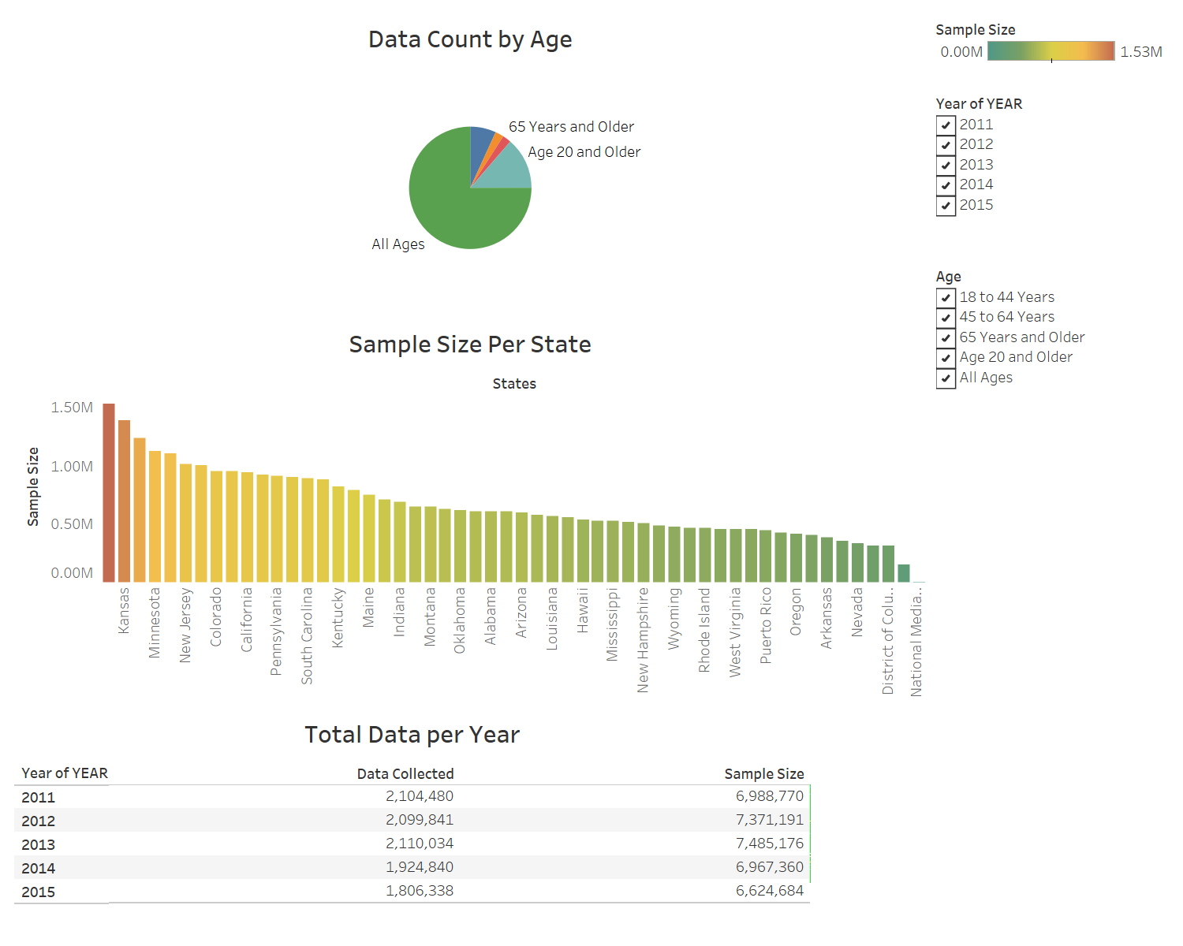

Slide 8
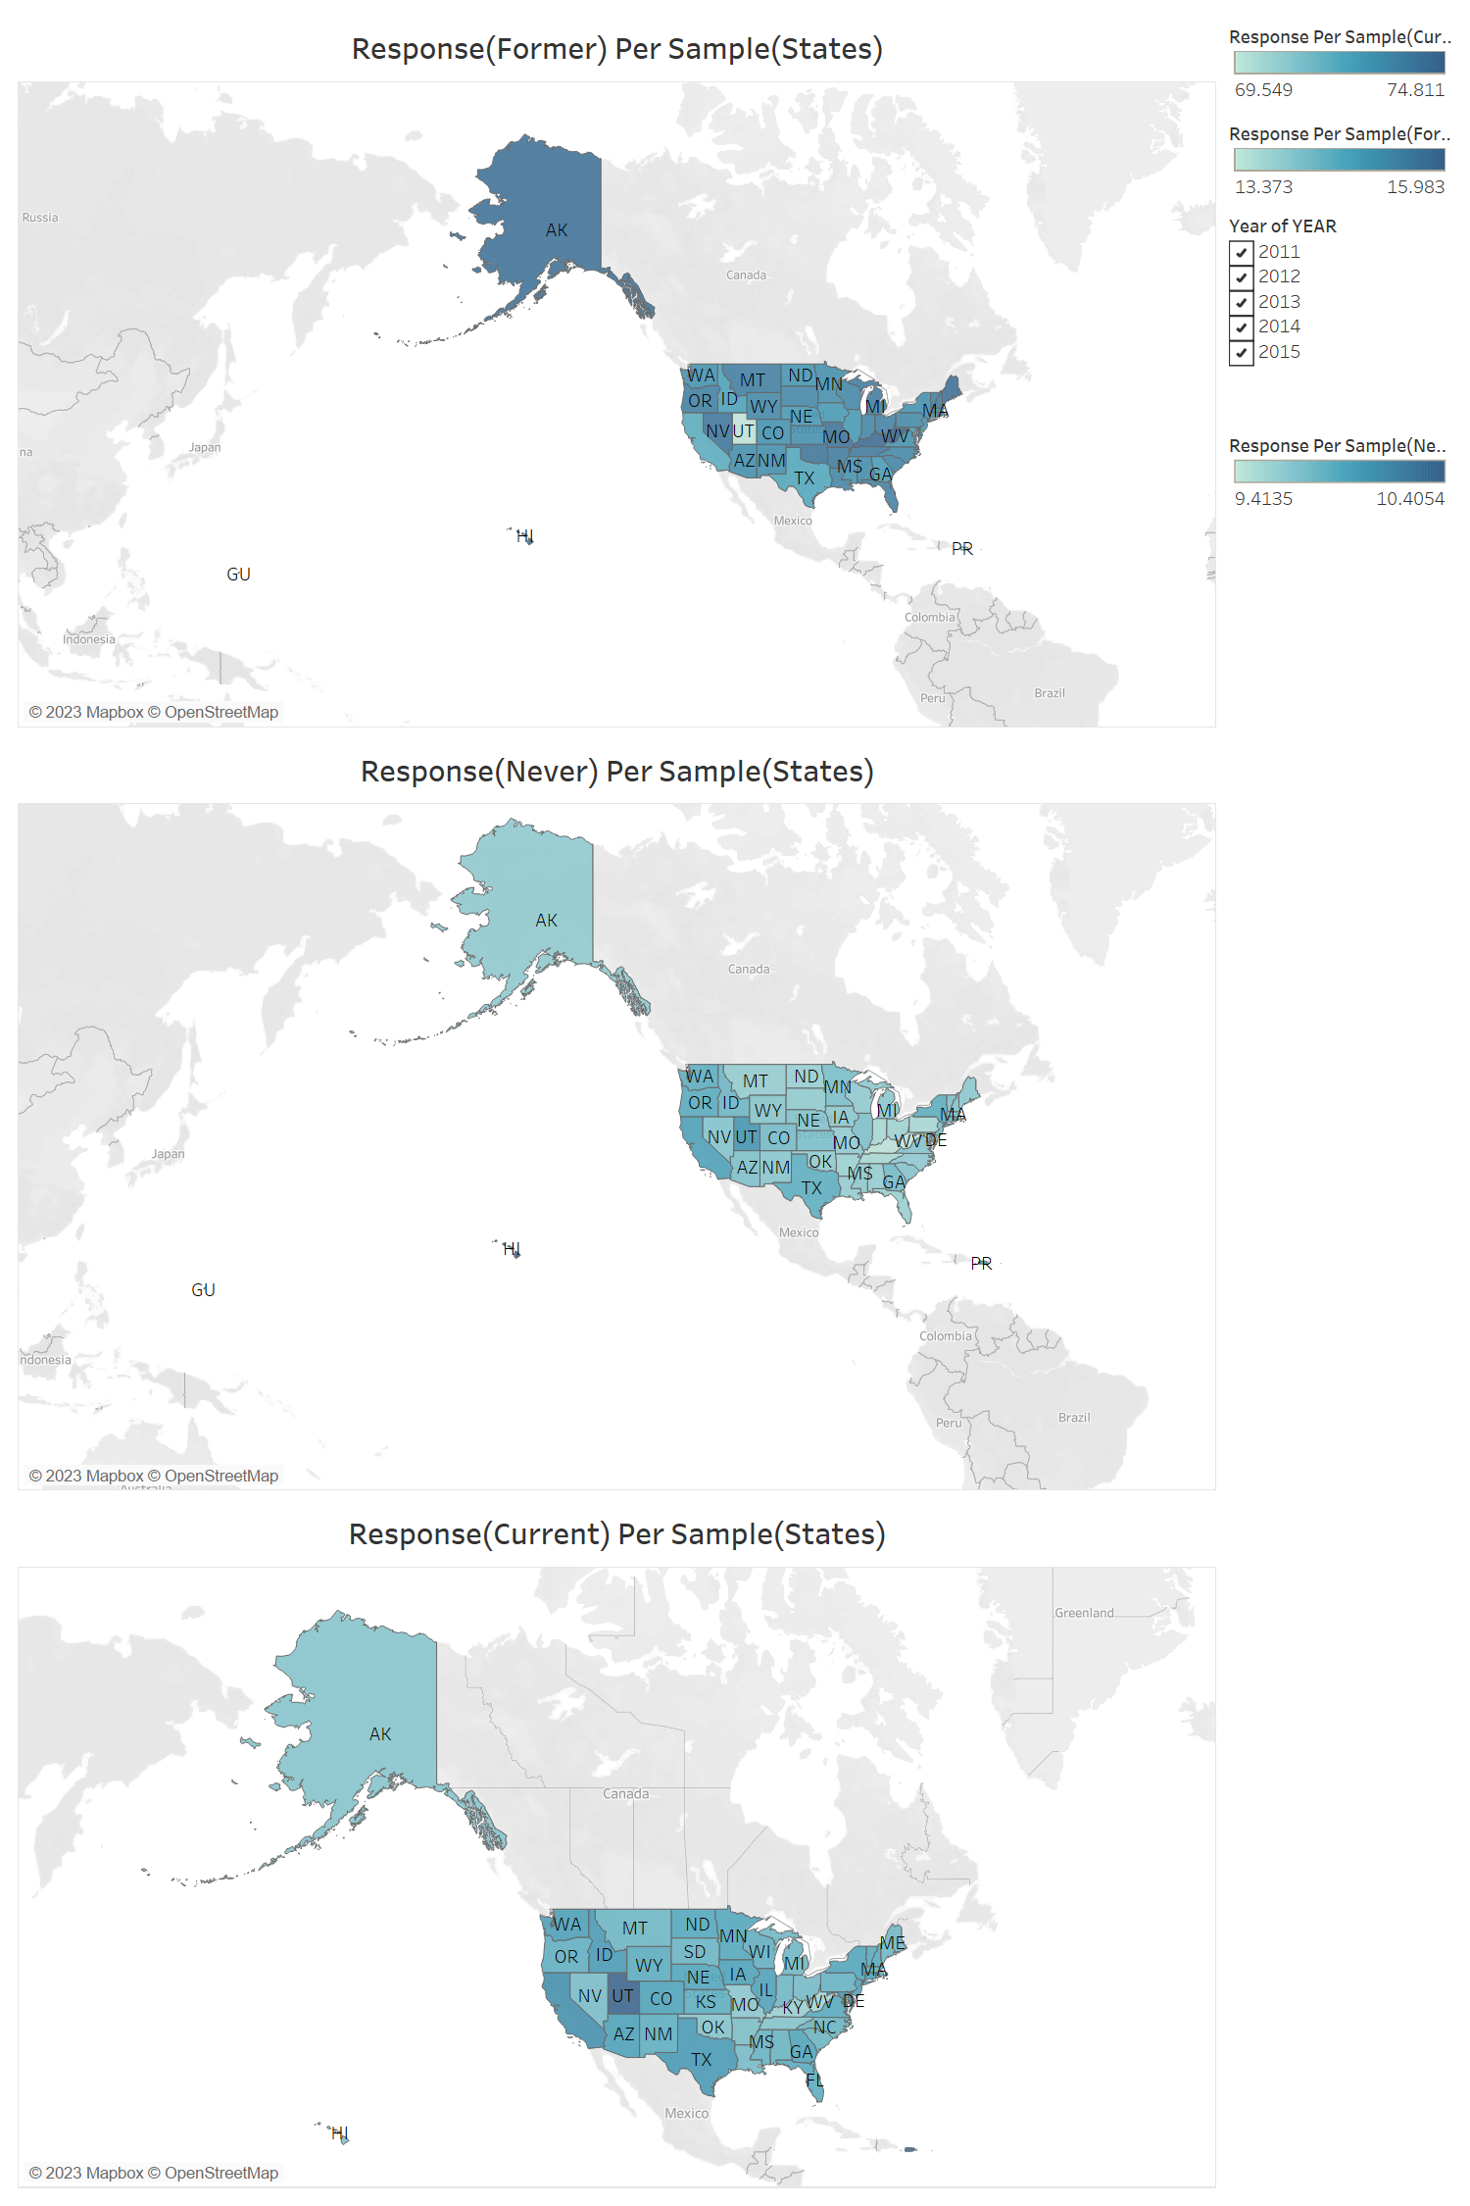

Slide 9
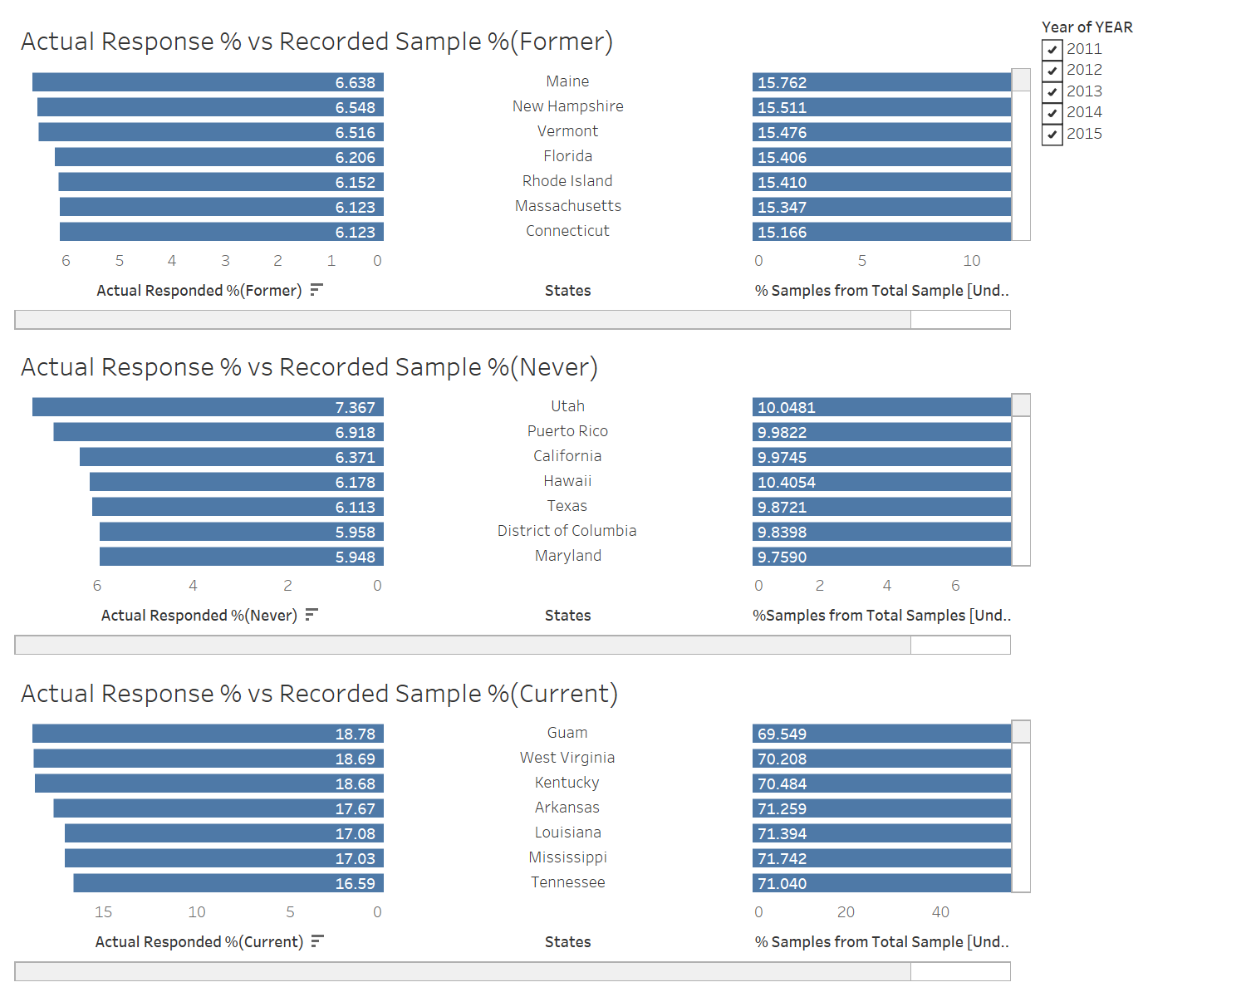

Slide 10
Lesson Learned - The Importance of Data Visualization
Our initial understanding of the dataset was limited to the raw data itself.
After transforming the data and visualizing it in different ways, we gained new insights that we did not previously anticipate.
In our analysis of the Tobacco Risk dataset, we initially relied solely on the recorded sample data to draw conclusions about the population.
Upon closer examination and further data exploration, we discovered that the actual respondents were very different from the recorded sample.
This experience highlights the importance of ensuring that the sample data used in analysis is representative of the true population to draw accurate conclusions and make informed decisions based on the data.

Slide 11
Conclusion
Tobacco Risk Analysis project provided a detailed analysis of the behavioral risk factors associated with tobacco usage in the United States. The project employed ELT (Extract, Load, Transform) processes to integrate and transform data from multiple sources, which was then loaded into staging and normalized tables for analysis. The use of data visualization tools such as Tableau allowed for the creation of intuitive and interactive dashboards to identify patterns and trends, making it easier to derive insights from the data.
This project emphasizes the importance of data-driven analysis in understanding and addressing public health challenges. The findings gained from this project can help public health officials and policymakers to develop effective strategies to reduce tobacco usage and improve public health.

