Slide 1

Loan Approval Prediction using Neural Networks
Applied Deep Learning
Predict loan approval using customer data
Name: Atharva Kahu
Net ID: axk220142

Slide 2
Data Preprocessing
One-hot encoding for categorical variables
Ordinal encoding for education
Standard_Scaler applied to numerical features
Data Split
Split: 60% Train, 20% Validation, 20% Test

Slide 3
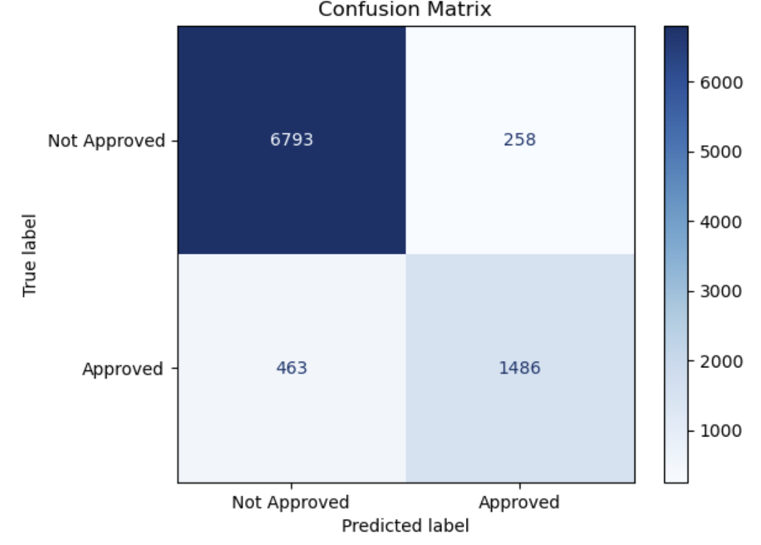
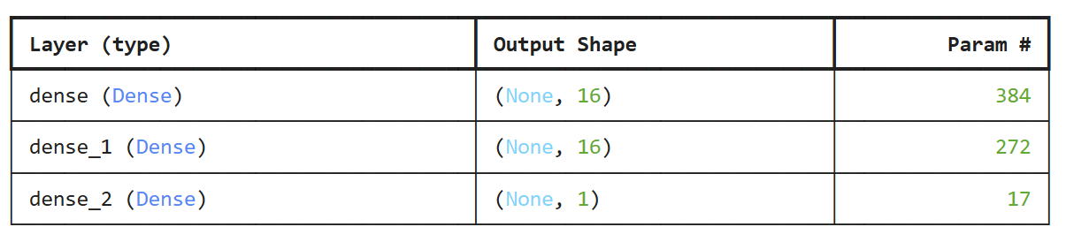
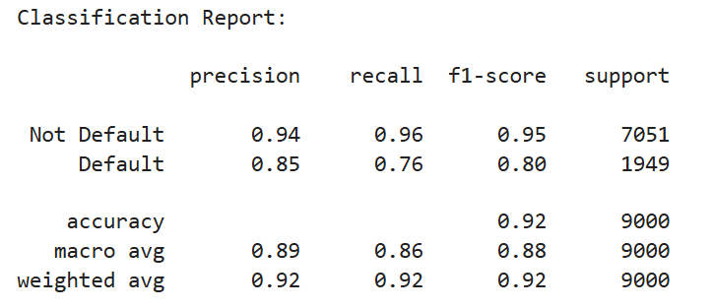
Model 1
Performance
Layer 1: ReLU of 16 units
Layer 2: ReLU of 16 units
Output Layer: Sigmoid Function
Total Parameters: 673

Slide 4
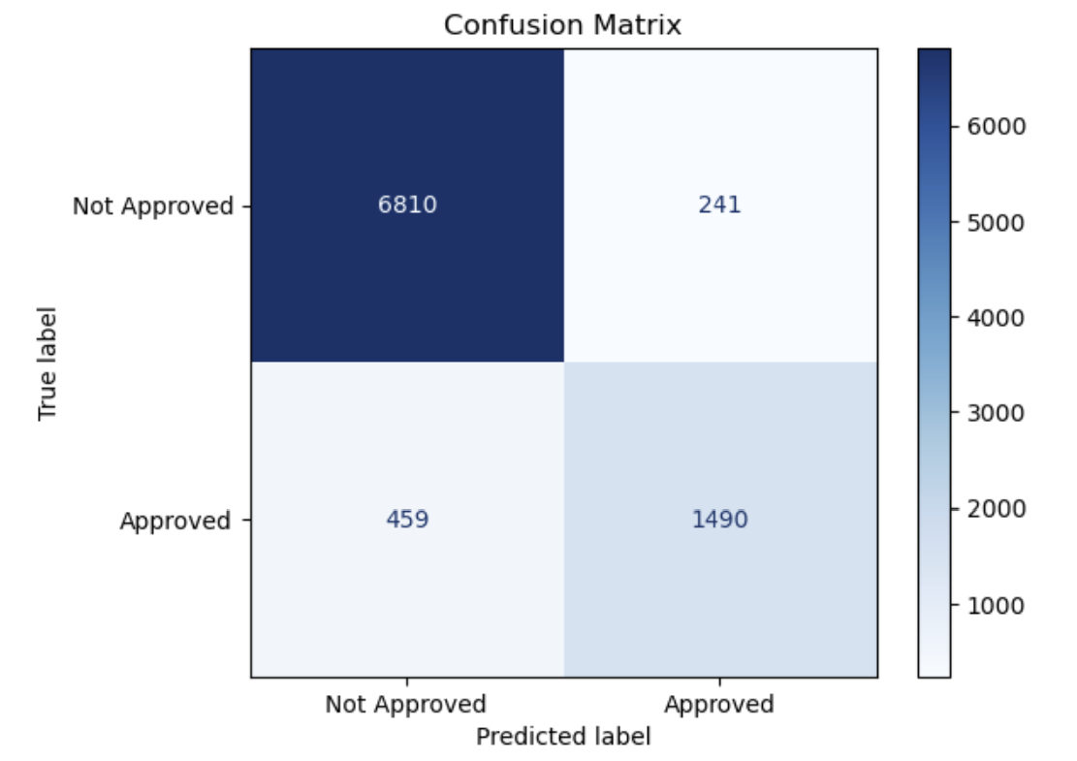
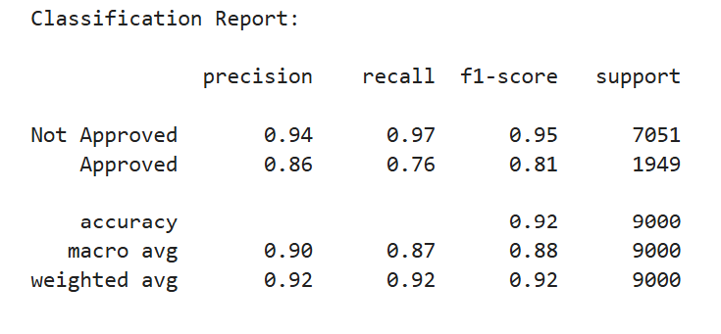
Model 2 –
Hyperparameter Tuning
Performance
Hyperband Tuner
Choice in Tanh, ReLU, Sigmoid
Dense Range (Min, Max) = (32, 128)
Max Epochs - 20

Slide 5
Challenges & Solutions
Class Imbalance – Used Stratify for predictor variable
Categorical variables – used One-Hot & Label Encoding
Overfitting – Regularization Like Early Stopping

