Slide 1
Group 3
Script Snakes
1)Adittya Lahane
2)Atharva Kahu
3)Aditya Deoke
4)Rohan Huddar

Slide 2
Introduction
The dataset at hand comprises 10,000 records, each representing unique instances with various attributes such as unique ID, date, name, school, type, rating, tuition fee, and acceptance rate. In our preliminary analysis, a crucial step involved data cleaning, addressing missing values through the application of mean and mode methods. This meticulous process ensures the integrity of the dataset and lays the foundation for a more robust and accurate exploration of the relationships and patterns within the data. As we delve into the subsequent analysis, the cleaned dataset provides a reliable basis for uncovering insights and drawing meaningful conclusions from the wealth of information contained in its records.

Slide 3
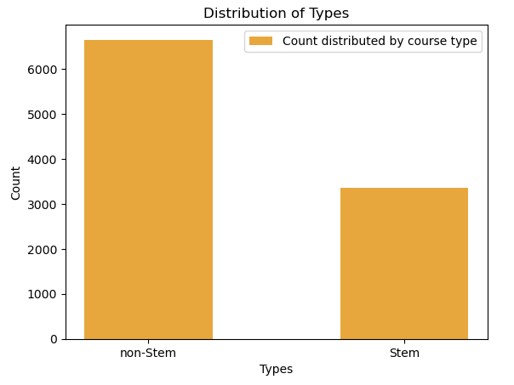
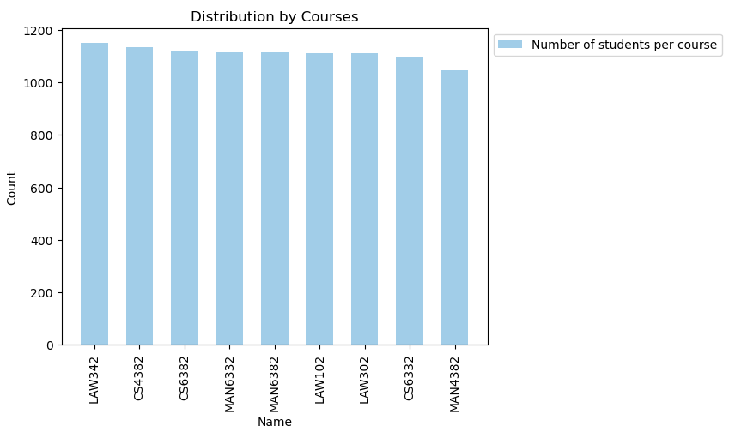
Bar ChartS

Slide 4
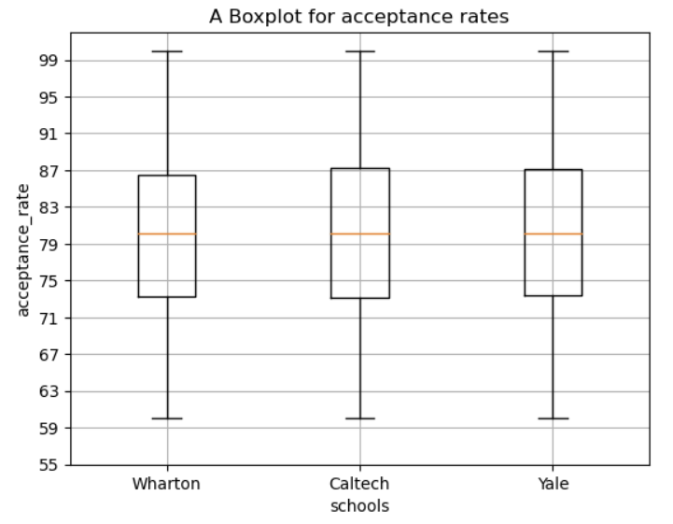
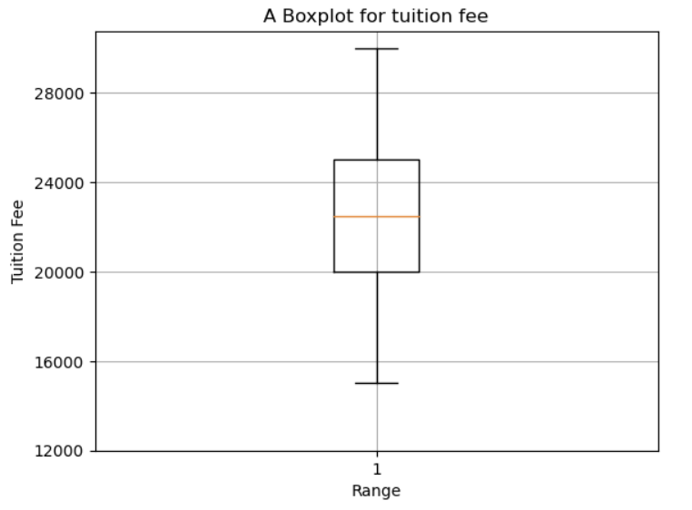
BOXPLOTS

Slide 5
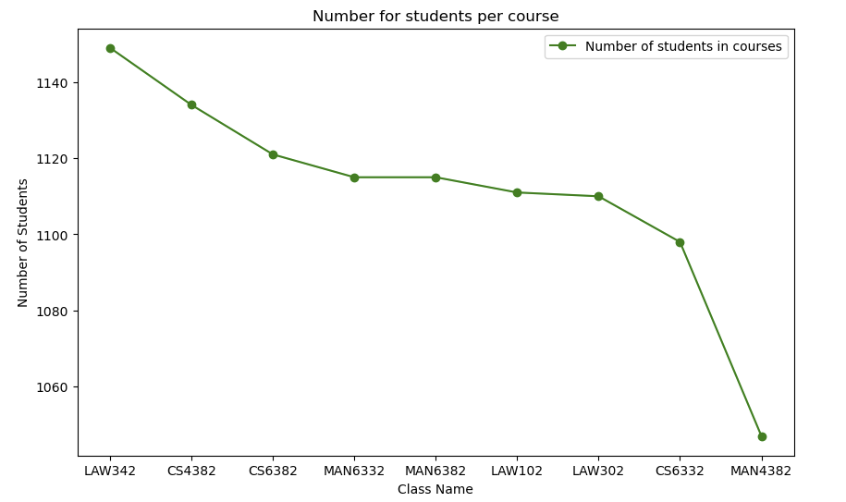
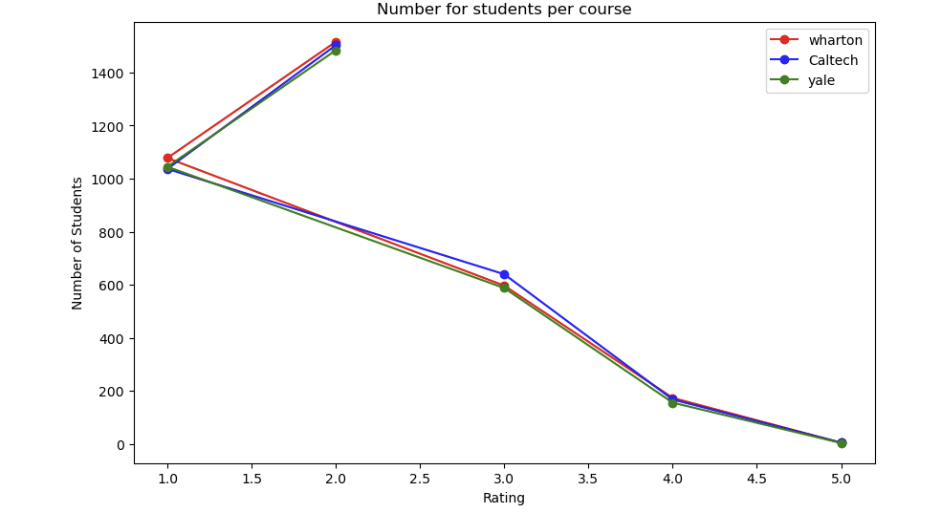
Line Plots

Slide 6

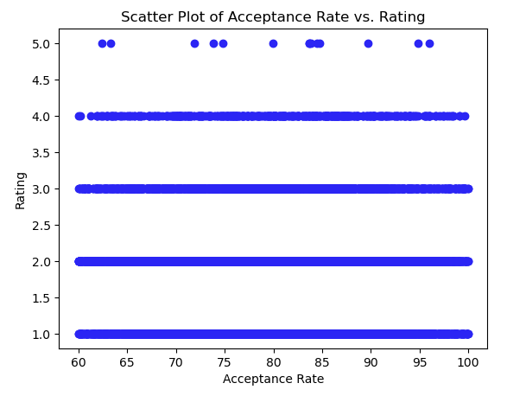

SCATTER PLOTS

Slide 7
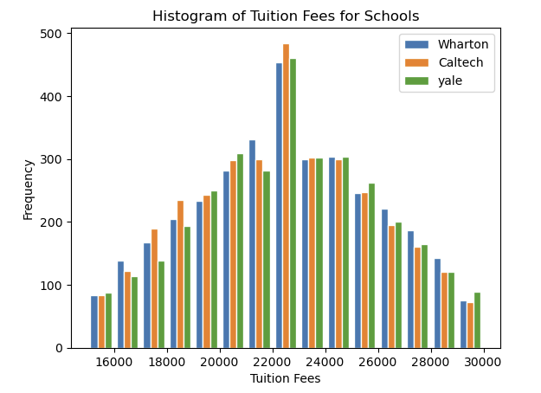
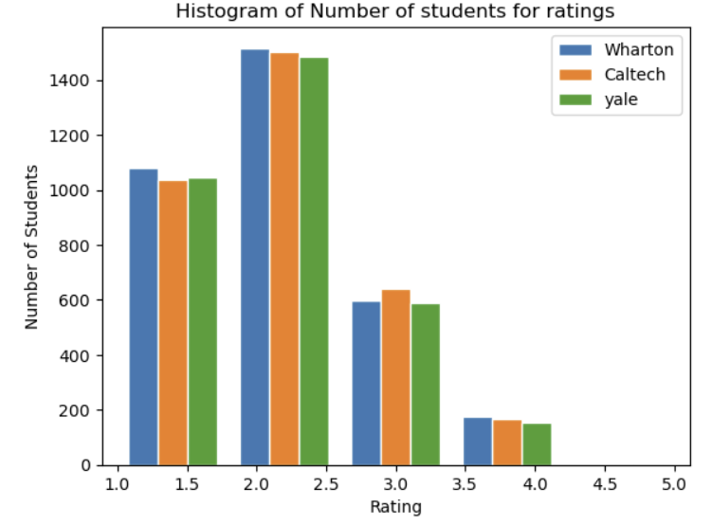
HISTOGRAMS

Slide 8
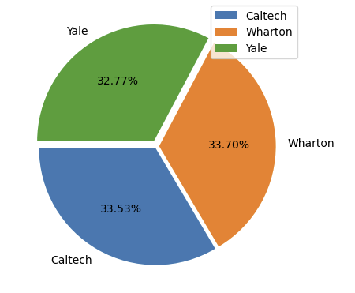
PIE CHARTS

Slide 9
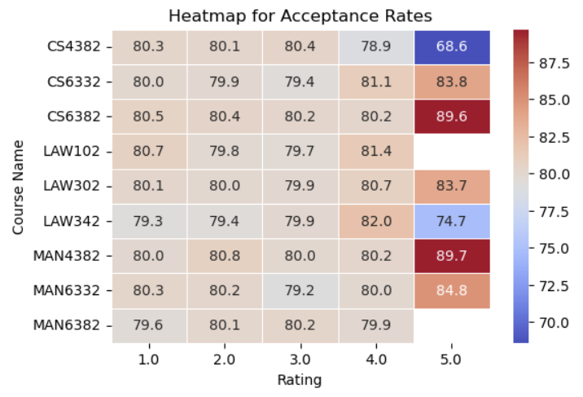
HEAT MAPS

Slide 10
CONCLUSION
In our project, we undertook the task of creating data visualizations encompassing seven different types of graphs—namely, bar charts, line plots, box plots, scatter plots, pie charts, histograms, and heatmaps. The objective was to compare diverse parameters within a given dataset, including date, name, school, type, rating, tuition fee, and acceptance rate. Through the visual representations generated, we were able to discern meaningful trends in the data. These trends, vividly demonstrated in the graphs and plots, provided valuable insights into the relationships and variations among the specified parameters. Overall, our data visualizations served as a powerful tool for comprehending and interpreting the dataset's complexities, contributing to a deeper understanding of the underlying patterns and correlations.

