Slide 1
Predict severity of Accident using Seattle accident data
- Atharva Parikh

Slide 2
DATA:
The data consists of 37 independent variables and 194,673 rows. The dependent variable, “SEVERITYCODE”, contains numbers that correspond to different levels of severity caused by an accident from 0 to 4.
Severity codes are as follows:
0: Little to no Probability (Clear Conditions)
1: Very Low Probability — Chance or Property Damage
2: Low Probability — Chance of Injury
3: Mild Probability — Chance of Serious Injury
4: High Probability — Chance of Fatality

Slide 3
Target Features:
Among all the features, the following features have the most influence in the accuracy of the predictions:
“WEATHER”,
“ROADCOND”,
“LIGHTCOND”

Slide 4
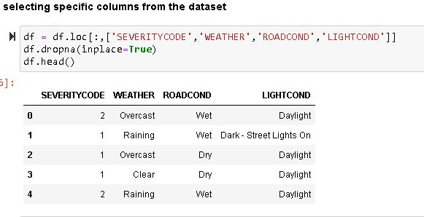
Selecting specific columns from the dataset.

Slide 5
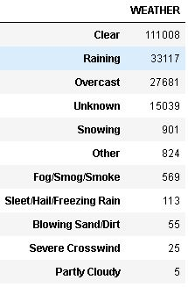
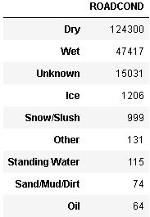
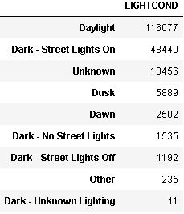
Getting info about the columns:

Slide 6
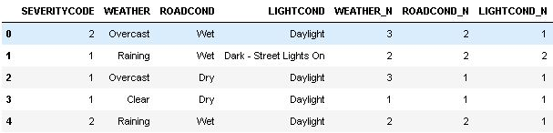
Converting the categorical variables to numerical ones:

Slide 7

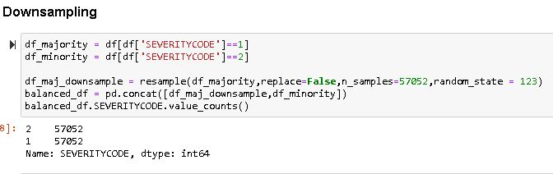
Down sampling to sustain the equality
Before down sampling
After down sampling

Slide 8
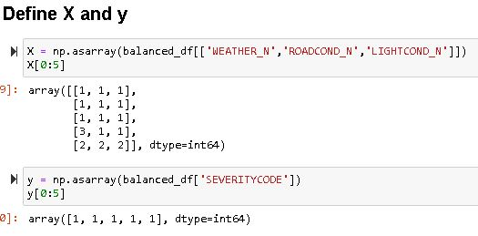
Defining X and Y

Slide 9
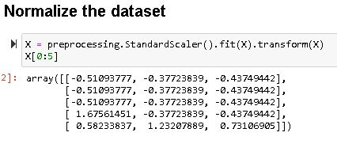
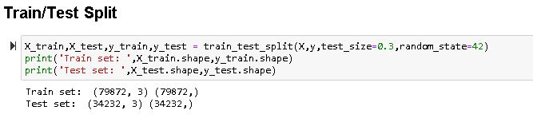
Normalising and dividing the dataset

Slide 10
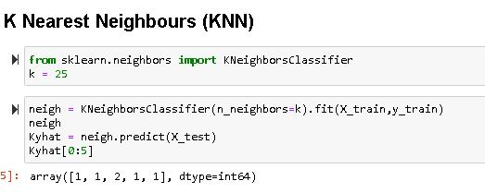
KNN

Slide 11
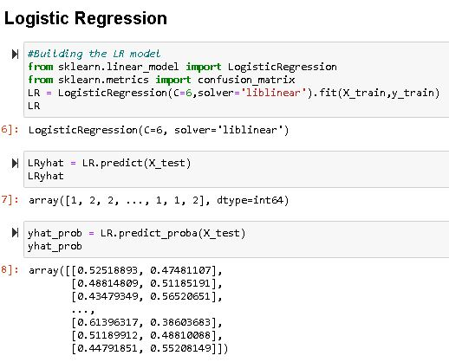
Logistic Regression

Slide 12
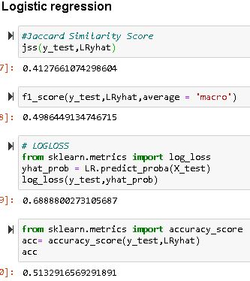
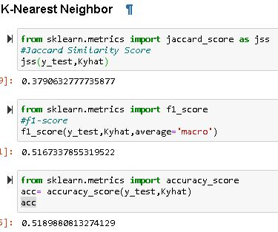
Checking the Accuracy

Slide 13
Comparison
MODEL | Jaccard Score | F1 score | Accuracy
KNN | 0.3791 | 0.5167 | 0.5189
Logistic Regression | 0.4127 | 0.4986 | 0.5133
Conclusion:
It appears that both the models have given close results but the accuracy of KNN is more than that of Logistic Regression by a small extent.

