Slide 1
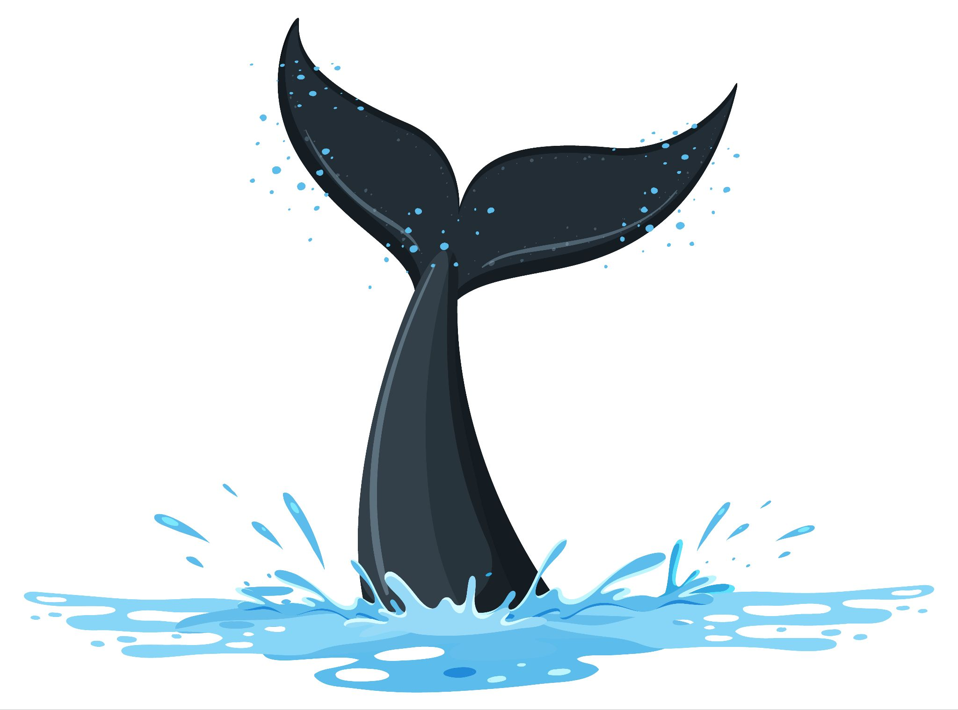
Whale ReID: Identifying whales by their flukes
Group: 30
Name: Atharva Phatak
ID : 1141133

Slide 2
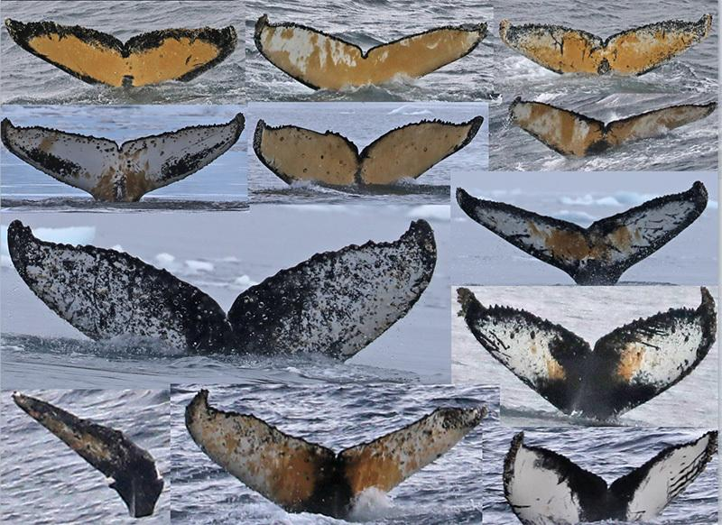
Introduction : Humpback whales and their decreasing population
After centuries of intense whaling, recovering whale populations still have a hard time adapting to warming oceans and struggle to compete every day with the industrial fishing industry for food.
To aid whale conservation efforts, scientists use photo surveillance systems to monitor ocean activity.
They use the shape of whales’ tails and unique markings found in footage to identify what species of whale they’re analyzing and meticulously log whale pod dynamics and movements

Slide 3
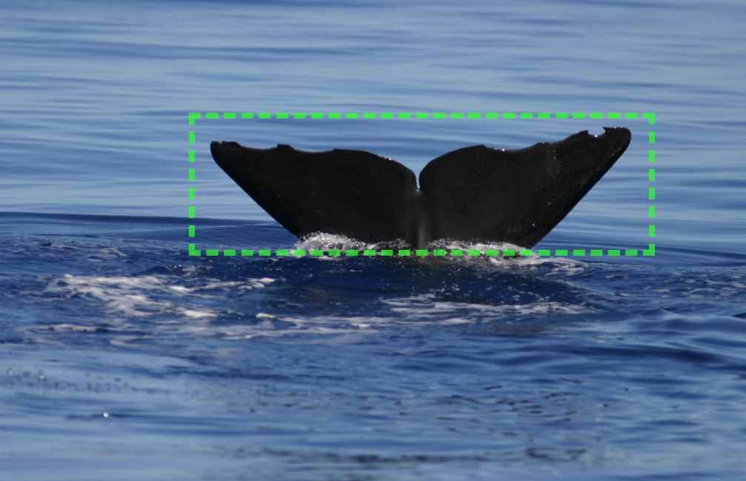
Objective: Automatic Identification of Whale by their flukes
For the past 40 years, most of this work has been done manually by individual scientists, leaving a huge trove of data untapped and underutilized.
Recent progress in the field of computer vision has given us AI tools that can help us ID these whales !
Computer vision algorithms have achieved SOTA performance on tasks like face recognition, image classification and object recognition.
Similar approaches can be applied to recognize whales by their caudal fins or flukes !

Slide 4
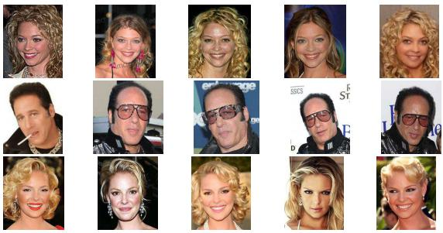
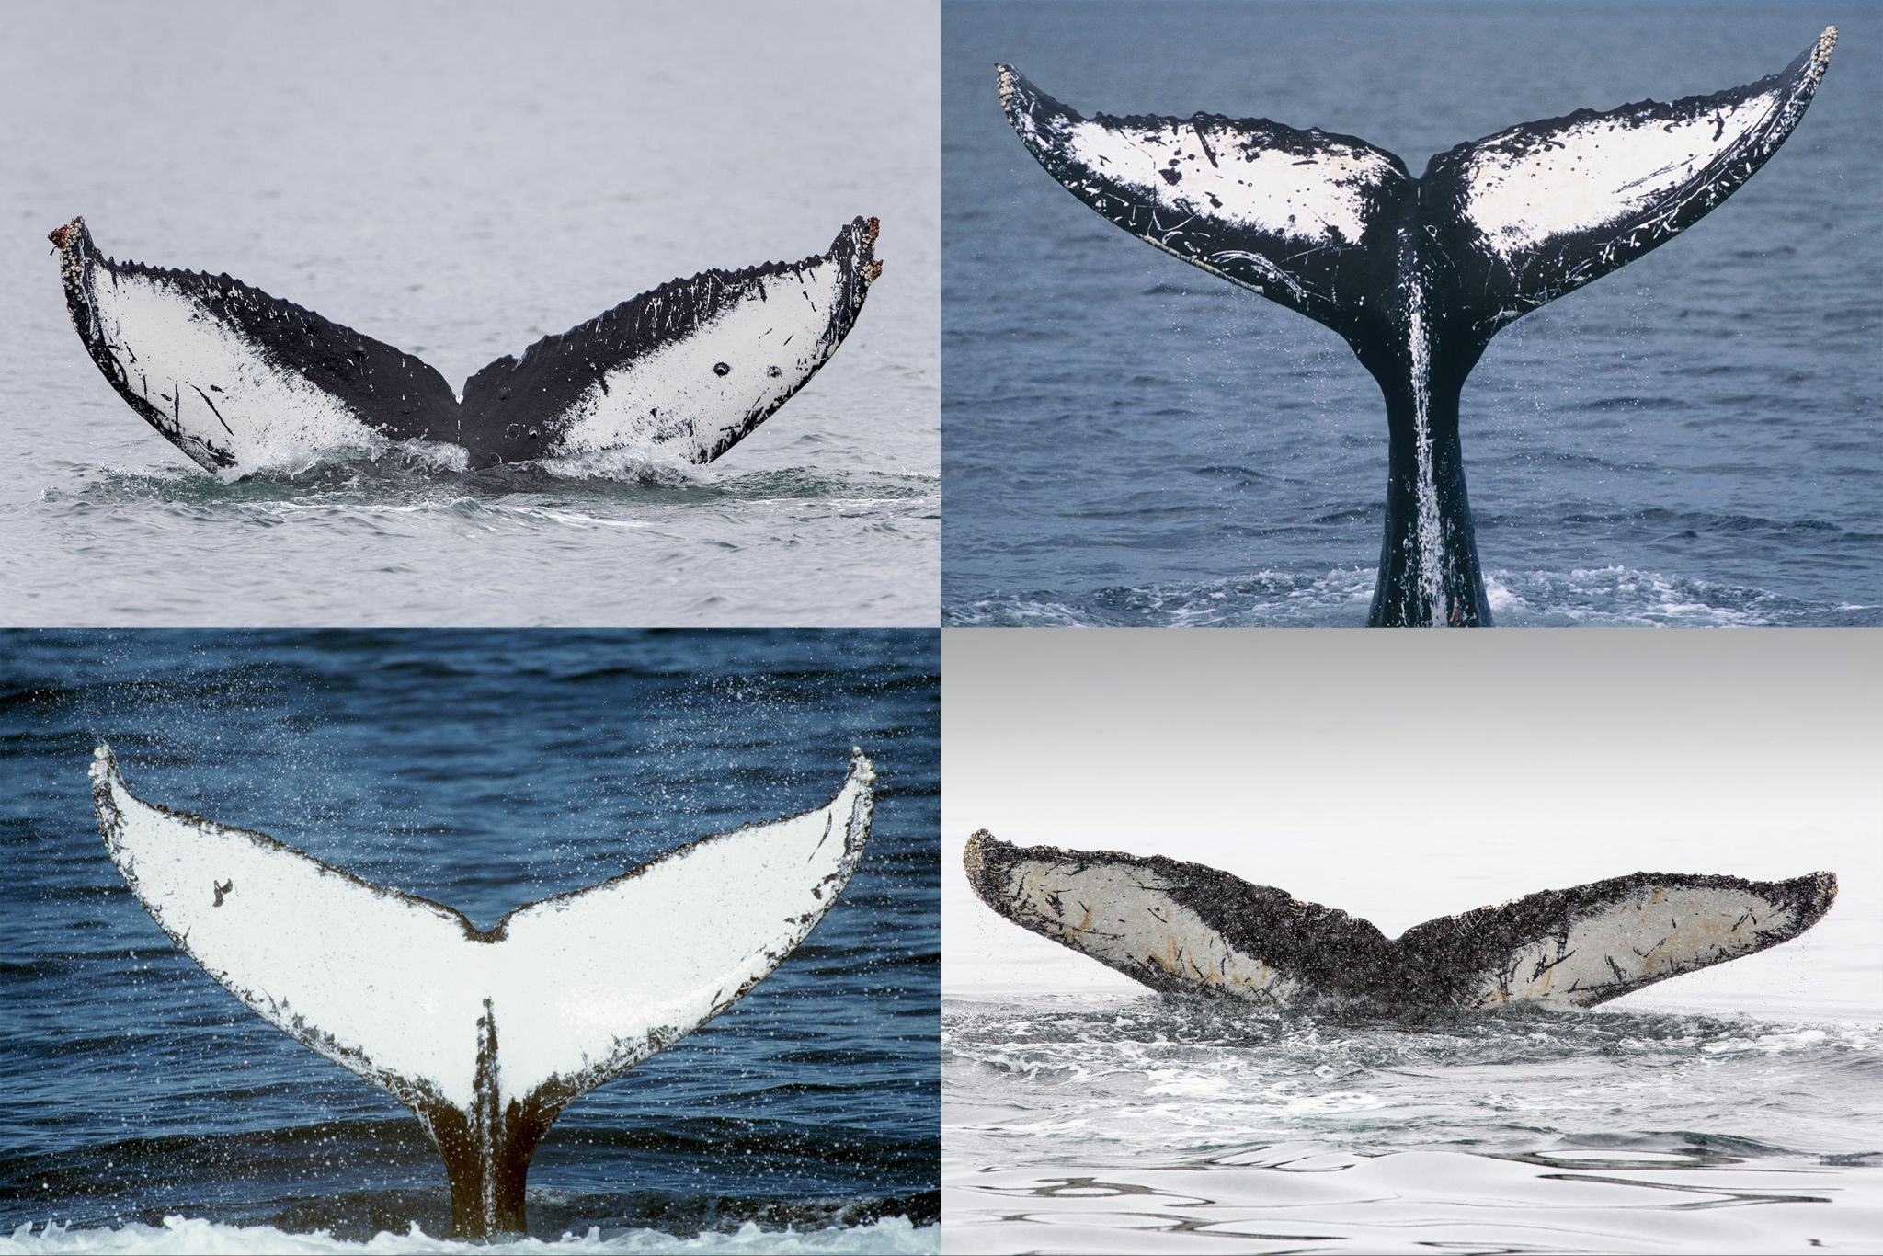
Face Recognition
Facial recognition is the task of making a positive identification of a face in a photo or video image against a pre-existing database of faces.
Similar approach can be applied to recognize whales by their caudal fins or flukes !
Face Recognition
Whale Recognition

Slide 5
Exploratory Data Analysis and Data Pipelines
Data Size ~ 33k images with varied resolution
Train Size ~ 25k images
Test Size ~ 8k images
5005 classes
The problems with the data
Noisy images/Distorted Images
The dataset is long tailed i.e there are classes which consist of very less amount of samples.
The images are both RGB and Gray

Slide 6
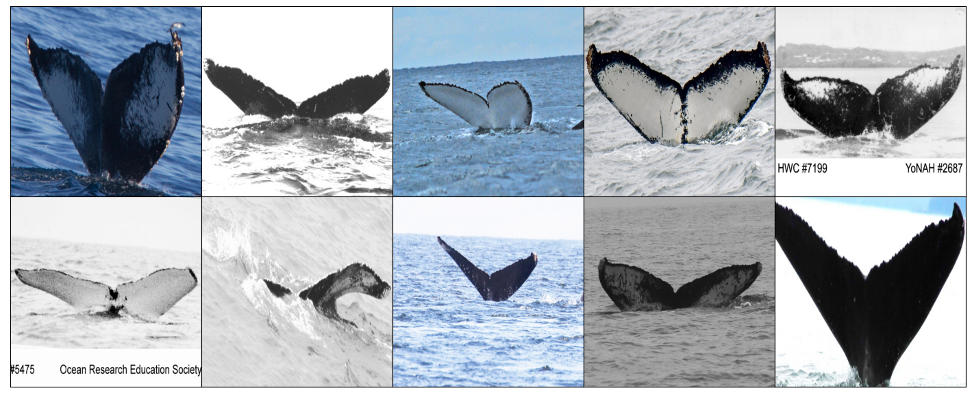

Slide 7
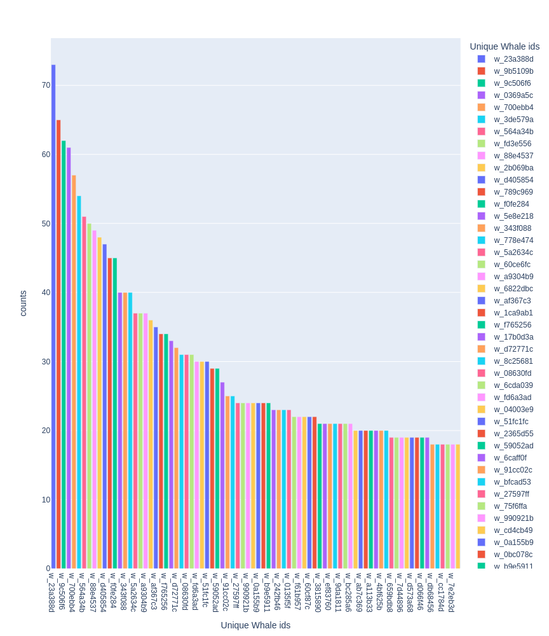
The maximal amount of images which belong to single class is 72
2073 Classes have a single image
There is a new category of class called “new_whale” which don’t have a tag yet.
9700 images belong to the “new_whale” class

Slide 8
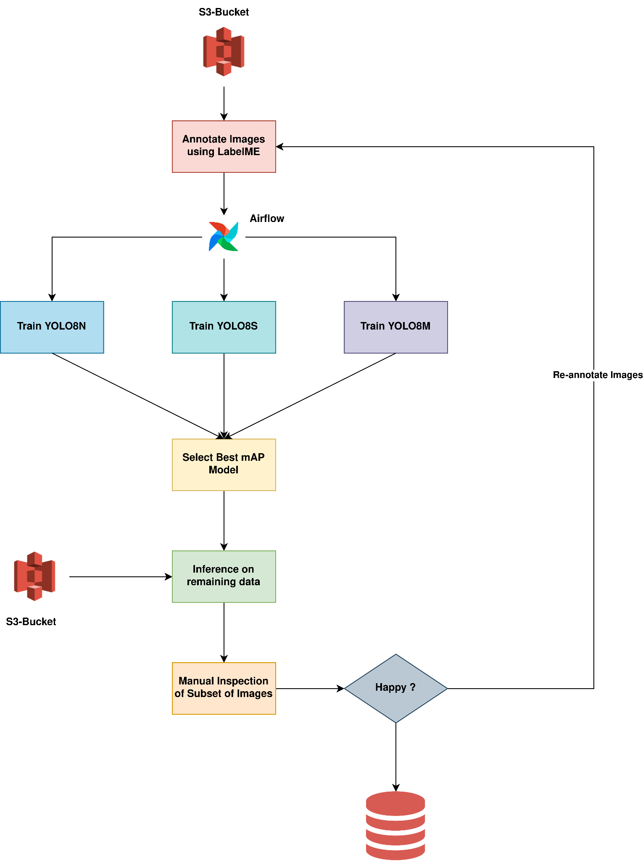
Better Images via the help of YOLOv8
Manually annotated -> 300 Images from train dataset.
Trained 3 variants of YOLOv8 models with YOLOv8M performing the best

Slide 9
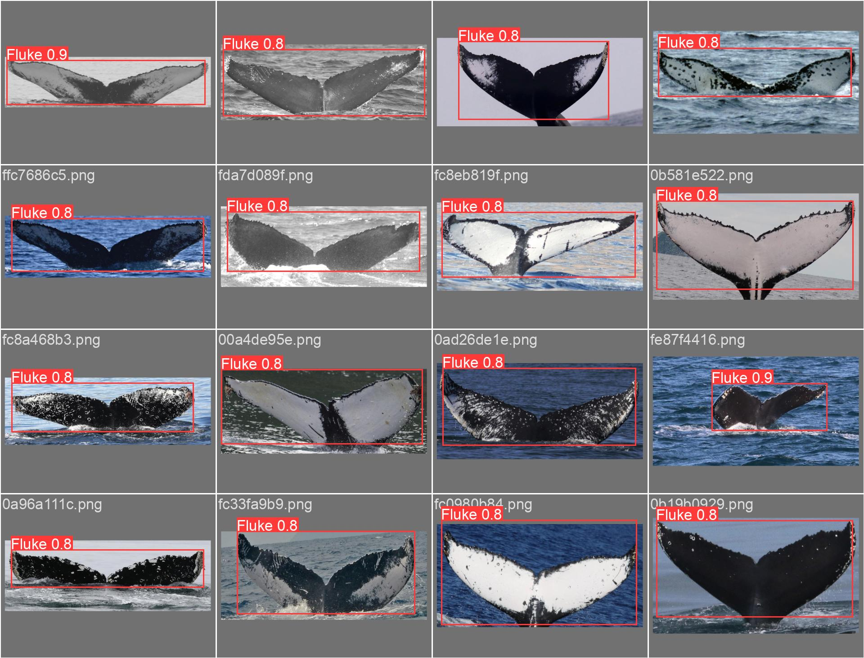

Slide 10
Tech Stack
AWS S3/MinIO
LabelME
Airflow
PyTorch/lightly
Mlflow

Slide 11
Plan of Action
Week 3 - Week 4: Dataset collection/Data cleaning & EDA
Week 5 - Week 6: Model/Approach selection
Week 7 - Week 10: Experimentation and Testing
Week 11 - Week 12: Report Writing & Results presentation

Slide 12
References
Jaisakthi, S. M., Palaniappan Mirunalini, and Rutuja Jadhav. "Automatic Whale Matching System using Feature Descriptor." In CLEF (Working Notes). 2017.
Marcos, Diego, et al. "A Whale’s Tail-Finding the Right Whale in an Uncertain World." International Workshop on Extending Explainable AI Beyond Deep Models and Classifiers. Springer, Cham, 2022.
Joly, Alexis, et al. "Unsupervised individual whales identification: spot the difference in the ocean." CLEF: Conference and Labs of the Evaluation Forum. No. 1609. 2016.

Slide 13
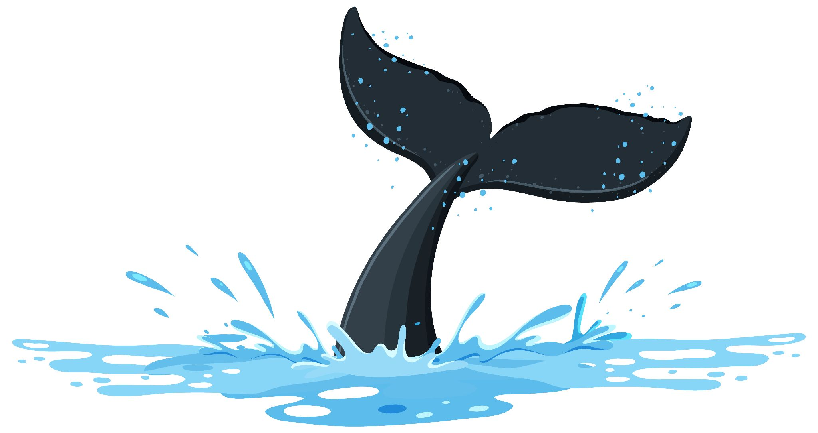
Thank you !
Any Questions ?

