Slide 1
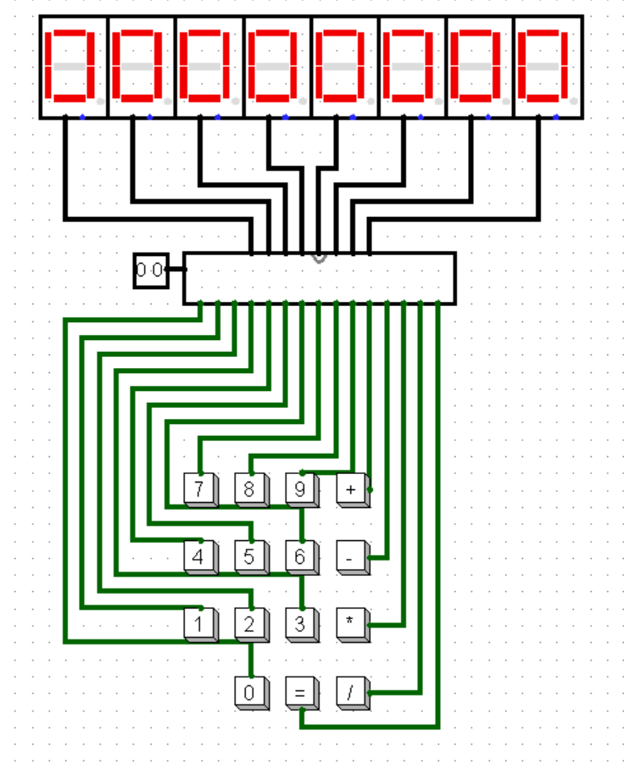
PROBLEM STATEMENT :
Implementation of a 32-bit calculator using Logisim.

Slide 2
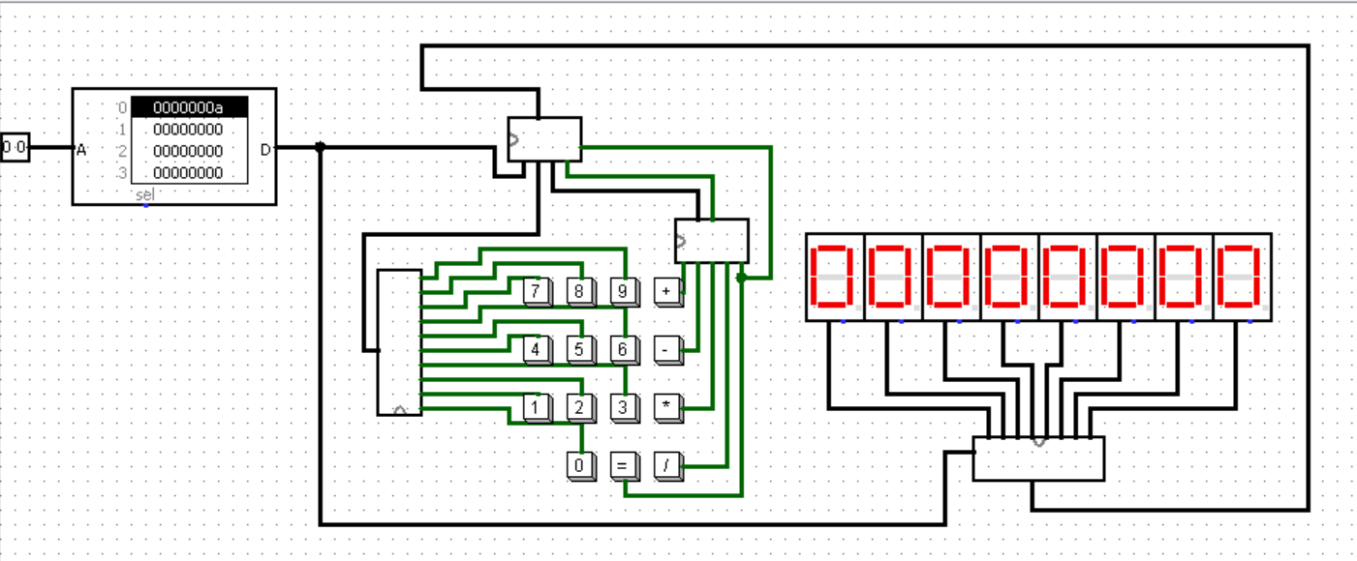
Connections

Slide 3
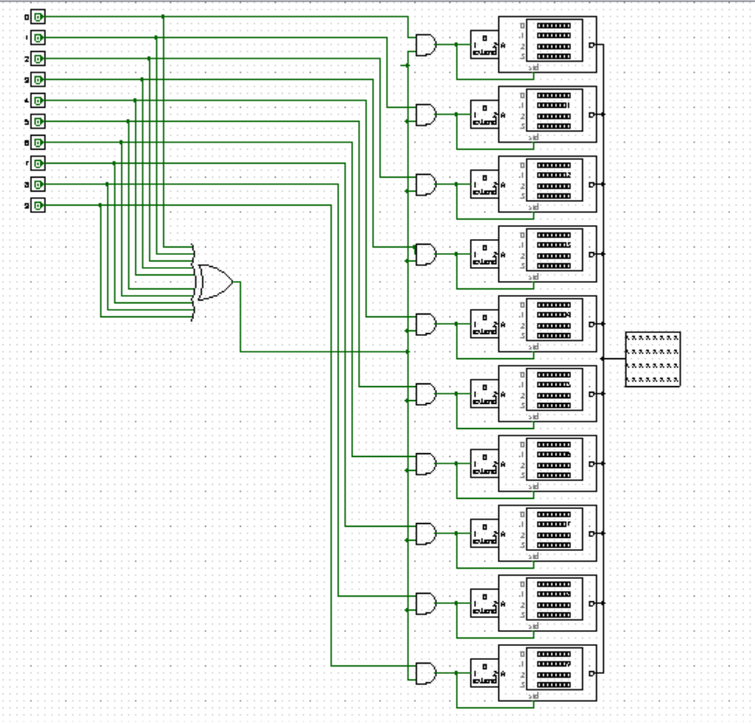
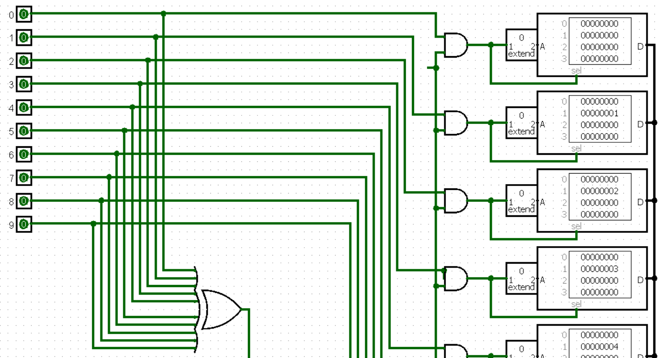
GetNUM Circuit

Slide 4
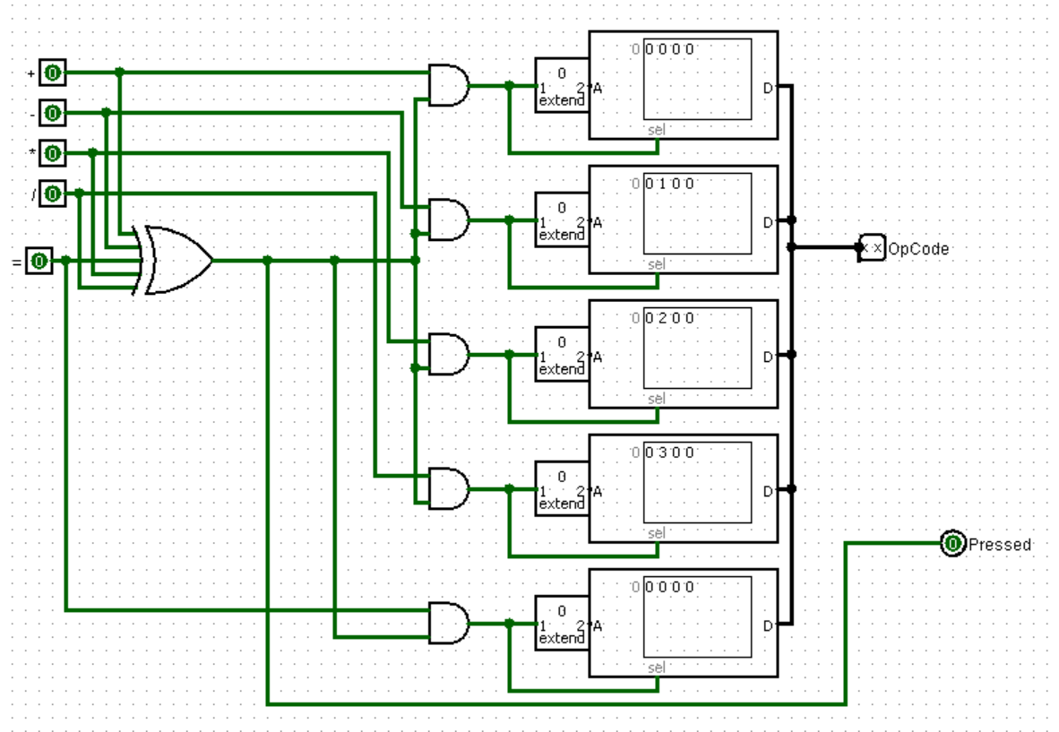
GetOPT Circuit

Slide 5
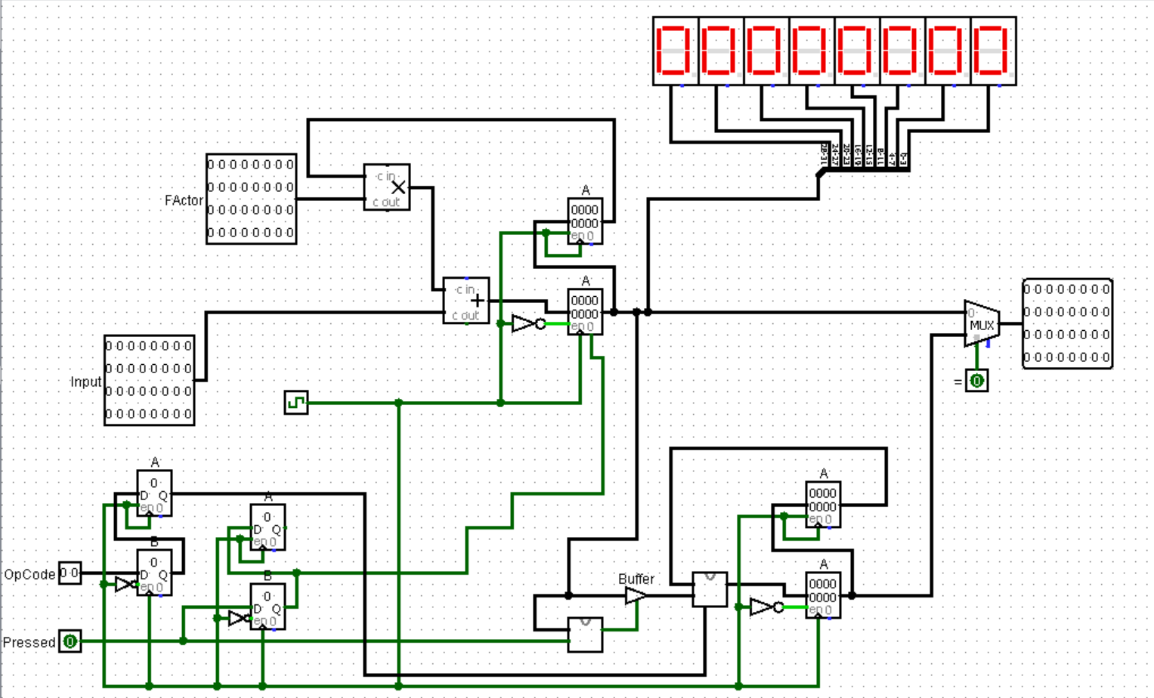
Memory Circuit

Slide 6
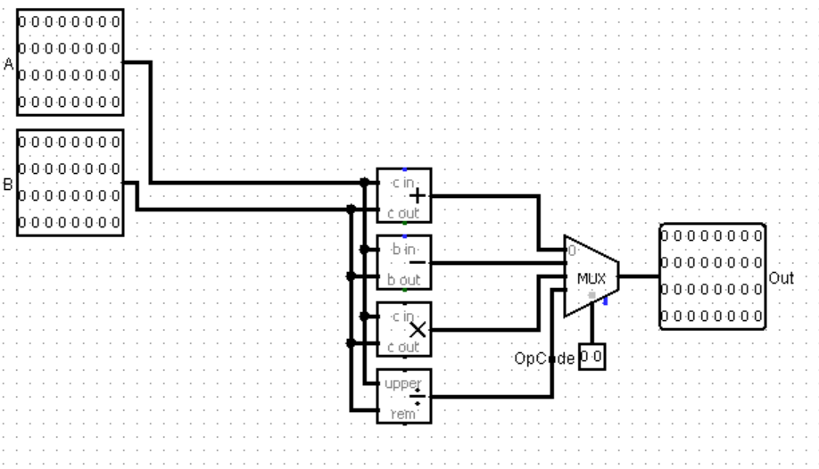
ALU

Slide 7
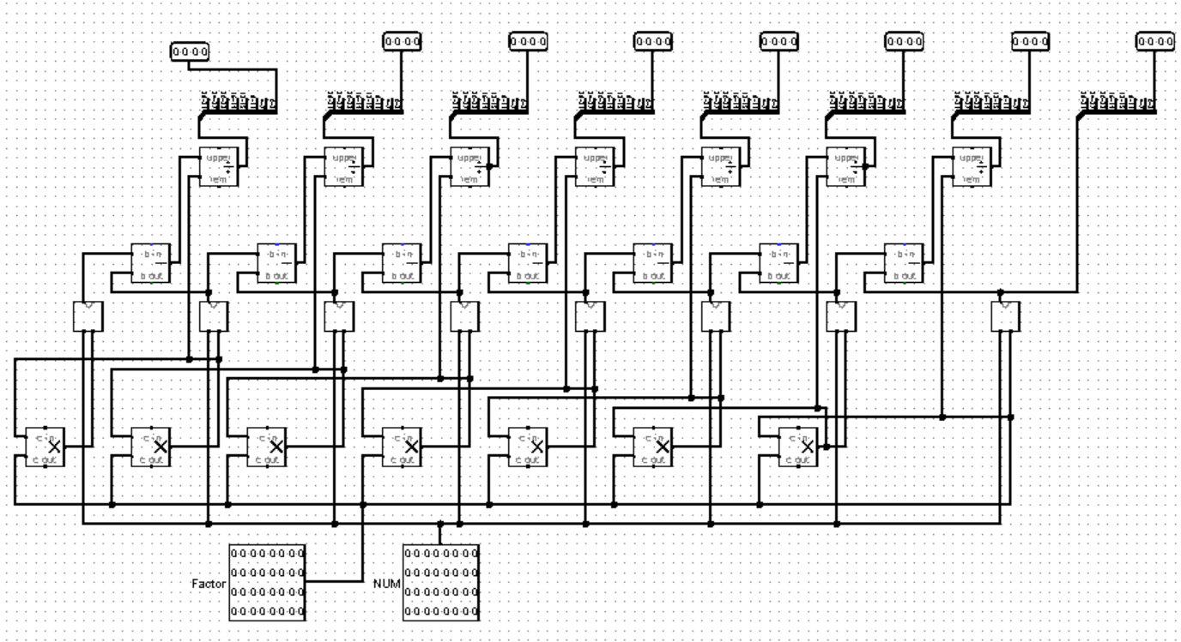
Display Circuit

Slide 8
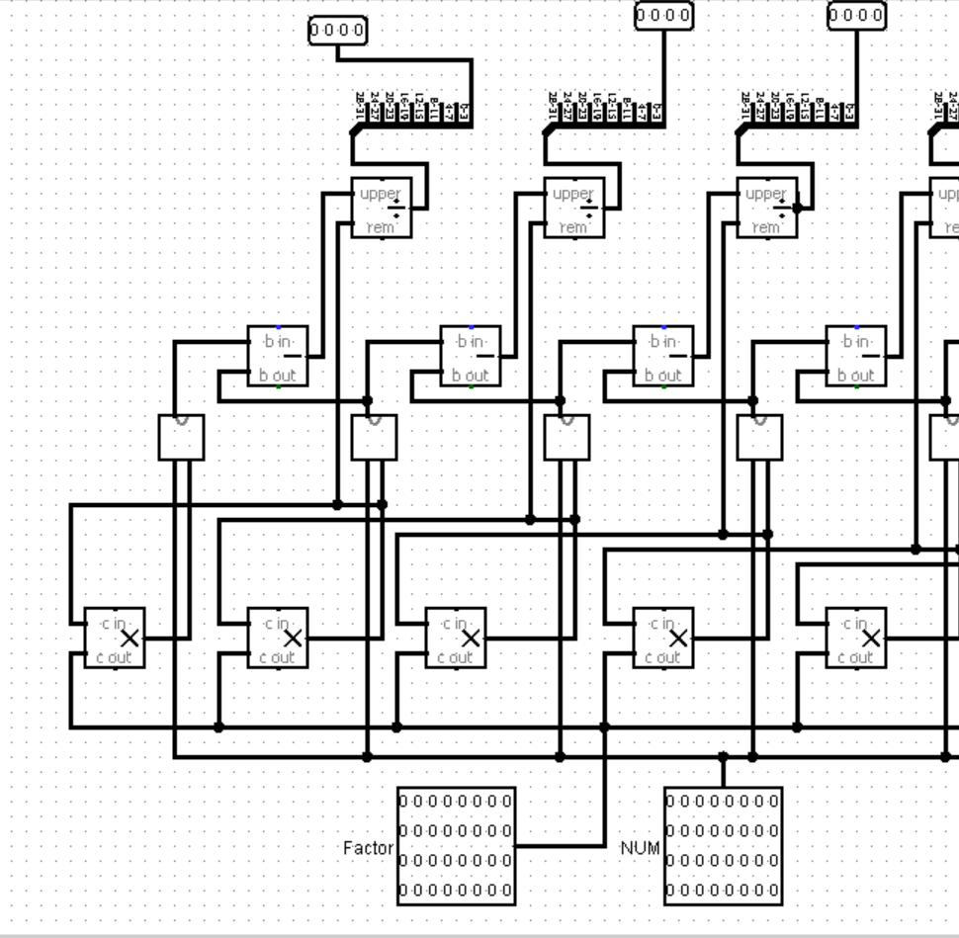
Display Circuit

Slide 9
THANK YOU

