Slide 1


Smt. Kashibai Navale College Of Engineering
Department of Information Technology
“ONE INDIA PORTAL APP”
Group No : 10
Vaishanvi Vaidya
Yash Chaskar
Pritam Shelke
Atharva Trivedi
Under Guidance of
Prof.A.S.Narote
A. Y. 2025-2026

Slide 2
Contents
Problem Statement of Project.
System Architecture & Literature Survey
Requirement Analysis
Methodology /Basic details of Implementation
Project Design
Project Planning
Conclusion
References
Centralized Government Information Portal

Slide 3
Problem Statement of Project
Government scheme and service information is scattered across many websites.
Citizens struggle to find reliable and complete details in one place.
Lack of awareness leads to under-utilization of helpful schemes.
There is no centralized portal for schemes, forms, documents, and updates.

Slide 4
System Architecture
Main Components (Short Points):
User Interface (Web/Mobile)
– Citizens access schemes, forms, and info.
Application Layer
– Handles search, filters, multilingual support.
Database Layer
– Stores scheme details, documents, forms, user profiles.
Admin Panel
– Updates government schemes and verifies content.

Slide 5
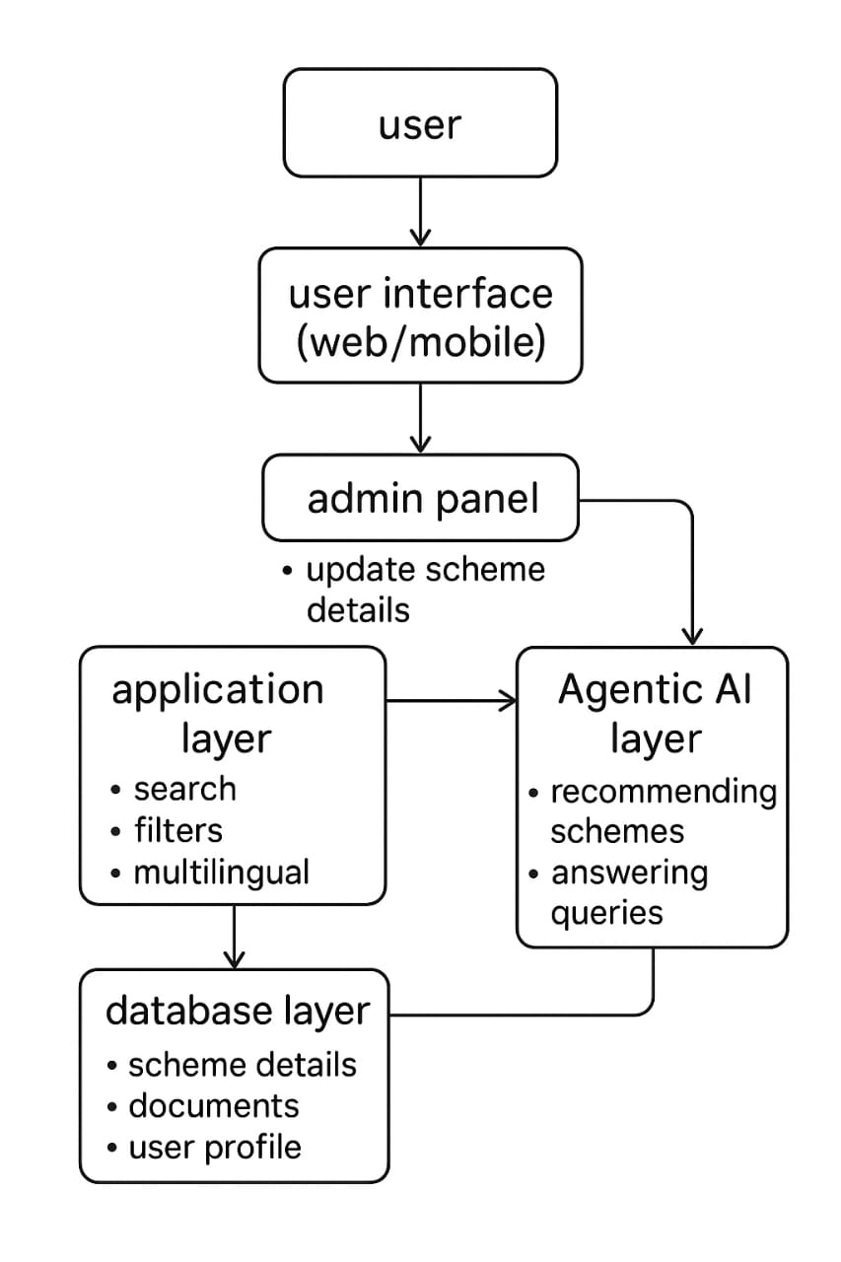
System Architecture

Slide 6
Literature Survey
E-Governance Platforms (UMANG, MyGov, MahaDBT)
– Provide services but lack centralized and user-friendly design.
Research Paper:
  “A Comparative Study of Indian Government e-Governance Portals”
  Dr. M. S. Rao, P. Jain, IJSRCSEIT, 2020.
  Highlights usability gaps in existing portals.
Research Paper:
  “Digital India and E-Governance Services”
  A. Sharma, International Journal of Computer Applications (IJCA), 2021.
  Stresses need for inclusive, accessible platforms.
Gap Identified
– No single portal provides all schemes with eligibility checks + document guidance.

Slide 7
Requirement Analysis
Application for government schemes and forms.
Category-wise search and filters for easy access.
Multilingual support for wider reach.
Admin panel for scheme updates and management.

Slide 8
Methodologies
Centralized Web Platform
All govt schemes, forms, and services in one place.
Category & Document Filters
Users can search schemes by type and view required documents.
Multilingual Interface
Support for English, Hindi, and Marathi.
Agentic AI Integration 🧠
Smart assistant suggests schemes based on user profile and queries.

Slide 9
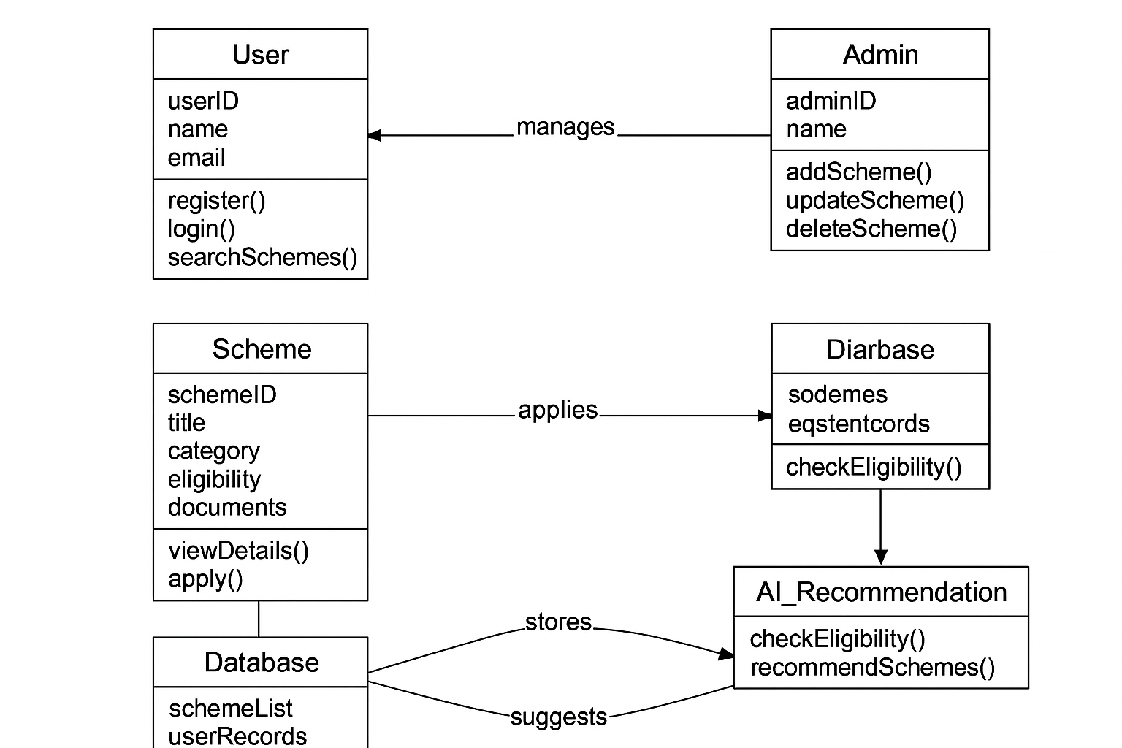
Project Design
Structural Diagrams

Slide 10
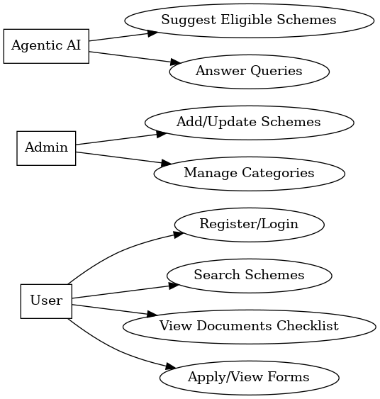
Project Design
Behavioral Diagram
Use- case

Slide 11
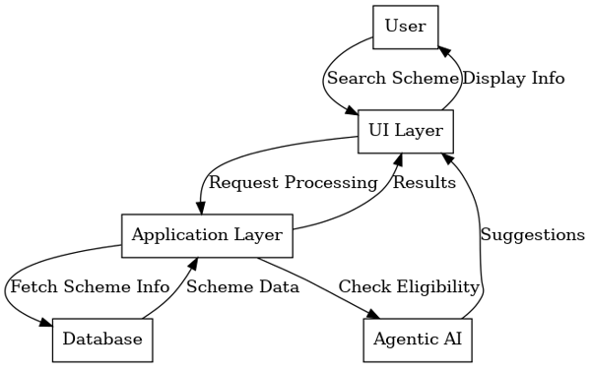
Project Design
Behavioral Diagram
Sequence

Slide 12
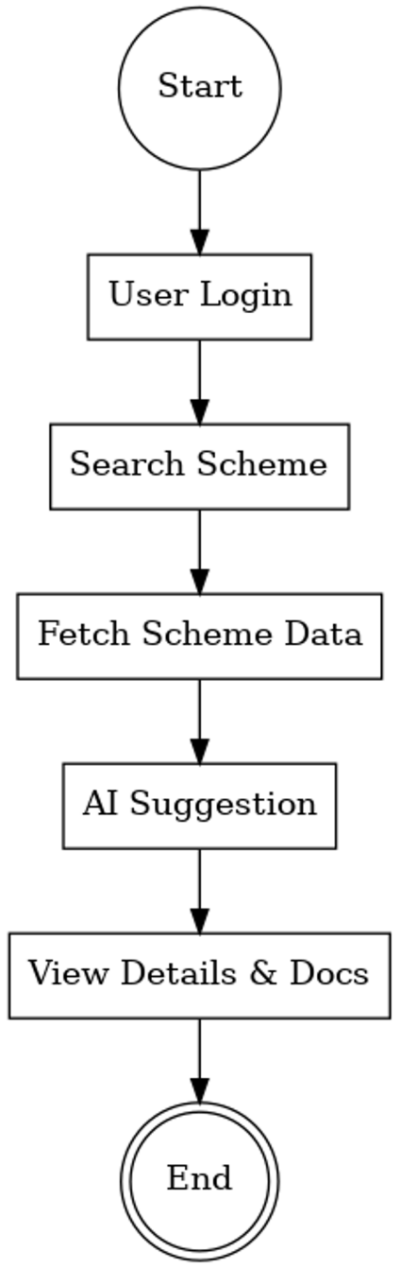
Project Design
Behavioral Diagram
Activity Diagrams

Slide 13
Project Planning
Requirement Gathering – Collect information about govt schemes, forms, and services.
System Design – Create architecture, structural and behavioral diagrams.
Implementation – Develop portal UI, database, admin panel, and AI module.
Testing – Verify functionality, usability, and data accuracy.
Deployment & Maintenance – Launch application and update schemes regularly.

Slide 14
Conclusion
A centralized portal reduces the difficulty of accessing government schemes and forms
.
Citizens get easy, reliable, and categorized information.
Multilingual support improves accessibility for rural users.
Agentic AI provides personalized scheme recommendations.
The project supports Digital India by promoting e-governance.

Slide 15
References
Ref. No [Year of Publication] | Improvement Goal | Algorithm | Metric Used | Topography | Assessment Method | Usage
1 [2016] | Digital India Framework | Web-based framework | Citizen adoption | National | Surveys | General E- Governance
2 [2017] | Digital India Framework | Web portal | Student participation | Education domain | User feedback | Scholarship schemes only
3[2020] | Unified citizen services (mobile) | Mobile app | Usage frequency | National utilities | Pilot project | Bill payment, ID services
4 [2020] | Challenges in centralized portals | Cloud deployment | System uptime | Crossdomain | Simulation | E-governance services
5 [2021] | Agile development in web portals | Agile methodology | Development speed | Software projects | Comparative analysis | Project methodology
6 [2022] | Framework for smart governance | Architectural model | Scalability | National level | Theoretical framework | Smart governance platforms
7 [2023] | AI-based citizen personalization | NLP, ML algorithms | Search efficiency | Citizen portals | Experimental testing | AI-driven personalization
8 [2024] | National service portals comparison | Comparative analysis | Citizen participation | International | Case studies | Generalized portal studies

