Slide 1
Causal Discovery from Naturalistic Driving Data
with V2X Cooperative Perception and Generative Replay of Near-Miss Scenarios
Atharva Abhyankar
MIS: 712552009 • Data Science
Internal Supervisor: Mr. S. S. Kumbhar

Slide 2
Overview & Motivation
Three converging research threads: how vehicles learn cause-and-effect from real driving data, how V2X extends what a vehicle can perceive, and how rare safety-critical events are synthesised for training.
1
2
3
Causal Discovery
V2X Cooperative Perception
Near-Miss Scenario Generation
Identifying which driver and vehicle actions causally trigger the actions of others, using counterfactual simulation and Bayesian structure learning.
Fusing onboard sensors with roadside-unit and connected-vehicle data to perceive agents beyond a single vehicle's line of sight.
Using generative models to synthesise rare, safety-critical near-collision events absent from most naturalistic datasets.

Slide 3
Literature Synthesis
Mapping each reviewed line of work against the three capabilities shows that none combine all three.
Work | Causal Discovery | V2X Perception | Near-Miss Generation
Howard & Kunze (Oxford) | Yes | — | —
Chang et al. (NUST / XJTLU) | Yes | — | —
Zimmer et al. — TUMTraf-V2X | — | Yes | Partial
Ren et al. (SJTU) | — | Yes | —
Onsu et al. (Univ. Ottawa) | — | Yes | Partial
Ding et al. — CMTS (CMU) | — | — | Yes
Pronovost et al. — Diffusion | — | — | Yes
Ding et al. — CausalAF | Partial | — | Yes
No reviewed work uses V2X-shared, multi-agent observations as input to causal discovery, and none uses the resulting causal structure to constrain near-miss generation.

Slide 4
Research Gap & Objectives
Causal discovery sees only one vehicle. Interactions outside ego-sensor range are invisible to the causal graph, even though V2X-style data already captures them.
Near-miss generators don't check causal plausibility. Generators are scored on realism, not on whether a reaction is actually caused by the agent it appears to respond to.
1
2
3
Build causal graphs with and without multi-agent context
Quantify the causal coverage gained from V2X-style context
Extract genuine near-miss events (true TTC & hard braking)
4
5
6
Generate near-miss scenarios constrained by the causal graph
Train an unconstrained baseline generator for comparison
Validate on causal consistency, realism, and diversity

Slide 5
Dataset & Methodology
NGSIM US-101 selected: open access, equivalent naturalistic-highway-trajectory structure, and a fixed overhead vantage point capturing every vehicle simultaneously.
1
2
3
4
Preprocessing
→
Causal Discovery
→
Generative Replay
→
Evaluation
Ego-only vs. ego+V2X feature sets; true-TTC & hard-braking near-miss extraction
PC algorithm run on both feature sets, α = 0.05
Causal-masked CVAE vs. unconstrained baseline CVAE
Reconstruction, diversity, and causal consistency, both models
Near-miss criteria: true TTC (closing-speed based) < 3.0s, or deceleration < −10 ft/s² (≈ −3.05 m/s²) • 4.0% of frames flagged → 12,101 events across 662 vehicles
HighD (referenced in the original literature review) was considered, but NGSIM was selected for its open accessibility and directly usable multi-agent structure.

Slide 6
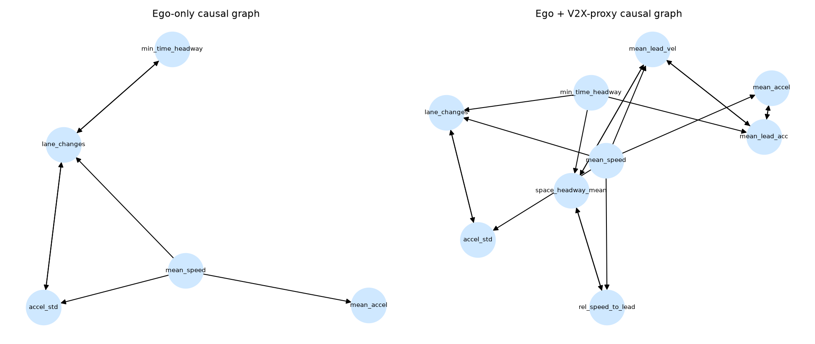
Causal Discovery: Ego-Only vs. V2X Context
7
Ego-only
graph edges
18
Ego+V2X
graph edges
12
New causal links
recovered
Notable new links: mean_accel ↔ mean_lead_acc, mean_speed → mean_lead_vel, mean_speed → rel_speed_to_lead — agent-to-agent reactions invisible to ego-only discovery.

Slide 7
Causal-Graph-Constrained Generative Replay
Two conditional VAEs generate the ego vehicle's reaction (acceleration, speed) from V2X context (leader kinematics, headway, relative speed).
Causal-Masked CVAE
Unconstrained Baseline CVAE
Decoder’s context→output path masked by the discovered causal graph
Architecturally identical, fully dense context→output path
Only causally-linked context features can drive the generated reaction
390 trainable params, 300 epochs, M2/MPS)
0.137ms single-scenario inference
Any context feature can influence the generated reaction
390 trainable params, 300 epochs, M2/MPS
0.123ms single-scenario inference
Both models are computationally negligible relative to any real-time V2X communication budget — the causal constraint adds no meaningful deployment cost.

Slide 8
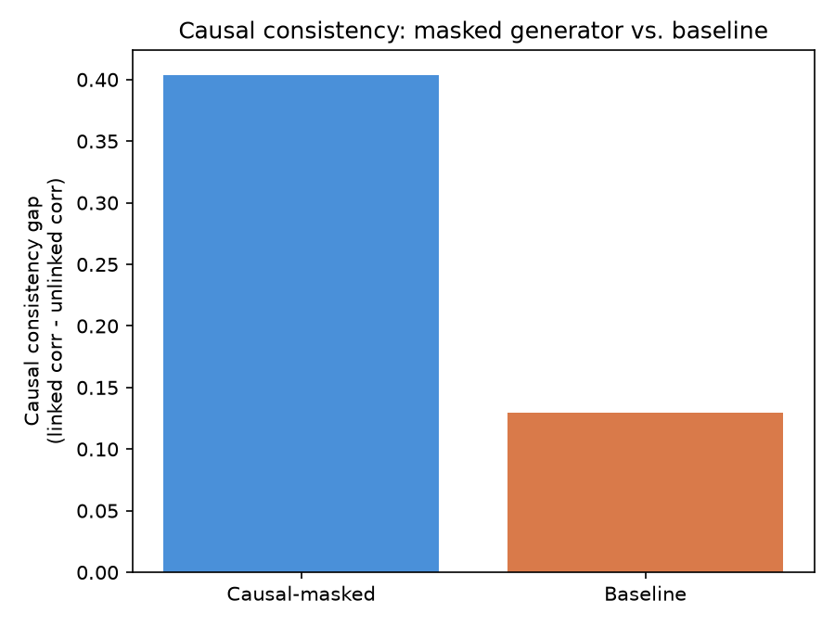
Evaluation: Causal Consistency
Metric | Masked | Baseline
Linked-feature corr. | 0.4647 | 0.4115
Unlinked-feature corr. | 0.0609 | 0.2818
Consistency gap | 0.4038 | 0.1297
~3x higher causal consistency
than the unconstrained baseline — masked-model reactions are almost uncorrelated with context features the causal graph says shouldn't matter.
The causal-masked model matches baseline on causally-relevant correlation while suppressing spurious correlation with unrelated context by nearly 5x — encoding the causal graph directly into the generator enforces a correctness property the baseline cannot.

Slide 9
Discussion & Key Innovations
The causal-masked generator matches baseline on causally-relevant correlation while suppressing spurious correlation with unrelated context by nearly 5x — encoding the causal graph directly into the generator enforces a correctness property the baseline cannot.
I1: V2X-Perception Simulation Method
I2: Causal-Masked Generative Architecture
A reusable feature-engineering method that derives V2X-shared context directly from single-source naturalistic recordings — removing dependency on scarce, access-restricted multi-sensor V2X datasets for causal-discovery research.
A generative mechanism that encodes a data-derived causal graph directly into a model's decoder connectivity — mechanically constraining what the generator is architecturally permitted to produce, rather than evaluating causal plausibility only after generation.
Future work: extend validation to additional multi-sensor V2X datasets and sequence-level generation.

Slide 10
Conclusion
V2X-style multi-agent context reveals causal structure invisible to ego-only discovery — and using that structure to constrain a near-miss generator measurably improves causal faithfulness.
Cooperative Context Unlocks Hidden Logic: Proved that V2X multi-agent context expands the recovered causal graph from 7 to 18 edges, capturing 12 essential agent-to-agent driver dependencies invisible to isolated ego sensors.
Causally-Gated Generative Replay: Architected a novel CVAE with a custom PyTorch MaskedLinear layer that hardwires the discovered causal DAG as a decoder constraint, forcing synthetic near-miss reactions to obey physical cause-and-effect.
3.11x Causal Faithfulness Improvement: Demonstrated a Causal Consistency Gap of 0.4038 (vs. 0.1297 for baseline) and a 5x reduction in spurious correlations, proving that architectural masking enforces logical correctness black-box AI cannot match.
Real-Time Deployment Ready: Achieved sub-millisecond inference latency (0.137 ms per single-scenario generation on Apple Silicon MPS hardware), confirming zero computational overhead for live AV safety verification.

