Slide 1
BANKING SYSTEM
Dbms mini project

Slide 2
TEAM MEMBERS
Mentor:- Mr. Lalit Patil Sir
Roll No | Name
32215 | Atharva Borawake
32263 | Shivam Bunge
32204 | Aniesh Das
32248 | Abhishek Navle

Slide 3
CONTENTS
Page No. | Title
2 | Team Members
4 | Technologies Used
5 | About Project

Slide 4
TECHNOLOGIES USED
FRONT END:
HTML
CSS
BOOTSTRAP
JAVASCRIPT
BACKEND: PHP
DATABASE: MYSQL

Slide 5
ABOUT PROJECT
We have implemented a basic banking system which supports the following features:
Adding new user, updating user data and deleting user data
Adding new branch info, showing data of all branches of bank
Money transfer ,pay bills between users
Check transaction history.

Slide 6
Displaying total no of transactions
Displaying avg of last 10 transactions
Displaying Maximum amount transacted
Displaying Last transaction
Displaying Total money debited and credited in each account

Slide 7
Advantages of online banking
Availability
Easy to operate
Convenience
Time efficient
Transparency
Electronic billing

Slide 8
Implementation path:
We use Create ,alter etc DDL queries from creation of new user and adding new branch informations.
We implemented user log in authentication using select queries.
We implemented the money transaction and payment part using DML queries like UPDATE, INSERT etc.
We display the transaction history and some stats as well.
We use some MySQL aggregate function such as AVG,MAX,SUM. Etc as well.

Slide 9
Some SQL queries used in project:
INSERT INTO `customer_user` (`ID`, `name`, `acct_no`, `phone_no`, `address`, `password`, `branch`, `balance`, `fd_status`, `entry_date`) VALUES ('101', 'Virat Kohli', '10000001', '9898767600', '11 Evershine Shopping Centre, Versova Rd, Andheri (west), Mumbai', 'virat@123', 'andheri', '800000', '0', CURRENT_DATE());
INSERT INTO `branch_info` (`ID`, `branch_name`, `branch_addr`, `tel_no`, `email`, `work_hr`, `entry_date`) VALUES ('201', 'Pune', 'Trimurthi Chowk, Dhankawadi , pune-43', '02011110202', 'punebank@gmail.com', '10-4', current_timestamp());
INSERT INTO `transactions` (`ID`, `from_acct_no`, `from_name`, `to_acct_no`, `to_name`, `amount`, `transact_date`) VALUES ('111', '1', 'from', '2', 'to', '10', '2021-11-10 17:58:46');

Slide 10
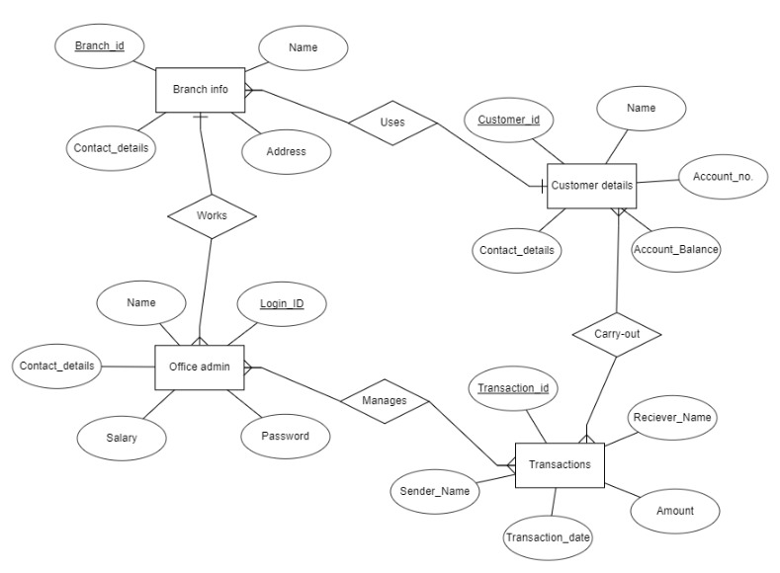
ER diagram:

Slide 11
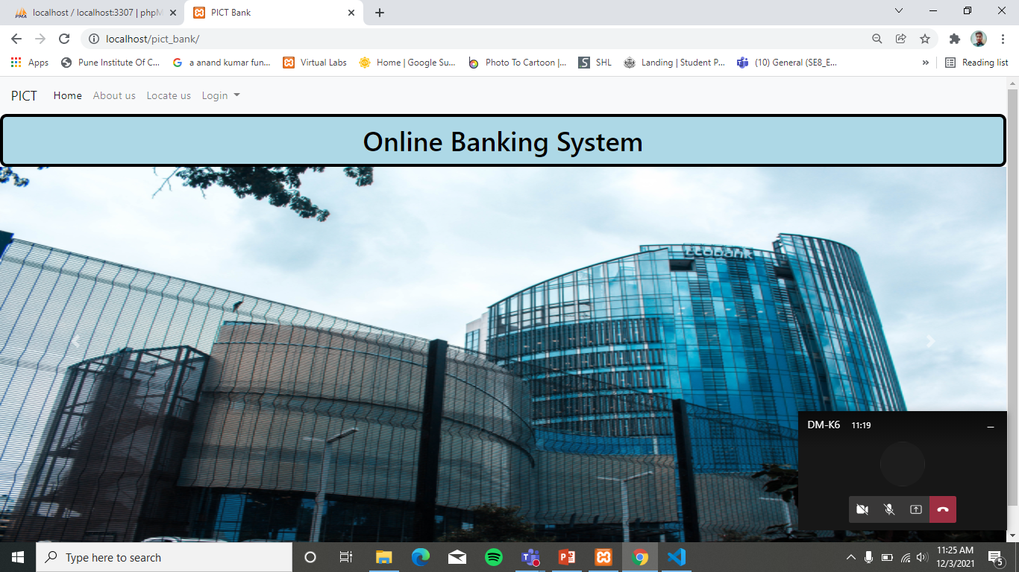
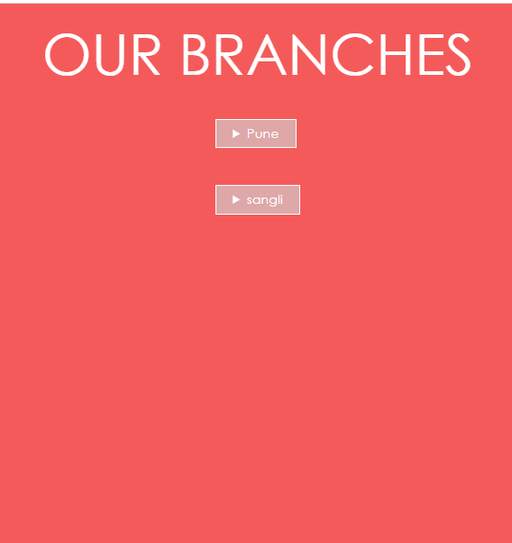
Screenshots

Slide 12
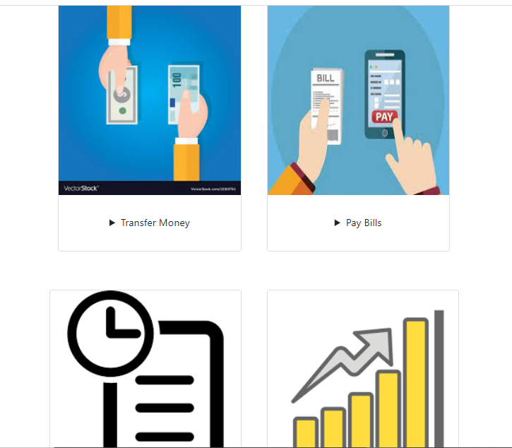

Slide 13


