Slide 1
Address Book Management System
Ganishka Technology
Internship of Computer Science & Information Technology
Presented by ATHARVA LACHAKE
BACHELOR OF TECHNOLGY(B-Tech)
COMPUTER SCIENCE AND DESIGN
2024 -2025
Github - https://github.com/Atharva1704-kbd/Adress_Book
Contact - atharvaslachake@gmail.com

Slide 2
Index
Introduction
Problem Statement
Objectives
Requirements
Features
UI Screens
Test Cases
Conclusion
Future Enhancements
Thank You

Slide 3
Introduction
Desktop application built using Java Swing.
Efficiently manage contact details.
Uses MySQL (XAMPP) as backend.
Developed with Apache NetBeans IDE.

Slide 4
Problem Statement
Manual contact management is difficult.
Risk of data loss in paper/unorganized files.
Lack of centralized and secure system.
Time-consuming to search or update contacts.

Slide 5
Objectives
User-friendly interface to manage contacts.
Support CRUD operations.
Enable search and filter functionality.
Export contacts to CSV.
Support role-based categorization (Students / Teachers).

Slide 6
Requirements
Hardware: 4 GB RAM, Dual-core processor, 500 MB storage.
Software: NetBeans IDE, Java JDK 8+, MySQL (XAMPP).
OS: Windows.

Slide 7
Features
User authentication (Login & Signup).
Manage Students and Teachers separately.
Add, Edit, Delete contacts.
Search by Name, Phone, or Role.
Export contacts into CSV.
Modern UI with gradients.

Slide 8
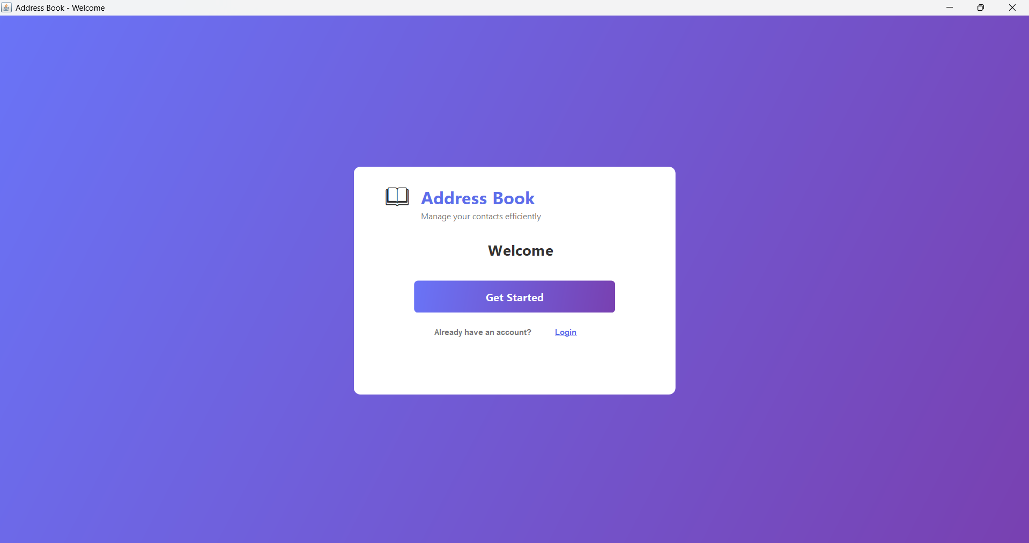
Welcome / Index Page
Modern gradient welcome screen.
Quick navigation: Get Started or Login.
Clean branding with Address Book logo.

Slide 9
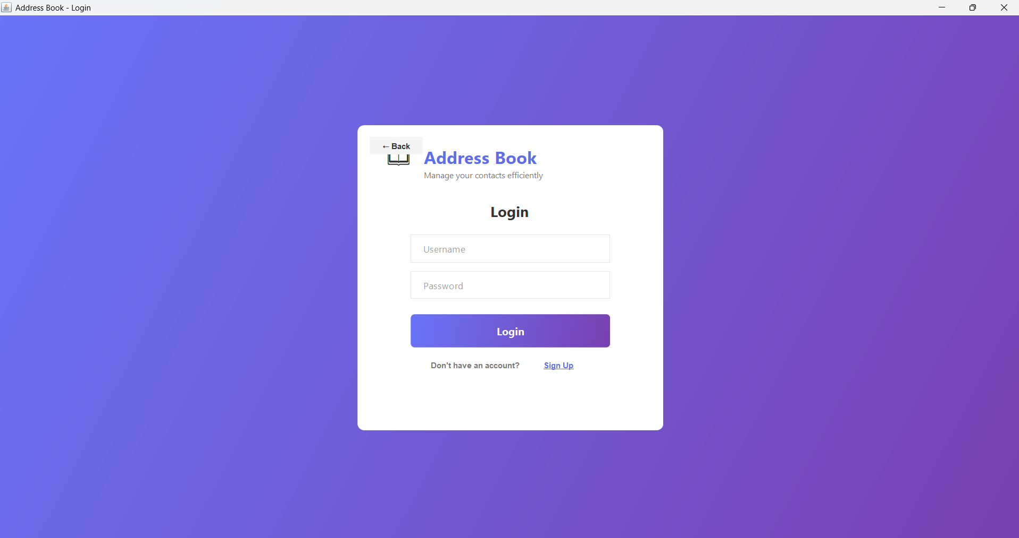
Login Page
Username and password authentication.
Secure access control.
Redirects to Dashboard after login.
Option to go to Signup.

Slide 10
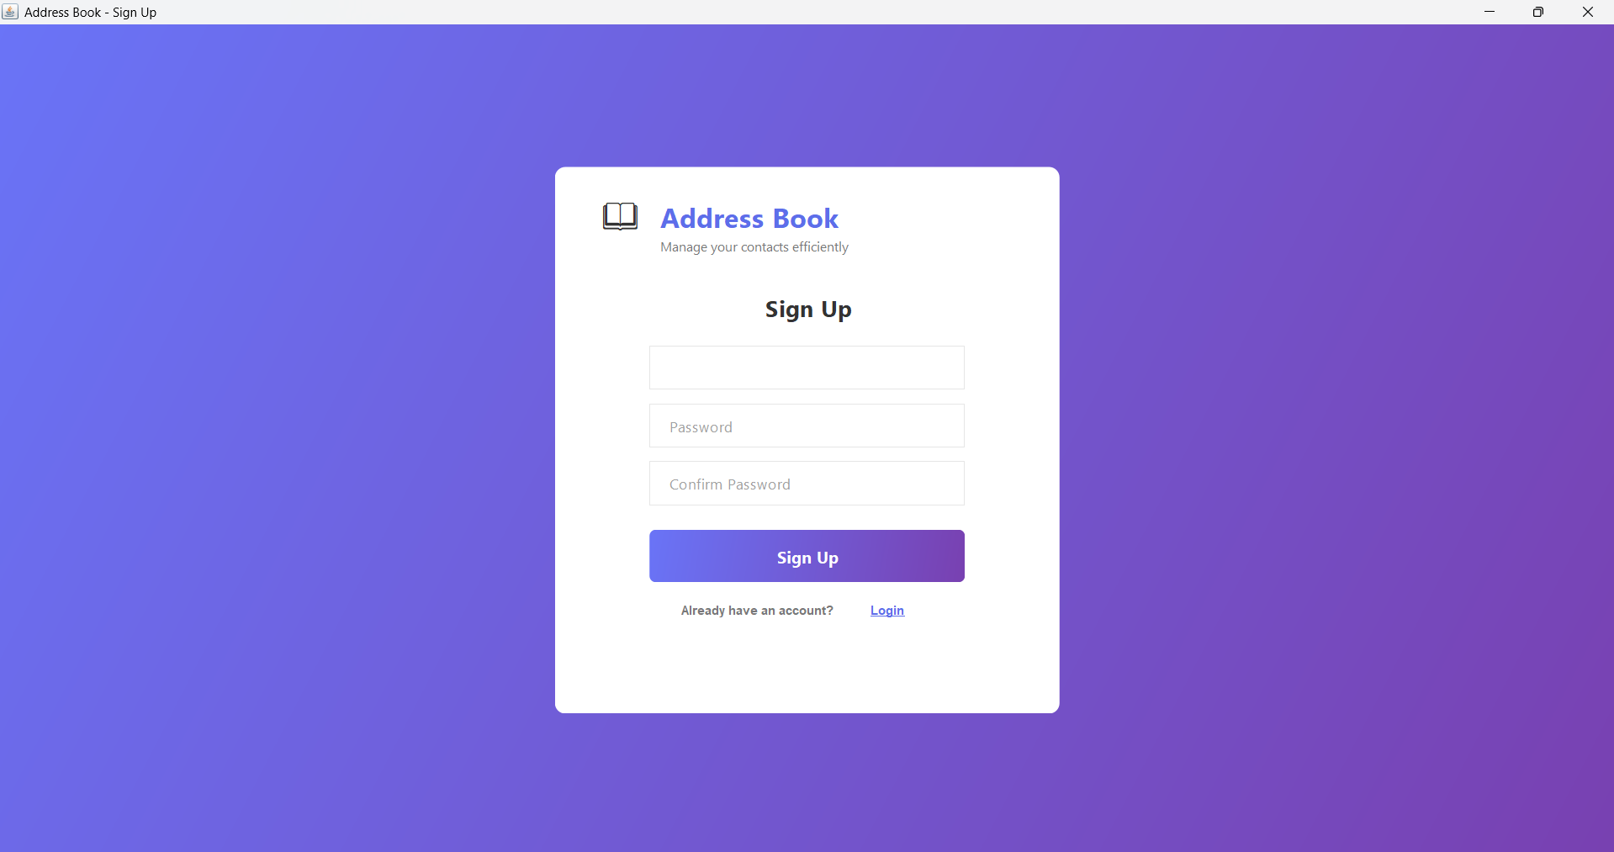
Sign Up Page
New account creation for users.
Password confirmation validation.
Redirects to Login after registration.

Slide 11
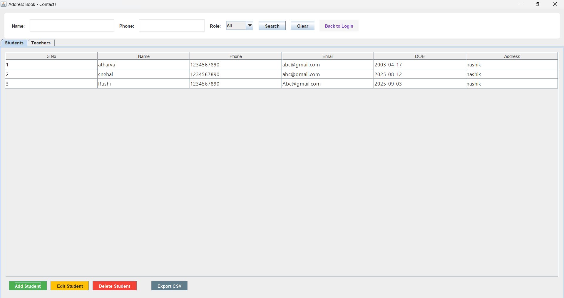
Student Table Interface
Displays student contacts in a table.
Add, Edit, Delete records.
Search by Name, Phone, or Role.
Export to CSV format.
Database connected via MySQL (XAMPP).

Slide 12
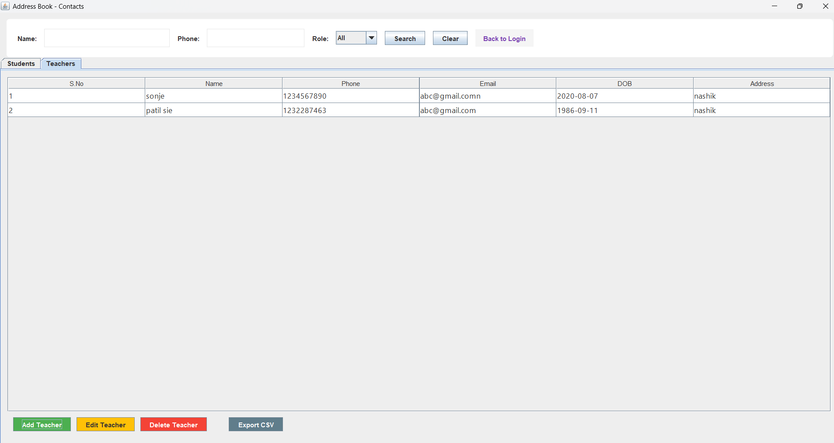
Teacher Table Interface

Slide 13
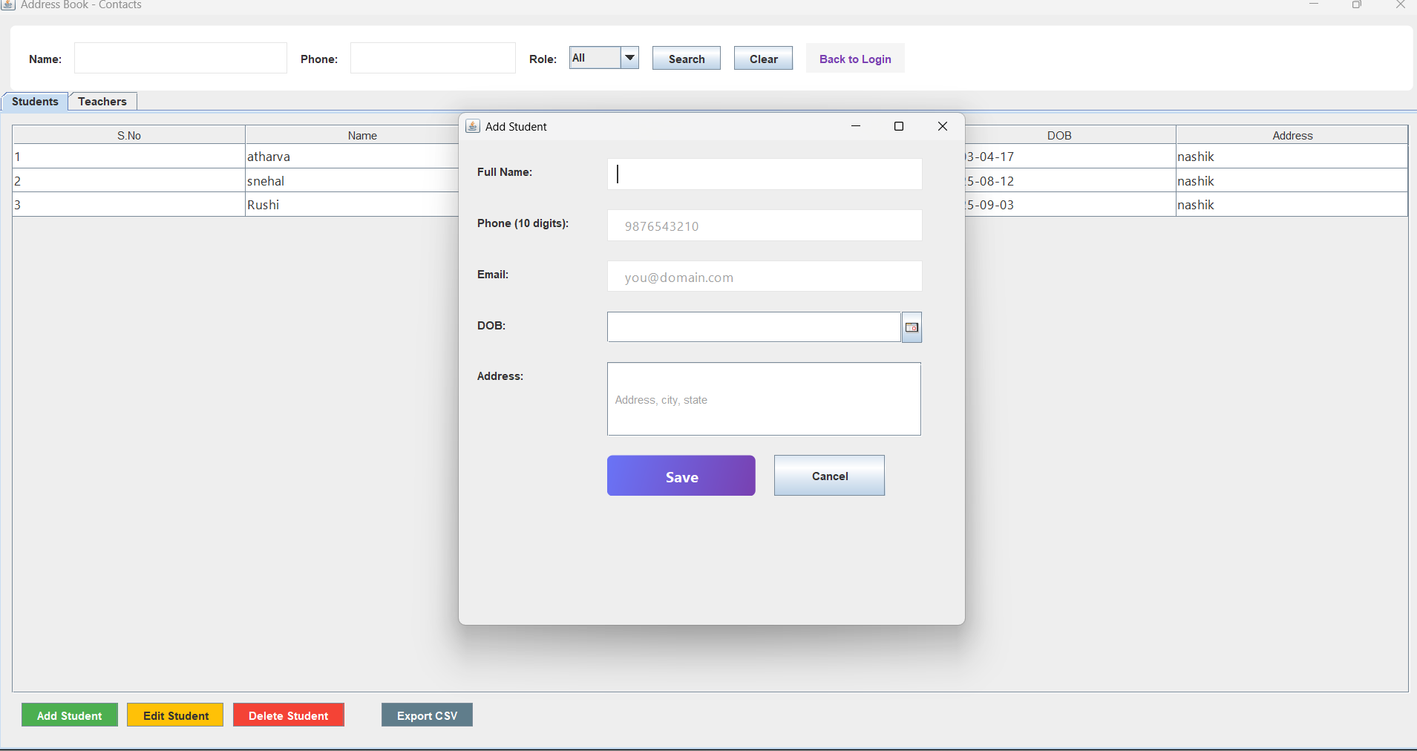
Add Contact Form For Student & Same for Teacher

Slide 14
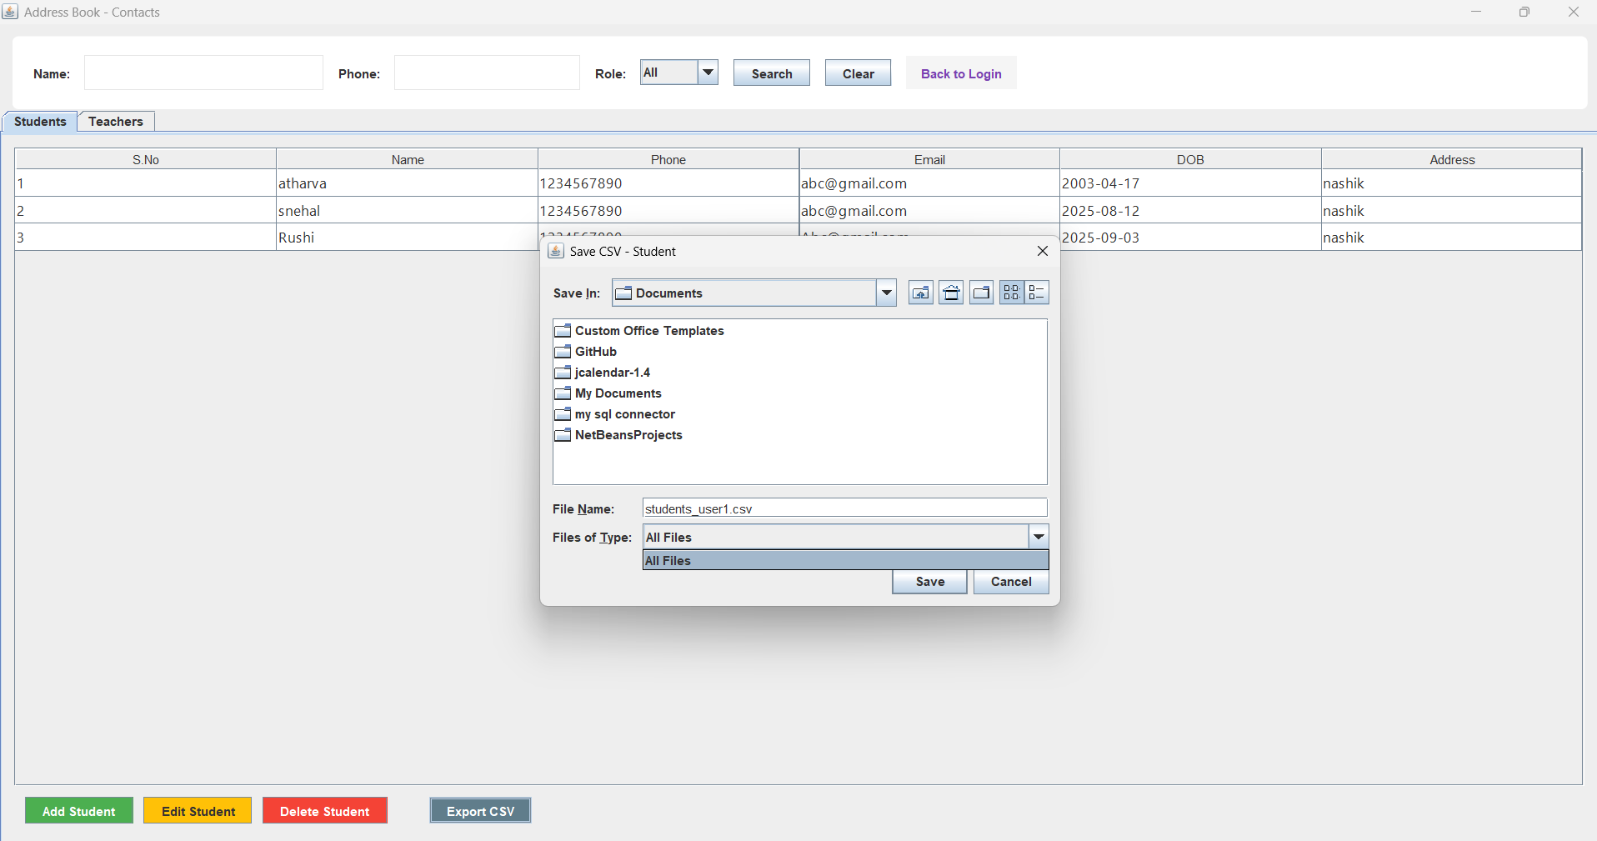
Export CSV File Button

Slide 15
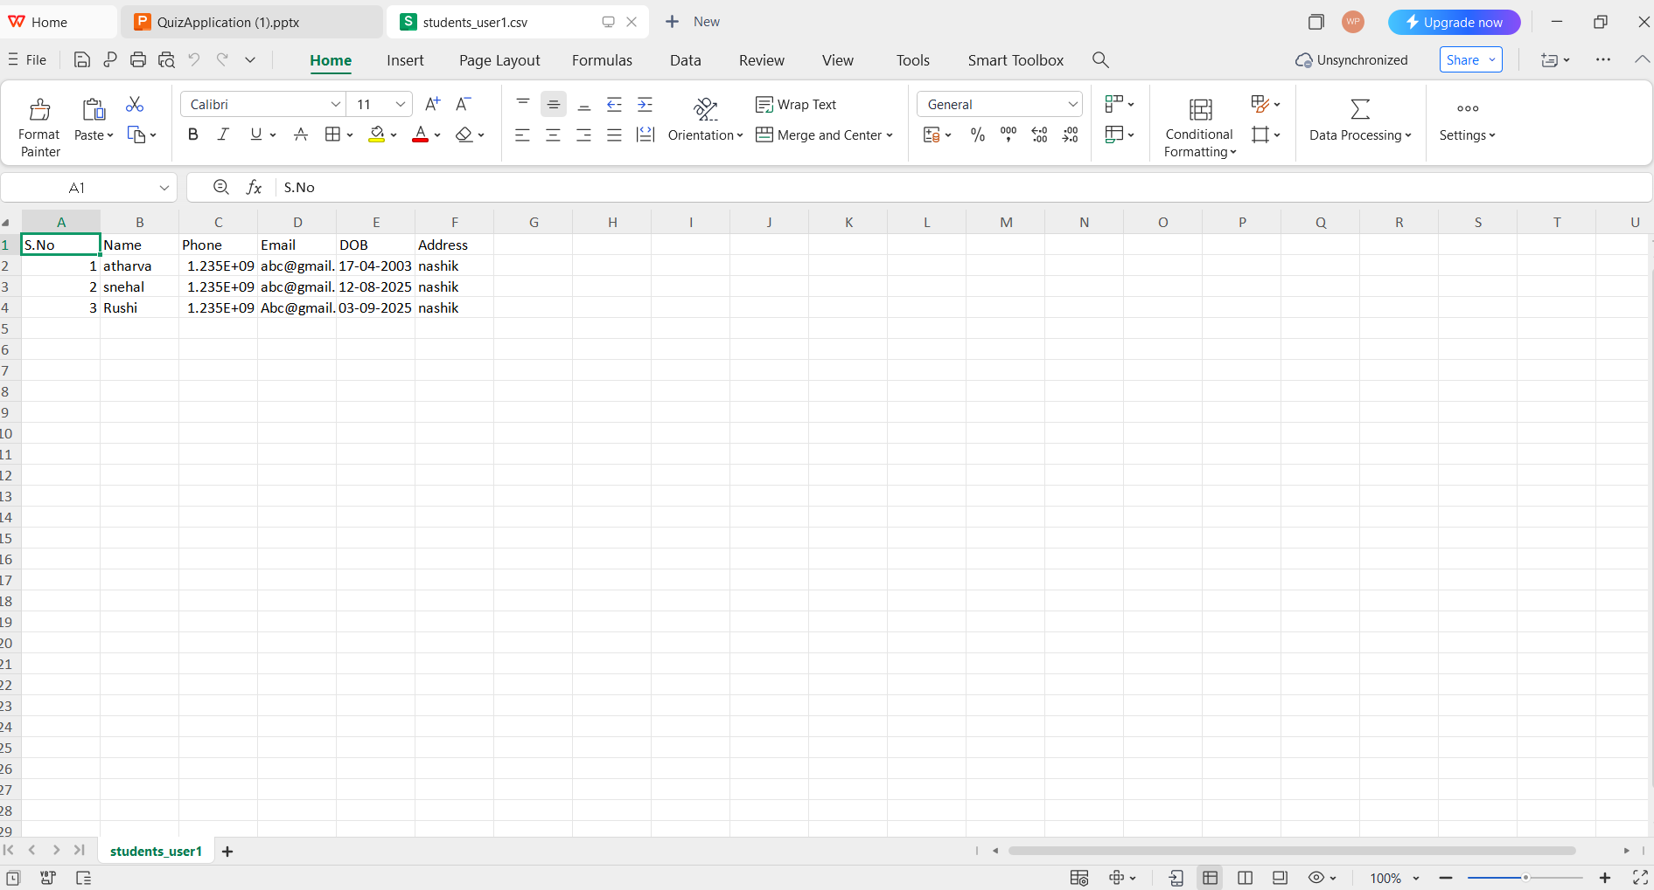
CSV File Downloaded In System

Slide 16
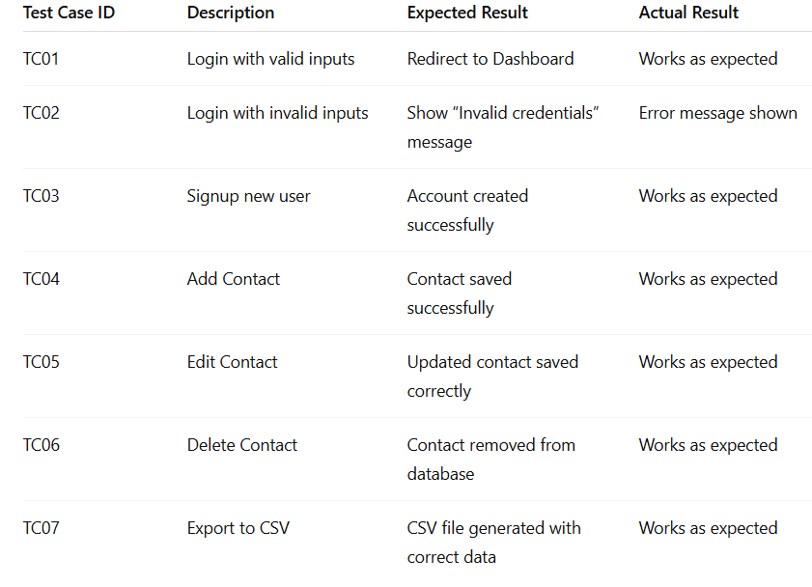
Test Cases

Slide 17
Conclusion
Provides digital solution for managing contacts.
Simplifies search, update, and export.
Improves data security.
Foundation for future enhancements.

Slide 18
Future Enhancements
Cloud storage integration.
Mobile application support.
Advanced search filters.
Data encryption.
Multi-user roles.

Slide 19
Thank You
Address Book Management System

