Slide 1

Agricultural Analytics & Climate Forecasting Pipeline
Analyzing rainfall, temperature, humidity, and crop yield across South India from 2004 to 2019 — powered by AWS S3, Snowflake, and Power BI.

Slide 2




Project Overview
This project analyzes agriculture data for locations in South India from 2004 to 2019. The goal is to see how rainfall, temperature, humidity, and crop yield change by year, season, crop, and location — making it easier to spot which crops, seasons, and places perform best.
AWS S3
Snowflake
Power BI
Raw CSV storage
SQL data preparation
4-page visual report

Slide 3
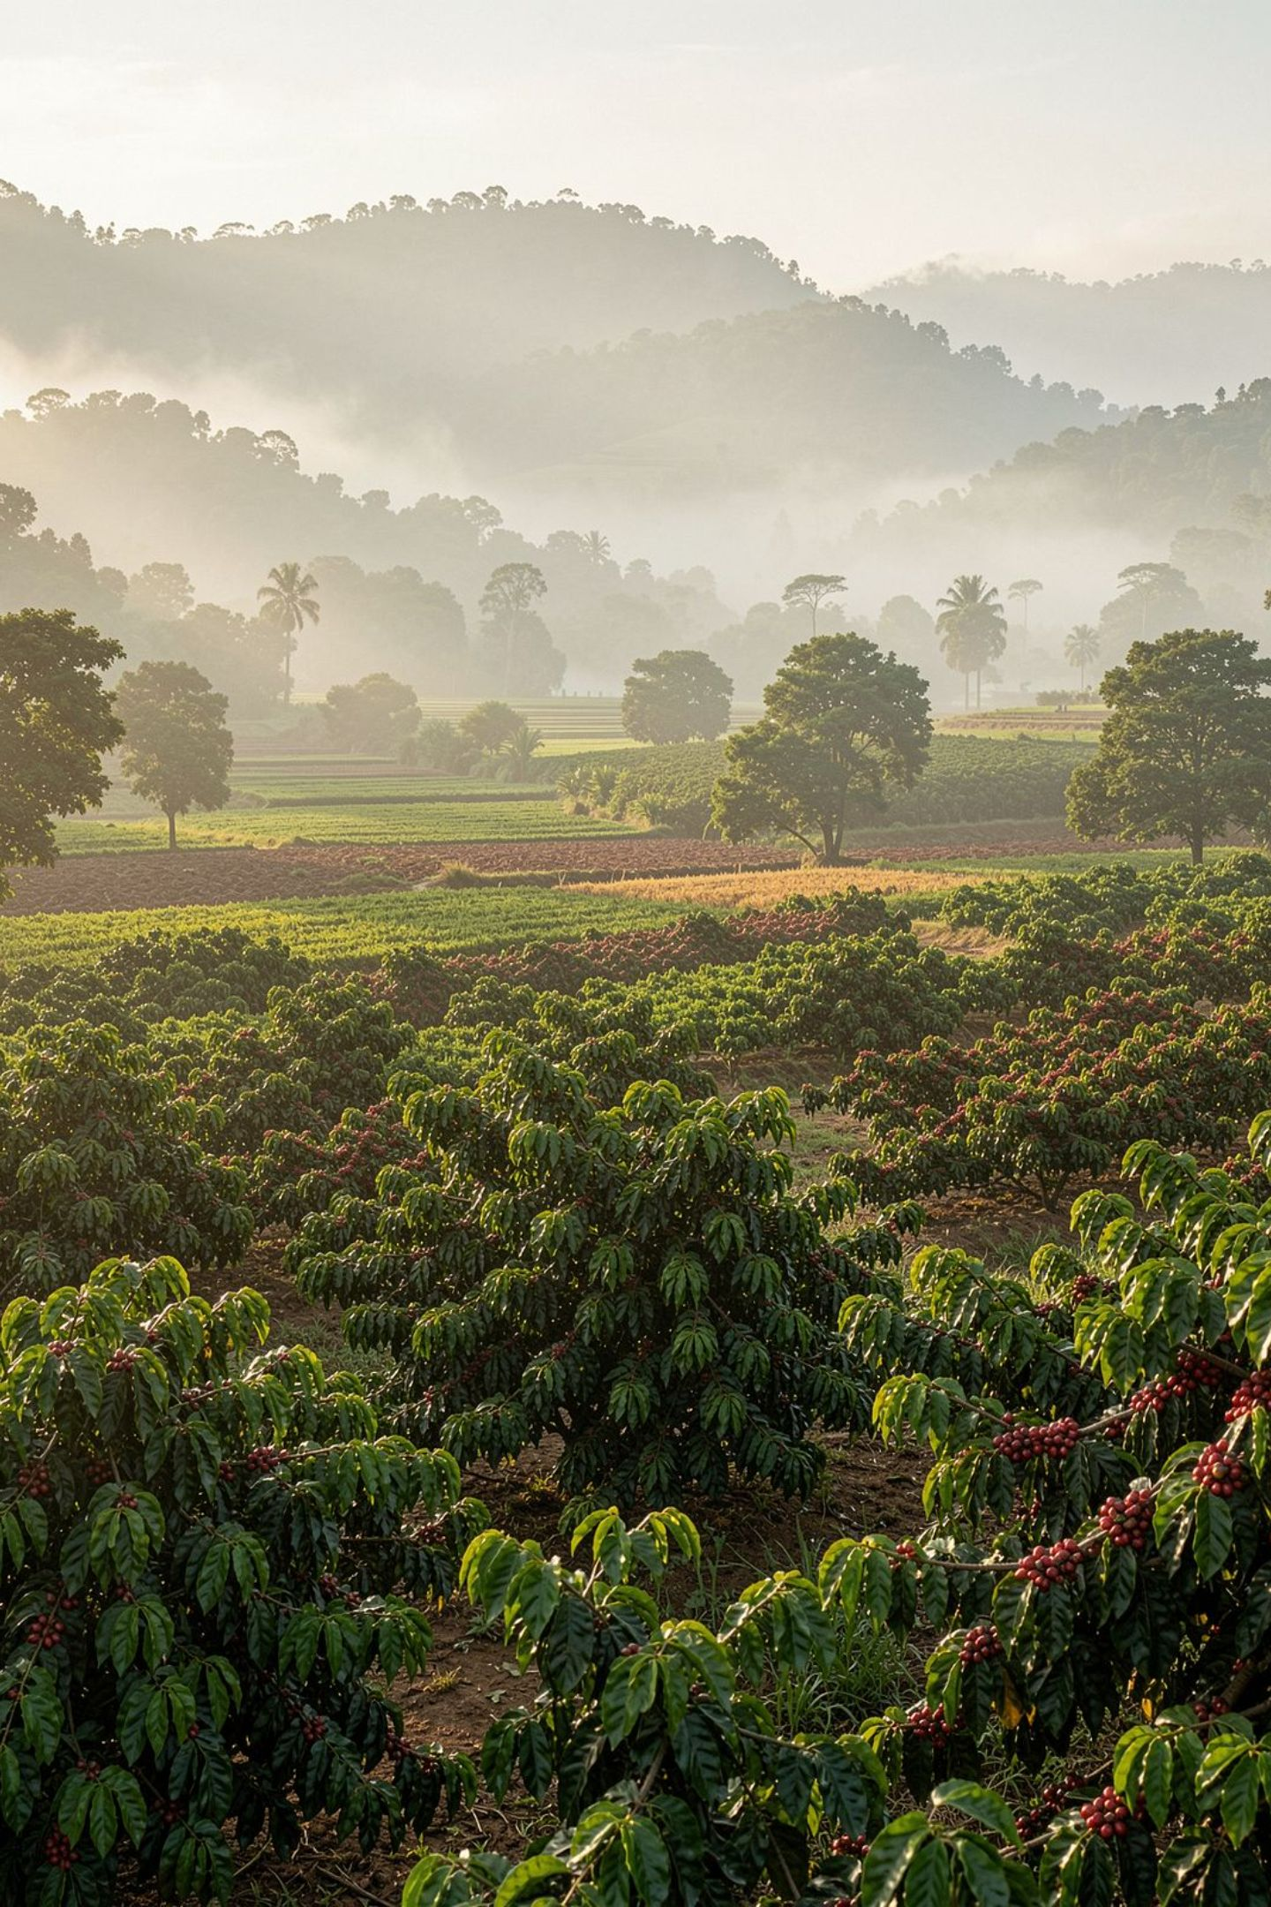
Dataset Summary
12 Columns
Year, Location, Season, Crop, Area, Rainfall, Temperature, Humidity, Soil Type, Irrigation, Yield, Price
2004–2019
16 years of records across 11 South India locations including Bangalore, Mysuru, Kodagu, Madikeri, Hassan, Mangalore, Chikmangaluru, Davangere, Raichur, Gulbarga, and Kasaragodu
3 Seasons
Rabi, Kharif, and Zaid
13 Crops
Paddy, cotton, coconut, tea, coffee, ginger, pepper, arecanut, cardamom, cashew, cocoa, groundnut, and blackgram
Rainfall values in the prepared table range from 255 to 4,103.

Slide 4

Data Loading: AWS S3 → Snowflake
The CSV was stored in AWS S3 and loaded into Snowflake through five steps:
Result: the raw data now sits in the Snowflake table PBI_Dataset, which is kept unchanged.
01
02
03
Storage Integration
External Stage
Database & Table
PBI_Integration links Snowflake to an AWS IAM role and the allowed S3 location
pbi_stage shortcut inside Snowflake pointing to the S3 bucket
Created PowerBI database, PBI_Data schema, and PBI_Dataset table with 12 columns
04
05
COPY INTO
Load Check
Loaded CSV into PBI_Dataset (comma delimited, header row skipped, rows with errors skipped)
Counted rows per year to confirm data loaded for every year

Slide 5
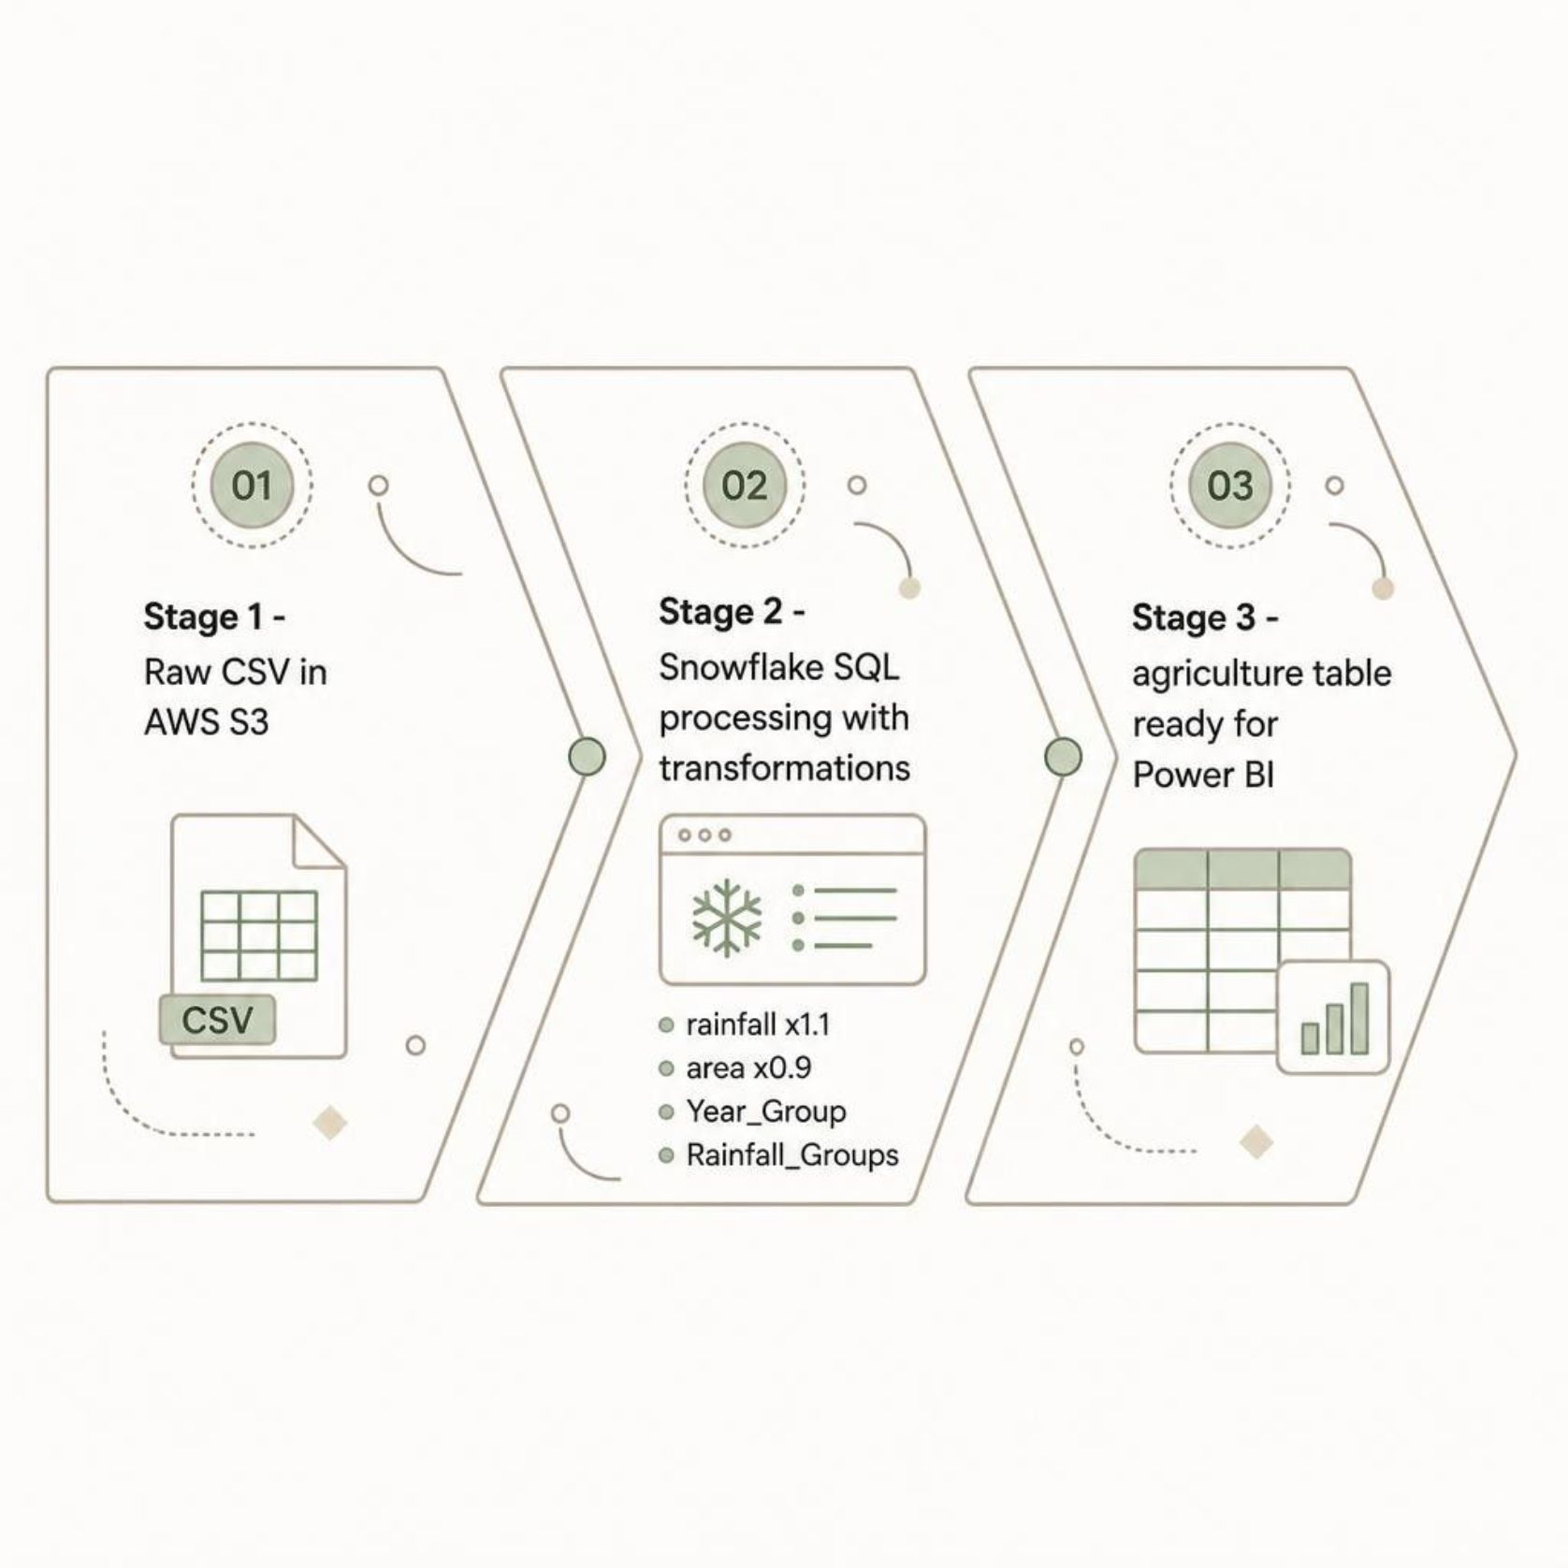
Data Preparation: SQL Transformations
A working copy table (agriculture) was created so the raw table stays untouched. Values were adjusted: rainfall multiplied by 1.1 and area multiplied by 0.9. Two new grouping columns were added:
Year_Group
Rainfall_Groups
Y1: 2004–2009 · Y2: 2010–2015 · Y3: 2016–2019
Low: 255–1,200 · Medium: 1,200–2,800 · High: 2,800+

Slide 6

POWER BI REPORT
4-Page Dashboard Architecture
Every page has four bar charts: average by Year, by Season, by Crop, and by Location. The report was published to Power BI Service.
Page 1
Rainfall Analysis
Page 2
Temperature Analysis
Page 3
Humidity Analysis
Page 4
Yield Analysis

Slide 7

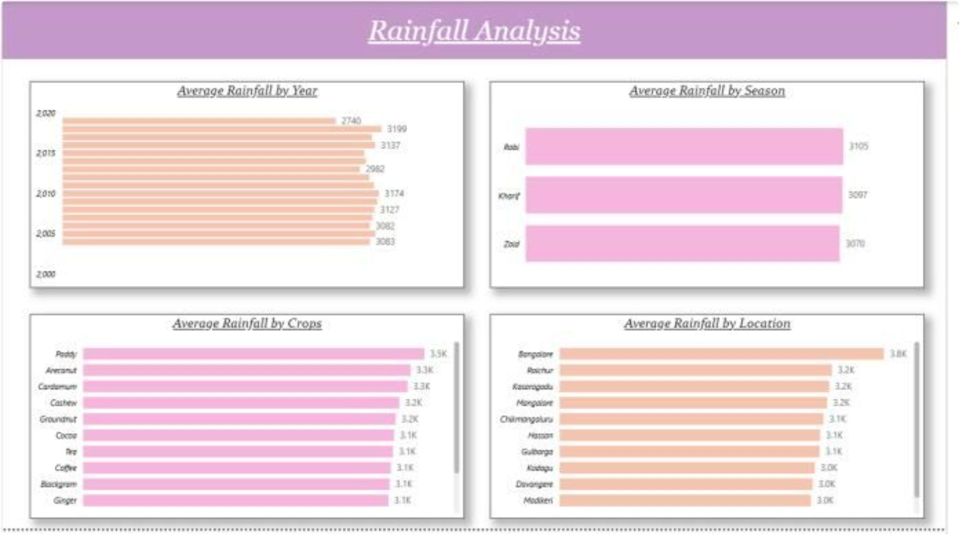


Rainfall Analysis
By Season
Rabi (3,105), Kharif (3,097), Zaid (3,070) — a gap of about 1%, so season does not change rainfall much
By Crop
Paddy highest at 3.5K; Arecanut, Cardamum, Cashew, Groundnut, Chilli, Tea, Coffee, Blackgram, and Ginger all at 3.1K–3.3K
By Location
Bangalore leads at 3.8K; other locations range from 3.0K to 3.2K
By Year
Yearly averages range from 2,740 to 3,199

Slide 8
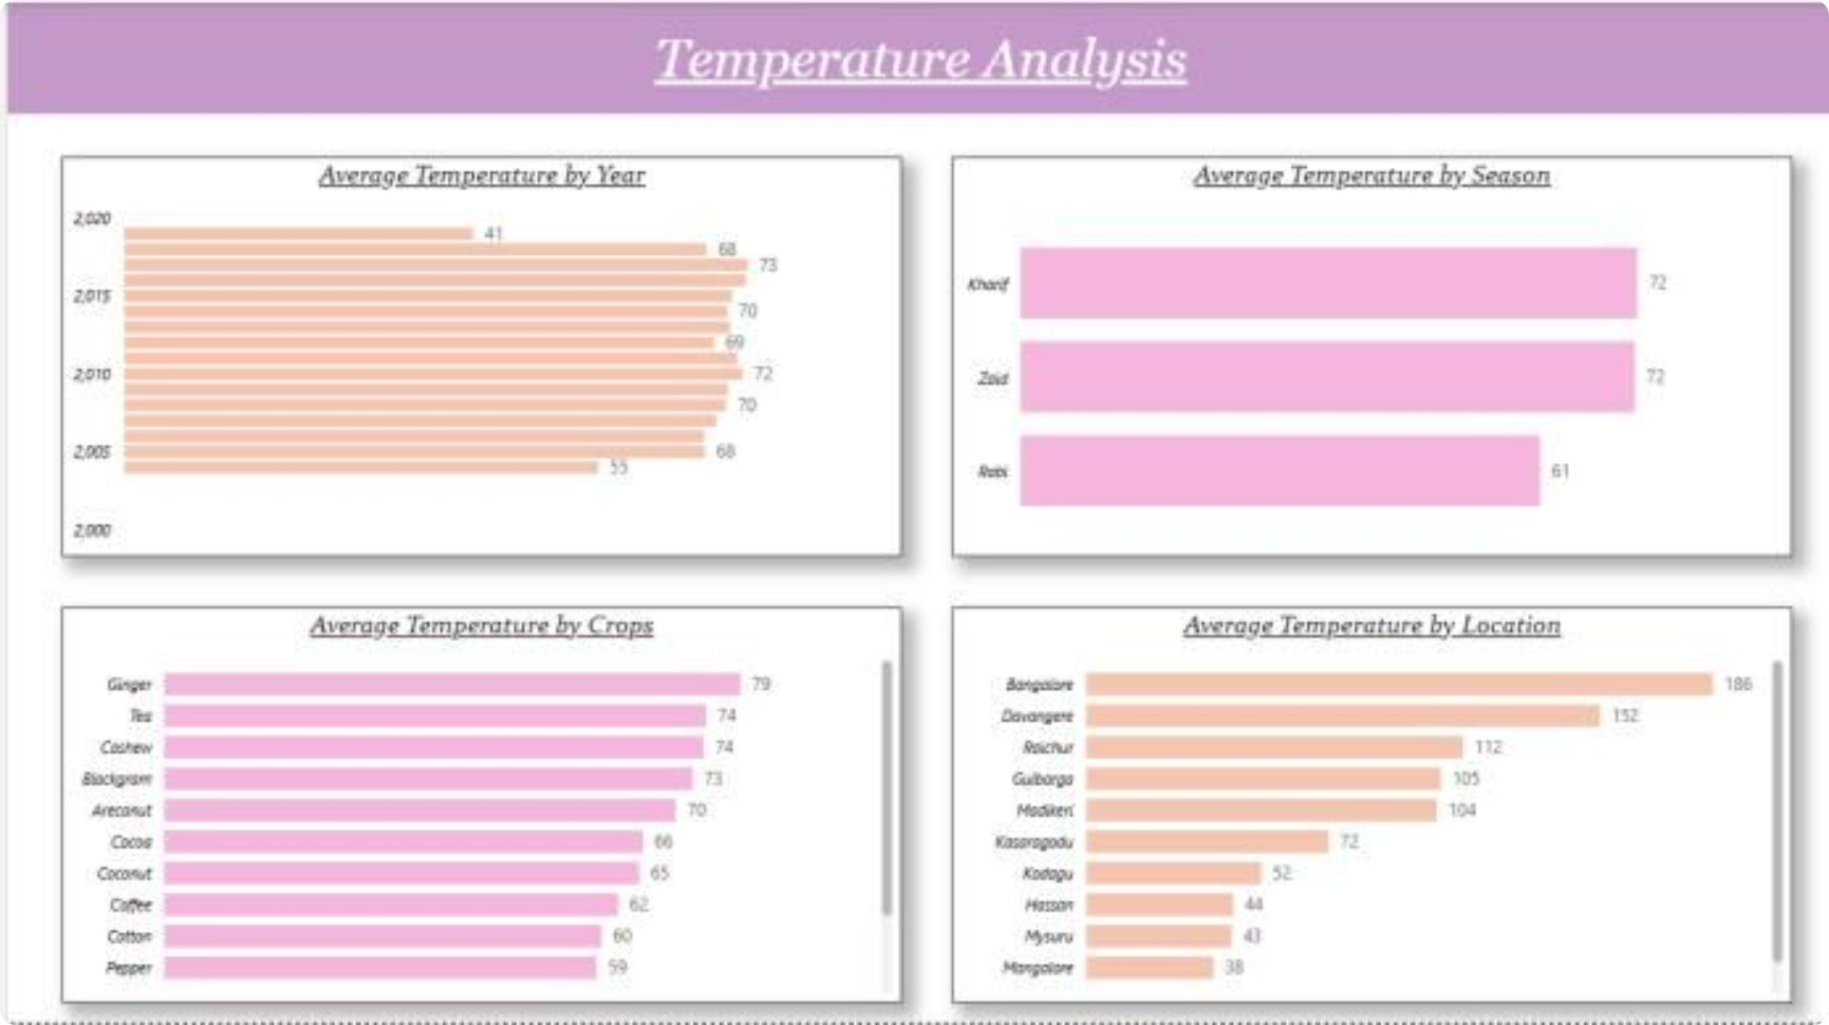
Temperature & Humidity Analysis
Temperature
Rabi is the cooler season (61), about 11 lower than Kharif and Zaid (72 each). Ginger (79), Tea (74), and Cashew (74) have the highest crop averages; Pepper (59) and Cotton (60) the lowest. Yearly averages range from 41 to 73. Unit not stated in dataset.
Humidity
Average humidity is about 55–56 for every year, season, crop, and location. Cardamum, tea, ginger, and arecanut show 55; the rest show 56 — a gap too small to matter. Humidity does not separate any group in this data, so it adds little to the analysis.

Slide 9

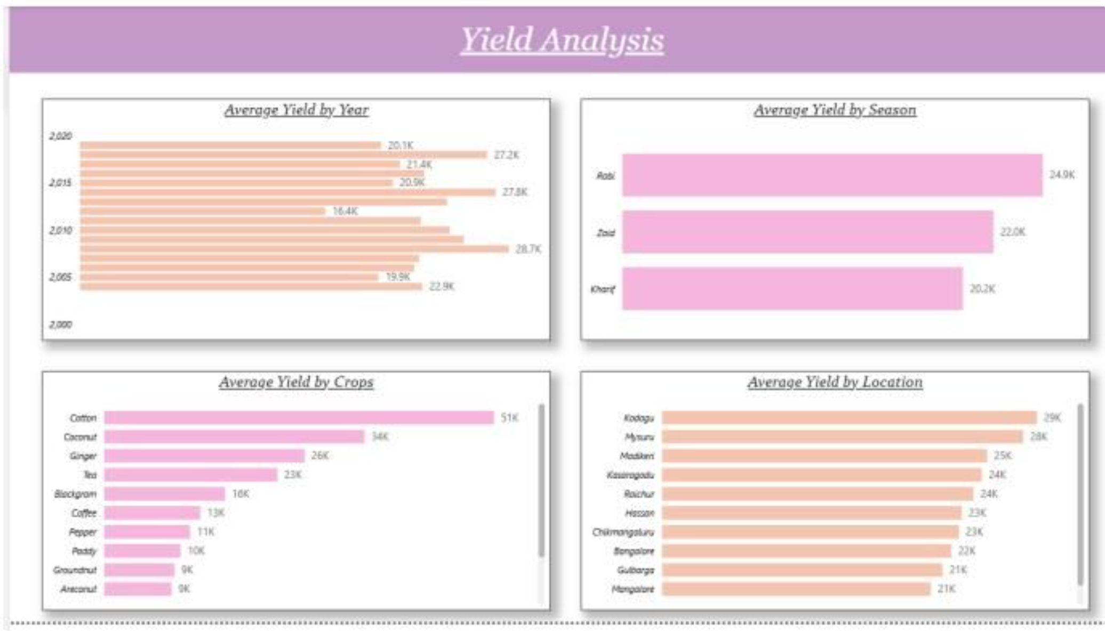
Yield Analysis
By Crop
Cotton (51K) and Coconut (34K) lead; Arecanut and Groundnut lowest (~9K)
By Season
Rabi highest at 24.9K — about 23% above Kharif (20.2K)
By Location
Kodagu (29K) and Mysuru (28K) lead; Mangalore and Gulbarga lowest (21K)
By Year
Yearly averages range from 16.4K to 28.7K — yield changes a lot from year to year

Slide 10
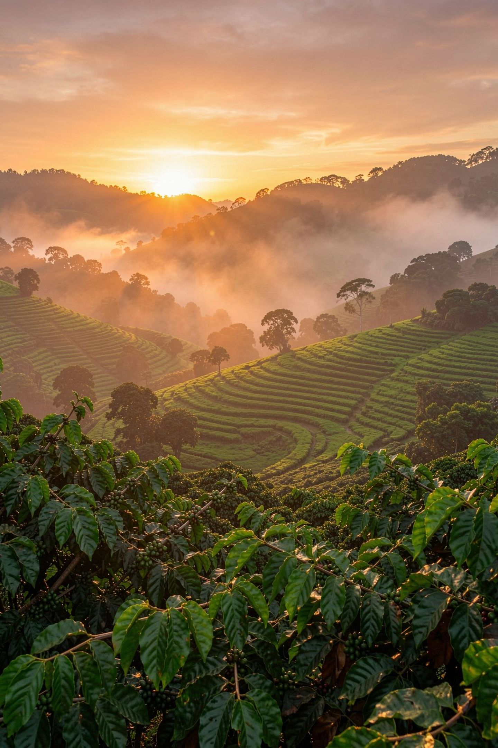




Key Takeaways
High-Yield Crops
Cotton (51K) and coconut (34K) stand out, followed by ginger (26K) and tea (23K)
Season Pattern
Rabi gives the highest yield (24.9K) and is also the cooler season — a pattern in the data, not proof of cause
Location Insight
Kodagu (29K) and Mysuru (28K) lead on yield. Bangalore has the highest rainfall (3.8K) but only 22K yield — more rain does not mean more yield
Humidity
Almost constant at 55–56 across all groups, so it is not useful for telling groups apart

