Slide 1
Multi-Modal Driver Drowsiness Detection and Behavior Profiling
Main Title: Multi-Modal Driver Drowsiness Detection and Behavior Profiling
Subtitle: A Deep Learning and Trajectory Analysis Approach for Safer Roads
This project integrates visual deep learning with real-world trajectory data to identify drowsy, aggressive, or distracted driving—offering both real-time inference and long-term behavioral profiling.

Slide 2
Introduction
Drowsy driving causes ~100,000 crashes annually
Traditional detection: Either vision or telemetry
Our system: Combines CNN for eye state with driving pattern clustering
Talking Point:
“Fatigue remains a silent killer on roads. Many solutions exist—but either compromise privacy with constant camera feeds or lack precision by only using speed data. We aimed to merge the strengths of both worlds.”

Slide 3
Outline
Introduction
Vision Module (CNN)
Trajectory Feature Engineering
Behavior Clustering
Results & Visualizations
Conclusion & Future Work
Questions

Slide 4
Vision Module Overview
Input: Grayscale 64×64 eye images
Lightweight CNN: 820K parameters
Real-time capable: Inference < 50ms
Output: Binary eye state (alert vs drowsy)
We trained a CNN optimized for size and speed—making it deployable on embedded boards like Jetson NX without sacrificing accuracy

Slide 5
Vision Module Overview
Key Characteristics
Input: 64×64 grayscale eye images
Lightweight CNN (~820K parameters)
Output: Alert vs. Drowsy probability
Real-time: <50 ms/frame

Slide 6
CNN Architecture
Layer Structure
Conv2D(32, 3×3) → ReLU → MaxPool(2×2)
Conv2D(64, 3×3) → ReLU → MaxPool(2×2)
Flatten → Dense(64) → Dropout(0.5) → Dense(2, Softmax)

Slide 7
CNN Results
Test Accuracy: 100%
Precision & Recall: 100%
Zero misclassifications across 8,359 samples
ROC-AUC: 1.00
The model's near-perfect performance shows how effective a simple but focused CNN can be when trained on clean, curated data

Slide 8
Trajectory Data
Dataset: NGSIM US-101
Collected in Los Angeles (2005)
Covers 1,600+ vehicles over 15 minutes
Captures: position, speed, acceleration, lane ID, spacing
This real-world dataset gave us an excellent canvas to study driving patterns. Unlike simulators, these are actual highway behaviors

Slide 9
Kinematic Feature Engineering
Each driver summarized with:
Mean/Std of Speed & Acceleration
Number of Lane Changes
Mean Spacing
Jerk (Δ Acceleration): Mean & Std
Rather than looking at every frame, we compressed each driver’s behavior into 8 intuitive metrics—creating a fingerprint of their driving style

Slide 10
Behavior Clustering
K-Means (k=3) on standardized data
Cluster centroids ranked by std_acc
Behaviors mapped to:
Cautious
Distracted
Aggressive
Rather than manually labeling behavior, we let the data speak. Using clustering, we uncovered natural groupings and then assigned meaning based on driving volatility

Slide 11
Cluster Centroids
Aggressive drivers: High velocity + high jerk
Distracted: Mid-range across all metrics
Cautious: Low mean velocity, low std_acc
Centroids confirmed our hypothesis: higher acceleration variability and erratic jerk are consistent markers of aggressive driving

Slide 12
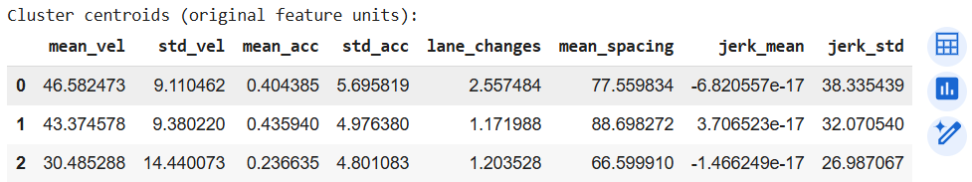

Slide 13
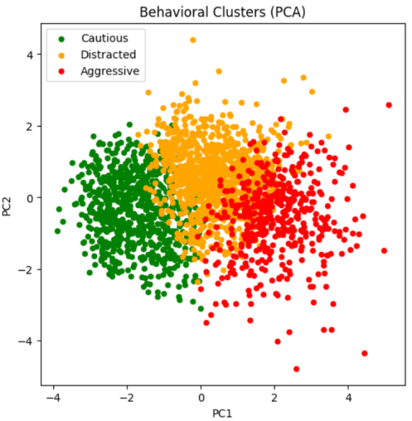
PCA Visualization
PCA lets us compress our 8D feature space into two dimensions. Each color here represents a behavior class. The clear separation validates that our clustering meaningfully
distinguishes driving styles.

Slide 14
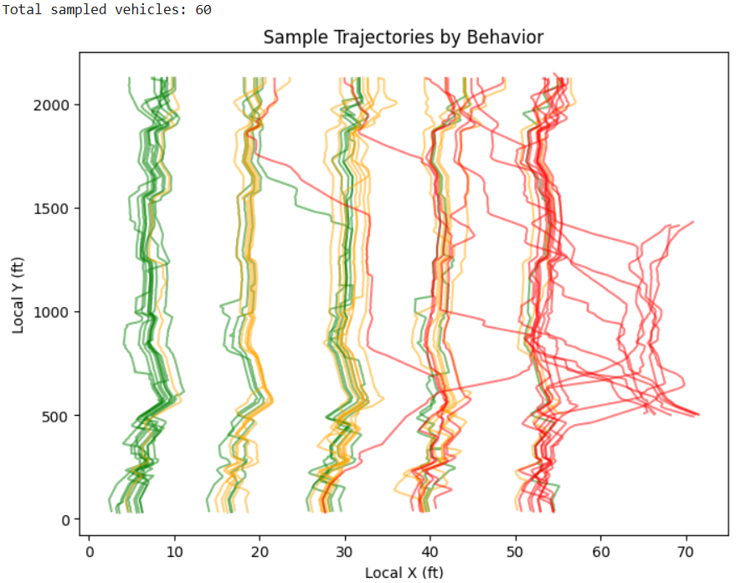
Static Trajectories
You can see behavior in motion: green (cautious) drivers stick to a lane; red (aggressive) drivers weave or shoot ahead. These static maps reinforce the cluster assignments.

Slide 15
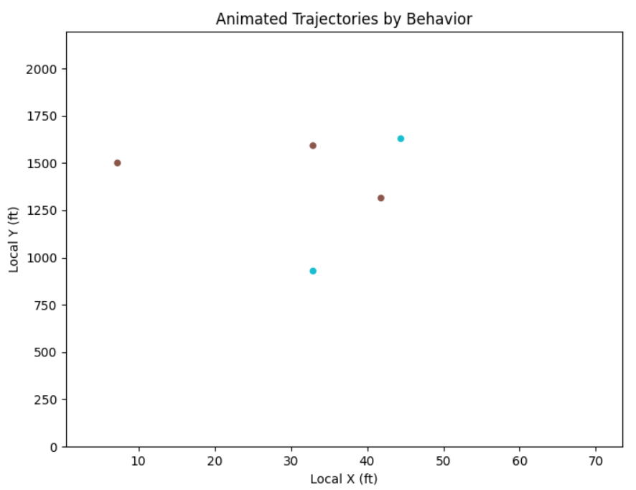
Animated Trajectories
The animation reveals time-based patterns. Aggressive drivers exhibit abrupt jumps and overtakes, while cautious ones show consistent lane adherence and smooth movement.

Slide 16
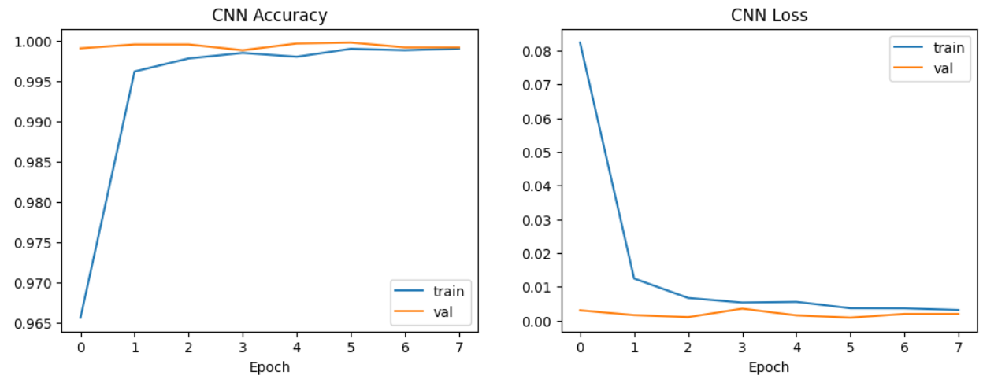
Accuracy

Slide 17
Conclusion & Future Work
CNN detects drowsiness with 100% accuracy
Behavior profiling shows 3 natural driver classes
Camera-free drowsiness detection is feasible
Future: Synchronize vision + telemetry + LSTM sequences
What began as a vision system became a framework for smart, interpretable, and scalable driver monitoring. We believe this opens doors for real-world ADAS integration.

Slide 18
Thank You
Reg. No. 1 ATHARVA SHUKLA 21BCT0324
Reg. No. 2 MOHIT KUMAR PANDA 21BCE2540

