Slide 1
Natural Language Based exploration and analysis of structured data

Slide 2

Introduction
The problem we are attempting to solve is complex, casts a wide net, and if solved - will enhance or potentially remove the need for EDA, Data Cleaning and even Data Scientists.
Essentially, we are trying to create an end-to-end service that will allow a user to gain insights from Structured Datasets by asking relevant questions about the data in only Natural Language (plain english).

Slide 3

Plan Of Action
Semantic understanding of user actions
Specialised Intent detection, based on data labels
Code generation from Intent categorization and Dataset Structure.
Standardization of Code Snippets for automated EDA
Dynamic Type capable snippets
Our work here will primarily revolve around fine-tuning existing models and creating carefully thought out test-train sets and scenarios.

Slide 4
GPT3
GPT3 is a large language model, [Generative Pre-trained Transformer 3] is an autoregressive language model that uses deep learning to produce human-like text.
We will be leveraging the API provided by OpenAPI, the creators of GPT3, to first test our initial hypothesis - and confirm that intent detection and semantic understanding of use actions can be automated.
The alternatives of GPT3 are few, and the ones that are open source are very computationally expensive to test and train, which is why we have stuck with GPT3.
The most important thing to us about this model is it’s few-shot learning capabilities. It can provide us with very accurate outputs with only a small set of examples. Moreover, the APIs provided, allow us to tune and re-train the model at 0 cost of computation via a token-based request system.
GPT3 also has an offshoot model trained on open source code from GitHub, called Codex, which will allow us to generate code dynamically, depending on the dataset.

Slide 5
API Linking
API Linking is the process in which we provide a communication platform for two applications for further processing.
API Linking starts with the process of finding / manual typing your own API key for a program and storing that API key. Once we have our own API key we go on the program platform where we need to use the previous program for combined application by mentioning the API key we have.
By this way we will be able to request whatever we need from the first program in form of a query and as we are connected to the first program the query will be resolved via running that application and it will send a response back to the current program.
General syntax for API Linking is given by:-
openai.api_key = 'fg-zfyj9uL0198R7U9oNy0mT3BlbkFJoQoFCMZClQa5Rbgeefefgg’'

Slide 6
PArameters Of open-ai models
Model Selection:- Model Selection is the parameter on which your Playground Runs on. There are different models available and supported by Open-AI. In this case we are using Davinci- Codex Model because of its wide range of Codebases available.
Temperature:- It is responsible for controlling Randomness. As the Temperature approaches zero the model will become more deterministic and repetitive.
Response Length:- It generally means that length of response you are expecting of your output should be. If you keep more response length than required then solution can be repetitive and if response length is less than required solution, the solution might be incomplete. So selecting the perfect response length range is very essential.

Slide 7

PArameters Of open-ai models
4.)Frequency and presence penalties:- The frequency and presence penalties found in the completions API can be used to reduce the likelihood of sampling repetitive sequences of tokens. They work by directly modifying the logits (un-normalized log-probabilities) with an additive contribution.
5.) Stop Sequences:- We can enter maximum of 4 sequences where the API will stop generating further tokens or further program generation. Can be used to terminate the process whenever required.

Slide 8
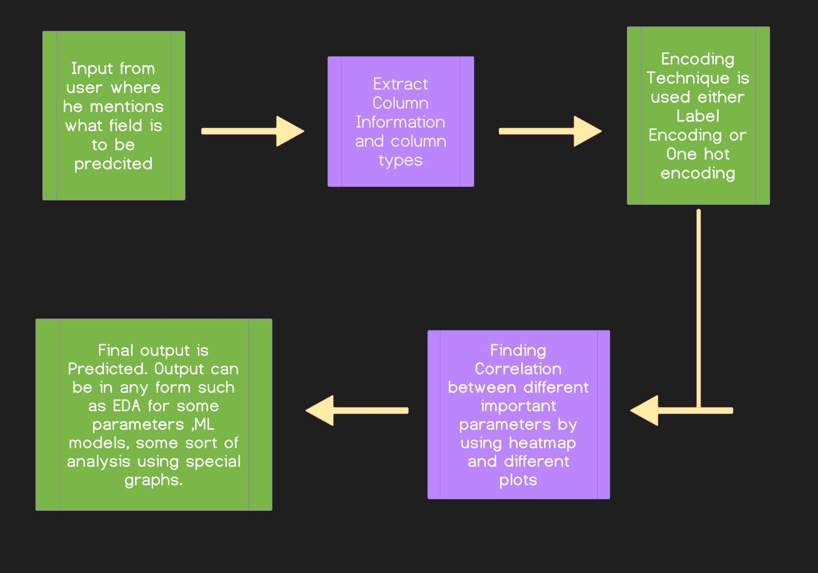
Flowchart

Slide 9
STREAMLIT io
Streamlit is an open source app framework in Python language. It helps us create web apps for data science and machine learning in a short time. It is compatible with major Python libraries such as scikit-learn, Keras, PyTorch, SymPy(latex), NumPy, pandas, Matplotlib etc.
With Streamlit, no callbacks are needed since widgets are treated as variables. Data caching simplifies and speeds up computation pipelines. Streamlit watches for changes on updates of the linked Git repository and the application will be deployed automatically in the shared link.

Slide 10
Basic FunctionS added to Streamlit for WEB
Get_good_correlation :
finds and returns the column with correlation greater than the threshold value.
Normalise and Encode :
It is used to normalise numerical values and used to encode Non-numerical values.
We have provided encoding options to users as well that includes label encoding and One Hot Encoding.
Train-Test split and models:
We are using it to provide a general 30-70 test train split and are giving users different options for model training such as Random-Forest, Decision-tree, Logistic Regression.

Slide 11
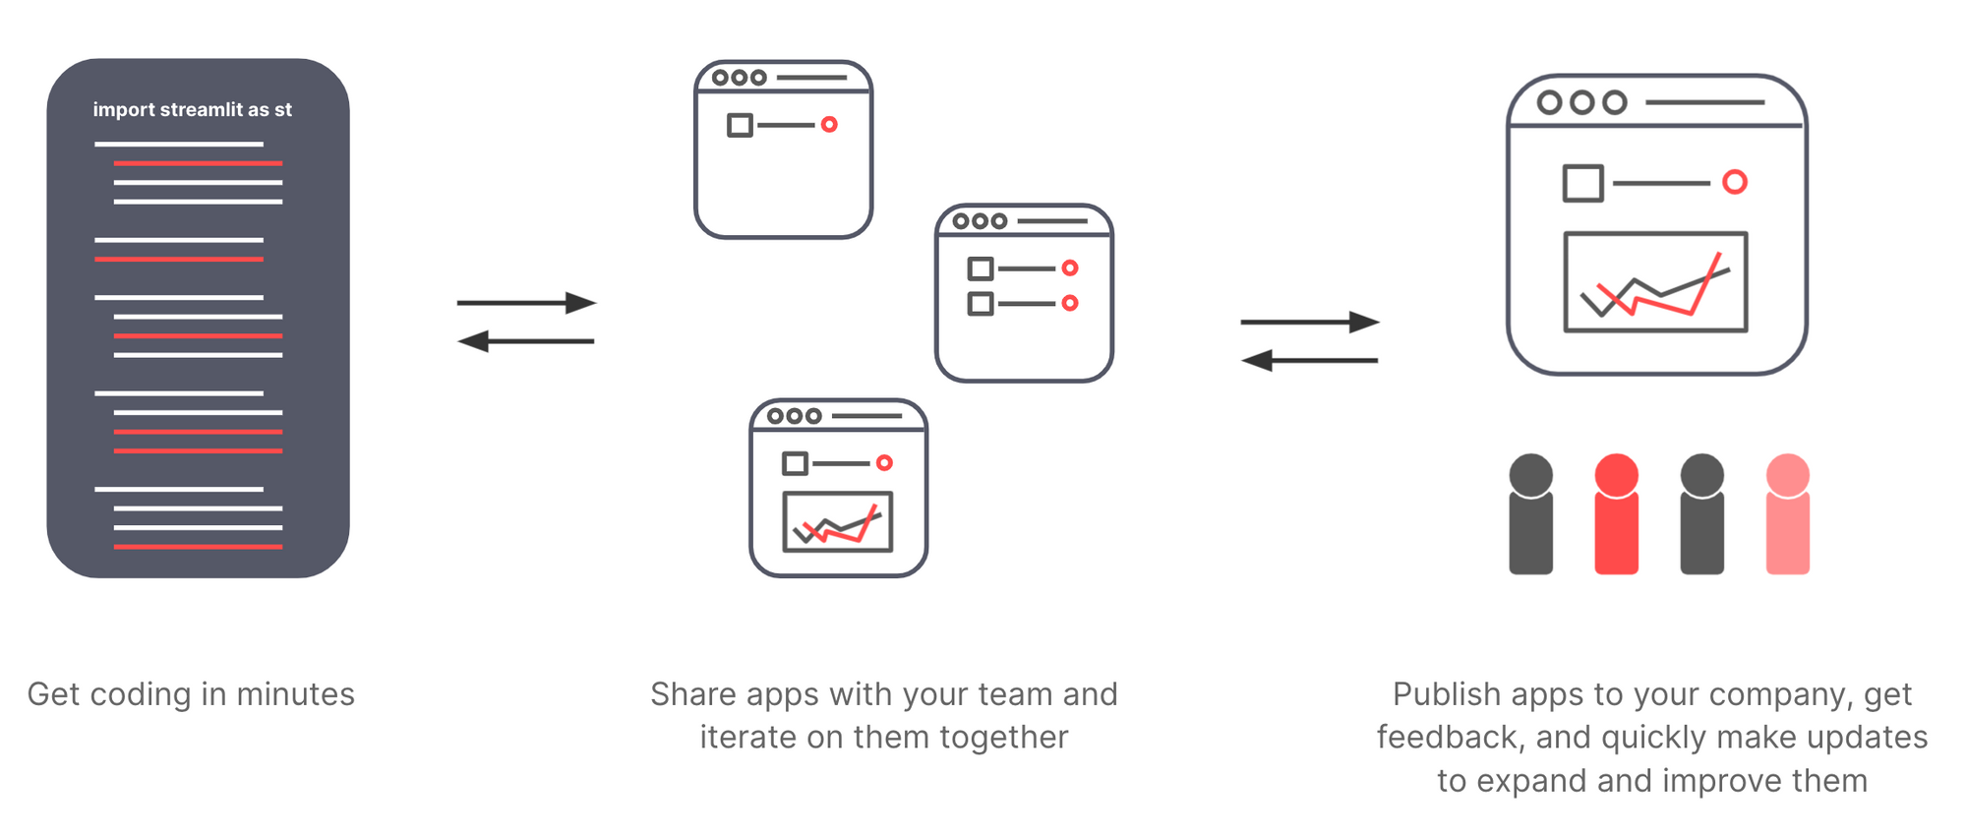
STREAMLIT-CLOUD io
Streamlit Cloud is a workspace for the team to deploy, share, and collaborate on the Streamlit apps.
When we work on an app in Streamlit Cloud—be it a new model, data analysis, or idea—we’re just a few clicks away from securely sharing it and collaborating on it with our team.

Slide 12
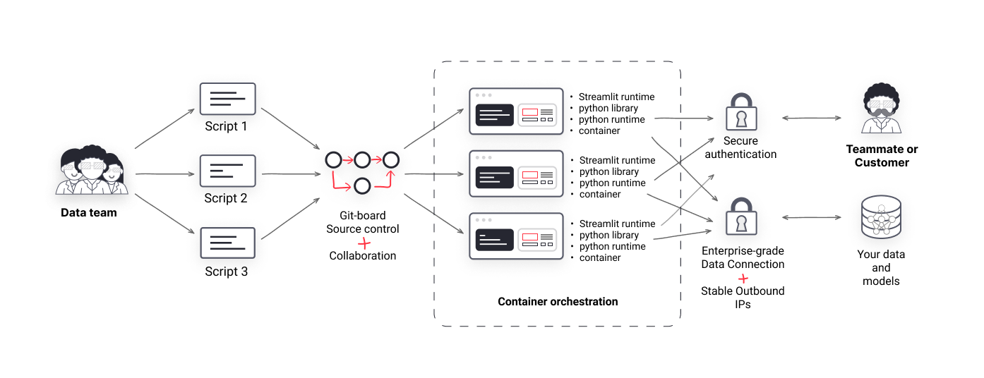
STREAMLIT-CLOUD IO
Build and deploy apps in minutes:
Streamlit Cloud handles all the IT, DevOps, and security for us—Python dependencies, Unix package management, container orchestration, server provisioning, scaling, data security, and more—in short handles all the server management tasks and issues for free.
Securely share apps:
Streamlit Cloud works with the preferred SSO provider. Easily lock down the app so only certain people can see it.

Slide 13
Applications
The future scope of our project is very expandable as it is a one shot solution for all the data understanding and analysis related problems. 4
Companies wouldn't have to invest a great effort and Time in analyzing the patterns and trends in a given dataset.
The project has the potential to greatly augment the work of a Data Scientist, or to replace them entirely with a simple API call to our service.

Slide 14
Thank
You

