Slide 1
CuSTOMER
CHURN
PREDICTION
MODEL
Made By:
Hrishank Chhatbar
Atharva Deshpande

Slide 2
01
Introduction
03 MODEL BUILDING
02
INSIGHTS
04 CONCLUSIONS
Project Overview and the Reason why we chose.
Building of model via python and explanation.
Business analytics and key insights that we observed.
Applications and Future Scope of the Project.

Slide 3
—JEFF BEZOS
“
Without a plan, even the most brilliant business can get lost. You need to have goals, create milestones and have a strategy in place to set yourself up for success.
”

Slide 4
01.
IntRODUCTION

Slide 5
INTRODUCTION
Churn prediction modeling techniques attempt to understand the precise customer behaviors and attributes which signal the risk and timing of customer churn.
It is widely used across many different Industries to avoid the business loss by predicting the behaviour of customer beforehand.
Churning rate is a very important statistical parameter for the company.

Slide 6
FAQ’S
Q.) What is univariate and multivariate analysis?
Q.) Justify the correlation graph?
Q.) How did we obtain key Insights from our dataset?
Q.) Which algorithm have we used and why?

Slide 7
TYPES OF CHURN SCENARIOS
Tariff Plan churn
SERVICE CHURN
USAGE CHURN
Product churn

Slide 8
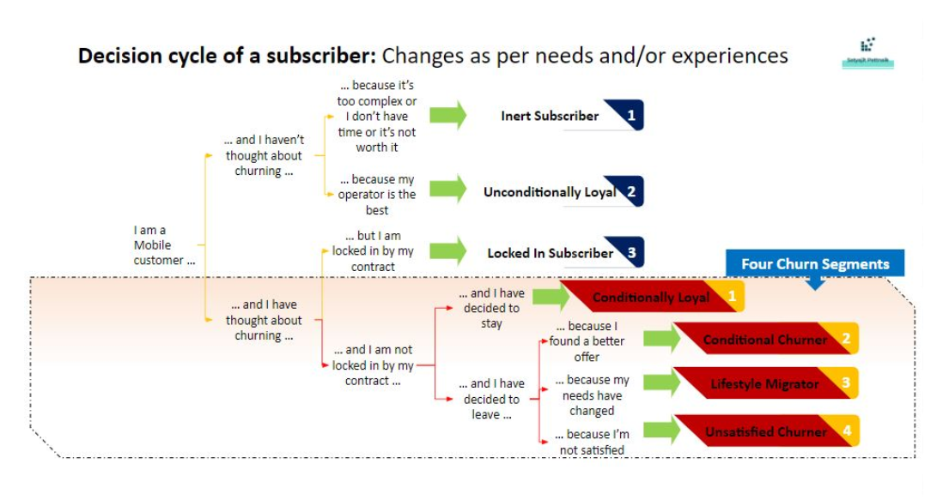

Slide 9
Why is Customer Churn Analysis Done?
Forward-thinking organizations are leveraging artificial intelligence (AI) and machine learning to forecast future trends and behaviors and identify previously hidden indicators that help to predict churn.
Customer churn analysis can be accomplished by fitting statistical models to historical data and trying to find a pattern in customers that may result in churn.

Slide 10
02.
POWER
BI

Slide 11
03.
MODEL
BUILDING

Slide 12
04.
Application
&
Conclusion

Slide 13
Applications
a
b
c
It can be used in automotive industry to find weather next car of user is going to be from same brand or not. It's a long process so activities of user is monitored accordingly.
It is used by all retails to assess the evaluation and check weather the services offered by them is really good.It is also used by all Big MNC’s to retain as well as increase the customer base for their products.
Now a days OTT platform is in boom so OTT companies such as Netflix,Prime Video,Hotstar uses Churn Prediction analysis to find what is the liking of user and try to retain their customers.

Slide 14
Conclusion
From this project we were able to understand what are the steps that company follows to find the customers who are more likely to churn. The process is quite long, It involves understanding the Input as well as Output Parameters, Research and Analysis by using Power BI, Building model by using Training set and Testing the same using different datasets.
We were able to find what are the crucial parameters that were responsible in affecting our Prediction. We also understood that how Churn Prediction models are made for different domains.

Slide 15
THANKS

