Slide 1
VNL 2024 Men Volleyball Analytics Dashboard
Generated from performance analysis visualizations

Slide 2
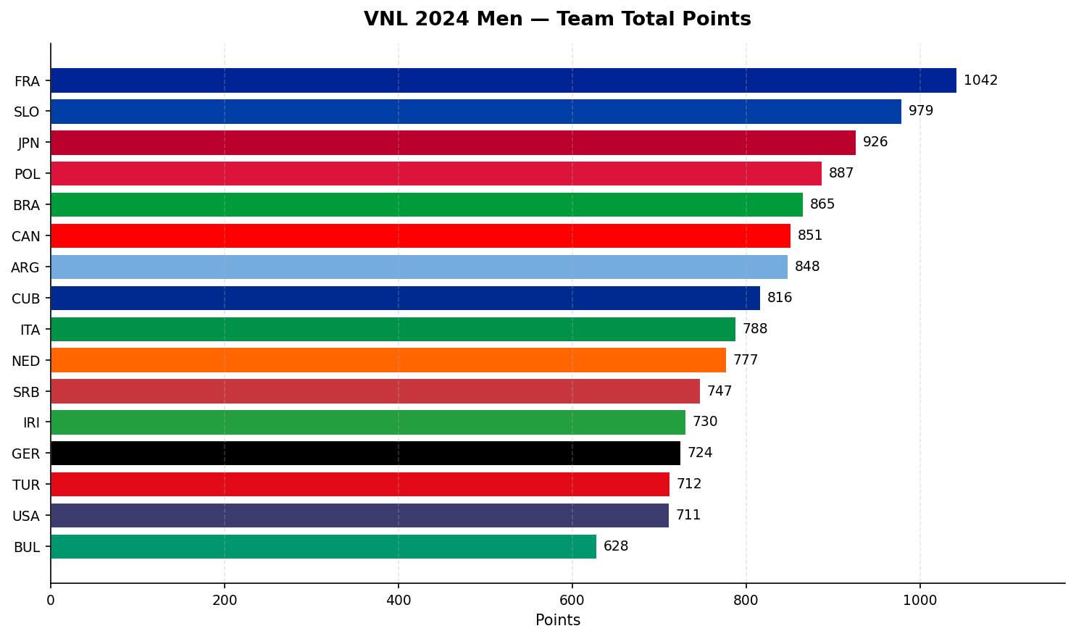
VNL 2024 Men — Team Rankings

Slide 3
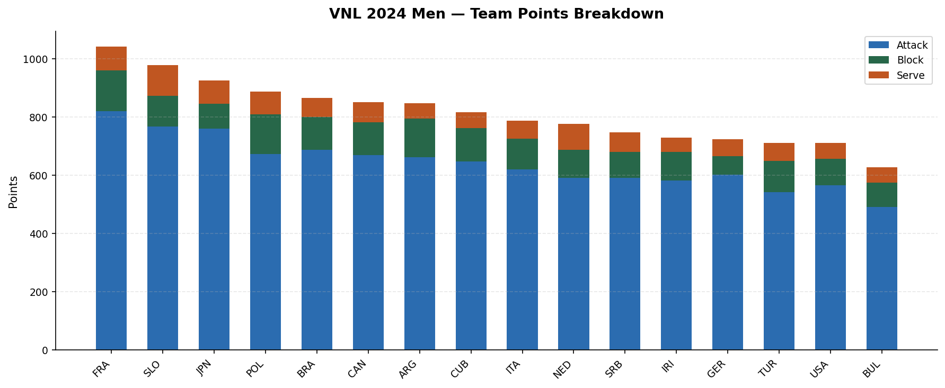
VNL 2024 Men — Team Points Breakdown

Slide 4
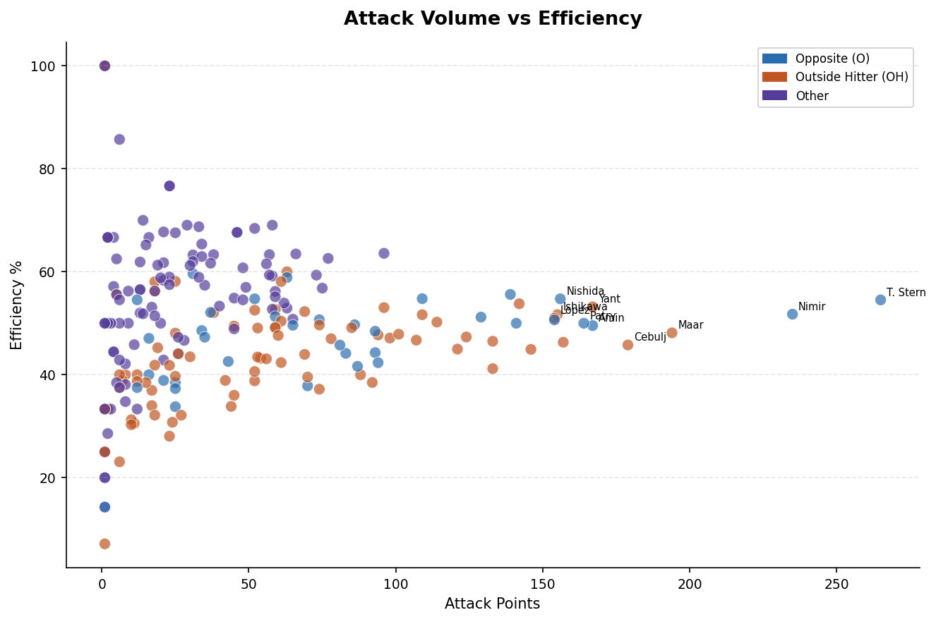
Attack Volume vs Efficiency

Slide 5
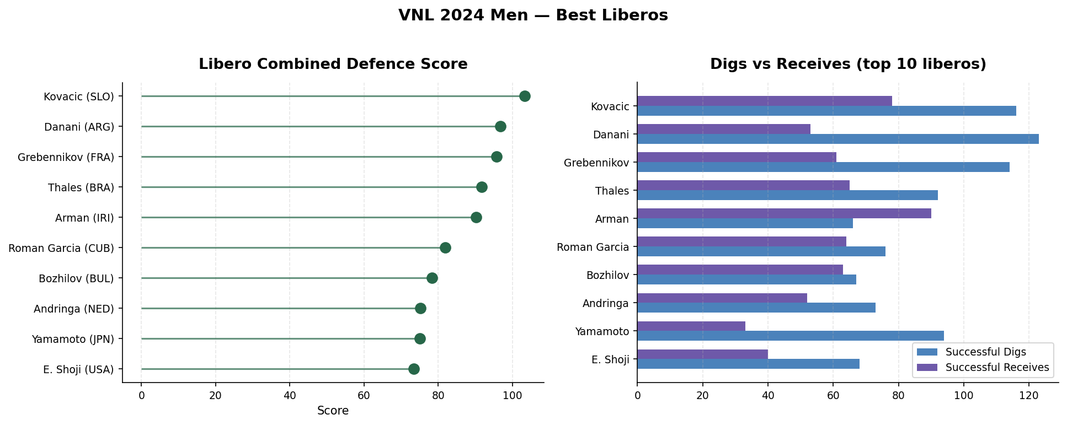
Best Liberos Analysis

Slide 6
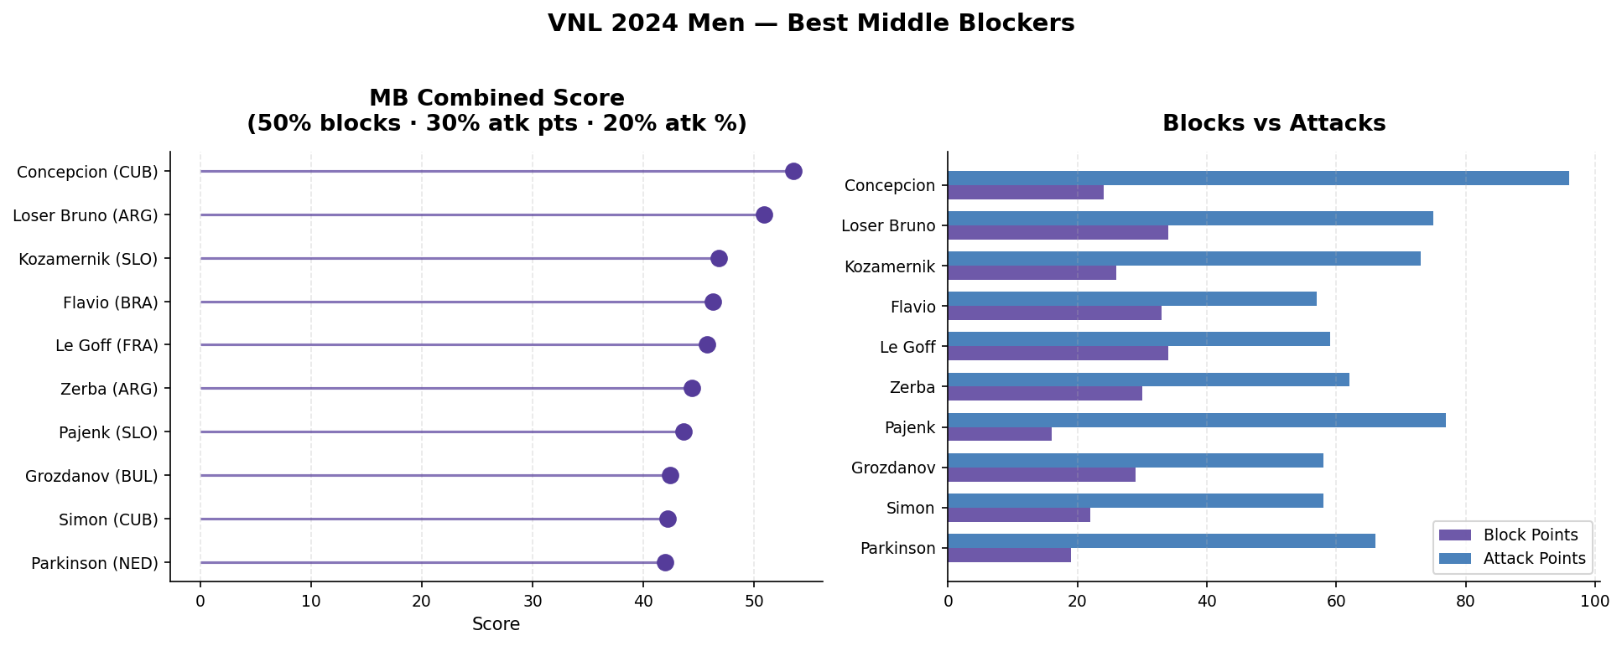
Best Middle Blockers Analysis

Slide 7
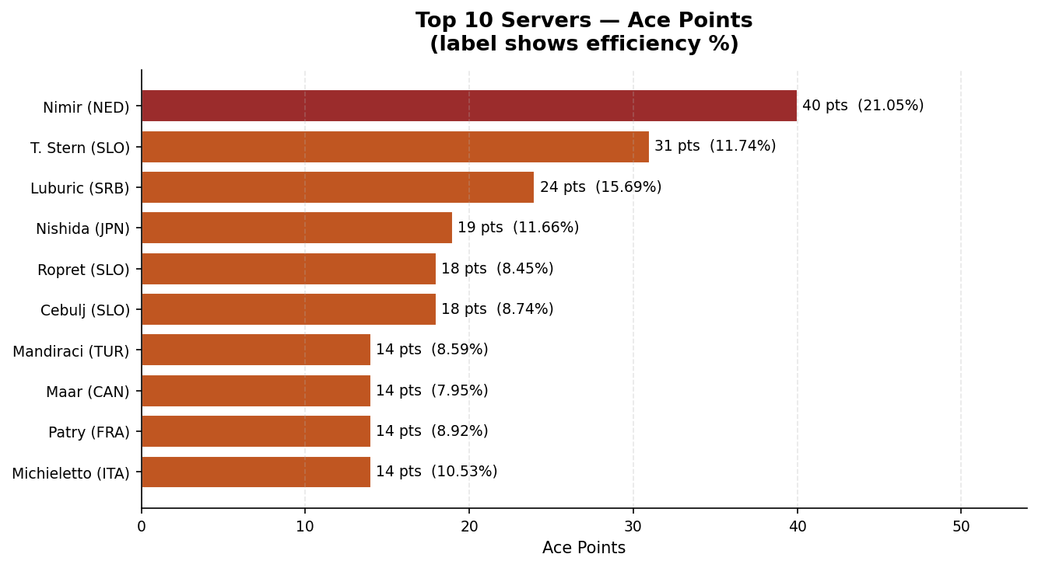
Top Servers — Ace Points

Slide 8
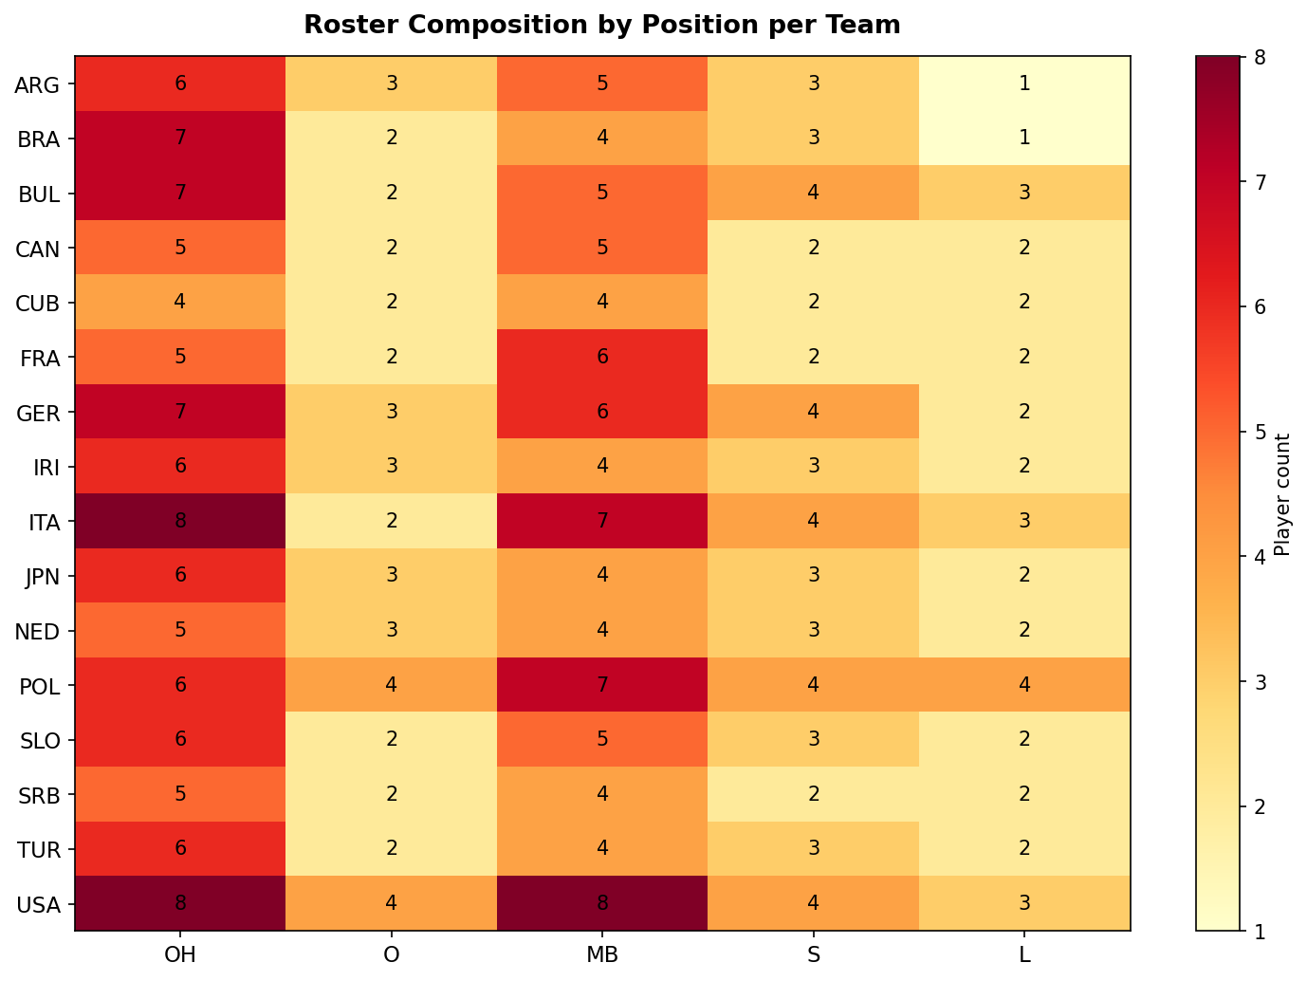
Roster Composition Heatmap

Slide 9
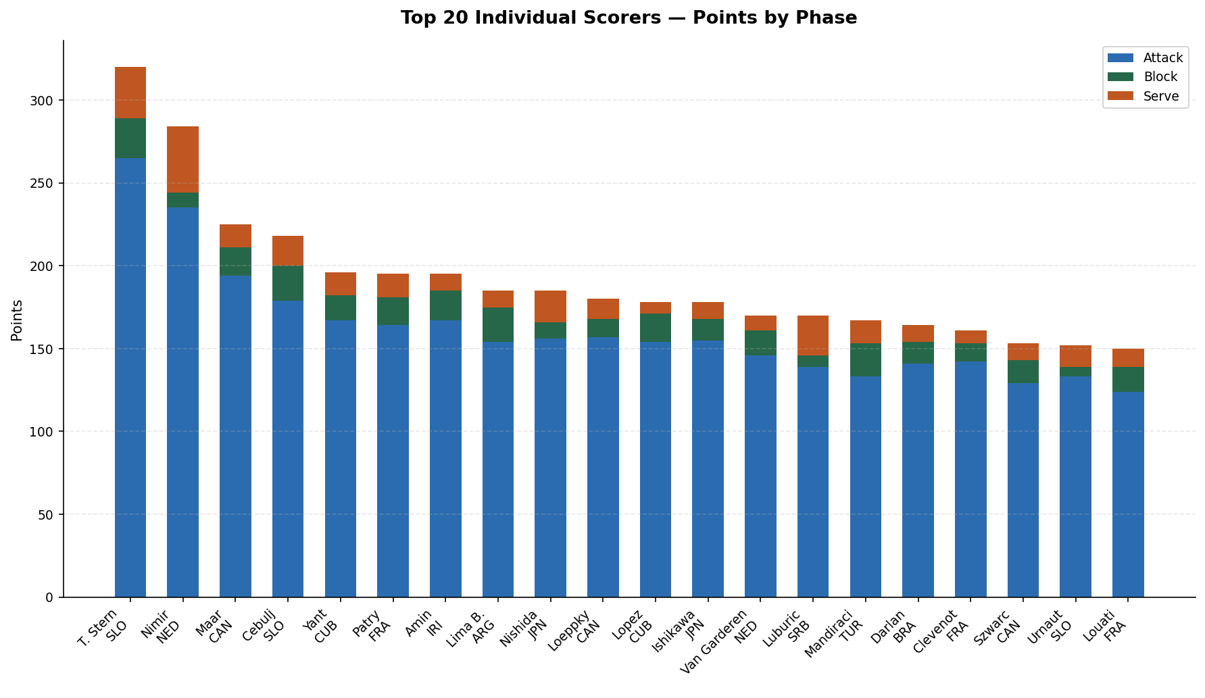
Top 20 Individual Scorers

Slide 10
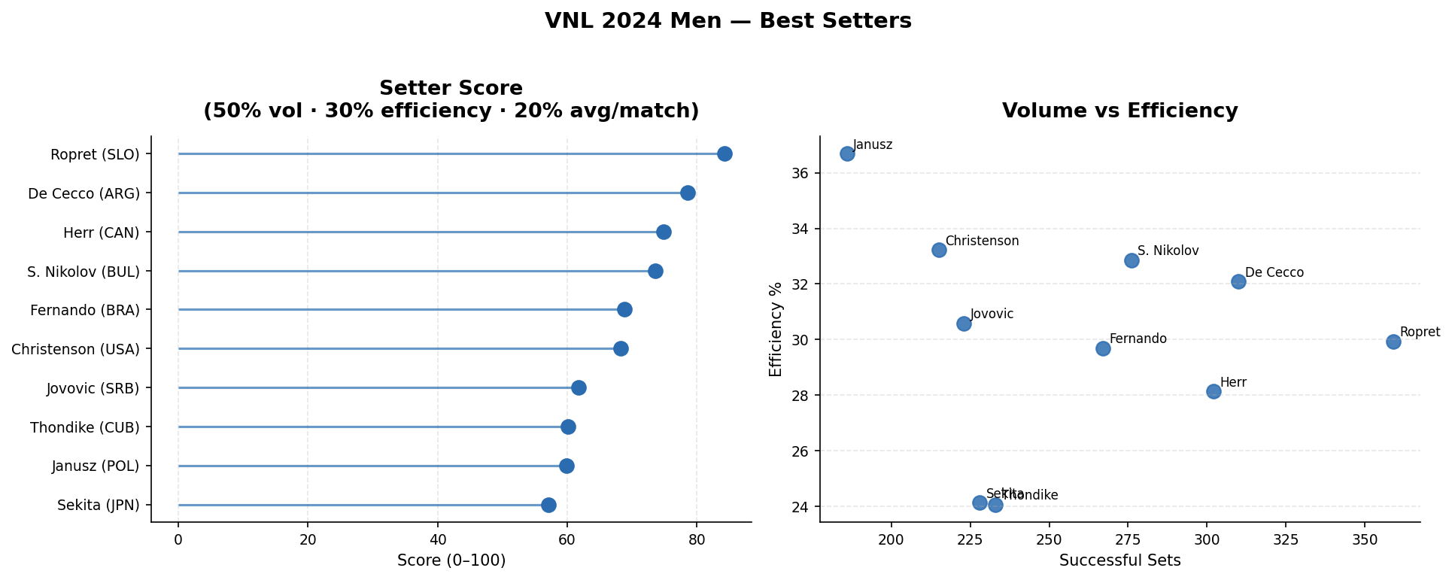
Best Setters Analysis

Slide 11
Conclusion
This presentation summarizes VNL 2024 Men’s Volleyball analytics,
including team performance, player efficiency, positional analysis,
and scoring trends.

