Slide 1
Cars24 Analysis Project
Insights & Key Findings

Slide 2
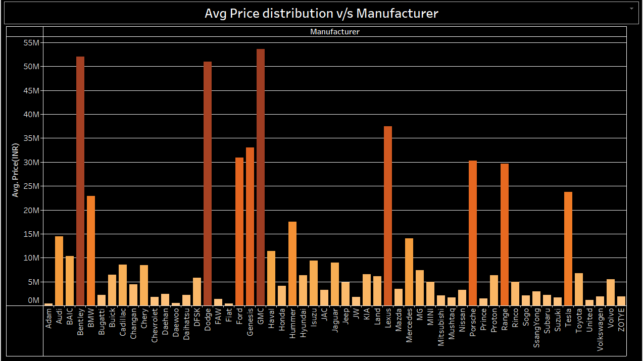
1. Avg Price Distribution vs Manufacturer
High-End Brands: Luxury brands like Bentley, Ferrari, and Rolls-Royce have the highest average prices, with values exceeding INR 30M.
Mid-Range Brands: Brands like Audi, BMW, and Mercedes have a mid-range average price, around INR 10M to INR 20M, indicating their positioning in the premium segment.
Budget Brands: Manufacturers like Suzuki, Honda, and Toyota show lower average prices, suggesting these brands are more accessible for a broader audience in terms of pricing.

Slide 3
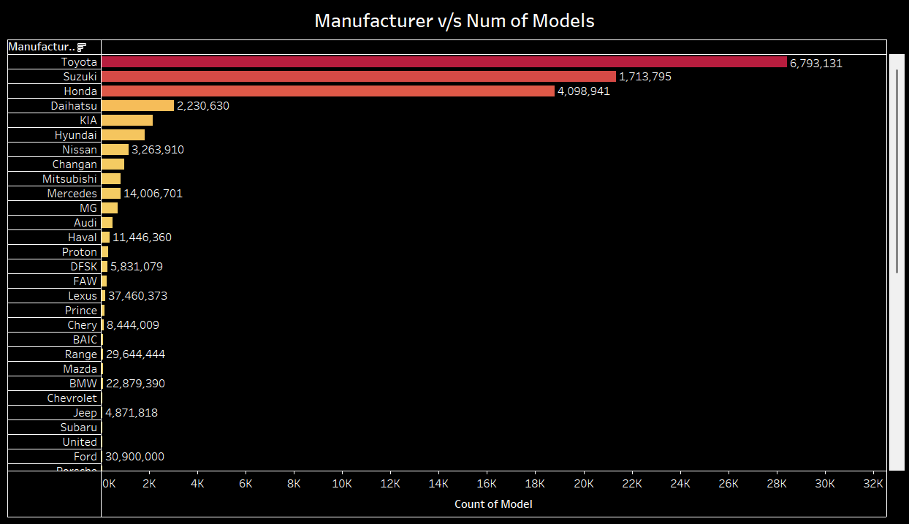
2. Manufacturer vs Number of Models
High Model Count: Toyota leads in terms of model variety, followed by Suzuki and Honda. This could indicate these brands have a wide range of vehicle offerings catering to different customer segments.
Low Model Count: Luxury brands like Bentley and Ferrari have fewer models, which aligns with their premium and niche market focus.

Slide 4
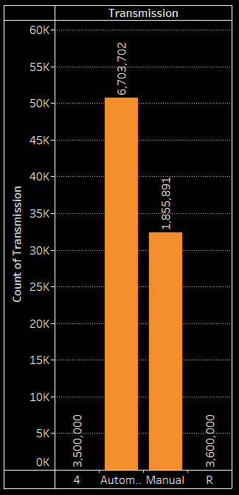
3. Fuel Type Count
Dominant Transmission Types: Automatic and manual transmissions are almost evenly distributed, with a slightly higher count of automatic vehicles.
Fuel Type Popularity: Petrol is the most common fuel type, followed by diesel, indicating a traditional fuel preference among the data sample.
Emerging Fuel Types: There is a small but notable presence of CNG, hybrid, and electric vehicles, indicating emerging trends towards alternative fuel types.

Slide 5
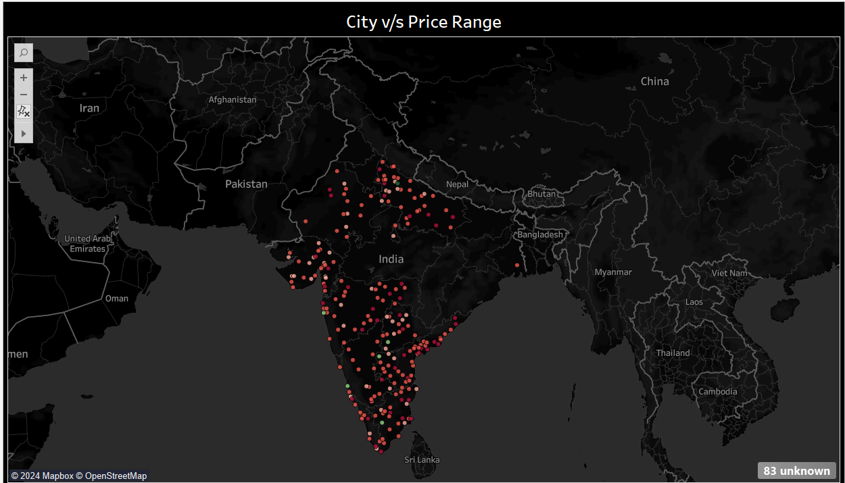
4. City vs Price Range (Map)
Geographical Distribution: There is a concentration of high-price vehicles in major metropolitan areas in India, suggesting a higher demand or market for premium vehicles in urban locations.
Regional Insights: Some cities outside of traditional metropolitan areas show a presence of cars, which could indicate growing demand for a diverse price range of vehicles across India.

Slide 6
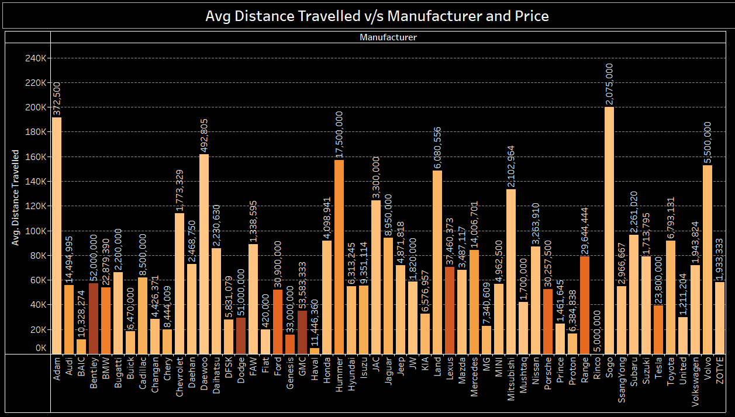
5. Avg Distance Traveled vs Manufacturer and Price
Higher Mileage for Budget Brands: Brands like Suzuki, Hyundai, and Honda tend to have higher average distances traveled, possibly indicating they are used as daily drivers.
Lower Mileage for Luxury Brands: Luxury brands like Bentley, Ferrari, and Maserati show lower average distances, which aligns with these cars often being used as status symbols rather than regular vehicles.
Mileage Variation: There is significant mileage variation across manufacturers, suggesting that the vehicle's target market and use case significantly affect the average distance traveled.

Slide 7
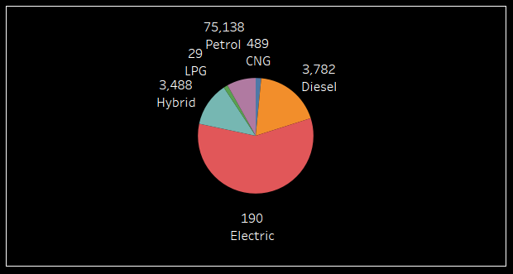
6. Fuel Type Distribution (Pie Chart)
Petrol Dominance: Petrol vehicles dominate the market, which is consistent with trends in developing markets.
Diesel Presence: Diesel vehicles are also prevalent, typically preferred for longer distances or specific use cases.
Alternative Fuel Types: CNG, hybrid, and electric vehicles, though a smaller proportion, reflect a shift towards more sustainable energy sources.

Slide 8
Conclusion and Recommendations
Key Findings:
Strong demand for budget and mid-range vehicles (Suzuki, Honda, Toyota).
Luxury vehicles show lower mileage and higher prices, indicating limited use and niche demand.
Rising interest in alternative fuel types (especially electric), though still in early stages.
Geographic concentration of high-end vehicles in metro areas with growing demand in smaller cities.
Recommendations:
Expand inventory in high-demand regions based on price segmentation.
Consider diversifying fuel types, particularly electric, to capture emerging green trends.
Focus on high-demand budget and mid-range vehicles for broader market penetration.

