Slide 1




Team: ChainShield
Track: AI & Supply Chain Optimization
ChainShield: Explainable Supply-Chain Resilience Copilot
Converting supply chain disruptions into deterministic, auditable action plans in under 60 seconds.

Slide 2

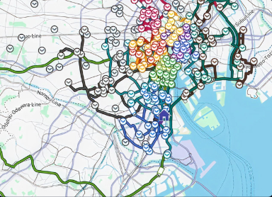

Cascading Disruption
A single port disruption can cascade across hundreds of shipments.
Meanwhile, idle assets sit unused.
Cold-chain damage may remain invisible until delivery.
SAMPLE SHIPMENT IMPACT
$520,000
Cargo Value Stalled

Slide 3






The Operator's Trilemma
Operations teams need to answer three questions immediately during a crisis:
What is Affected?
What Moves Instead?
Is Cargo at Risk?
Monitoring if temperature-sensitive cargo is approaching excursion threshold
Tracking blocked shipment routes as geographic disruptions cascade.
Locating idle trucks and determining viable alternative routes.

Slide 4
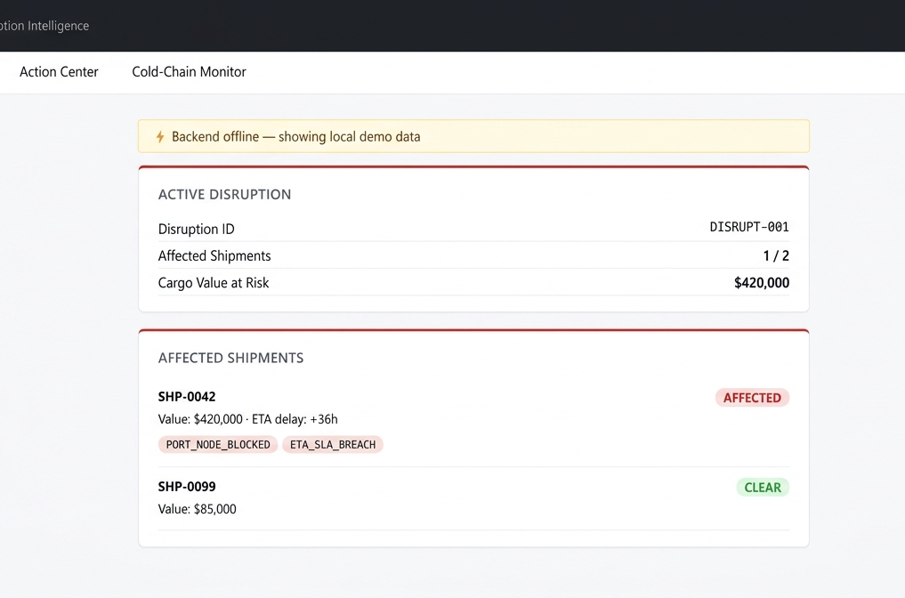
Disruption to Decision
ChainShield converts disruption signals and sensor logs into an explainable action plan in under 60 seconds.
Operator activates the disruption scenario.
System ingests signals and evaluates impact.
Generates optimized, verified routing recommendations.

Slide 5







Automated Impact Detection
The impact engine uses route overlap and time-window analysis to identify exactly which shipments are affected and why.
AFFECTED SHIPMENTS
CARGO VALUE AT RISK
42
$8.7M
Reason Code:
Aggregated financial exposure evaluated instantly.
PREDICTED SLA BREACHES
COLD-CHAIN SHIPMENTS AT RISK
11
4
Reason Code:
Reason Code:

Slide 6






Constraint-Based Rerouting
The system checks real carrier availability and ranks feasible alternatives by time, cost, capacity, and cold-chain risk.
Carrier A
Carrier B
Carrier C
+17.2 hours
+5.4 hours
+12.0 hours
Unavailable
$1,800 add'l cost
$800 add'l cost
Reefer capacity available
Deadline breached

Slide 7




Idle Asset Redeployment
TRUCK-17
42 km away
Available in 25 minutes
Reefer capable
Compatible with SHP-0042
ChainShield finds idle compatible assets that can be redeployed to protect high-priority shipments. Asset matching is constrained by mode, reefer capability, capacity, and availability time.

Slide 8
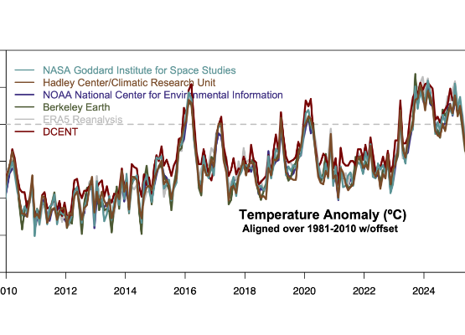

Pre-Delivery Excursion Detection
The cold-chain engine detects the excursion before delivery, identifies the policy breach, and records the evidence for review.
Policy range: 2°C to 8°C
Observed maximum: 10.4°C
Duration out of range: 18 minutes
*The system uses configurable policy profiles, not hardcoded thresholds, adapting to different products and jurisdictions.

Slide 9








Explainability & Evidence
The language model does not make the operational decision. It explains deterministic results, cites the evidence, and exposes uncertainty.
Why this recommendation?
Recommended because:
Every recommendation includes reason codes and source data so operators can audit and trust the decision.
Affected because:

Slide 10

Technical Architecture
All core logic runs locally with cached data; external APIs are optional and have timeouts and fallbacks.
Frontend: React + TypeScript
Backend: FastAPI + DuckDB Local Store
Impact Engine: NetworkX + GeoPandas
Optimization Engine: OR-Tools
Cold Chain Engine: Pydantic
Explanation Layer: Granite via watsonx.ai

Slide 11
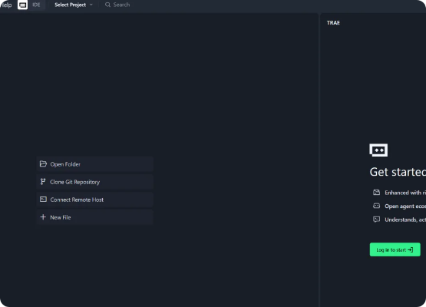
IBM Bob IDE Integration
IBM Bob IDE was used as the core development partner for architecture, implementation, testing, documentation, and code review.
Every relevant task is exported to the bob_sessions folder for judging.
Bob ensured that the solution is auditable, well-tested, and aligned with best practices.

Slide 12





Operational Impact & Metrics
ChainShield turns disruption data into evidence-backed action before cargo, capacity, and customer commitments are lost.
Under 60 Secs
0%
DECISION TIME
ROUTE CONSTRAINT VIOLATIONS
98%+
$8.7M
EXCURSION DETECTION RECALL
CARGO VALUE AT RISK IDENTIFIED

Slide 13








The ChainShield Team
Devanshi Shah
Atharva Bhatt
Rutu Modi
Harsh Aacharya
Backend / Data
Optimization / Algorithmic Topology
AI & Cold Chain
Frontend / UX
Architected the core FastAPI backend and engineered the DuckDB analytical store for high-speed data ingestion.
Developed the constraint-based routing logic using Google OR-Tools and NetworkX graph propagation.
Built the deterministic Cold Chain engine and integrated watsonx.ai Granite for explainable recommendations.
Designed and implemented the React interface, translating complex data sets into an intuitive operator dashboard.

