Slide 1

AM and FM Modulation Simulation using Python Course: Analog and Digital Communication (AY 2024-25, Semester II) Submitted by : S. Y. B. Tech. Division: A Batch: A2
P. R. No. | Roll No. | Name of Student | Mobile No. | VIIT Email ID
22310847 | 211030 | Atharva Santosh Suryavanshi | 7840972377 | atharva.22310847@viit.ac.in
22310981 | 211037 | Atharva Vinayak Maslekar | 7719097941 | atharva.22310981@viit.ac.in
22311008 | 211039 | Sameer Chavan | 9967805132 | sameer.22311008@viit.ac.in
22311496 | 211049 | Atharva Rajendra Joshi | 9527043551 | atharva.22311496@viit.ac.in
BRACT’S, Vishwakarma Institute of Information Technology, Pune-48
(An Autonomous Institute affiliated to Savitribai Phule Pune University)
(NBA and NAAC accredited, ISO 9001:2015 certified)

Slide 2
Contents
1. Abstract
2. Introduction
3. Design Constraints
4. Methodology
5. Observations & Calculations
6. Results
7. Conclusion
211030, 37, 39, 49, Department of Electronics and Telecommunication, VIIT, Pune-48

Slide 3
Abstract
This project presents a simulation and visualization of Amplitude Modulation (AM) and Frequency Modulation (FM) using Python programming. Modulation is a key aspect of communication systems, where message signals are superimposed on high-frequency carrier signals for efficient transmission. The main focus of this project is to demonstrate the behaviour and impact of varying the modulation index on both AM and FM signals through a real-time interactive interface. Python libraries such as Tkinter and Matplotlib are utilized for GUI creation and plotting. The developed simulation offers an effective learning tool for students and learners to grasp fundamental concepts of modulation intuitively and visually.
211030, 37, 39, 49, Department of Electronics and Telecommunication, VIIT, Pune-48

Slide 4
Introduction
Analog Modulation Techniques are used in transmitting data over long distances. Modulation are of two types:
AM i.e., Amplitude modulation: Amplitude of the carrier signal is
varied in accordance with the amplitude of the message signal.
2. FM i.e., Frequency modulation: Frequency of the carrier signal is
varied as per the instantaneous amplitude of the message signal.
To Visualize these modulation for various values we have created an Interactive Python-GUI based Simulation model where we can vary modulation index of the single and analyze the changes.
21030, 37, 39, 49, Department of Electronics and Telecommunication, VIIT, Pune-48

Slide 5
Design Constraints
As the Project is implemented as a software-based model using Python and matplotlib, this design do not contain any resistors, capacitors, transistors, etc. Instead, we have used Various signal parameters to attain accuracy and clarity of the modulation signal such as:
AM modulation index
FM modulation index
Message frequency for AM and FM
Carrier Frequency
These Parameters are set to user defined for user to simulate their signal as per the current conditions.
211030, 37, 39, 49, Department of Electronics and Telecommunication, VIIT, Pune-48

Slide 6

Calculations
AM Wave Calculations:
$s_{AM}$​ (t)=$A_{c}$​⋅(1+µ⋅m(t))⋅$\cos{(2}\text{π}f_{c}t)$
$A_{c}$= amplitude of the carrier
µ = amplitude modulation index
m(t)= message signal
$f_{c}$ = carrier signal
211030, 37, 39, 49, Department of Electronics and Telecommunication, VIIT, Pune-48

Slide 7
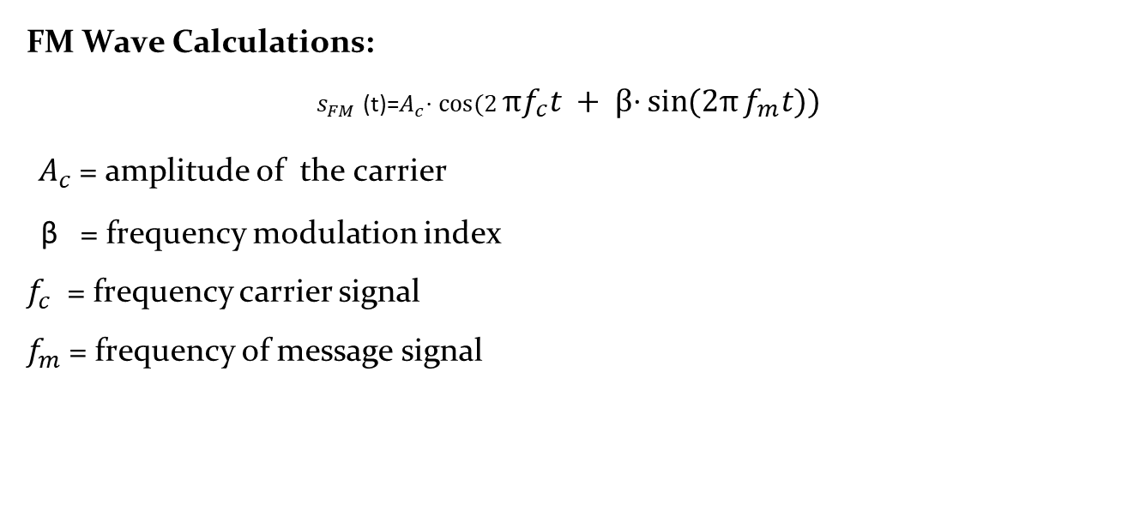
Calculations
FM Wave Calculations:
$s_{FM}$​ (t)=$A_{c}$​⋅ $\cos{(2}\text{π}f_{c}t + β\text{⋅}\sin{(2π}f_{m}t))$
$A_{c}$= amplitude of the carrier
β = frequency modulation index
$f_{c}$ = frequency carrier signal
$f_{m}$ = frequency of message signal
211030, 37, 39, 49, Department of Electronics and Telecommunication, VIIT, Pune-48

Slide 8
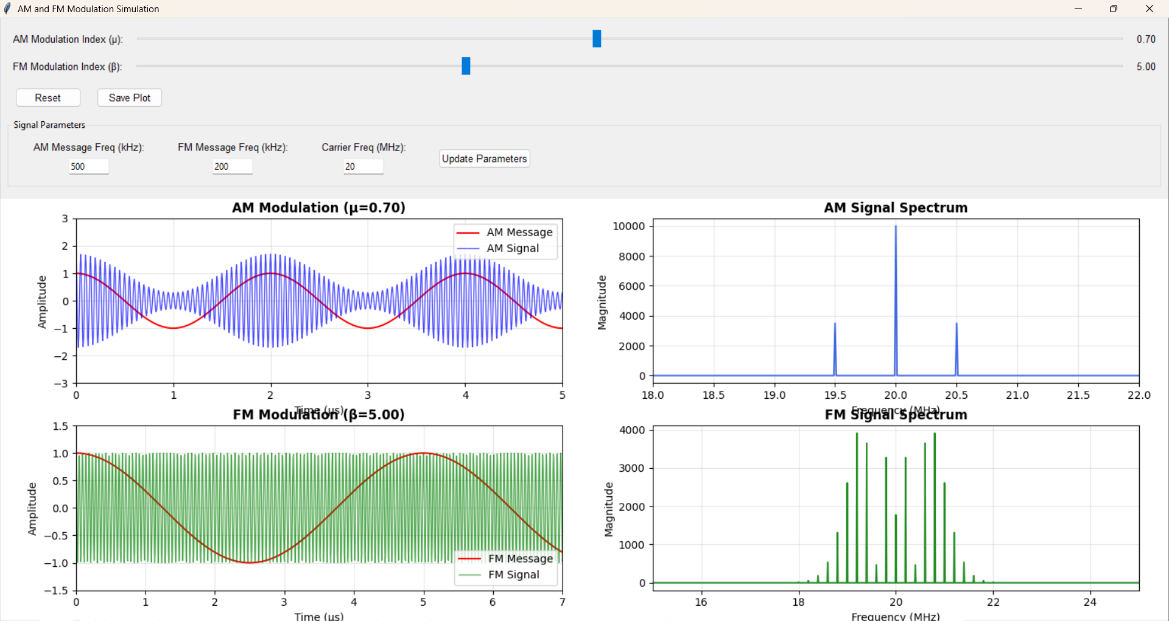
Observation
211030, 37, 39, 49, Department of Electronics and Telecommunication, VIIT, Pune-48

Slide 9
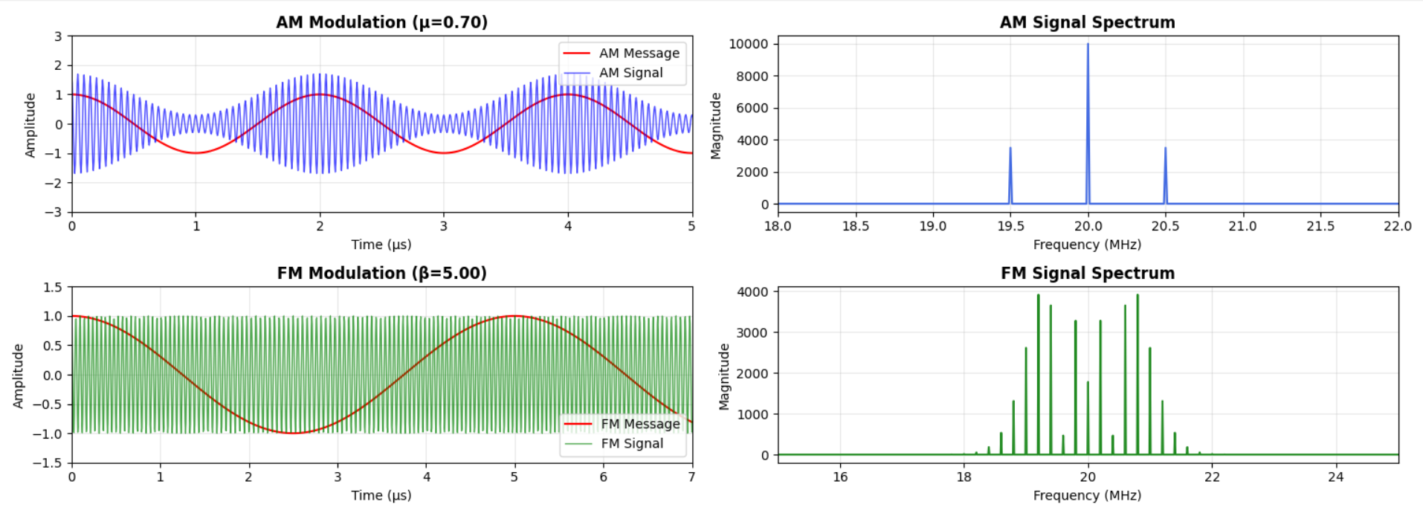
Results
211030, 37, 39, 49, Department of Electronics and Telecommunication, VIIT, Pune-48

Slide 10
Conclusion
This project successfully demonstrates the core concepts of amplitude and frequency modulation using Python and Matplotlib. By creating an interactive simulation, it provides users with the ability to observe how the modulation index influences signal characteristics. The use of Python, Tkinter, and Matplotlib ensures the project remains open-source, easy to use, and suitable for educational environments. Overall, the tool serves as a valuable aid in understanding modulation principles, helping in better understanding of the concepts.
211030, 37, 39, 49, Department of Electronics and Telecommunication, VIIT, Pune-48

Slide 11
Thank You!
211030, 37, 39, 49, Department of Electronics and Telecommunication, VIIT, Pune-48

